Slide 1

TRUSTFALL
Human data.
Safer inboxes.
A privacy-first workflow that turns real, redacted messages into human-labeled scam-safety intelligence.
Berkeley Hackathon 2026
Collection → redaction → consensus labels → Qwen adaptation

Slide 2
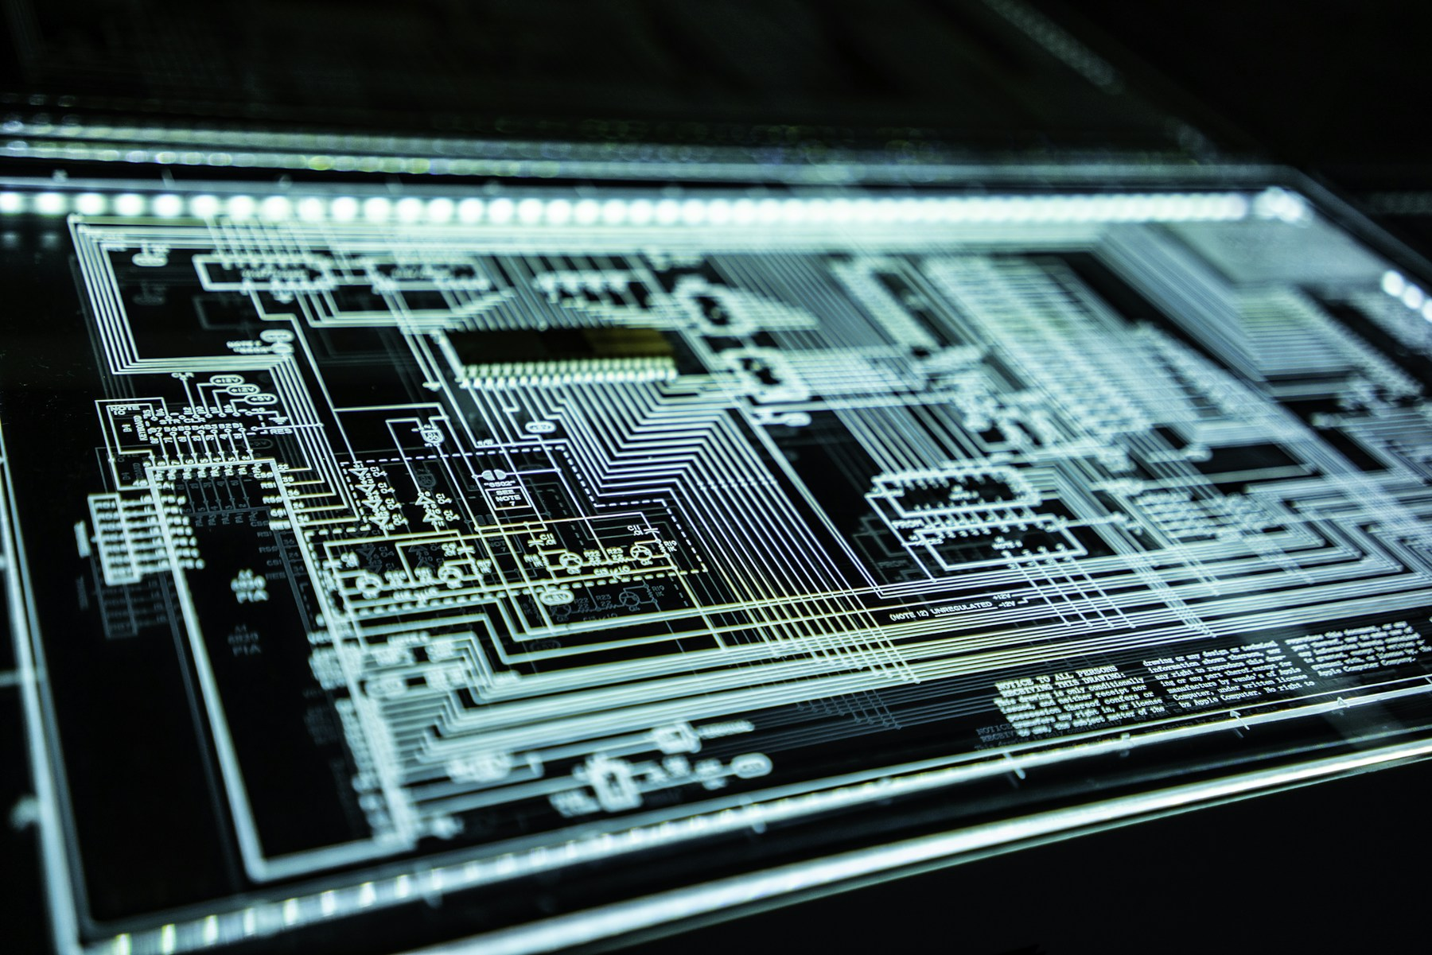
TRUSTFALL
The inbox is an adversarial interface.
Scams borrow the visual language of trust. People need a calm, practical second opinion at the moment of uncertainty.
01
02
03
Real signals
Private by default
Advice people use
Tone, links, sender mismatch, and urgency matter together.
Raw emails should not become a training-data liability.
A risk score is not enough; people need the next safe action.
2 | Live metric refresh: 2026-06-21 08:37 UTC

Slide 3
TRUSTFALL
Trustfall converts lived experience into an inspectable learning loop.
Every stage is intentionally narrow: collect safely, remove identifiers, ask humans for judgment, then adapt the model.
01
02
03
04
Collect
→
Redact
→
Label
→
Learn
Real messages via Terac
Client + server safety layers
Independent human judgments
LoRA adapter + holdout test
3 | Live metric refresh: 2026-06-21 08:37 UTC

Slide 4
TRUSTFALL
Privacy is product architecture—not a cleanup step.
Trustfall keeps the useful evidence while stripping the sensitive payload.
Raw .eml stays client-side
✓
Headers, attachments, and original files are not stored.
Identifiers become placeholders
✓
Names display as [PERSON]; links are defanged and tracking is removed.
Training uses sanitized fields
✓
Only redacted text and structured safety features reach the model pipeline.
4 | Live metric refresh: 2026-06-21 08:37 UTC

Slide 5

TRUSTFALL
The pilot is real: people submit, people review, the system learns.
Live operations are separated from synthetic QA fixtures and the model never edits source evidence.
58
21
116
real sanitized messages
Wave 2 labeler capacity
human labels saved
The collection and labeling layer is already running in production through Terac. Every metric in this deck comes from the same database the app uses.
5 | Live metric refresh: 2026-06-21 08:37 UTC

Slide 6
TRUSTFALL
Consensus is a quality gate, not a checkbox.
Messages need two independent labels and sufficient agreement before they enter a training snapshot.
51
35
final-target messages in frozen snapshot
training examples
9
frozen test holdout
Provenance: 23 worker-consensus + 28 expert-adjudicated. Unreadable records, insufficient labels, and low agreement stay excluded rather than treated as truth.
6 | Live metric refresh: 2026-06-21 08:37 UTC

Slide 7
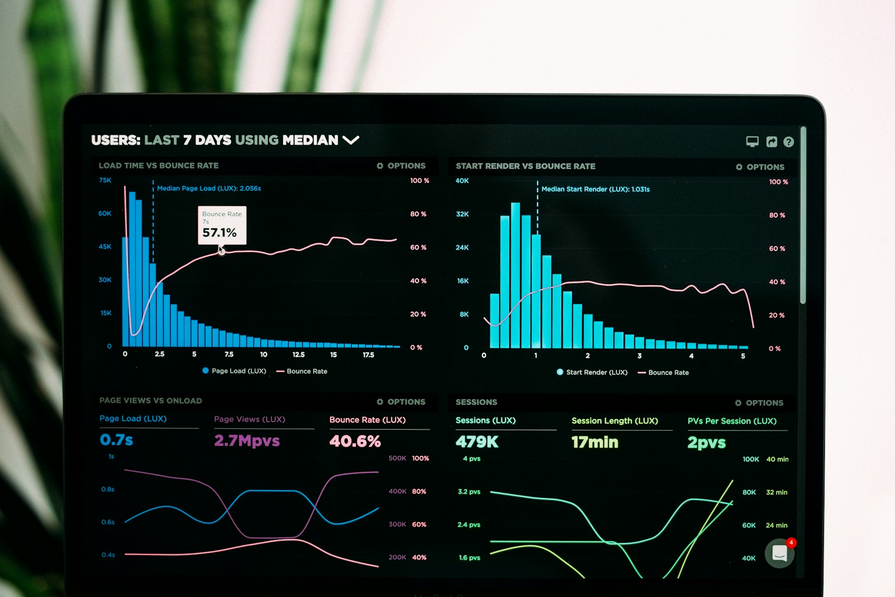
TRUSTFALL
Start with a baseline, not a claim.
Qwen/Qwen3-0.6B first reads the original sanitized Wave 1 data. Its outputs become the before-training reference.
89%
33%
0%
valid JSON on held-out messages
risk-level exact match
scam-type exact match
The baseline gives us something far more honest than a demo screenshot: a concrete point of comparison for formatting, safety-taxonomy alignment, and advice quality.
7 | Live metric refresh: 2026-06-21 08:37 UTC

Slide 8
TRUSTFALL
Fine-tuning improves structured behavior—while the evidence stays modest.
The LoRA adapter was trained on the frozen consensus snapshot and evaluated only on unseen messages.
What changed
• Valid JSON rose to 100% on the frozen test split.
• Risk within-one-level: 78%. Directional only: the test split has 9 examples.
• The adapter is a pilot artifact, not a production claim.
8 | Live metric refresh: 2026-06-21 08:37 UTC

Slide 9
TRUSTFALL
A pipeline that is inspectable at every handoff.
The operational app, data store, and local ML workflow stay deliberately separate.
Production app
Data layer
ML workstation
Vercel + Next.js
Terac task routes
Admin review
Neon Postgres
Sanitized messages
Assignments + labels
Qwen baseline
Consensus export
LoRA adapter + holdout
→
→
9 | Live metric refresh: 2026-06-21 08:37 UTC

Slide 10
TRUSTFALL
What makes Trustfall more than a scam classifier demo.
The product is the feedback loop: real examples, privacy boundaries, human judgment, and measured model change.
Real-world inputs
Human consensus
Collected through a live task workflow—not a fabricated benchmark.
Independent labels create a visible quality gate.
Before / after evidence
Re-runnable metrics
A frozen holdout protects the story from self-deception.
One refresh script updates the deck as data arrives.
10 | Live metric refresh: 2026-06-21 08:37 UTC

Slide 11
TRUSTFALL
The next build is stronger agreement—not a bigger claim.
The pilot has proven the loop. More completed labels make the next training snapshot materially more credible.
Now
Next
Then
Finish active Wave 2 labels
Refresh metrics
Rebuild consensus snapshot
Retrain adapter
Expand frozen holdout
Review disagreements
Prototype the end-user warning experience
Test whether advice changes safer behavior
Trustfall is designed to become more useful as human judgment accumulates—without relaxing the privacy rules that make the data usable in the first place.
11 | Live metric refresh: 2026-06-21 08:37 UTC

Slide 12
Trustfall
Build safer inboxes from human judgment—without treating private messages as raw material.
Deck refresh
set -a; source .env.local; set +a
.venv-qwen/bin/python scripts/refresh_presentation_metrics.py
node scripts/generate_presentation.cjs
Photography credits: Unsplash — cover laptop (photo-1516321318423-f06f85e504b3), cybersecurity (photo-1550751827-4bd374c3f58b), analytics (photo-1551288049-bebda4e38f71), team (photo-1521737711867-e3b97375f902).
12 | Live metric refresh: 2026-06-21 08:37 UTC

