Slide 1
import this: building your first python package
Luke Keating Hughes 27/10/2020

Slide 2
Hi!
First some housekeeping
I am your COVID Marshal while in the office.
Please let me know if you have any of the following symptoms:
Fever
Cough
Shortness of breath
Runny nose
Headache
Sore Throat
Please social distance, regularly sanitise, try not to handle each other’s pens.
If you feel it’s necessary point out any hazards to me.

Slide 3

Hi!
Acknowledgement of Country
Notes:
'I would like to begin by acknowledging the Kaurna people, Traditional Custodians of the land on which we meet today, and pay my respects to their Elders past and present. I extend that respect to Aboriginal and Torres Strait Islander peoples here today. I would also like to acknowledge that this land – which we benefit from occupying – was stolen, and that sovereignty was never ceded.

Slide 4



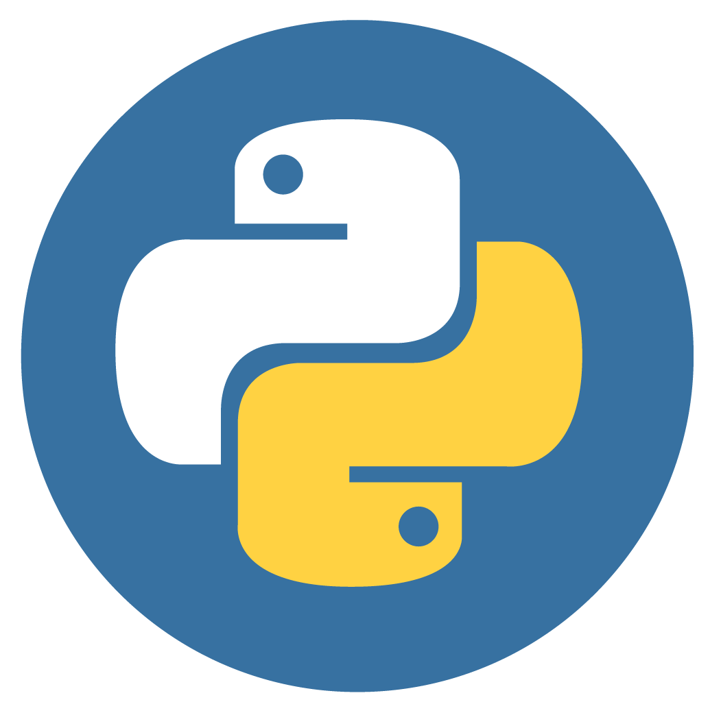
import this: building your first python package
An overview of today

Slide 5
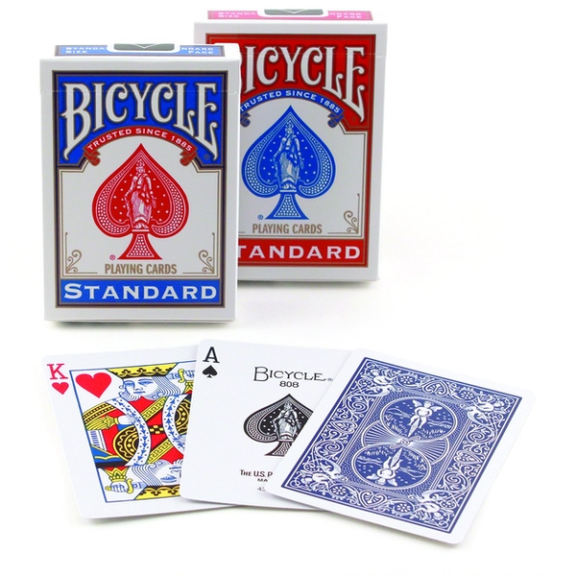
import this: building your first python package
An overview of today

Slide 6
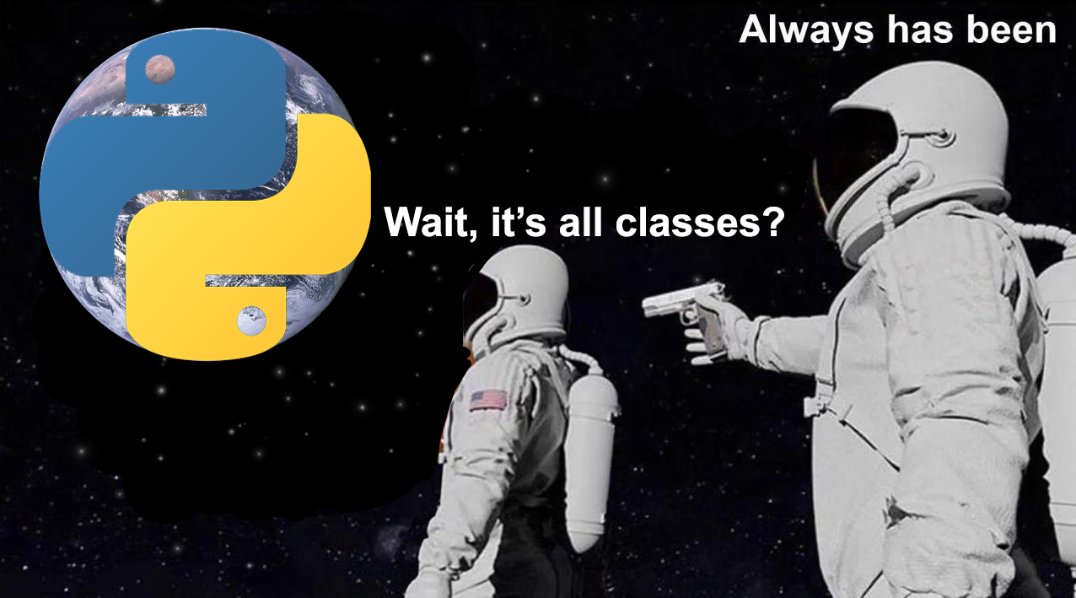
import this: building your first python package
An overview of today

Slide 7
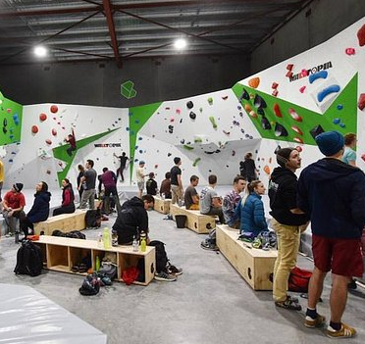




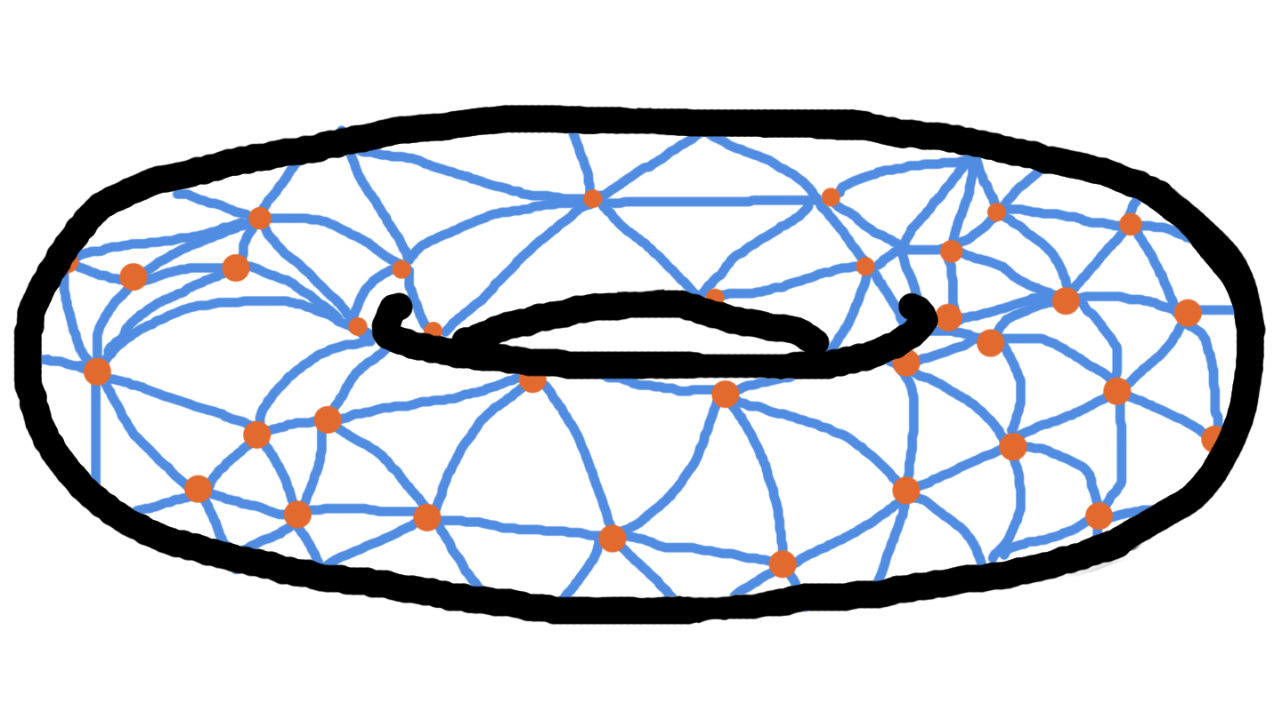
A little bit about me

Slide 8
Experience
(Why you shouldn’t be listening to me)
Started at Capgemini
Started learning python
Started at SvA
First exposure to OOP
Made my second package
Made my first “package”
Now
March 2019
April 2019
May 2019
October 2019
Dec 2019
April 2020
October 2020
time
(not to scale)
Please correct me on explanations, add extra context and butt in for questions!
There are people in the audience who have far more experience than me!

Slide 9
A little bit about the audience
Icebreaker
Could we go around the room and introduce ourselves by saying:
Your name,
Your preferred pronouns (he/she/they),
How often you use python,
One thing they would like to understand better about python. (e.g. what’s with the underscores?)

Slide 10

First things first
Set up our project
Firstly, create a git project:
Choose a git host (I’m going to choose GitHub)
Create a very basic readme
Choose a licence (I’m going to choose the MIT licence)
Pull git project into my local
Secondly, set up a virtual environment:
This is a very good idea for any new python project and it will help you understand the minimum requirements that your new project will require for other machines.

Slide 11

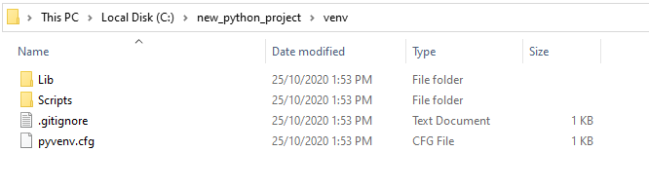
Virtual environment
A little bit more context for those new to virtual environments
[Visit https://docs.python-guide.org/dev/virtualenvs/ for more information]

Slide 12

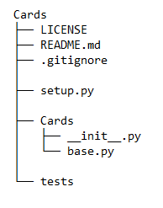
A quick note on package architecture
So we can get started with the coding
Note: The __init__.py file will allow us to call Cards as a module rather than as a folder containing scripts. When we import Cards it will run what ever is in the init script.

Slide 13



A note on python IDEs
For those with no background
Notes:
We’re going to use pycharm for the bulk of our package coding and jupyter for testing

Slide 14
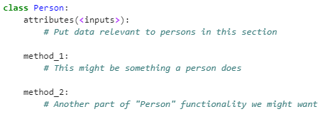
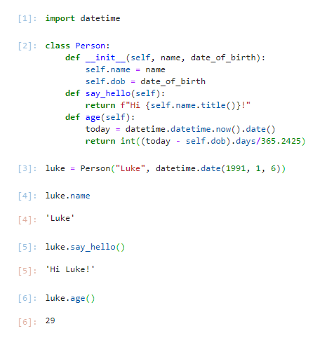
Introduction to python classes
For those with no background

Slide 15
Introduction to python classes
For those with no background
attributes go into __init__

Slide 16
Brainstorming classes and objects
Activity
Task: Break into two groups and brainstorm some objects a deck of cards has on a whiteboard for 5 minutes and some classes that will be our blueprint.
Example: Every deck of cards has an ace of spades object.
After the 5 minutes, we will have a short discussion about what objects we need and then code them up.

Slide 17
Brainstorming attributes
Activity
Task: Break into a group for each class we came up with. In your groups brainstorm the attributes each class will need for 5 minutes.
Example: Every Deck object contains 52 playing cards.
After the 5 minutes, we will have a short discussion about what attributes each group thinks their object will need and then code them up.

Slide 18

Methods
The functions of classes
A method in a class is just a function that is called from inside of a class.
They follow exactly the same rules as regular old functions in python, except for one detail. An object will always pass itself into the method as the first argument.
This means we can have many instances of the same class without having to worry about accessing the right attributes of the right instance of our class.
By convention we will use “self” to refer to the instance of the class.
Here’s Guido Van Rossum’s blog post on the usage of self if you’d like to know more:
https://neopythonic.blogspot.com/2008/10/why-explicit-self-has-to-stay.html

Slide 19
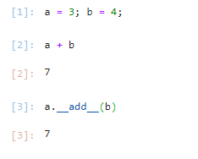

Magic Methods
Why python classes makes your code beautiful
Because everything in python is a class, almost every operation (like print, addition, less than, etc.) can be tailored for our classes.
In python, when you add two integers together, it calls the __add__
magic method. If you create a new class, you can implement your own
way of adding your classes together.

Slide 20
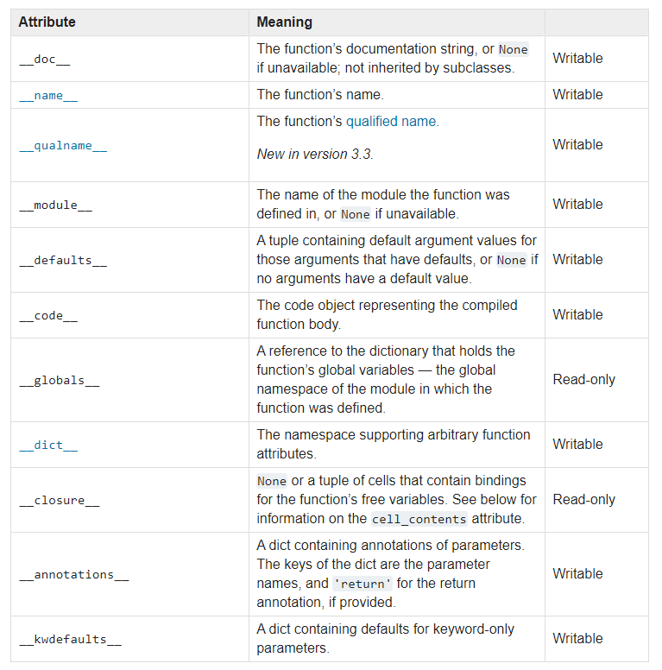
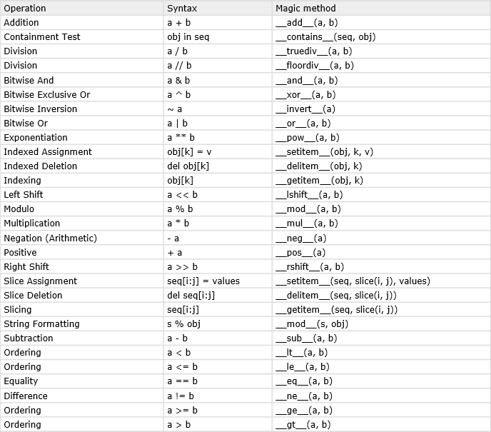
Magic Methods
Why python classes makes your code beautiful
Here are a list of some of the magic methods that can be defined within a class.
Operation | Syntax | Magic method
Addition | a + b | __add__(a, b)
Containment Test | obj in seq | __contains__(seq, obj)
Division | a / b | __truediv__(a, b)
Division | a // b | __floordiv__(a, b)
Bitwise And | a & b | __and__(a, b)
Bitwise Exclusive Or | a ^ b | __xor__(a, b)
Bitwise Inversion | ~ a | __invert__(a)
Bitwise Or | a | b | __or__(a, b)
Exponentiation | a ** b | __pow__(a, b)
Indexed Assignment | obj[k] = v | __setitem__(obj, k, v)
Indexed Deletion | del obj[k] | __delitem__(obj, k)
Indexing | obj[k] | __getitem__(obj, k)
Left Shift | a << b | __lshift__(a, b)
Modulo | a % b | __mod__(a, b)
Multiplication | a * b | __mul__(a, b)
Negation (Arithmetic) | - a | __neg__(a)
Positive | + a | __pos__(a)
Right Shift | a >> b | __rshift__(a, b)
Slice Assignment | seq[i:j] = values | __setitem__(seq, slice(i, j), values)
Slice Deletion | del seq[i:j] | __delitem__(seq, slice(i, j))
Slicing | seq[i:j] | __getitem__(seq, slice(i, j))
String Formatting | s % obj | __mod__(s, obj)
Subtraction | a - b | __sub__(a, b)
Ordering | a < b | __lt__(a, b)
Ordering | a <= b | __le__(a, b)
Equality | a == b | __eq__(a, b)
Difference | a != b | __ne__(a, b)
Ordering | a >= b | __ge__(a, b)
Ordering | a > b | __gt__(a, b)

Slide 21
Brainstorming magic methods
Activity
Task: Together we will brainstorm on a whiteboard what magic methods we will want in order to code for playing a game of cards for 15 minutes.
Example: A card should implement __str__ so that it prints to screen nicely.

Slide 22
Brainstorming methods
Activity
Task: Split into as many groups as there are classes. In groups, brainstorm methods we will want in order to code for playing a game of cards for 5 minutes.
Example: A Hand object should implement a suit method to return cards of that suit.

Slide 23
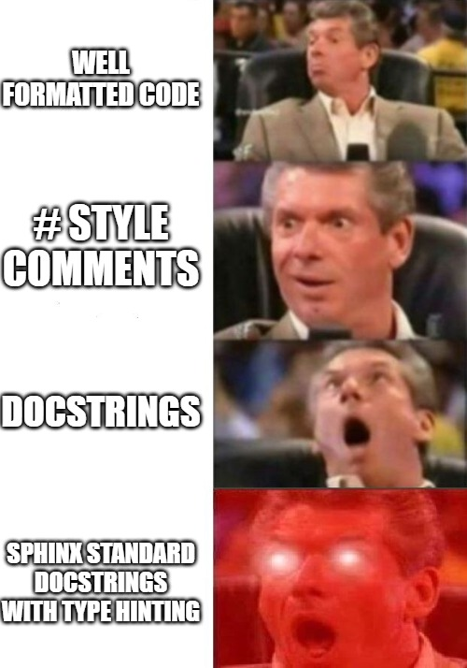
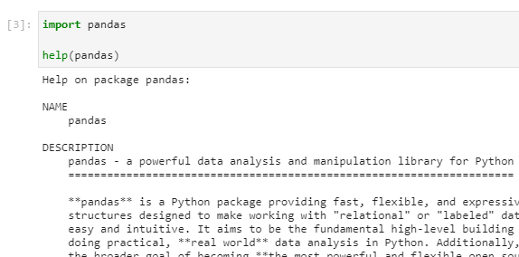
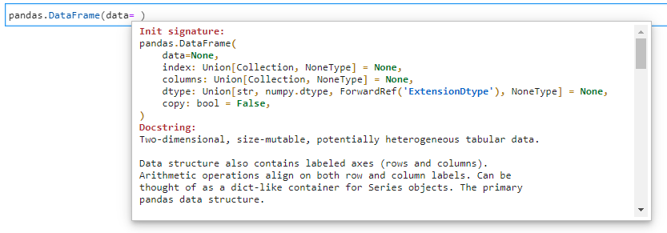
Docstrings
Taking your functions and methods to the next level
In python, a # turns what ever follows it on that line into a comment. Comments are really good for helping other developers understand your code. But if you’re importing a package, how do you read the comments explaining how the code runs?
How do we utilise help or autocompletion?
https://www.python.org/dev/peps/pep-0257/

Slide 24
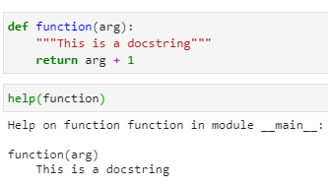
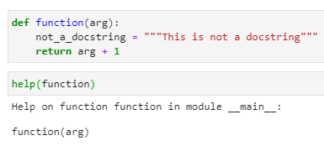
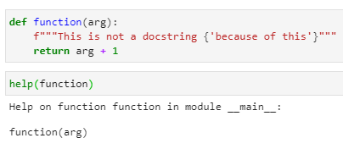
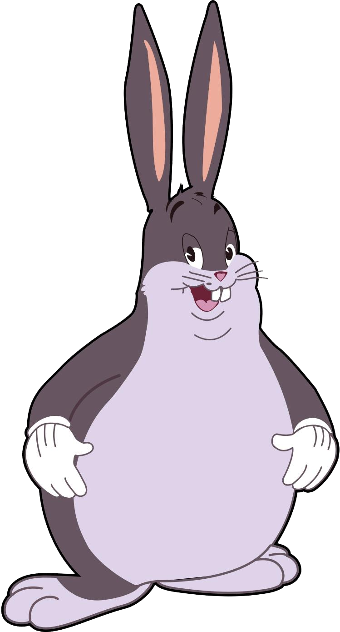
Docstrings
Taking your functions and methods to the next level
The answer is docstrings.
If a (static) string is present as the first line after the definition of a function or class, it will be recorded into the magic method __doc__ which is called when you use help(...). Lots of python IDEs will print docstrings as you type use classes so that you don’t have to remember everything about the package you’re using.
I won’t go into much depth about what you can do with docstrings, but I’d personally recommend using the Sphinx standard.
If you utilise them in your code, your team members will love you!

Slide 25
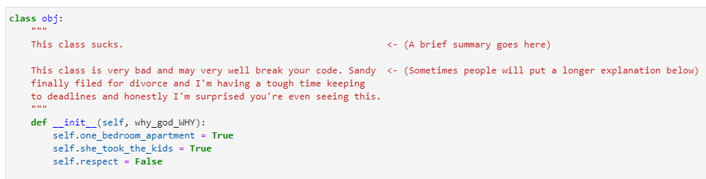
Brainstorming class docstrings
Activity
Task: Since we’re making new classes, we should provide some documentation.
To help users understand how to use our classes, we’ll put some documentation into them. For each class let’s quickly summarise what they represent.

Slide 26
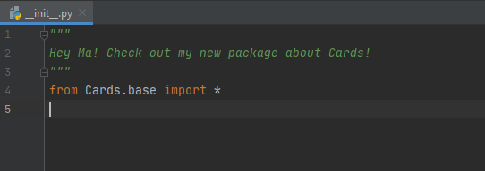
Brainstorming package docstrings
Activity
Task: You can also write docstrings for your modules! Let’s quickly write a docstring for our package in __init__.py just to prove we can.

Slide 27
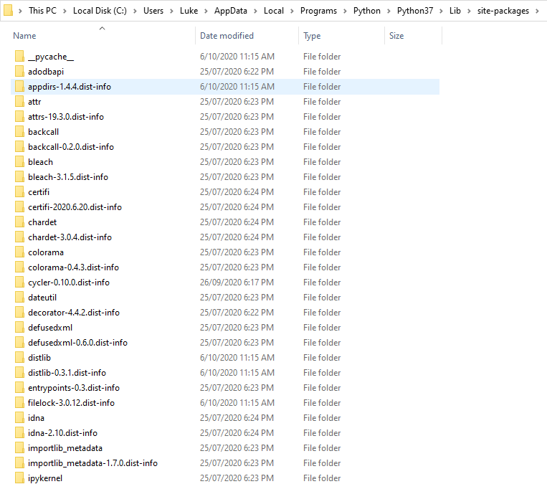
Creating your own package
The final frontier
Now that we have a robust (er…), well documented (um…), functioning (about that…) module, it’s time to release it upon the world.
If want to use this module elsewhere in this state, you’d have to either import it using it’s filepath or copy it into every project where you use it. Neither of these are very good solutions… so how do we make sure we can use it elsewhere?
When you pip install a package it usually ends up in a specific folder. When you import at the beginning of a python script, python looks in one of a few locations.
We need to figure out how to get our module into the folder where any script can call our module as a package.

Slide 28
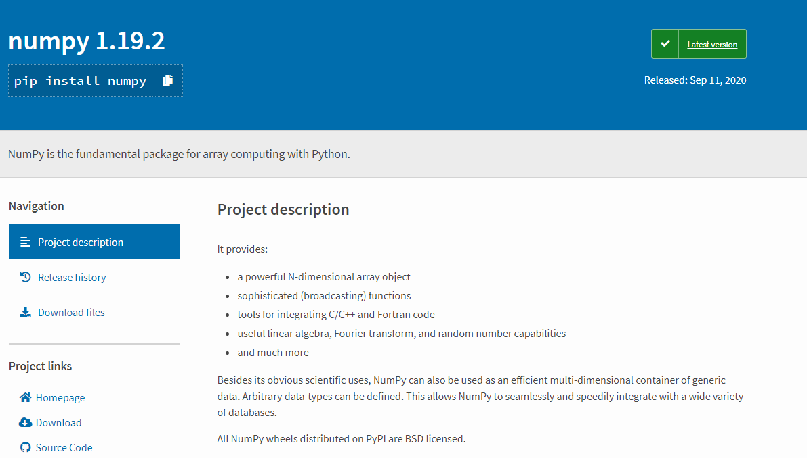
Creating your own package
PyPI
Most packages you’re familiar with either come with python or are open source and can be accessed via PyPI – the Python Package Index. PyPI allows python users and developers to develop suites of tools for personal use, business use or open sourcing a popular tool for rapid development.
You may ask “what’s stopping someone putting malware on PyPI?”
The answer is: not a lot. Use caution when a package with little support claims to solve a python problem you’ve been struggling with!
To keep PyPI honest, we’ll utilise test.pypy.org, which is used for development and testing. We don’t actually need to distribute our code from this evening!

Slide 29

Wheels
And creating a package
The standard for creating python packages was set in 2012 with PEP 427 introducing the wheel.
We won’t go into too much detail here, but a wheel will wrap our package up into a small set of files that pip/python will know how to work with and have a standard format that PyPI will know how to host.
Ironically, we need to pip install the wheel package first. Then we will populate a setup.py file which will act as the metadata for our package.
https://packaging.python.org/tutorials/packaging-projects/

Slide 30
Creating setup.py
Activity
Task: I have a dummy setup.py file ready. As a group, lets go over the field and fill out the basics.

Slide 31
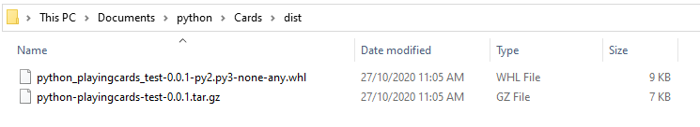
Wheels
And creating a package
Now that we have our setup.py file ready, we can just run this code which will generate our wheel. Once we have our wheel, we can upload the package to test.pypi!
You’ll notice that there are some new folders that were generated after running this command. We are mostly interested in the new /dist folder and its contents.

Slide 32
Twine
Bear with me…
Finally, we just need to get the package onto the internet. This bit is super simple if everything before this step has gone to plan, but can sometimes be a bit fiddly if you’re new and missed/messed up a step.
In practice, we will need to setup an account with a username, password and go through account verification – but that would make for a very boring exercise. We’ll just use my personal one for now, but reach out if you’re finding this bit difficult and I’ll do what I can to help.
Notes:
I myself have bashed my head against a wall for hours trying to get this to work and correctly upload.
Now that I’ve done it a couple of times, it took me about 5 minutes to get this to work with one error when testing before this talk.

Slide 33
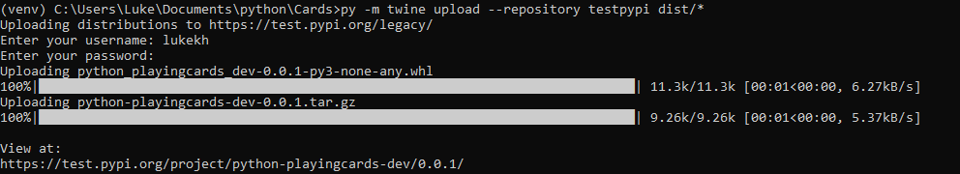
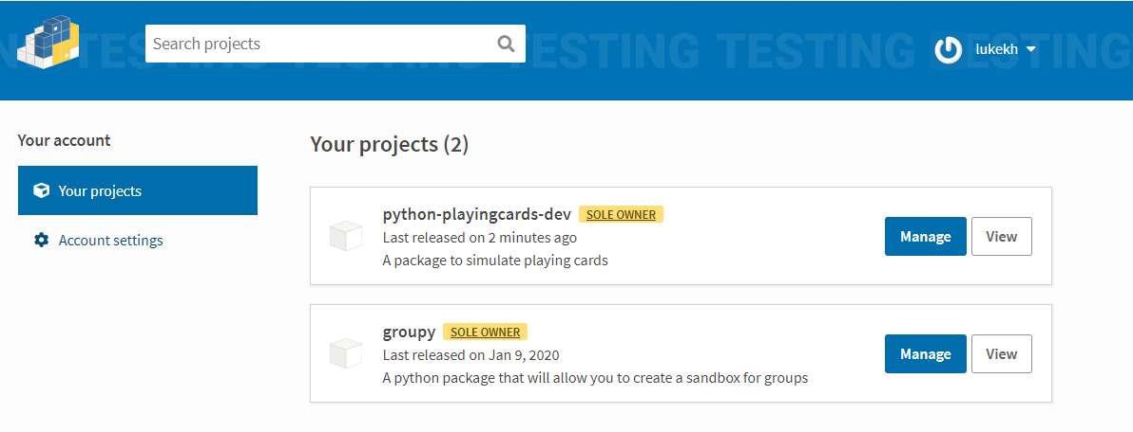
The Grand Finale!
Activity
Task: I couldn’t think of a good way to do this so you’re just going to have to watch me fiddle with twine. Below are some snips of what it looks like when it’s working. Compelling content, I know!

Slide 34
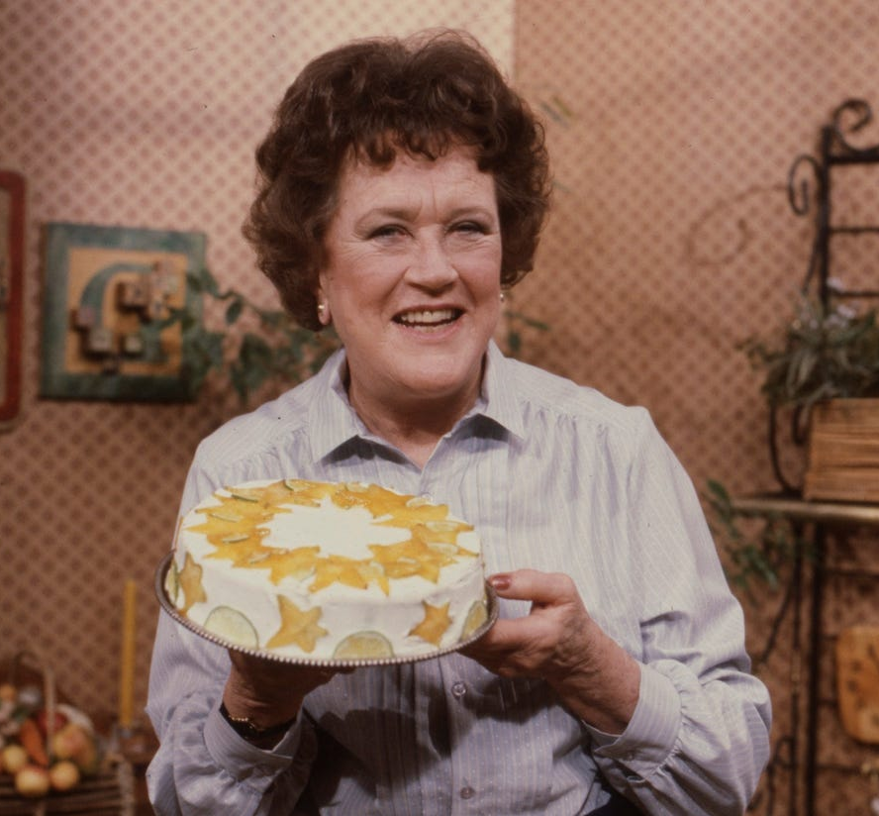
Let’s see it in action!
Here’s one I prepared earlier
Notes:
pip install -i https://test.pypi.org/simple/ python-playingcards-dev

Slide 35

“Maintainable code is more important than clever code.”
-- Guido Van Rossum
Thank you

