Slide 1
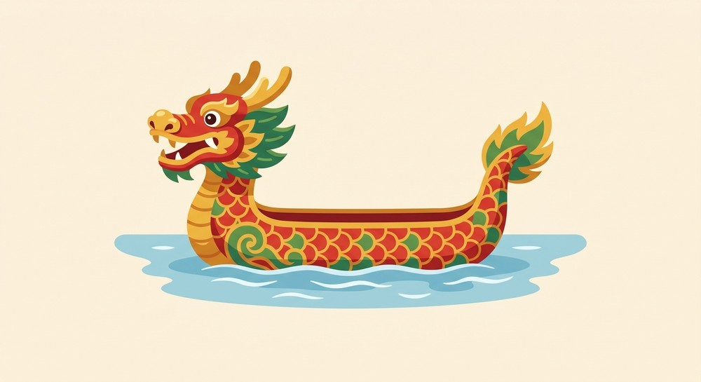
DRAGON BOAT QUEST
A Dragon Boat Festival adventure — name each thing in English to win the race!
▶ START

Slide 2
STAGE 1 OF 4 · THE BOAT
You climb aboard for the race. What is this boat called?
Sailboat
Dragon boat
Canoe

Slide 3
✕
SPLASH!
That's not it. Look at the dragon's head!
← Try again

Slide 4
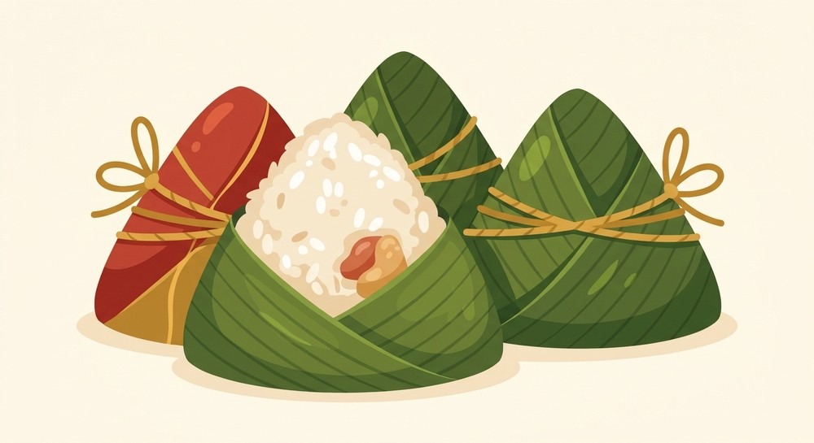
STAGE 2 OF 4 · THE SNACK
Grandma packs a festival snack. What are these called?
Rice dumplings
Pancakes
Sandwiches

Slide 5
✕
SPLASH!
Not quite — they're wrapped in bamboo leaves.
← Try again

Slide 6
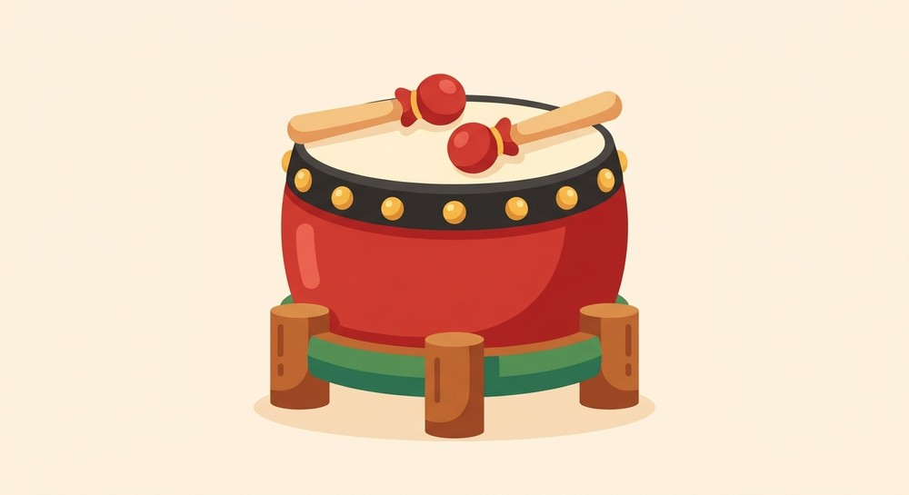
STAGE 3 OF 4 · THE BEAT
Someone keeps the rowing beat. What is this instrument?
Bell
Trumpet
Drum

Slide 7
✕
SPLASH!
Listen again — you hit it with sticks!
← Try again

Slide 8
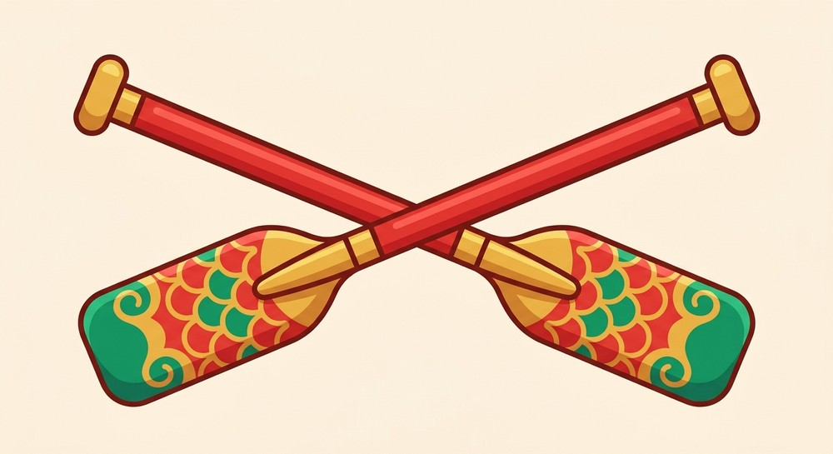
STAGE 4 OF 4 · ROW!
Grab one and row hard! What is this called?
Spoon
Paddle
Umbrella

Slide 9
✕
SPLASH!
Almost — it's what you row a boat with.
← Try again

Slide 10
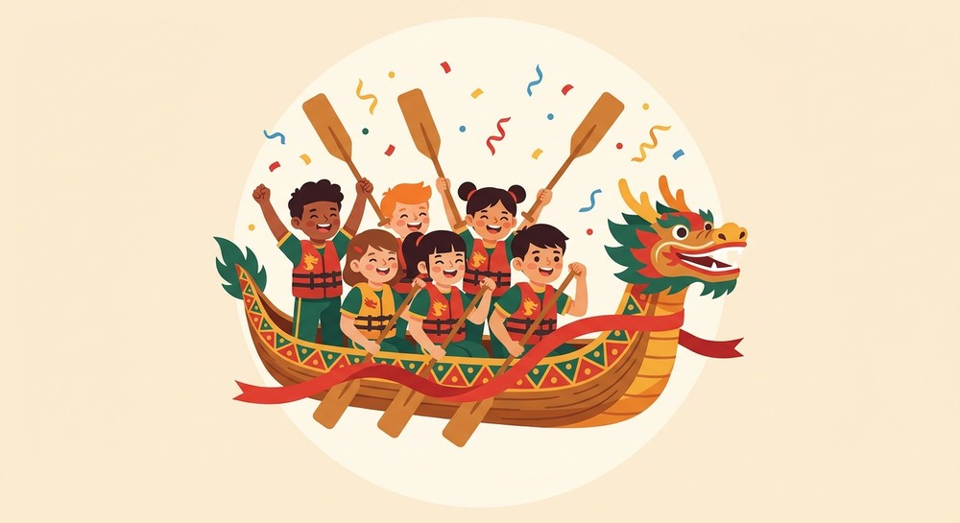
YOU WON THE RACE!
Happy Dragon Boat Festival — brilliant English!
▶ Play again

