Slide 1
Real-Time Market Access Controls
SEC Rule 15c3-5
Streaming Analytics, Kafka, and AWS in Practice

Slide 2

Lucas Little
Head of Intelligent Data & Cloud | Ippon Technologies
Formerly Ally Invest, Vanguard
AWS Certification SME (2019–2024)
UNC Charlotte Class of 2009

Slide 3
August 1, 2012
Knight Capital
$440M
Deployed untested trading software to production
Runaway algorithm executed millions of erroneous trades
Lost in 45 minutes
No centralized kill switch — couldn't stop all servers
Company acquired at fire-sale price 6 months later
"The company that defined electronic trading was destroyed by its own technology."

Slide 4
SEC Rule 15c3-5
The Market Access Rule
Pre-trade Controls
Every order must be checked before it reaches the market
Kill Switch
Must be able to immediately halt all trading from any account
Direct & Exclusive Control
The broker-dealer controls the switch — not the customer
Audit Trail
Complete records of all controls and their operation
Before an order touches the market, something must check it. If something goes wrong, you must stop everything immediately. And you must prove you did.

Slide 5
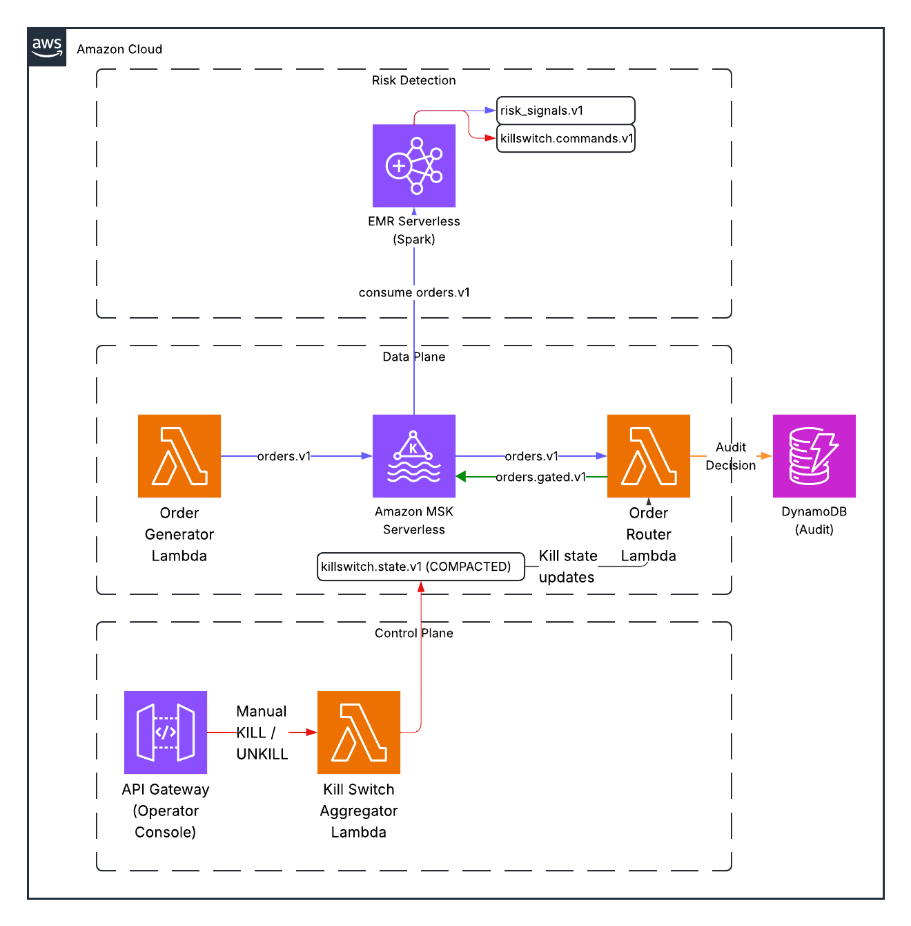
System Architecture

Slide 6
End-to-End Order Flow
1 Order Generated
Lambda produces order → orders.v1
2 Spark Analyzes
60s window → risk_signals.v1
3 Breach Detected
Spark emits → killswitch.commands.v1
4 State Updated
Aggregator → killswitch.state.v1 (compacted)
5 Order Dropped
Router checks state, drops → audit.v1
6 Operator Reviews
Human unkills → orders flow again
Every step tracked by correlation ID — 6 Kafka topics — Full audit trail from order to enforcement
Kill Switch Scopes
GLOBAL stops everything | ACCOUNT:12345 stops one account | SYMBOL:AAPL stops one stock

Slide 7
Kafka
The Event Backbone
6 Topics
Log Compaction
orders.v1
Raw order stream
Commands topic
Everything that ever happened
ACCT:123 → KILL (t=100)
ACCT:123 → UNKILL (t=200)
ACCT:123 → KILL (t=300)
State topic (compacted)
What's true right now
ACCT:123 → KILLED (t=300)
risk_signals.v1
Windowed metrics from Spark
killswitch.commands.v1
Kill/unkill commands
killswitch.state.v1
Current state per scope
orders.gated.v1
Allowed orders
audit.v1
Every routing decision

Slide 8
Spark Structured Streaming
Risk Detection with Windowing
60-Second Tumbling Windows
Window 1
:00 – :60
Window 2
:00 – :60
Window 3
:00 – :60
orders_df
.withWatermark("event_time", "60 seconds")
.groupBy(
window(event_time, '60 seconds'),
account_id
)
.agg(count(*), sum(notional), collect_list(symbol))

Slide 9
The Detection Pipeline
From raw orders to kill commands — the actual code
1 Aggregate
compute_risk_signals()
Per account, per 60s window:
count(*) → order_count
sum(notional) → total_notional
collect_list(sym) → concentration
Single aggregation pass — no
stream-stream joins needed.
2 Detect Breaches
detect_threshold_breaches()
Three boolean checks:
order_count > 100
total_notional > $1M
top_symbol_share > 70%
Filter: keep only rows where
at least one breach is True.
3 Emit Kill
write_kill_commands()
Build command with:
scope
reason
metric + value
corr_id
Write to Kafka as JSON.
All thresholds are configurable via Terraform variables. The entire pipeline is a single Spark Structured Streaming job with two output sinks (risk_signals.v1 and killswitch.commands.v1).

Slide 10
Three Thresholds
> 100 orders / 60s
Order Rate
Runaway algorithm sending orders faster than any human could
> $1M / 60s
Notional Value
Too much dollar exposure accumulating too quickly
> 70% one symbol
Concentration
Hammering a single stock — broken algo or manipulation
Knight Capital would have tripped all three within seconds.

Slide 11
Kill Switch Lifecycle
1
2
3
4
5
6
Normal
Breach
KILL
Blocked
Review
UNKILL
Orders flowing
Spark detects
Command emitted
Orders dropped
Operator checks
Access restored
Automatic detection
Spark triggers the kill switch — no human in the loop for detection
Manual recovery
A human must review and explicitly restore access
Every step is audited with correlation IDs for full traceability.

Slide 12
Why AWS
MSK Serverless
Kafka without managing brokers, ZooKeeper, storage
EMR Serverless
Spark without managing clusters. Submit a job, it scales.
Lambda
Functions without servers. No patching, no capacity planning.
DynamoDB
Fast key-value lookups. On-demand pricing.
API Gateway
HTTP API in one line of Terraform.

Slide 13
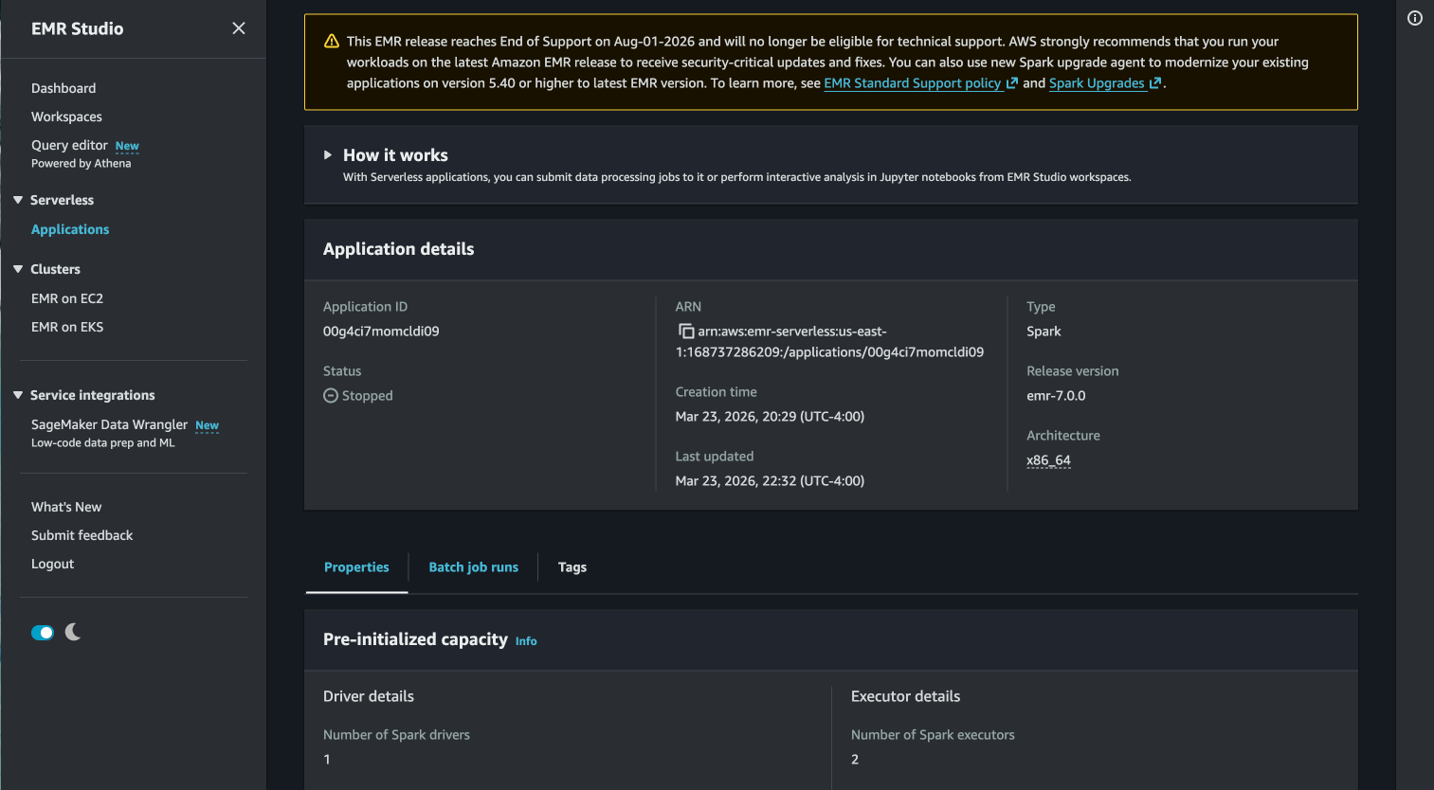
Amazon EMR

Slide 14
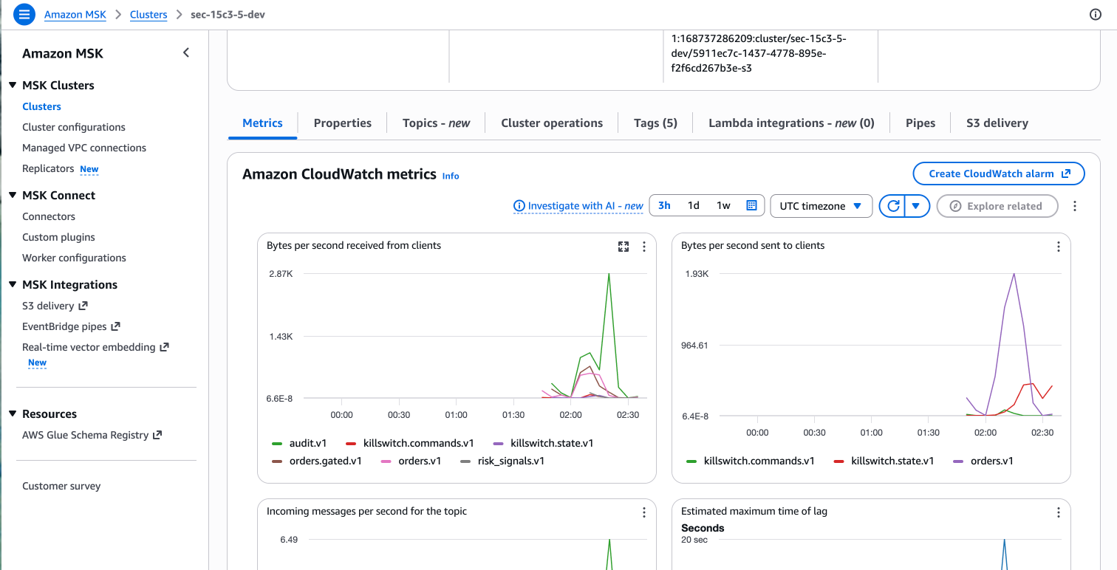
Amazon MSK

Slide 15
How AWS Addresses SEC 15c3-5
Mapping each regulatory requirement to AWS services
Pre-Trade Controls
Every order checked in real-time before execution
MSK + Lambda + EMR Serverless
Kill Switch
Immediate halt capability with sub-second propagation
API Gateway + Lambda + Kafka Compacted Topic
Direct & Exclusive Control
Human operator controls the switch — not the algo
API Gateway (Operator Console)
Audit Trail
Immutable, append-only log with correlation IDs
Kafka (90-day) + DynamoDB + CloudWatch
Detection is decoupled from enforcement. Spark detects, Lambda enforces, Kafka connects them.

Slide 16
Demo
Let's see it in action.

Slide 17
Try It Yourself
Run It Locally in 2 Minutes
$ git clone github.com/lukelittle/sec-15c3-5-market-access-controls-example
$ cd sec-15c3-5-market-access-controls-example/local
$ docker compose up --build -d
# That's it. Kafka, Spark, all 4 services, Kafka UI.
AKHQ (Kafka UI)
localhost:8080
See all topics and messages
Operator Console
localhost:8000
Manual kill/unkill API
Spark Risk Detector
(background)
Auto-detects anomalies
Cost: $0. Requires: Docker. That's it.

Slide 18
Infrastructure as Code
Terraform
What is Terraform?
# This project's modules:
terraform/modules/
vpc/ # Network isolation
msk/ # Kafka cluster
lambdas/ # 4 functions
emr_serverless/ # Spark
dynamodb/ # State + audit
api_gateway/ # HTTP API
cloudwatch/ # Monitoring
iam/ # Permissions
Describe your infrastructure in code
Run terraform apply to create it all
Run terraform destroy to tear it down
Reproducible, version-controlled, reviewable
No clicking through AWS console
If you're applying for cloud or platform engineering roles, Terraform is on every job listing.

Slide 19
Deploying to AWS
$ make build
$ cd terraform/envs/dev
$ terraform init && terraform apply
# Wait 15-20 min. Done.
What does it cost?
Service
What
Cost/hour
MSK Serverless
Managed Kafka
$2-3
EMR Serverless
Managed Spark
$1-2
Lambda + DynamoDB + S3
Compute, storage, cache
~$0.50
Total
$4-6

Slide 20
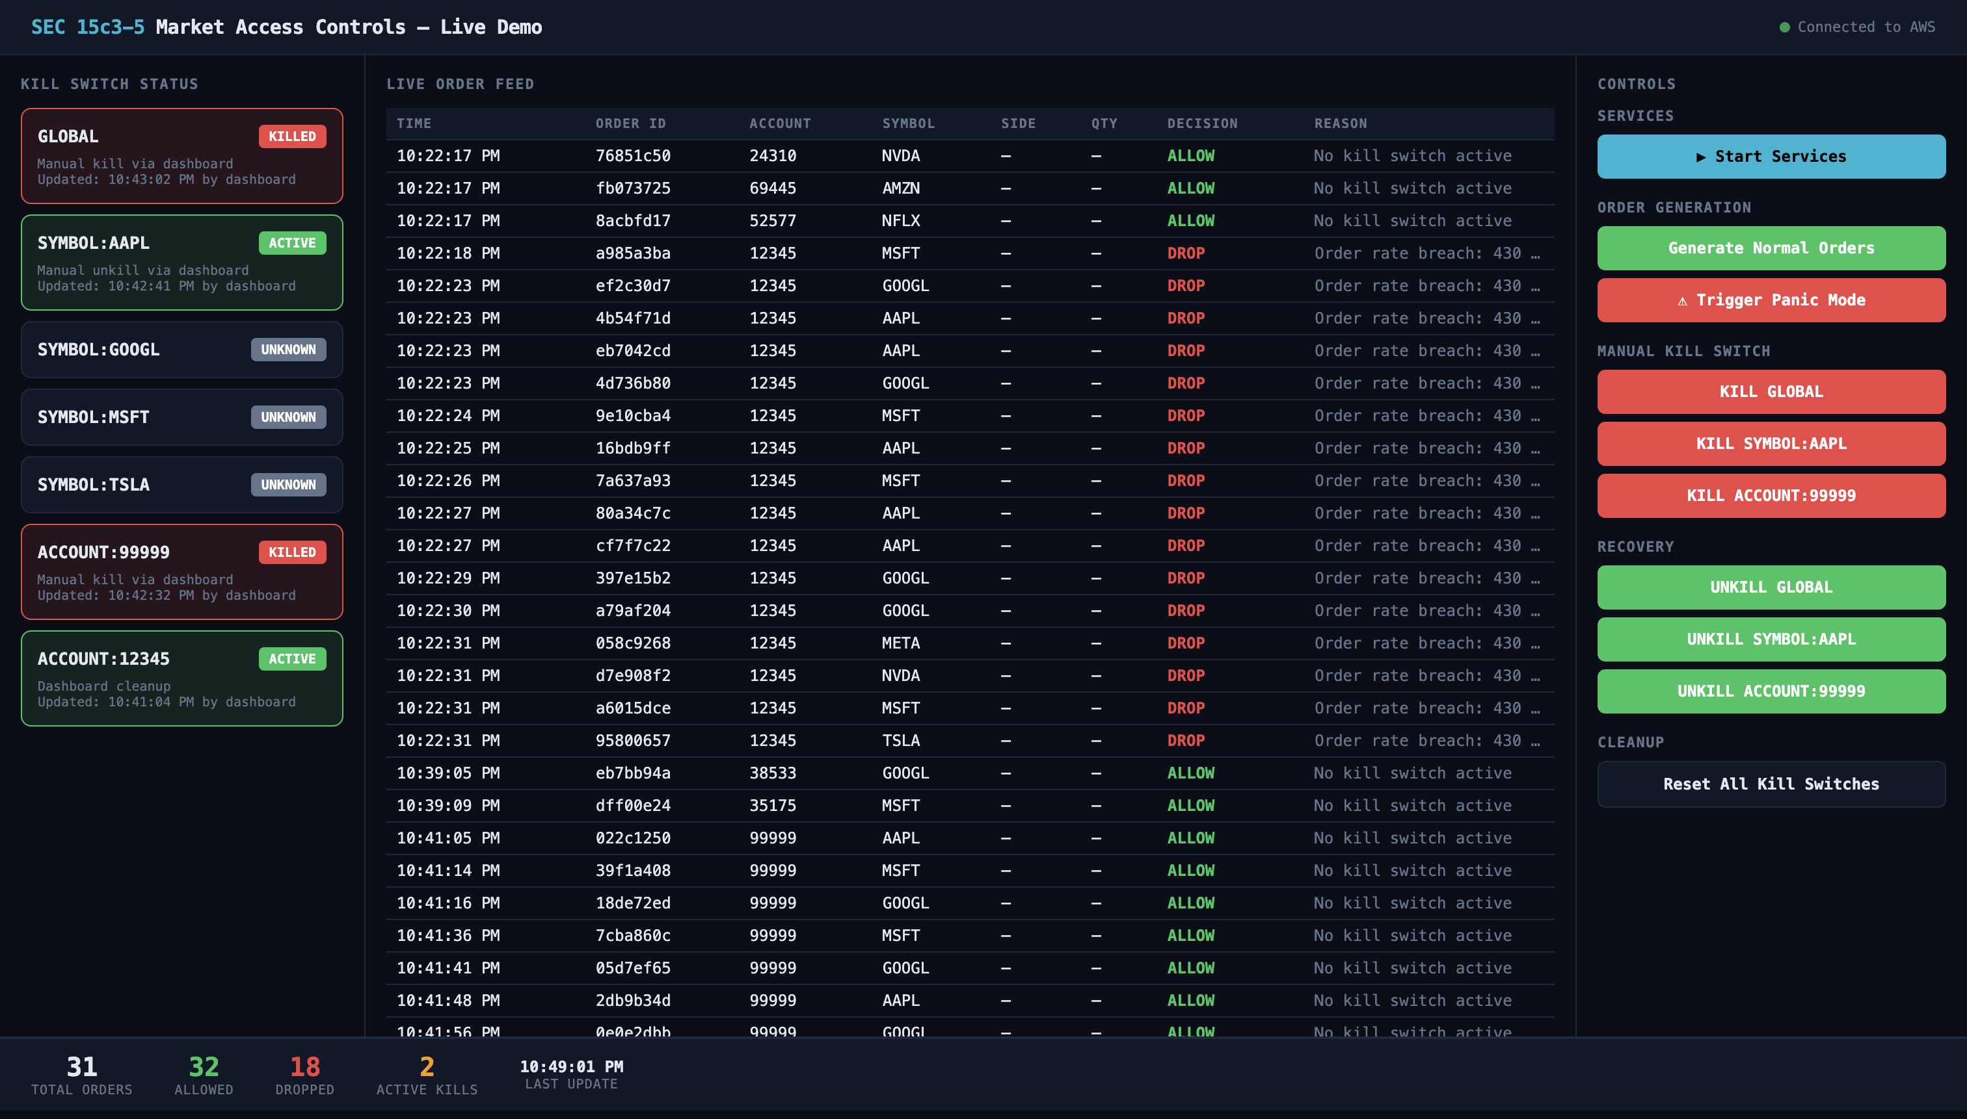
AWS Demo Console

Slide 21
Security & Production Gaps
What this demo does well, and what a real broker-dealer would need
What This Demo Includes
Least-privilege IAM roles per Lambda
VPC isolation for MSK and Lambda
IAM authentication for Kafka (SASL_IAM)
TLS encryption in transit
Immutable audit trail with correlation IDs
No hardcoded credentials
What Production Needs
Encryption at rest (KMS for MSK, DynamoDB, S3)
API authentication (OAuth/IAM on operator API)
Rate limiting and input validation
7-year audit retention (SEC requirement)
Compliance officer sign-off and testing
Disaster recovery and incident response
This demo prioritizes education over production hardening. Always engage security and compliance teams before deploying trading systems.

Slide 22
Why This Matters for Your Career
Kafka
LinkedIn, Netflix, Uber, every major bank
Spark Streaming
Fraud detection, risk analytics, recommendations
AWS Managed Services
How teams ship without managing infrastructure
Terraform
Baseline expectation for cloud engineering roles
Event-Driven Architecture
The dominant pattern for systems that scale
These patterns apply beyond finance: fraud detection, infrastructure monitoring,
IoT alerting, content moderation, and anywhere anomalies need real-time response.

Slide 23
Get Involved
github.com/lukelittle/sec-15c3-5-market-access-controls-example
1
Clone it and run locally with Docker Compose
Free, 2 minutes, no AWS needed
2
Try the 10 exercises
From beginner (add a kill scope) to advanced (chaos engineering)
3
Extend it
Build a dashboard, add throttling, implement multi-window detection
4
Apply the patterns to course projects
Streaming detection, event-driven responses, audit trails

Slide 24

Connect with Me
linkedin.com/in/lucaslittle
Thank you!

