Slide 1
ASSISTIVE TECH PROJECT
✦
UniEnable
Plan campus life with less overload.
Tasks, timetables and accessible routes —
in one calm, offline command-line app.
A 5–7 minute introduction for NUS freshmen
Notes:
Opening (about 40 seconds)
Ask: ‘When a week gets crowded, what takes more energy — doing the work, or deciding what to do next?’
Introduce UniEnable as a student-built, offline planning tool designed around predictable routines and accessibility.
Promise the audience three things: the problem, a live workflow, and a QR code they can try immediately.
[Sources]
- https://github.com/lukelouyu/SelfTeamProject
[/Sources]

Slide 2
WHY THIS MATTERS
Planning should not consume the energy meant for studying
A normal university day can require several different kinds of planning at once.
01
What comes next?
Turn an unstructured task list into one relevant next action.
02
When can it fit?
Respect fixed commitments, flexible windows and personal planning hours.
03
Can I get there?
Check local facility information and a confirmed accessible route.
UniEnable • NUS Enablers
02
Notes:
Problem framing (about 55 seconds)
Do not diagnose or generalise about neurodivergent students. Describe the planning load itself.
Use one quick scenario: a student has a lecture, a flexible assignment, and an unfamiliar route to another building.
Transition: ‘UniEnable keeps those decisions explicit and predictable.’
[Sources]
- https://github.com/lukelouyu/SelfTeamProject
[/Sources]

Slide 3
WHAT UNIENABLE DOES
One command surface connects routine planning and accessibility
•
Tasks + timetable
UniEnable • offline CLI
Fixed and flexible activities with energy and sensory-load context.
> preference view
Preferred hours: 07:30–21:00
Minimum buffer: 30 minutes
> recommend next week
Proposal generated — preview only
[1] Project work Tue 14:00–15:30
> route from/AS7 to/CLB
Total distance: 270 m
•
Preference-aware recommendations
Preferred hours are hard boundaries; preview first, adopt only when ready.
•
Facilities + routes
Read-only local accessibility data and confirmed route search.
Readable output. Explicit confirmation. No account or internet required.
UniEnable • NUS Enablers
03
Notes:
Feature overview (about 70 seconds)
Point to the terminal, then explain the three capabilities from top to bottom.
Be precise: recommendations depend on the saved preference profile, activity windows, duration, existing commitments and current time. Tomato/Pomodoro affects an advisory line, not slot placement.
Be precise about routes: they use supplied local reference data, not live campus conditions.
[Sources]
- https://github.com/lukelouyu/SelfTeamProject
- https://github.com/lukelouyu/SelfTeamProject/blob/main/docs/UserGuide.md
[/Sources]

Slide 4
LIVE DEMONSTRATION
Demo one decision loop — preference, proposal, route
Run these in order. Let the output tell the story; avoid explaining every command.
1
> preference view
Show the student’s current planning boundaries
2
> recommend next week
Generate a read-only proposal
3
> recommend adopt
Explain confirmation — then answer n for a safe demo
4
> route from/AS7 to/CLB
Finish with a concrete accessible route
Fallback: keep a screenshot of the expected output open in another window.
UniEnable • NUS Enablers
04
Notes:
Live demo (about 2½ minutes)
Before presenting: extract the release ZIP, open a terminal in that folder, and run java -jar unienable.jar.
Use preference view first. Then recommend next week. Highlight that generation is a preview and does not save.
For recommend adopt, answer n unless you intentionally prepared disposable demo data.
Run route from/AS7 to/CLB and read only the first and final line plus total distance.
If anything fails, switch immediately to the screenshot and continue. Never troubleshoot live for more than ten seconds.
[Sources]
- https://github.com/lukelouyu/SelfTeamProject/releases/tag/v2.0.1
- https://github.com/lukelouyu/SelfTeamProject/blob/main/docs/UserGuide.md
[/Sources]

Slide 5
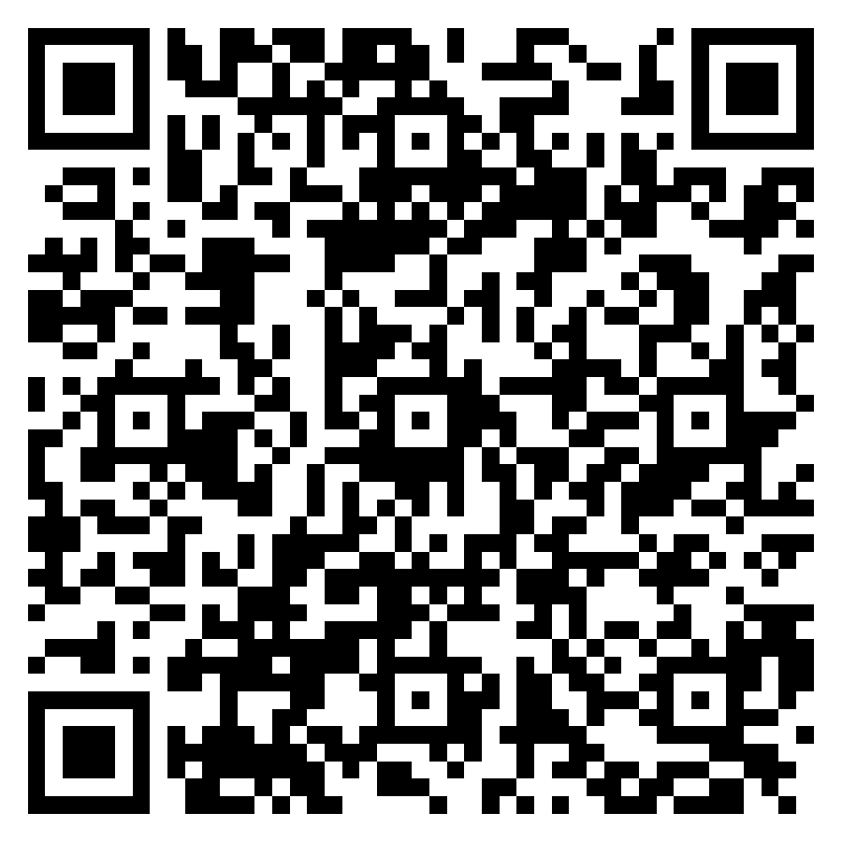
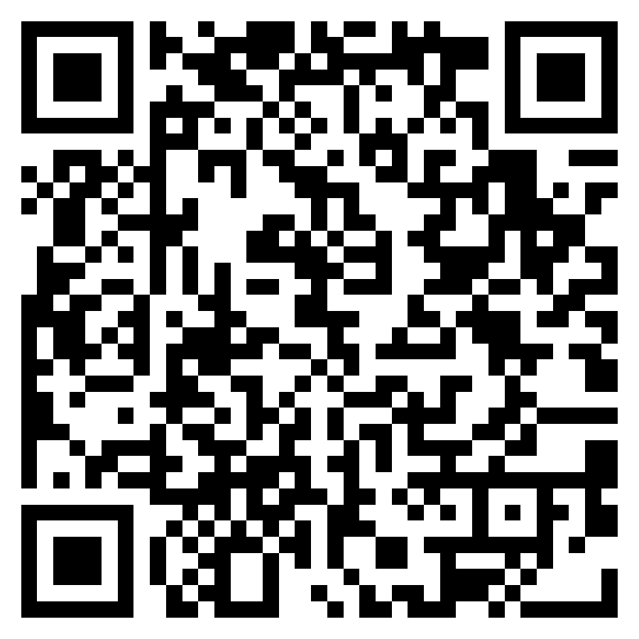
YOUR TURN
Scan now: try the release or explore the code
Download v2.0.1
Explore the repository
ZIP → extract → java -jar unienable.jar
Read the guides • inspect the code • contribute
github.com/lukelouyu/SelfTeamProject/releases/tag/v2.0.1
github.com/lukelouyu/SelfTeamProject
UniEnable • NUS Enablers
05
Notes:
Audience action (about 60 seconds)
Pause here. Ask everyone to take out their phones and scan one code.
Recommend the release code for first-time users and the repository code for students interested in development.
Say: ‘The distributable is the ZIP because the academic-calendar data file lives beside the JAR.’
Ask one person near the back to confirm the code opens before moving on.
[Sources]
- https://github.com/lukelouyu/SelfTeamProject/releases/tag/v2.0.1
- https://github.com/lukelouyu/SelfTeamProject
[/Sources]

Slide 6
TAKE ONE NEXT STEP
✦
Try it. Break it. Improve it.
UniEnable is useful as an app — and as a small Java codebase you can learn from.
Try
Test
Contribute
Use it for one planning session.
Find a confusing command or edge case.
Open an issue or propose a focused improvement.
github.com/lukelouyu/SelfTeamProject
UniEnable • NUS Enablers
06
Notes:
Close (about 35 seconds)
Return to the opening question: the goal is to spend less energy deciding and more energy doing.
Invite practical feedback from first-time users, especially unclear wording, difficult setup steps and accessibility assumptions.
End with a concrete ask: ‘Please try one workflow and tell me the first point where you hesitate.’
[Sources]
- https://github.com/lukelouyu/SelfTeamProject
[/Sources]

