Slide 1
Property manager
The Terminal application
by Luke Lovekin

Slide 2
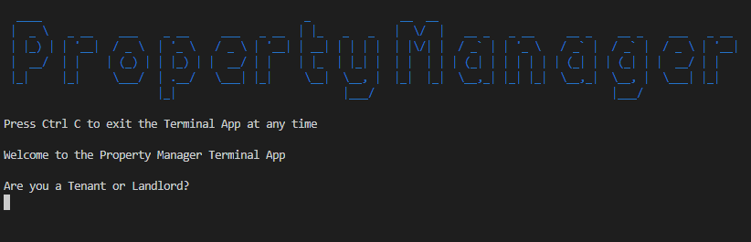

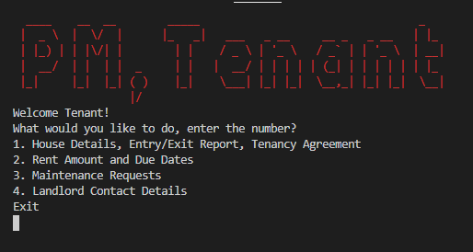
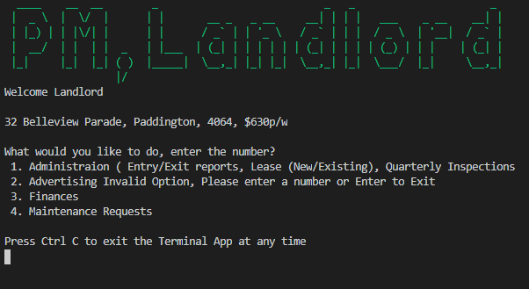

Property manager, Terminal App
Features
Easy to use, easy to follow, organization.
Stores Tenants request to csv which is readable by Landlord
Opens files when called upon in the terminal (Maybe)
Landlord feature and Tenant feature
More….(Maybe)
Use
Predominantly for the landlord
Organised platform for Landlords and Tenants to store documents
-Tools to help get your property rented, keep track of payments, maintenance requests and more
-Replace property managers
Structure
Two sides, Tenant and Landlord,
Flows one page to the next through users choice of options

Slide 3
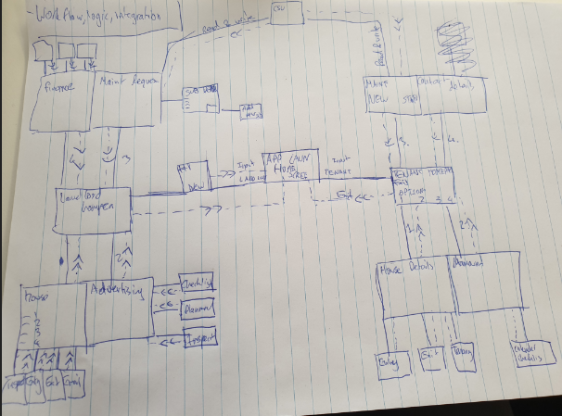
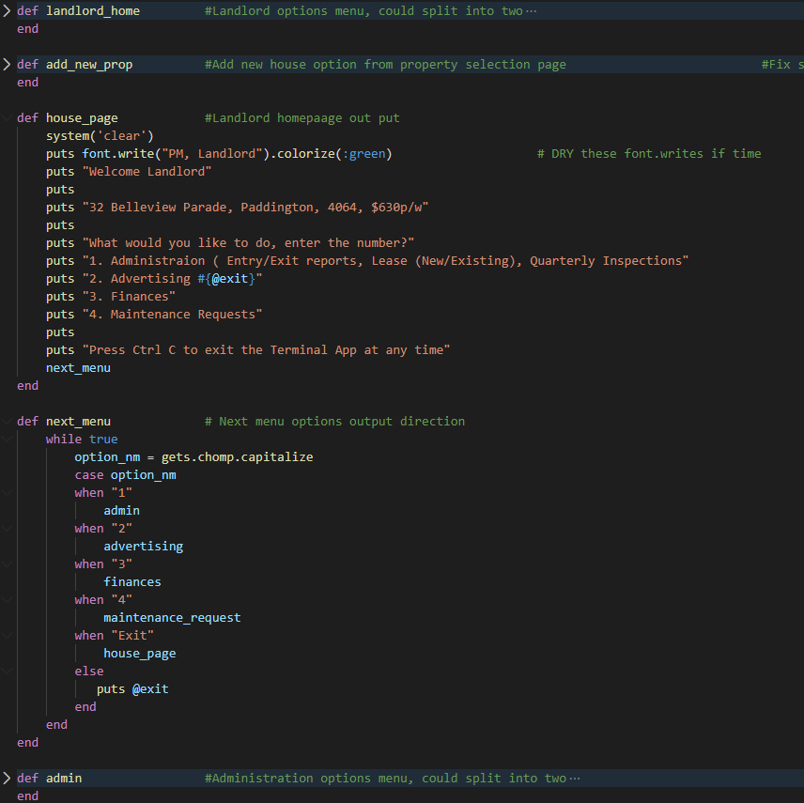
Property manager, Terminal App
Logic/ Code
-Case statement Heavy
-Input /Output heavy
-Loop heavy
-Method Heavy
-Puts Heavy
-Gems
Important Parts
- User being directed down the right path with their input
- Checking all the different options to make sure they don’t get stuck in loops

Slide 4

Upon Reflection
What I learnt
Time consuming
How much longer things actually take
Plan better
A lot of sprinkles will get left off
Anything id do differently
Make a smaller, more complex app
Favorite Part
The Challenge
Biggest challenges
Time
Learning new content while trying to finish in time
Getting expectations up, to finish less than expected
Settling must haves over wants

Slide 5
Property manager, Terminal App
Q and A?

