Slide 1
Chapter 10
Financial Statement Analysis

Slide 2
Learning Objectives
LO1 Perform an industry and company analysis.
LO2 Perform a horizontal analysis.
LO3 Perform a vertical analysis.
LO4 Prepare common size financial statements
LO5 Use ratios to make business decisions.

Slide 3
Learning Objective One
Perform an industry and company analysis
Notes:
The first learning objective is to perform an industry and company analysis.

Slide 4
Industry and Company Analysis (1 of 2)
When evaluating a company, it is important to understand the business and consider the industry the company is in
How would you predict Empire’s sales and net earnings for 2022 and beyond?
This chapter examines some of the tools of financial analysis
Notes:
Given the sales and net earnings data for Empire Company Ltd., how would you predict Empire’s sales and net earnings for 2022 and beyond? Based on the recent past, you would probably extend the sales and the net earnings lines upward.

Slide 5
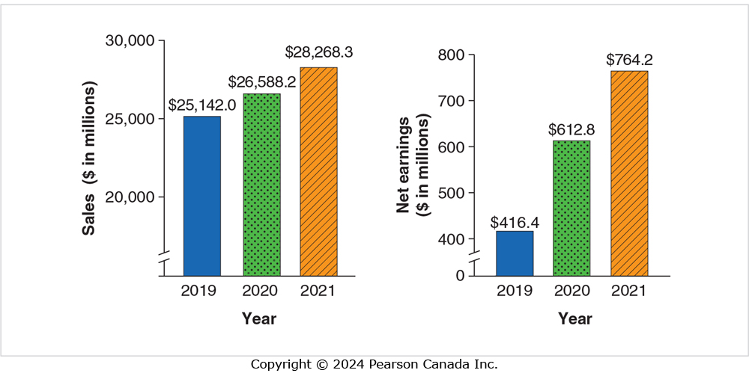
Industry and Company Analysis (2 of 2)
Notes:
Given the sales and net earnings data for Empire Company Ltd., how would you predict Empire’s sales and net earnings for 2022 and beyond? Based on the recent past, you would probably extend the sales and the net earnings lines upward.

Slide 6
Learning Objective Two
Perform a horizontal analysis
Notes:
The second learning objective is to perform a horizontal analysis.

Slide 7
Horizontal Analysis
Study of percentage changes from year-to-year
Two steps to compute a percentage change:
  1. Compute dollar amount of change
  2. Divide dollar amount of change by base-period amount
Notes:
Investors and creditors cannot evaluate a company by examining only one year’s data. This is why most financial statements are comparative, that is, they cover at least two periods. Many decisions hinge on the trend of revenues, expenses, income from operations, and so on. Have revenues increased from last year? By how much? Suppose net sales have increased by $50,000. Considered alone, this fact is not very helpful, but knowing the long-term percentage change in net sales helps a lot. It’s better to know that net sales have increased by 20% than to know that the increase is $50,000. It’s even better to know that percentage increases in net sales for the past several years have been rising year over year.
The study of percentage changes from year to year is called horizontal analysis. Computing a percentage change takes two steps:
1. Compute the dollar amount of the change from one period (the base period) to the next.
2. Divide the dollar amount of change by the base-period amount.

Slide 8
Horizontal Analysis - Example (1 of 2)
Empire Company Limited Comparative Income Statements For the Years Ended May 1, 2021 and May 2, 2020
 | 2021 | 2020 | $ Change | % Change
Sales | $28,268 | $26,588 | $1,680 | 6.3%
STEP 1
Compute the dollar amount of change in sales from 2020 to 2021:
2021 − 2020 = Increase
$28,268 − $26,588 = $1,680
Notes:
The study of percentage changes from year to year is called horizontal analysis. Computing a percentage change requires two steps: 1. Compute the dollar amount of the change from one period (the base period) to the next. 2. Divide the dollar amount of change by the base-period amount.

Slide 9
Horizontal Analysis - Example (2 of 2)
Empire Company Limited Comparative Income Statements For the Years Ended May 1, 2021 and May 2, 2020
 | 2021 | 2020 | $ Change | % Change
Sales | $28,268 | $26,588 | $1,680 | 6.3%
STEP 2
Divide the dollar amount of change by the base-period amount. This computes the percentage change for the period:
Percentage change = $ 1,680 × 100 = 0.0632 × 100 = 6.3%
$26,588

Slide 10
Trend Percentages (1 of 2)
Form of horizontal analysis
Base year selected and set equal to 100%
  Amount of each following year stated as a percent of base
Notes:
Trend percentages are a form of horizontal analysis. Trends indicate the direction a business is taking. How have revenues changed over a five-year period? What trend does net income show? These questions can be answered by trend percentages over a representative period, such as the most recent five years. Trend percentages are computed by selecting a base year whose amounts are set equal to 100%. The amount for each following year is stated as a percentage of the base amount. To compute a trend percentage, divide an item for a later year by the base-year amount. You can perform a trend analysis on any item you consider important.

Slide 11
Trend Percentages (2 of 2)
Trend percentages are computed by selecting a base year whose amount is set equal to 100%.
Trend % = Any year $ ÷ Base year $
 | 2021 | 2020 | 2019
Sales | $28,268 | $26,588 | $25,142
 | 112% | 106% | 100%
*2019 is the base year
Notes:
In this example, 2019 is the base year. The sales from that year, $25,142 is divided by $25,142 to give one, or 100%. For 2020, the sales of $26,588 is divided by $25,142 to give 1.06 or 106%. The same is done for 2021 to give 1.12 or 112%.

Slide 12
Learning Objective Three
Perform a vertical analysis
Notes:
The third learning objective is to perform a vertical analysis.

Slide 13
Vertical Analysis
Shows relationship of a financial-statement item to its base
  For Income Statement, total revenue is the base
  For Balance Sheet, total assets is the base
Notes:
Vertical analysis shows the relationship of a financial-statement item to its base, which is the 100% figure. All items on the particular financial statement are reported as a percentage of the base. For the income statement, total revenue (sales) is usually the base. For the balance sheet, total assets is the base.

Slide 14
Learning Objective Four
Prepare common-size financial statements
Notes:
The fourth learning objective is to prepare common-size financial statements.

Slide 15
Common-Size Statements
Report only vertical analysis percents
  No dollar amounts
Help in the comparison of different companies
  Financial results in terms of a common denominator
Notes:
Financial statements can be modified to report only vertical analysis percentages (no dollar amounts). Such financial statements are called common-size statements. In order to perform vertical analysis, you must first convert the financial statements to common-size format. On a common-size income statement, each item is expressed as a percentage of the revenue amount. Total revenue is therefore the common size. In the balance sheet, the common size is total assets. A common-size financial statement aids the comparison of different companies because all amounts are stated in percentages, thus expressing the financial results of each comparative company in terms of a common denominator. Comparing the dollar amounts of companies of different size will always result in favouring the larger company, but comparing the same companies using percentages can equalize the companies to determine operating efficiency with their respective resources.

Slide 16
Benchmarking
Compares company to a standard set by others
  Often a key competitor
Facilitated by common-size statements
Has goal of improvement
Now we will use the file “Chapter 10 Example.xls” to practice horizontal and vertical analysis, trend % and common-size statements
Notes:
Benchmarking compares a company to some standard set by others. The goal of benchmarking is improvement. Besides a key competitor, companies also often compare themselves to their industry as a whole to see their position among all the companies doing the same type of business.

Slide 17
Learning Objective Five
Use ratios to make business decisions
Notes:
The fifth learning objective is to use ratios to make business decisions.

Slide 18
Ratio Categories
Measuring ability to pay current liabilities
Measuring turnover and cash conversion
Measuring leverage
Measuring profitability
Analyzing shares as an investment
Notes:
Ratios are a major tool of financial analysis. A ratio expresses the relationship between various types of financial information. Many companies include ratios in a special section of their annual reports. The ratios we discuss in this chapter are classified as follows:
Measuring ability to pay current liabilities
Measuring turnover and cash conversion
Measuring leverage: overall ability to pay debts
Measuring profitability
Analyzing shares as an investment

Slide 19
Ability to Pay Current Liabilities
Working capital
Current ratio
Quick (Acid-test) ratio
Notes:
Three figures help determine a company’s ability to pay current liabilities—working capital, current ratio, and acid-test ratio.

Slide 20
Working Capital and Current Ratio
Notes:
Working capital measures the ability to pay current liabilities with current assets. In general, the larger the working capital, the better the ability to pay debts. Recall that capital is total assets minus total liabilities. Working capital is like a “current” version of total capital.
The most common ratio evaluating current assets and current liabilities is the current ratio, which is current assets divided by current liabilities. The current ratio measures the ability to pay current liabilities with current assets. In general, a higher current ratio indicates a stronger financial position. What is an acceptable current ratio? The answer depends on the industry. The norm for companies in most industries is around 1.50, as reported by the Risk Management Association.

Slide 21
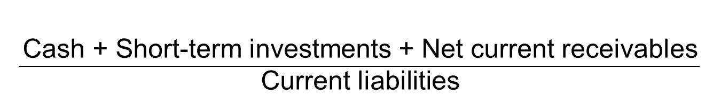
Quick (Acid-Test) Ratio
Notes:
The acid-test (or quick) ratio tells us whether the entity could pass the acid test of paying all its current liabilities if they came due immediately. The acid-test ratio uses a narrower base to measure liquidity than the current ratio does. To compute the acid-test ratio, we add cash, short-term investments, and net current receivables (accounts and notes receivable, net of allowances) and divide by current liabilities. Inventory and prepaid expenses are excluded because they are less liquid. A business may be unable to convert inventory to cash immediately.

Slide 22
Data for Calculations (1 of 2)
Apple Inc.
Consolidated Balance Sheets (USD $)
As at September 26, 2020 and September 28, 2019
(in millions) | Sept. 26, 2020 | Sept. 28, 2019
Current assets:
Cash and cash equivalents | $ 38,016 | $ 48,844
Short-term marketable securities | 52,927 | 51,713
Accounts receivable, net | 16,120 | 22,926
Inventories | 4,061 | 4,106
Vendor non-trade receivables | 21,325 | 22,878
Other current assets | 11,264 | 12,352
Total current assets | 143,713 | 162,819
Marketable securities | 100,877 | 105,341
Property, plant, and equipment, net | 36,766 | 37,378
Other non-current assets | 42,522 | 32,978
Total assets | 323,888 | 338,516
Notes:
Use Apple Inc.’s balance sheet to calculate working capital, the current ratio and the quick ratio.

Slide 23
Data for Calculations (2 of 2)
Current liabilities:
Accounts payable | 42,296 | 46,236
Other current liabilities | 42,684 | 37,720
Deferred revenue | 6,643 | 5,522
Commercial paper | 4,996 | 5,980
Term debt | 8,773 | 10,260
Total current liabilities | 105,392 | 105,718
Term debt | 98,667 | 91,807
Other non-current liabilities | 54,490 | 50,503
Total liabilities | 258,549 | 248,028
Commitments and contingencies
Shareholders’ equity:
Share capital | 50,779 | 45,174
Retained earnings | 14,966 | 45,898
Accumulated other comprehensive income/(loss) | (406) | (584)
Total shareholders’ equity | 65,339 | 90,488
Total liabilities and shareholders’ equity | $ 323,888 | $ 338,516

Slide 24

Working Capital
2020 $38,321 = $143,713 – $105,392
2019 $57,101 = $162,819 - $105,718
Notes:
Apple’s working capital as of September 26, 2020 (the end of its 2020 fiscal year), was $38,321 million. This compares with $57,101 million at the end of its 2019 fiscal year. Why the dramatic change in working capital? The company’s reduction in working capital reflects its strategic decision to return cash to its shareholders in 2020.

Slide 25

Current Ratio
2020 1.36 = $143,713 ÷ $105,392
2019 1.54 = $162,819 ÷ $105,718
Notes:
Apple’s current ratio decreased during 2020, from 1.54 to 1.36, for the same reason that its working capital decreased: use of excess cash to pay dividends and repurchase shares from shareholders.

Slide 26
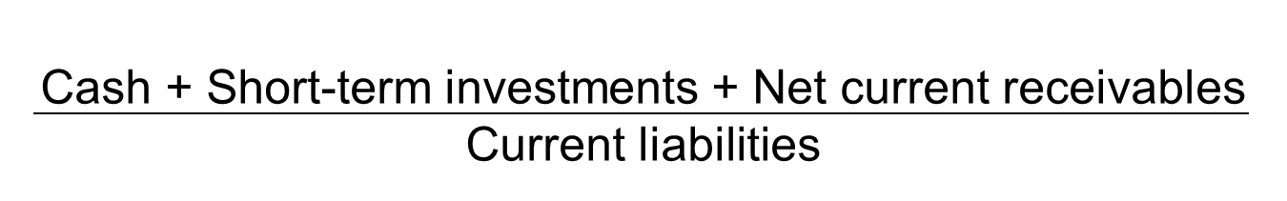
Quick Ratio
2020 1.02 = $38,016 + 52,927 + 16,120 $105,392
2019 1.17 = $48,844 + 51,713 + 22,926 $105,718
Notes:
Like the current ratio, the company’s quick ratio declined during 2020. However, because of Apple’s ability to generate cash quickly, a low quick ratio doesn’t spell liquidity problems.

Slide 27
Measuring Turnover and the Cash Conversion Cycle
Inventory turnover
Accounts receivable turnover
Accounts payable turnover
Notes:
The ability to sell inventory and collect receivables, as well as pay accounts payable, is the lifeblood of any retail, wholesale, or manufacturing concern. In this section, we discuss three ratios that measure this ability—inventory turnover, accounts receivable turnover, and accounts payable turnover— as well as the relationship between them, called the cash conversion cycle .

Slide 28


Inventory Turnover
(Beginning inventory + Ending inventory)/2)
Notes:
Companies generally strive to sell their inventory as quickly as possible. The faster inventory sells, the sooner cash comes in. Inventory turnover, measures the number of times a company sells its average level of inventory during a year. A fast turnover indicates ease in selling inventory; a low turnover indicates difficulty. A value of 6 means that the company’s average level of inventory has been sold 6 times during the year, and that’s usually better than a turnover of 3 times. A low inventory turnover can indicate either slow sales or too much inventory on hand. But too high a value can mean that the business is not keeping enough inventory on hand, which can lead to lost sales if the company can’t fill orders. Therefore, a business strives for the most profitable rate of turnover, not necessarily the highest rate.
To compute inventory turnover, divide cost of goods sold by the average inventory for the period. We use the cost of goods sold—not sales—in the computation because both cost of goods sold and inventory are stated at cost.

Slide 29
Measuring Ability to Sell Inventory
Apple’s inventory turnover: 2020
$169,559 ÷ $4,083.5 = 41.5
Competitor’s was 98.1
A high number indicates an ability to
sell inventory quickly.
Notes:
A fast turnover indicates ease in selling inventory; a low turnover indicates difficulty. A value of 6 means that the company’s average level of inventory has been sold six times during the year, and that’s usually better than a turnover of three times. But too high a value can mean that the business is not keeping enough inventory on hand, which can lead to lost sales if the company can’t fill orders. Therefore, a business strives for the most profitable rate of turnover, not necessarily the highest rate.
Apple’s inventory turned over 41.5 times in 2020. On a daily basis (days’ inventory outstanding), that means once every 8.8 or 9 days (365/41.5)!

Slide 30

Accounts Receivable Turnover
(Beginning net receivables + Ending net receivables)/2)
Days’ sales outstanding (DSO) = 365/Turnover
Notes:
Accounts receivable turnover measures the ability to collect cash from customers. In general, the higher the ratio, the better. A low ratio could indicate credit policies that are too loose, extending credit to customers who don’t have the ability to pay, or could also indicate lax collection practices, not following up on outstanding receivables to promote collection. However, a receivable turnover that is too high may indicate that credit is too tight, and that may cause you to lose sales to good customers. To compute accounts receivable turnover, divide net sales by average net accounts receivable. The ratio tells how many times during the year average receivables were turned into cash. To convert accounts receivable turnover to days’ sales outstanding (DSO), divide 365 by accounts receivable turnover.

Slide 31
Measuring Ability to Collect Receivables
(1 of 2)
Apple’s accounts receivable turnover: 2020
$274,515 ÷ $19,523 = 14.1 times
Competitor’s was 6.5
The higher the ratio, the better.
Notes:
Net sales comes from the Income Statement. Average net accounts receivable is figured by adding beginning and ending receivables then dividing by 2. If accounts receivable vary widely during the year, compute the average by using the 12 monthly balances. Apple collected its average accounts receivable 14.1 times during 2020. It’s competitor’s accounts receivable turnover was 6.5. Apple owns and operates a large number of retail stores, and much of its sales are for cash, which makes the receivables balance very low relative to the sales balance.

Slide 32
Measuring Ability to Collect Receivables
(2 of 2)
Days’ sales in receivable (DSO):
365 ÷ 14.1 = 26 days
The competition was 56 days.
Notes:
Businesses must convert accounts receivable to cash. All else being equal, the lower the receivable balance, the better the cash flow.
The days’ sales outstanding (DSO) or days’ sales in receivables ratio, shows how many days’ sales remain in accounts receivable. First, if you have already calculated receivables turnover, simply divide the turnover into 365. For Apple, days’ sales in receivables works out to 26 days (365/14.1).

Slide 33


Accounts Payable Turnover
Notes:
Accounts payable turnover measures the number of times per year that the entity pays off its accounts payable. To compute accounts payable turnover, divide cost of goods sold by average accounts payable. To convert accounts payable turnover to days’ payable outstanding (DPO), divide 365 by payables turnover.

Slide 34
Cash Conversion Cycle
DIO = Days’ Inventory Outstanding
DSO = Days’ Sales Outstanding
DPO = Days’ Payables Outstanding
Notes:
By expressing the three turnover ratios in days, we can compute a company’s cash conversion cycle as shown.

Slide 35
Measuring Leverage: Overall Ability to Pay Debts
Debt ratio
Times-interest-earned
Notes:
These two ratios can measure a company’s ability to pay debts.

Slide 36

Debt ratio
Notes:
The debt ratio tells us the proportion of assets financed with debt. A debt ratio of 1 reveals that debt has financed all the assets. A debt ratio of 0.50 means that debt finances half the assets. The higher the debt ratio, the greater the pressure to pay interest and principal. The lower the ratio, the lower the risk to shareholders.

Slide 37

Times-Interest-Earned
Notes:
Analysts use a second ratio—the times-interest-earned ratio —to relate income to interest expense. To compute the times-interest-earned ratio, divide income from operations (operating income) by interest expense. This ratio measures the number of times operating income can cover interest expense and is also called the interest-coverage ratio. A high ratio indicates ease in paying interest; a low value suggests difficulty.

Slide 38
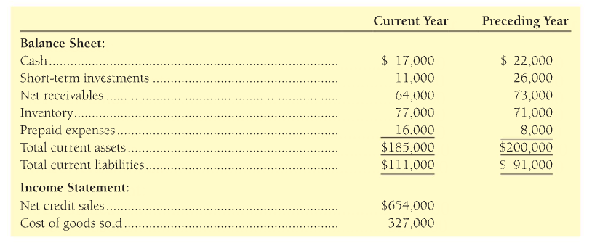
E10-19 page 594
Calculate the following ratios for the current year:
Current Ratio, Quick Ratio
Inventory Turnover, Accounts Receivable Turnover, Days Sales in Receivables

Slide 39
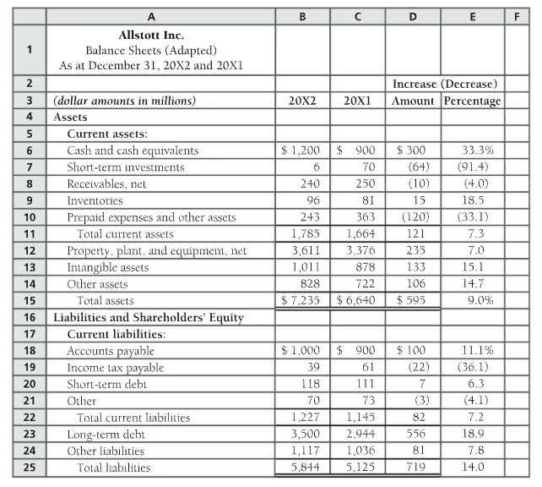
S10-7 page 590

Slide 40
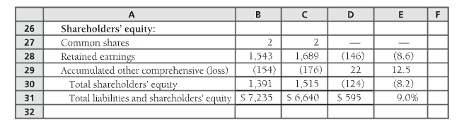
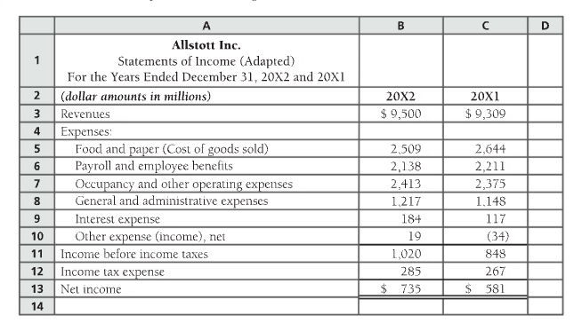
S10-7 page 590
For 2022 calculate:
Inventory turnover & DIO
DSO
A/P turnover & DPO
Cash Conversion Cycle in days

Slide 41
Measuring Profitability
Gross profit percentage
Operating income percentage
Return on sales
Asset turnover
Return on assets
Leverage ratio
Return on equity
Earnings per share
Notes:
The fundamental goal of business is to earn a profit, and so the ratios that measure profitability are reported widely and listed above.

Slide 42
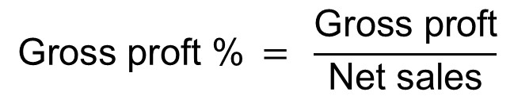
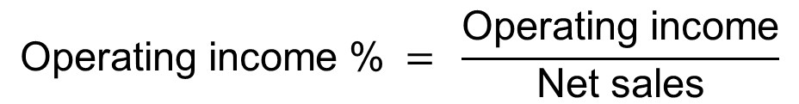
Gross Profit and Operating Income Percentages
Notes:
Gross profit is net sales minus cost of goods sold. That is, gross profit is the amount of profit that the entity makes from merely selling a product before other operating costs are subtracted. Operating income (profit) percentage is net income from operations as a percentage of net sales. It is an important statistic, because it measures the percentage of profit earned from each sales dollar in a company’s core business operations. The first component of high operating earnings is a high gross profit percentage. After that, maximizing operating income depends on keeping operating costs as low as possible, given the level of desired product quality and customer service.

Slide 43
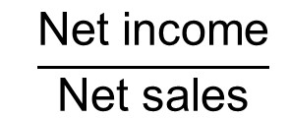
Return (Net Profit Margin) on Sales
Notes:
In business, return refers to profitability. Consider the rate of return on net sales, or simply return on sales (ROS). (The word net is usually omitted for convenience.) This ratio shows the percentage of each sales dollar earned as net income. Companies strive for a high rate of return on sales. The higher the percentage, the more profit is being generated by sales dollars.

Slide 44
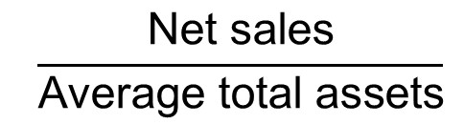
Asset Turnover
Notes:
Asset turnover measures the amount of net sales generated for each dollar invested in assets. As such, it is a measure of how efficiently management is operating the company. Companies with high asset turnover tend to be more productive than companies with low asset turnover.

Slide 45
Return on Total Assets
Net income
Average total assets
Notes:
Return on assets (ROA) measures how much the entity earned for each dollar of assets invested by both shareholders and creditors. Companies with high ROA have both selected assets and managed them more successfully than companies with low ROA.

Slide 46
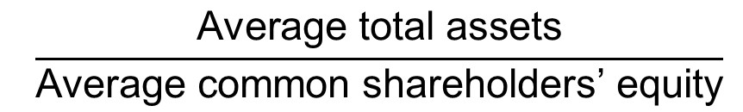
Leverage (Equity Multiplier) Ratio
Notes:
Leverage measures the impact of debt financing on profitability. It can be advantageous to use borrowed capital to finance a business. Earlier, we expressed the debt ratio as the ratio of total liabilities to total assets. The leverage ratio, or equity multiplier, measures the proportion of each dollar of assets financed with shareholders’ equity. Since total assets – shareholders’ equity = total liabilities, the leverage ratio is a way of inversely expressing the debt ratio—it merely looks at financing from the other side of the fundamental accounting equation.

Slide 47
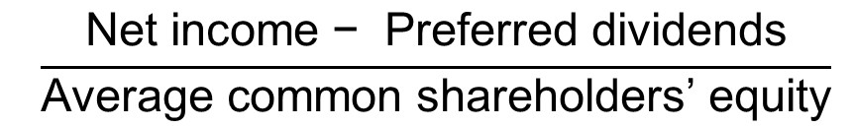
Return on Common Shareholders Equity
Notes:
A popular measure of profitability is rate of return on common shareholders’ equity, often shortened to return on equity (ROE). This ratio shows the relationship between net income and common shareholders’ investment in the company—how much income is earned for every $1 invested.
To compute this ratio, first subtract preferred dividends from net income to measure income available to the common shareholders. Then divide income available to common shareholders by average common equity during the year. Common equity is total equity minus preferred equity.

Slide 48
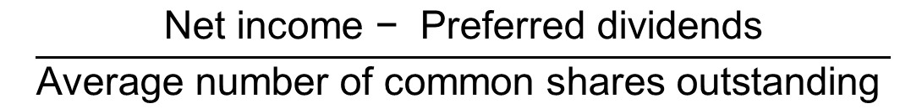
Earnings per Share
Notes:
Earnings per common share, or simply earnings per share (EPS), is the amount of net income earned for each common share outstanding. EPS is the most widely quoted of all financial statistics. It’s the only ratio that appears on the income statement. Earnings per share is computed by dividing net income available to common shareholders by the average number of common shares outstanding during the year. Preferred dividends are subtracted from net income because the preferred shareholders have a prior claim to their dividends.

Slide 49
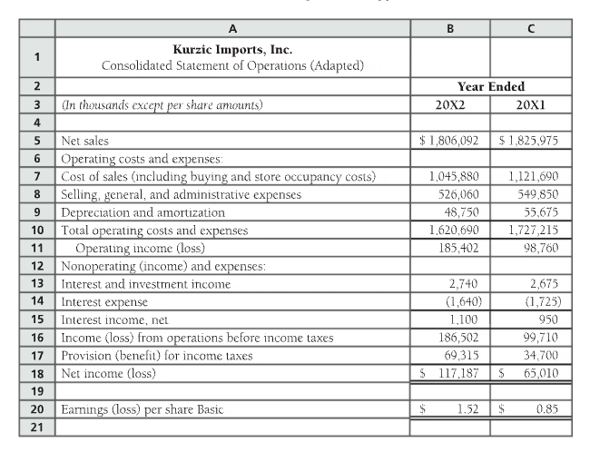
E10-18 page 593
In 20X2:
How much gross profit was earned on the sale of products?
How much was operating income?
How much net income was earned?
At the end of 20X2 what $ amount of income would investors use to predict 20X3 income?

Slide 50
Analyzing Shares as an Investment
Price/Earnings ratio
Dividend yield
Book value per common share
Notes:
Investors buy shares to earn a return on their investment. This return consists
of two parts:
gains (or losses) from selling the shares.
dividends.
These three ratios can help analyze their investments.

Slide 51

Price/Earnings Ratio
Notes:
The price/earnings ratio is the ratio of common share price to earnings per share. This ratio, abbreviated P/E, shows the market price of $1 of earnings. The P/E Ratio shows how much above earnings that a share of stock is currently selling.

Slide 52
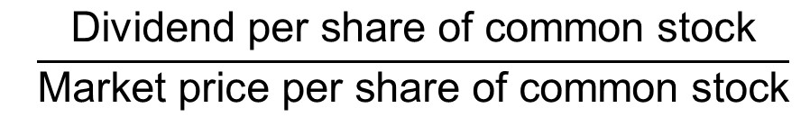
Dividend Yield
Notes:
Dividend yield is the ratio of dividends per share to the share’s market price. This ratio measures the percentage of a share’s market value returned annually to the shareholders as dividends. Preferred shareholders pay special attention to this ratio because they invest primarily to receive dividends.

Slide 53
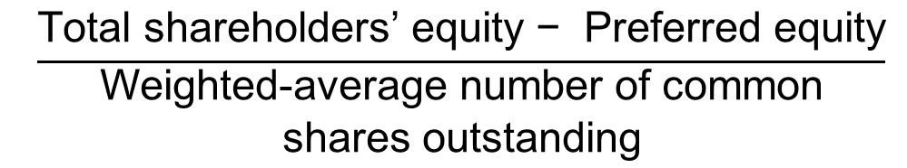
Book Value
Notes:
Book value per common share is simply common shareholders’ equity divided by the number of common shares outstanding. Common equity equals total equity less preferred equity.
Book value per share indicates the recorded accounting amount for each share outstanding. Many experts believe book value is not useful for investment analysis because it bears no relationship to market value and provides little information beyond what’s reported on the balance sheet. But some investors base their investment decisions on book value. For example, some investors rank common shares by the ratio of market price per share to book value per share. The lower the ratio, the more attractive the common share. These investors are called “value” investors, as contrasted with “growth” investors, who focus more on trends in net income.

Slide 54
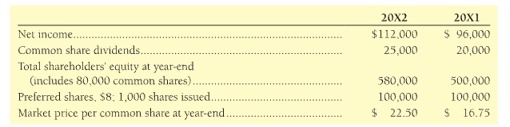
E10-22 page 599
Evaluate the common shares of Phillips Distributing Ltd. as an investment. Use the two share ratios to determine whether the commons shares increased or decreased in attractiveness during the past year.

Slide 55
Red Flags in Financial Statement Analysis
Earnings problems
Decreased cash flow
Too much debt
Inability to collect receivables
Buildup of inventories
Trends of sales, inventory and receivables
Notes:
Recent accounting scandals have highlighted the importance of red flags in financial analysis. The following conditions may mean a company is very risky.
■ Earnings Problems. Have income from continuing operations and net income decreased for several years in a row? Has income turned into a loss? This maybe okay for a company in a cyclical industry, such as an airline or a home builder, but some companies may be unable to survive consecutive loss years.
■ Decreased Cash Flow. Cash flow validates earnings. Is cash flow from operations consistently lower than net income? Are the sales of plant assets a major source of cash? If so, the company may be facing a cash shortage.
■ Too Much Debt. How does the company’s debt ratio compare to that of major competitors and to the industry average? If the debt ratio is much higher than average, the company may be unable to pay debts during tough times.
■ Inability to Collect Receivables. Are days’ sales in receivables growing faster than for other companies in the industry? A cash shortage may be looming.
■ Buildup of Inventories. Is inventory turnover slowing down? If so, the company may be unable to move products, or it may be overstating inventory as reported on the balance sheet. Recall from the cost-of-goods-sold model that one of the easiest ways to overstate net income is to overstate ending inventory.
■ Trends of Sales, Inventory, and Receivables. Sales, receivables, and inventory generally move together. Increased sales lead to higher receivables and require more inventory in order to meet demand. Strange movements among these items may spell trouble.

Slide 56
End of Chapter Ten
Slides adapted from Pearson Canada Inc. 2024
Notes:
This concludes Chapter Ten.

