Slide 1
Chapter 4
Cash and Receivables

Slide 2
Chapter 4’s Learning Objectives
Report cash on the balance sheet
Prepare a bank reconciliation
Account for accounts receivable
Evaluate collectability using the allowance for uncollectible accounts
Account for notes receivable and interest revenue
Evaluate liquidity using ratios
Analyze receivables collectability using an aging schedule created with an Excel pivot table
.

Slide 3
Learning Objective One
Report cash on the balance sheet
Notes:
The first learning objective is to report cash on the balance sheet.

Slide 4
Accounting for Cash
Companies usually combine all cash amounts into a single total the balance sheet called “Cash & Cash Equivalents”.
  Cash is the most liquid asset because it is the medium of exchange and used for paying bills, employees’ salaries, repaying loans, buying equipment, and etc.
  Cash equivalents include liquid assets such as treasury bills, commercial papers, and money market funds, which are interest bearing accounts with less than 3 months maturity
Notes:
Most companies have numerous bank accounts, but they usually combine all cash amounts into a single total called “Cash and Cash Equivalents.” Cash equivalents include liquid assets such as treasury bills, commercial paper, and money market funds. These are interest-bearing accounts that can be withdrawn with no penalty, or interest-bearing securities. Slightly less liquid than cash, cash equivalents are sufficiently similar to be reported along with cash.

Slide 5
Learning Objective Two
Prepare a bank reconciliation
Notes:
The second learning objective is to prepare a bank reconciliation.

Slide 6
The Need to Control Cash
Cash is the most liquid asset but it is easy to conceal and relatively easy to steal.
Most businesses create specific controls for cash:
  Keep cash in a bank account.
  Separation of duties (the person handling cash should not be responsible for recording cash transactions).
  Proper authorization for purchases.
  Proper authorization for cash payments.
  Authorize a limited number of people to sign cheques.
  Require daily deposits of cash receipts.

Slide 7
Bank Account as Control Device
Signature card
Protects against forgery
Deposit slip
Proof of transaction
Cheque
3 parties: maker, payee, bank where funds drawn
Bank statement
Bank reconciliation
Notes:
Cash is the most liquid asset because it’s the medium of exchange. Cash is easy to conceal and relatively easy to steal. As a result, most businesses create specific controls for cash. Keeping cash in a bank account helps control cash because banks have established practices for safeguarding customers’ money. The documents used to control a bank account include the:
■ Signature card - Banks require each person authorized to sign on an account to provide a signature card. This protects against forgery. Banks will not cash cheques that don’t bear an authorized signature and for cheques presented at the bank in person will often check the signature against the one on file
■ Deposit slip - Banks supply standard forms such as deposit slips. The customer fills in the amount of each deposit and lists the detailed amounts of each cheque being deposited and the amount of cash included in the deposit. As proof of the transaction, the customer keeps a deposit receipt
■ Cheque - To pay cash, the depositor can write a cheque, which tells the bank to pay the designated party a specified amount. There are three parties to a cheque:
1. the maker, who signs the cheque
2. the payee, to whom the cheque is paid
3. the bank on which the cheque is drawn
Cheques written by companies often have a stub attached, called a remittance advice, that tells the payee the purpose of the payment. The payee is required to endorse the back of the cheque when cashing it as proof that only the authorized payee received the funds.
■ Bank statement
■ Bank reconciliation

Slide 8
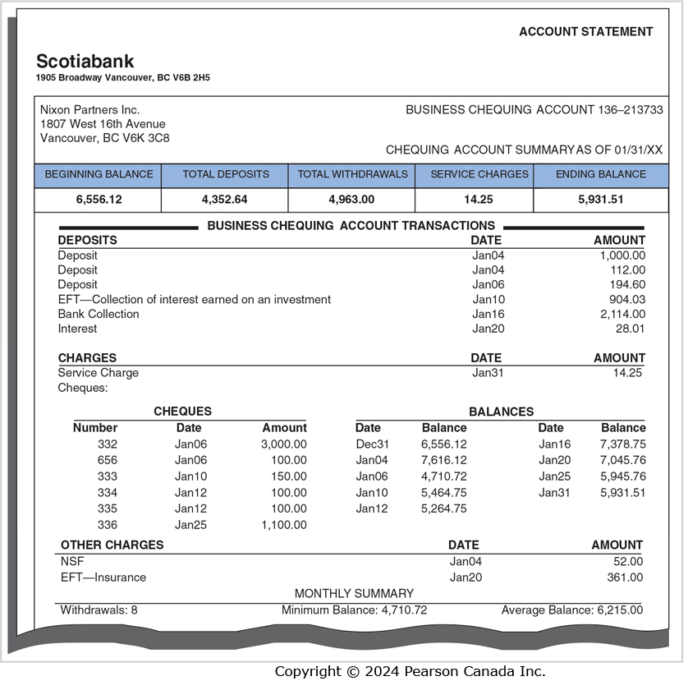
Bank Statement
Reports:
  Activity in a bank account
Electronic Funds Transfer (EFT)
  Make payments by electronic communication
Notes:
Banks send monthly statements to customers. A bank statement reports what the bank did with the customer’s cash. The statement shows the account’s beginning and ending balances, cash receipts, and payments. Included with the statement are copies of the maker’s canceled cheques (or the actual paid cheques). Electronic funds transfer (EFT) moves cash by electronic communication. It is cheaper to pay without having to mail a cheque, so many people pay their mortgage, rent, utilities, and insurance by EFT. Companies also pay bills using EFT because it enables them to control their cash more closely by knowing exactly when the money will leave the bank account.

Slide 9
Bank Reconciliation
Two records of a business’s cash
  The Cash account in the General Ledger (the “Books”)
  The Bank Statement
Amounts are usually different
  Time lags in recording transactions, missing items, recording errors
The Bank Reconciliation explains differences between:
  The balance on the Bank Statement and
  The balance of the Cash account in the General Ledger (“Books”)
Notes:
There are two records of a business’s cash:
The Cash account in the company’s general ledger.
The bank statement, which shows the cash receipts and payments transacted through the bank.
The books and the bank statement usually show different cash balances. Differences arise because of a time lag in recording transactions—two examples:
When you write a cheque, you immediately deduct it in your chequebook. But the bank does not subtract the cheque from your account until the bank pays the cheque a few days later. And you immediately add the cash receipt for all your deposits. But it may take a day or two for the bank to add deposits to your balance. Your EFT payments and cash receipts are recorded by the bank before you learn of them. The most likely transactions to not have cleared the bank by the bank statement date are those completed near or at the end of the month.
To ensure accurate cash records, you need to update your cash record—either online or after you receive your bank statement. The result of this updating process creates a bank reconciliation, which you must prepare. The bank reconciliation explains all differences between your cash records and your bank balance. As an internal control over cash, the person who prepares the bank reconciliation should have no other cash duties. Otherwise, they can steal cash and manipulate the reconciliation to conceal the theft.

Slide 10
Bank Side of the Reconciliation
Deposits in transit (outstanding deposits)
Outstanding cheques
Bank errors
Notes:
Here are the items that appear on a bank reconciliation. They are all caused by differences between the bank balance and the book balance.
1. Items to show on the Bank side of the bank reconciliation include:
a. Deposits in transit (outstanding deposits). You have recorded these deposits in the general ledger, but the bank has not cleared the deposit yet through your bank account. Add deposits in transit on the bank reconciliation.
b. Outstanding cheques. You have recorded these cheques, but the bank has not yet paid them because they haven’t been presented for payment by the payee or the payee’s bank. Subtract outstanding cheques.
c. Bank errors. Correct all bank errors on the Bank side of the reconciliation. For example, the bank may erroneously subtract from your account a cheque written by someone else or it may transpose numbers in recording a deposit to your account. Also make sure to contact the bank about correcting the error so it has been cleared up by the next bank statement date.

Slide 11
Book Side of the Reconciliation
Bank collections
Electronic funds transfers (EFT)
Service charges
Interest income
Nonsufficient funds (NSF) cheques
Cost of printed cheques
Book errors
Notes:
Items to show on the Book side of the bank reconciliation:
a. Bank collections. Bank collections are cash receipts that the bank has recorded for your account. But you haven’t recorded the cash receipt yet. Many businesses have their customers pay directly to their bank. This is called a lock-box system and reduces theft. An example is a bank collecting an account receivable for you. Add bank collections on the bank reconciliation.
b. Electronic funds transfers. The bank may receive or pay cash on your behalf. An EFT may be a cash receipt or a cash payment. Add EFT receipts and subtract EFT payments.
c. Service charge. This cash payment is the bank’s fee for processing your transactions. Subtract service charges or any other charges the bank makes against your account for the cost of goods or services associated with your account.
d. Interest income on your chequing account. On certain types of bank accounts, you earn interest if you keep enough cash in your account. The bank statement tells you of this cash receipt. Add interest income.
e. Nonsufficient funds (NSF) cheques are cash receipts from customers for which there are not sufficient funds in the bank to cover the amount. NSF cheques (sometimes called hot, bounced, or bad cheques) are treated as cash payments on your bank reconciliation. Subtract NSF cheques. If possible, you should attempt to collect the cash receipt again from the maker, but requiring a form of payment such as a money order or cash is advisable.
f. The cost of printed cheques. This cash payment is handled like a service charge. Subtract this cost.
g. Book errors. Correct all book errors on the Book side of the reconciliation. For example, you may have recorded a $150 cheque that you wrote as $510.

Slide 12
Bank Reconciliation Example
The bank statement of Nixon Partners Inc.,
shows a balance of $5,931.51 on January 31.
The company Cash account on the
books has a balance of $3,294.21.
The following reconciling items
explain why the two balances differ:
Notes:
The book’s cash balance of $3,294.21 does not agree with the bank’s cash balance of $5,931.51. A bank reconciliation will determine why there is a difference.

Slide 13
Bank Reconciliation Example, Bank Side
Deposit in transit: $1,591.63
Bank error: the bank deducted $100.00 for a cheque written by another company. Add $100.00 to the bank balance.
Outstanding cheques – total of $1,350.14
Cheque No. | Date | Amount
337 | Jan. 27 | $ 286.00
338 | 28 | 319.47
339 | 28 | 83.00
340 | 29 | 203.14
341 | 30 | 458.53
Total |  | $1,350.14
Notes:
Nixon Partners have deposited $1,591.63 late on January 31, but the bank will not learn of this until they open its overnight deposit box on February 1.
The bank should not have recorded a withdrawal.
Nixon Partners has written cheques totalling $1,350.14, but the bank is not aware of this yet.

Slide 14
The Bank Reconciliation Example
Balance per bank, January 31 | $5,931.51
Add deposit in transit | 1,591.63
Cheque erroneously charged | 100.00
 | $7,623.14
Less outstanding cheques | –1,350.14
Adjusted bank balance | $6,273.00
Notes:
To “correct” the bank’s balance, the deposit in transit and cheque error are added to the balance the bank reported, and the outstanding cheques amount is subtracted.

Slide 15
Bank Reconciliation Example, Book Side
EFT receipt of your rent revenue earned on an investment: $904.03.
Bank collection of your note receivable including interest of $2114.00: $2114.00.
Interest revenue earned on your bank balance: $28.01
Book error: You recorded cheque no. 333 for $510. The amount you actually paid on account was $150.00. Add $360 to book balance.
Notes:
4. An automatic payment of $904.03 has been deposited into Nixon’s account that it has not recorded yet.
5. A note receivable has matured and the cash has been deposited into Nixon’s account. That is the $1,900.00 principle and $214.00 interest.
6. The bank has paid you $28.01 interest on the cash in Nixon’s account.
7. Nixon recorded a $510 decrease in its cash account when it wrote a cheque for $150.00. That was $360 too much.

Slide 16
The Bank Reconciliation Example, Book Side
Bank service charge: $14.25.
NSF cheque from a customer: $52.00. Subtract $52.00 from your book balance.
EFT payment of insurance expense: $361.00.
Notes:
8. The bank charged Nixon $14.25 for the services it provided.
9. Nixon recorded an increase of $52.00 cash when it thought it had received payment from a customer. The customer did not have sufficient funds to cover the cheque that was submitted, so Nixon did not receive any cash.
10. The insurance company withdrew $361.00 from Nixon’s account that was owed to them.

Slide 17
The Bank Reconciliation Example
Balance per books, January 31 |  | $3,294.21
Add: ETF receipt of rent revenue |  | 904.03
Collection of note receivable |  | 2,114.00
Interest revenue earned |  | 28.01
Correction of book error |  | 360.00
 |  | $6,700.25
Less: Service charge | $ 14.25
NSF cheque | 52.00
Payment of insurance expense | 361.00 | – 427.25
Adjusted book balance |  | $6,273.00
Notes:
To the Nixon’s book cash balance
Add:
ETF rent revenue $ 904.03
Collection of note receivable 2,114.00
Collection of interest on bank account 28.01
Correction of book error 360.00
Subtract:
Payment of service charge $ 14.25
NSF cheque 52.00
Payment of insurance expense 361.00
Adjusted book balance equals adjusted bank balance of $6,273.00.

Slide 18
Summary of Reconciling Items
BANK BALANCE - ALWAYS | BOOK BALANCE - ALWAYS
Add deposits in transit | Add bank collections, interest revenue, and EFT receipts
Subtract outstanding cheques | Subtract services charges, NSF cheques, EFT payments
Add or subtract correction of bank errors | Add or subtract correction of book errors
Notes:
This table summarizes the items on a bank reconciliation – on which side they appear and if they are added or subtracted.

Slide 19
Journalizing Bank Reconciliation Items (1 of 3)
All items on the book side of the bank reconciliation require journal entries
If the item is added to book side
  Debit Cash
If the items is subtracted from the book side
  Credit Cash
Notes:
The bank reconciliation is an accountant’s tool separate from the journals and ledgers. It does not account for transactions in the journal. To get the transactions into the accounts, we must make journal entries and post to the ledger. All items on the Book side of the bank reconciliation require journal entries.

Slide 20
Journalizing Bank Reconciliation Items (2 of 3)
JOURNAL
Item | Accounts and explanation | Debit | Credit
4 | Cash | 904.03
 | Interest Revenue |  | 904.03
 | To record interest earned on the bank statement
5 | Cash | 2,114.00
 | Note Receivable |  | 1,900.00
 | Interest Revenue |  | 214.00
 | Note receivable collected by bank
6 | Cash | 28.01
 | Interest Revenue |  | 28.01
 | Interest earned on bank balance
7 | Cash | 360.00
 | Accounts Payable |  | 360.00
 | Correction of cheque no. 333
Notes:
Some entries that typically result from a bank reconciliation are shown above.
EFT collections will usually be credited to an appropriate revenue account or a receivable.
If there is a company error, cash can be either debited or credited. The other account in the entry is the account debited or credited when the error was made.

Slide 21
Journalizing Bank Reconciliation Items (3 of 3)
JOURNAL
Item | Accounts and explanation | Debit | Credit
8 | Bank Charge Expense | 14.25
 | Cash |  | 14.25
 | Bank service charge
9 | Accounts Receivable – L. Ross | 52.00
 | Cash |  | 52.00
 | NSF customer cheque returned by bank
10 | Insurance Expense | 361.00
 | Cash |  | 361.00
 | Payment of monthly insurance
Notes:
Notice that the NSF cheque is debited to Accounts Receivable. This is because the company will attempt to collect the amount from the customer who wrote the “bad” cheque.
EFT payments will be debited to an appropriate expense account or a payable as the other side of the cash transaction.

Slide 22
Short Exercise 4-4
The Cash account of Switzer Ltd reported a balance of $2,500 at Aug 31, 20XX. Included were outstanding cheques totalling $900 and an Aug 31 deposit of $500 that did not appear on the bank statement.
The bank statement listed an Aug 31, 20XX balance of $3,405. Included in the bank balance was an August 30 collection of $550 on account from a customer who pays the bank directly. The bank statement also shows a $20 service charge, $10 of interest revenue that Switzer earned on its bank balance, and an NSF cheque for $35.
Prepare a bank reconciliation to determine the Aug 31, 20XX cash balance

Slide 23
Short Exercise 4-5
After preparing the Switzer Ltd. Bank reconciliation in S4-4, make the company’s journal entries for transactions that arise from the bank reconciliation. Include an explanation with each entry.

Slide 24
Learning Objective Three
Account for accounts receivable
Notes:
The third learning objective is to account for accounts receivable.

Slide 25
Receivables
Third most liquid asset
Monetary claims against others
Acquired mainly by:
  selling goods and services (accounts receivable)
  lending money (notes receivable)
Notes:
Receivables are the third most liquid asset—after cash and short-term investments. Receivables are monetary claims against others. Receivables are acquired mainly by selling goods and services (accounts receivable) and by lending money (notes receivable).

Slide 26
Accounts Receivable
Amounts collectible from customers
Balance in general ledger
  Control account: summarizes total amount due from all customers
Subsidiary ledger
  Separate account for each customer
Notes:
A business’s accounts receivable are the amounts collectible from customers from the sale of goods and services on account. Accounts receivable, which are current assets, are sometimes called trade receivables or merely receivables. The Accounts Receivable account in the general ledger serves as a control account that summarizes the total amount receivable from all customers. Companies also keep a subsidiary record of accounts receivable with a separate account for each customer.

Slide 27
Control Account and Subsidiary Ledger
General Ledger
Accounts Receivable Subsidiary Ledger
Accounts Receivable
Balance 9,000
Customer A
Balance 5,000
Customer B
Balance 1,000
Total
$9,000
Customer C
Balance 3,000
Notes:
These T-accounts illustrate the control account, Accounts Receivable, in the general ledger and the individual customer accounts in the subsidiary ledger. The subsidiary ledger provides the detail of the accounts receivable balance.

Slide 28
Notes Receivable
More formal than accounts receivable
Written promise to pay a sum at the maturity date
  Plus interest
Also called promissory notes
Notes:
Notes receivable are more formal contracts than accounts receivable. For a note, the borrower signs a written promise to pay the lender a definite sum at the maturity date, plus interest. This is why notes are also called promissory notes. The note may require the borrower to pledge security for the loan. This means that the borrower gives the lender permission to claim certain assets, called collateral, if the borrower fails to pay the amount due.

Slide 29
Risks of Selling on Credit
Decision | Guidelines
What are the benefits and costs of extending credit to customers? | Benefit – increase in sales Cost – risk of not collecting
Extend credit to only creditworthy customers. | Run a credit check on prospective customers.
Pursue collection from customers to maximize cash flow. | Keep a close eye on customer paying habits.
Notes:
By selling on credit, companies run the risk of not collecting some receivables. Unfortunately, some customers don’t pay their debts. The prospect of failing to collect from a customer provides the biggest challenge in accounting for receivables. Here are the management issues a company faces when it extends credit to customers.

Slide 30
Learning Objective Four
Evaluate collectability using the allowance for uncollectible accounts
Notes:
The fourth learning objective is to evaluate collectability using the allowance for uncollectible accounts.

Slide 31
Uncollectible Receivables
Benefit of selling on credit
Cost of selling on credit
Customers that do not have cash available can buy on credit
Sales and profits increase
Company cannot collect from some customers
This cost is called “uncollectible-account expense,” “doubtful-account expense,” or “bad debt expense”
Notes:
A company gets an account receivable only when it sells its product or service on credit (on account). Ideally, the company would collect cash for all of its receivables. However, companies rarely collect all of their accounts receivables. So companies must account for their uncollectible accounts.
Selling on credit creates both a benefit and a cost:
■ Benefit: Customers who cannot pay cash immediately can buy on credit, so sales and profits increase.
■ Cost: The company cannot collect from some customers. Accountants label this cost uncollectible-account expense, doubtful-account expense, or bad-debt expense.
Uncollectible-account expense is an operating expense in the selling, general and administrative category along with salaries, depreciation, rent, and utilities.

Slide 32
The Allowance Method
Records collection losses based on company’s collection experience
Estimates Bad Debt Expense
Also sets up Allowance for Uncollectible Accounts
  Contra-account to Accounts Receivable
  Shows amount of receivables expected not to be collected
Notes:
The best way to measure bad debts is by the allowance method. This method records collection losses based on estimates developed from the company’s collection experience. A company doesn’t wait to see which customers will not pay. Instead, it records the estimated amount as Bad Debt Expense and also sets up Allowance for Uncollectible Accounts. Other titles for this account are Allowance for Doubtful Accounts and Allowance for Bad Debts. This is a contra-account to Accounts Receivable. The allowance shows the amount of the receivables the business expects not to collect. The allowance shows how much of the receivable has been expensed.

Slide 33
Net Realizable Value
Partial Balance Sheet
Current assets:
Accounts receivable | $100,000
Less: Allowance for uncollectible accounts | (5,000)
Accounts receivable, net | $95,000
Or
Partial Balance Sheet
Current assets:
Accounts receivable, less allowance of $5,000 | $95,000
Notes:
Accounts receivable are reported at net realizable value on the balance sheet. This is the balance of Accounts Receivable less the Allowance for Uncollectible Accounts. This is the amount the company expects to collect from its customers. The allowance can be shown as a separate line item on the balance sheet, as shown in the top figure. Or it can be combined into one line item shown at the net balance.

Slide 34
Method to Estimate Uncollectibles
Aging-of-Receivables Method
Balance-sheet approach
Notes:
The best way to estimate uncollectibles uses the company’s history of collections from customers. This is called the Aging-of-receivables method. The aging method is a balance-sheet approach.

Slide 35
Aging-of-Receivables (1 of 2)
Focuses on proper valuation of accounts receivable on the balance sheet
Individual customer balances analyzed based on time outstanding
  Aging schedule
Allowance for Uncollectible Accounts adjusted to equal amount from aging schedule
Notes:
Aging-of-receivables is a balance-sheet approach because it focuses on what should be the most relevant and faithful representation of accounts receivable as of the balance sheet date. In the aging method, individual receivables from specific customers are analyzed based on how long they have been outstanding.

Slide 36
Aging-of-Receivables (2 of 2)
Age of Account
Customer | 1-30 days | 31-60 days | 61-90 days | Over 90 days | Total Balance
Customer A | $1,500 | $1,000 | $0 | $ 2,500 | $5,000
Customer B | 66,070 | 57,000 | 10,300 | 0 | 133,370
Totals | $67,570 | $ 58,000 | $ 10,300 | $ 2,500 | $138,370
Est. % uncollectible | × 2% | × 5% | × 10% | × 35%
Allowance balance should be: | $1,351 | $2,900 | $1,030 | $875 | $6,156
Allowance for Uncollectible Accounts
Balance before adjustment |  | 346
 |  | 5,810 | Adjustment needed
 |  | 6,156 | Ending balance equals aging schedule
Notes:
Above is an example of an abbreviated aging schedule. Customer account balances are grouped by days outstanding. A percent uncollectible is estimated for each category—the older the account, the less likely payment will be received. The totals of the columns come to $6,156. This is the amount the Allowance account should equal after adjustment. Assume the Allowance account had a beginning balance of $346. An adjustment of $5,810 would be needed.

Slide 37
Aging of Accounts Receivable (1 of 2)
Accounts before the year-end adjustment:
Allowance for Uncollectible Accounts
 | 346
Accounts Receivable
Bal. 138,370
Notes:
Account balances from slide 33.

Slide 38
Aging of Accounts Receivable (2 of 2)
Bad Debt Expense ($6,156 - $346) | 5,810
Allowance for Uncollectible Accounts |  | 5,810
Recorded expense for the year
Accounts after the year-end adjustment:
Allowance for Uncollectible Accounts
 | 346
 | Adj. 5,810
 | 6,156
Accounts Receivable
Bal 138,370

Slide 39
Writing Off Uncollectible Accounts
JOURNAL
Date | Accounts and explanation | Debit | Credit
 | Allowance for Uncollectible Accounts | 900
 | Accounts Receivable |  | 900
 | Write off uncollectible receivable
Accounts Receivable
Bal. 138,370 | 900
137,470
Allowance for Uncollectible Accounts
900 | 6,156 Bal.
 | 5,256
Notes:
When a specific customer account is deemed uncollectible, the Allowance account is reduced for the amount of the customer account. Accounts receivable is credited to remove the customer’s account from the books.

Slide 40
Impact of Write-Off
Partial Balance Sheet – Before Write Off
Current assets:
Accounts receivable | $138,370
Less: Allowance for uncollectible accounts | (6,156)
Accounts receivable, net | $132,214
Partial Balance Sheet – After Write Off
Current assets:
Accounts receivable | $137,470
Less: Allowance for uncollectible accounts | (5,256)
Accounts receivable, net | $132,214
Notes:
The write-off of uncollectibles has no effect on a company’s total assets, no effect on current assets, and no effect on net accounts receivable. There is no effect on net income either. Why is there no effect on net income? Net income is unaffected because the write-off of uncollectibles does not affect an expense account. If the company uses the allowance method as discussed in the previous section, expenses would have been properly recognized in the period they were incurred, which is the same period in which the related sales took place.

Slide 41
Computing Cash Collections from Customers
 | Accounts Receivable
200 | Beginning balance | Write-offs of uncollectibles | 100
1,800 | Sales on credit | Collections from customers? | 1,500
400 | Ending balance
Notes:
A company earns income and then collects the cash from customers. For most companies, there is a time lag between earning the income and collecting the cash. Collections from customers are the single most important source of cash for any business.
You can compute a company’s collections from customers by analyzing its Accounts Receivable account. Receivables typically hold only five items, as reflected in the five elements of the following Accounts Receivable account balance. Suppose you know all these amounts except collections from customers. You can compute collections by solving for ? in the T-account.

Slide 42
Speeding Up Cash Flow from Sales
Rapid cash flow allows companies to pay current liabilities faster and finance new projects
Strategies to shorten credit cycle and collect cash more quickly:
  Offer sales discounts for early payment
  Charge interest on overdue customer accounts
  Credit card sales
  Debit card sales
Notes:
All companies want speedy cash receipts. Rapid cash flow means companies have the ability to pay off current liabilities faster, as well as to finance new products, research, and development. Thus, companies develop strategies to shorten the credit cycle and collect cash more quickly. A common strategy has been to emphasize credit card or debit card sales.

Slide 43
Credit Card (and Debit Card) Sales
Increases sales
Retailer is charged fee (an operating expense)
3% of sale
JOURNAL
Date | Accounts and explanation | Debit | Credit
 | Cash | 485
 | Credit Card (or Debit Card) Expense | 15
 | Sales Revenue |  | 500
 | Record credit card sale
Notes:
A merchant sells merchandise and lets the customer pay with a credit card, such as VISA or MasterCard, or a company credit card such as HBC (Hudson’s Bay Company). This strategy may dramatically increase sales, but the added revenue comes at a cost, which is typically about 2% to 3% of the total amount of the sale. Let’s see how credit cards and debit cards work from the seller’s perspective. Suppose a company sells a product for $500, and the customer pays with a MasterCard, which charges a 3% fee. The entry to record the sale is shown in this slide.

Slide 44
Short Exercise 4-2
At December 31, 20XX, before any year-end adjustments are made, White Corporation had a $50 million balance in Accounts Receivable and a $0.6 million debit balance in the Allowance for Uncollectible Accounts.
What is the normal balance in the Allowance for Uncollectible Accounts? What would cause this account to have a debit balance?
How does management determine the amount of uncollectible accounts?
The aging of receivables indicates that White Corporation will not collect $1.5 million of its accounts receivables. Prepare the journal entry to record the bad debt expense for 20XX.

Slide 45
Learning Objective Five
Account for notes receivable and interest revenue
Notes:
The fifth learning objective is to account for notes receivable and interest revenue.

Slide 46
Notes Receivable (1 of 2)
Can be current or long-term assets
Terms:
Creditor | Party to whom money is owed; Lender
Debtor | Party that borrowed and owes money; Maker, borrower
Interest | Cost of borrowing money; stated as annual percentage rate
Maturity date | Date when debtor must pay note
Principal | Amount borrowed by debtor
Term | Length of time the debtor has to repay the note
Notes:
Notes receivable are more formal than accounts receivable. Notes receivable due within one year or less are current assets. Notes due beyond one year are long-term receivables and are reported as long-term assets. Some notes receivable are collected in installments. The portion due within one year is a current asset and the remainder is long term.
Let’s define some key terms:
Creditor. The party to whom money is owed. The creditor is also called the lender.
Debtor. The party that borrowed and owes money on the note. The debtor is also called the maker of the note or the borrower.
Interest. Interest is the cost of borrowing money. The interest is stated in an annual percentage rate.
Maturity date. The date on which the debtor must pay the note.
Principal. The amount of money borrowed by the debtor.
Term. The length of time from when the note was signed by the debtor to when the debtor must pay the note.

Slide 47
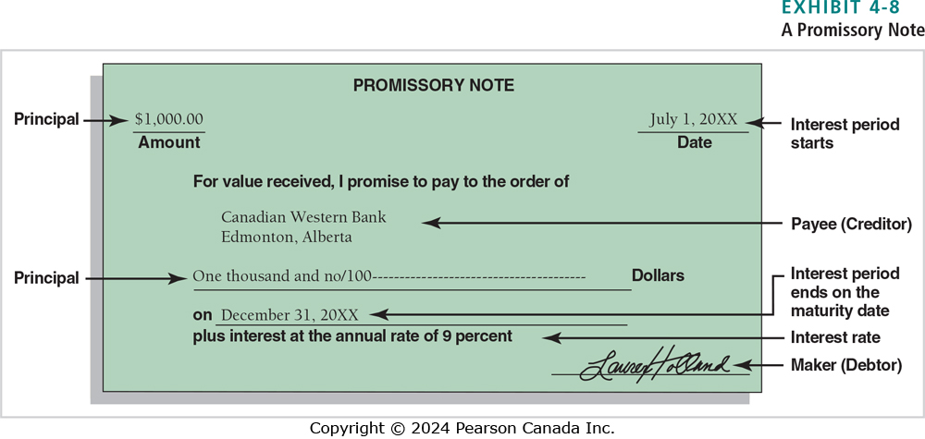
Notes Receivable (2 of 2)
Notes:
There are two parties to a note:
■ The creditor accepts a note receivable.
■ The debtor issues a note payable.
The figure above is a typical promissory note. The principal amount of the note ($1,000) is the amount borrowed by the debtor, lent by the creditor. This 6-month note receivable runs from July 1, 20XX to December 31, 20XX, when Lauren Holland (the maker) promises to pay Canadian Western Bank (the creditor) the principal of $1,000 plus 9% interest. Interest is revenue to the creditor and expense to the debtor.

Slide 48
Accounting for Notes Receivable
JOURNAL
Date | Accounts and explanation | Debit | Credit
20XX
July 1 | Notes Receivable—L. Holland | 1,000
 | Cash |  | 1,000
 | Made a loan
Oct 31 | Interest Receivable | 30
 | Interest Revenue |  | 30
 | Accrued interest revenue at year end
Dec 31 | Cash | 1,045
 | Notes Receivable—L. Holland |  | 1,000
 | Interest Receivable |  | 30
 | Interest Revenue |  | 15
 | Collected note at maturity
Notes:
Using the promissory note on the previous slide, we will record entries for transactions related to the note in the accounting records of Canadian Western Bank.
After Lauren Holland signs the note, Canadian Western Bank gives her $1,000 cash. The bank’s entry on July 1 would show an increase to Notes Receivable and a decrease to Cash.
Canadian Western Bank earns interest on the note from July to October (year-end). At October 31, the bank accrues interest at 9% for 4 months. Interest Receivable is debited and Interest Revenue is credited for the amount of $30 ($1,000 × 9% × 4/12).
The bank collects the note on December 31 and records the receipt of cash. Three accounts are credited: Notes Receivable for the principal, Interest Receivable to zero out the amount recorded in the adjusting entry, and Interest Revenue to record the amount earned from November 1 to December 31.

Slide 49
Interest
Interest rates are usually expressed as an annual percent
For time periods less than a year, a fraction is used
  Months/12
Often interest is computed based on days
  Denominator would be 365
Notes:
You should remember some specific items about interest. Interest rates are usually expressed as annual percentage rate. Therefore, if interest is being accrued for a period less than a year, a fraction is used in the formula. For example, if a note receivable was signed on November 1 and the term is expressed in months, the year-end accrual would use 2/12 in the formula. Often, interest is computed by days, instead of months, if the term is expressed in days. In this situation, the denominator of the fraction would be 365—the number of days in a year.

Slide 50
Reporting on the Statement of Cash Flows
Accounts receivable bring in cash when the business collects from customers
  Operating activity on the statement of cash flows
Notes receivable bring in cash when debtors pay off notes
  Investing activity on the statement of cash flows

Slide 51
Short Exercise 4-12
Metro Credit Union in Charlettown, PEI loaned $90,000 to David Mann on a six-month, 8% note. Record the following for Metro Credit Union:
Lending the money on March 6
Collecting the principal and interest at maturity. Specify the date. Explanations are not required.

Slide 52
Learning Objective Six
Evaluate liquidity using ratios
Notes:
The sixth learning objective is to evaluate liquidity using ratios.

Slide 53
Current Ratio
Notes:
The balance sheet lists assets in the order of relative liquidity:
1.Cash and cash equivalents
2.Short-term investments
3.Accounts (or notes) receivable
4. Merchandise inventory
5. Prepaid expenses
Managers, shareholders, and creditors care about the liquidity of a company’s assets. The current ratio measures ability to pay current liabilities with current assets.

Slide 54
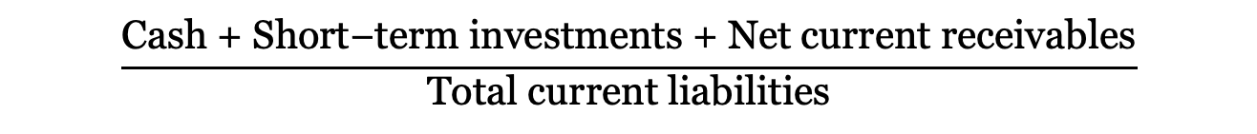
Acid-Test (or Quick) Ratio
$$\frac{\text{Cash}\text{ + }\text{Short}\text{−}\text{term} \text{investments}\text{ + }\text{Net} \text{current} \text{receivables}}{\text{Total} \text{current} \text{liabilities}}$$
Notes:
A more stringent measure of ability to pay current liabilities is the acid-test (or quick) ratio. The higher the quick ratio, the easier it is to pay current liabilities. The quick ratio excludes inventory and prepaid expenses, which may not be as liquid as needed to meet current liability requirements. Traditionally, companies have wanted an acid-test ratio of at least 1.0 to be safe. The ratio needs to be high enough for safety, but not too high. After all, cash and the other liquid assets don’t earn very high rates of return, as inventory and plant assets do.

Slide 55
Days’ Sales in Receivables
(Beginning net receivables + Ending net receivables)/2
Notes:
After a business makes a credit sale, the next step is collecting the receivable. Days’ sales in receivables, also called the days sales outstanding (DSO) or the collection period, tells a company how long it takes to collect its average level of receivables. Shorter is better because cash is coming in quickly. The longer the collection period, the less cash is available to pay bills and expand. Days’ sales in receivables can be computed in two logical steps.
First, compute average daily sales (or average revenue for one day). Then divide average daily sales into average receivables for the period. Net sales come from the income statement, and the receivables amounts are taken from the balance sheet. Average receivables is the simple average of the beginning and ending balance. Companies watch their collection periods closely. Whenever collections slow down, the business must find other sources of financing, such as borrowing or selling receivables. During recessions, customers pay more slowly, and a longer collection period may be unavoidable.

Slide 56
Learning Objective Seven
Analyze receivables collectability using an aging schedule created with an Excel pivot table
Notes:
The seventh learning objective is to analyze receivables collectability using an aging schedule created with an Excel pivot table.

Slide 57
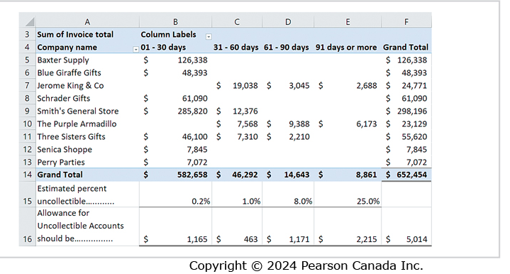
Excel Pivot Table
Managers can use a pivot table feature in Excel to summarize invoices by the “Days past due” category
They can then apply the estimated uncollectible percentages to the totals for each category to estimate total uncollectible accounts

Slide 58
End of Chapter Four
Notes:
This concludes Chapter Four.

