Slide 1
Chapter 8
Shareholder’s Equity
Notes:
This chapter covers the measurement and reporting principles for tangible long-lived assets (also known as property, plant
and equipment) as well as intangible assets.
If this PowerPoint presentation contains mathematical equations, you may need to check that your computer has the following installed:
1) MathType Plugin
2) Math Player (free versions available)
3) NVDA Reader (free versions available)

Slide 2
Learning Objectives
LO1 Explain the main features of a corporation.
LO2 Account for the issuance of shares.
LO3 Explain why a company repurchases shares.
LO4 Account for retained earnings, dividends, & stock splits.
LO 5 Evaluate a company’s return on equity.
LO 6 Report equity transactions and events in the financial statements

Slide 3
Learning Objective One
Explain the main features of a corporation
Notes:
The first learning objective is to explain the main features of a corporation.

Slide 4
Characteristics of a Corporation
Separate legal entity
Continuous life and transferability of ownership
Limited liability
Separation of ownership and management
Corporate taxation
Government regulation
Notes:
Separate Legal Entity
A corporation is a business entity formed under federal or provincial law. The federal or provincial government grants articles of incorporation, which consist of documents giving the governing body’s permission to form a corporation. A corporation is a distinct entity, an artificial person that exists apart from its owners, the shareholders. The corporation has many of the same rights as a person.

Slide 5
Corporate Characteristics
ADVANTAGES
DISADVANTAGES
Can raise more capital than a proprietorship or partnership
Continuous life
Transferability of ownership
Limited liability
Separation of ownership and management
Corporate taxation
Government regulation
Notes:
Continuous Life and Transferability of Ownership
Corporations have continuous lives regardless of changes in their ownership. The shareholders of a corporation may transfer shares as they wish.
Limited Liability
Shareholders have limited liability for the corporation’s debts, so they have no personal obligation to repay the company’s liabilities. The most that a shareholder can lose on an investment in a corporation’s shares is the cost of the investment.
Separation of Ownership and Management
Shareholders own the corporation, but a board of directors—elected by the shareholders—appoints officers to manage the business.
Corporate Taxation
Because corporations are separate legal entities, they must pay income taxes separate from those borne by their individual shareholders.
Government Regulation
Because shareholders have only limited liability for corporation debts, outsiders doing business with the corporation can look no further than the corporation if it fails to pay. To protect a corporation’s creditors and the shareholders, both federal and provincial governments monitor corporations. This regulation consists mainly of ensuring that corporations disclose the information in financial statements that investors and creditors need to make informed decisions.

Slide 6
Authority Structure in a Large Corporation
Shareholders
Board of Directors
President/Chief Executive Officer
Vice-Presidents
Chief Financial Officer
Secretary
Controller
Treasurer
Notes:
Ultimate control of the corporation rests with the Shareholders who elect a board of directors that sets company policy and appoints officers. The board elects a chairperson, who usually is the most powerful person in the organization. The board also designates the president, who is the chief executive officer (CEO) in charge of day-to-day operations. Most corporations also have vice presidents in charge of sales, manufacturing, accounting and finance (the chief financial officer, or CFO), and other key areas.

Slide 7
Shareholders’ Rights
Sell
Shares
Vote
Dividends
Residual Interest
Notes:
Ownership of shares entitles shareholders to four basic rights, unless a specific right is withheld by agreement with the shareholders:
1. The right to sell the shares. Shareholders have the right to sell their shares to other parties when they no longer wish to own them.
2. The right to vote. Shareholders have the right to participate in management by voting on matters that come before them. This is the shareholder’s sole voice in the management of the corporation. A shareholder is normally entitled to one vote for each common share owned. There are some classes of common shares that give the holder multiple votes or no vote.
3. The right to receive dividends. Shareholders have the right to receive a proportionate share of any distributions from the company’s retained earnings. Each share in a particular class receives an equal dividend.
4. The right to receive a residual interest upon liquidation. Shareholders have the right to receive a proportionate share of any assets remaining after the corporation pays all liabilities upon liquidation. When a company goes out of business, it sells its assets, pays its liabilities, and distributes any residual (or remaining) assets to shareholders.

Slide 8
Shareholders’ Equity
Four main components:
Share Capital
Contributed Surplus
Accumulated Other
Comprehensive Income
Retained Earnings
Notes:
Shareholders’ equity has four common and separate components:
1. Share capital—amounts contributed by shareholders in exchange for shares in the corporation.
2. Contributed surplus—any amounts contributed by shareholders in excess of amounts allocated to share capital.
3. Accumulated other comprehensive income—IFRS requires companies to report Accumulated Other Comprehensive Income, which is an accumulation of past earnings not included in retained earnings. This equity item is discussed in detail in Chapter 11. ASPE does not require companies to account for this item.
4. Retained earning—the accumulated balance of a corporation’s net income since inception, less any net losses and dividends declared during this time. When the accumulation is a negative number, the term deficit is used to describe it.

Slide 9
Share Capital
Corporate ownership is evidenced
by a share certificate, which may
be for any number of shares.
Authorized, issued, and outstanding
Notes:
A corporation issues share certificates to its owners in exchange for their investment in the business—usually cash. The basic unit of share capital is called a share. A corporation may issue a share certificate for any number of shares it wishes—one share, 100 shares, or any other number—but the total number of authorized shares is limited by charter. Shares are sometimes referred to as stock, but owning stock in a company means the same thing as owning shares in that company.
The terms authorized, issued, and outstanding are frequently used to describe a corporation’s shares. Authorized refers to the maximum number of shares a corporation is allowed to distribute to shareholders. Companies incorporated under the Canada Business Corporations Act are permitted to issue an unlimited number of shares. Issued refers to the number of shares sold or transferred to shareholders. Outstanding shares are those actually in the hands of shareholders. Sometimes a company repurchases shares it has previously issued so that the number of shares outstanding will be less than the number of shares issued.

Slide 10
Classes of Shares
COMMON
PREFERRED
Basic form of capital
Has four rights
Shareholders benefit most if corporation succeeds
  Take more risk
Has advantages over common
  Receive dividends first
  Receive assets first in liquidation
Shareholders earn a fixed dividend
Very few corporations issue
Notes:
Every corporation issues common shares, the basic form of capital. Unless designated otherwise, the word share is understood to mean “common share”. IFRS refers to common shares as ordinary shares. Common shareholders have the four basic rights of share ownership, unless a right is specifically withheld. The common shareholders are the owners of the corporation. They stand to benefit the most if the corporation succeeds because they take the most risk by investing in common shares.
Preferred shares gives its owners certain advantages over common shareholders. Preferred shareholders receive dividends before the common shareholders and they also receive assets before the common shareholders if the corporation liquidates. Preferred shares are usually non-voting, but otherwise the owners also have the other three basic shareholder rights, unless a right is specifically denied. Companies may issue different classes of preferred shares. Each class is recorded in a separate account. The most that preferred shareholders can expect to earn on their investments is a fixed dividend.
Preferred shares are a hybrid between common shares and long-term debt. Like debt, preferred shares pays a fixed dividend. But unlike interest on debt, the dividend is not required to be paid unless the board of directors declares the dividend. Also, companies have no obligation to pay back true preferred shares. Preferred shares that must be redeemed (paid back) by the corporation are a liability masquerading as a stock. Preferred shares are less frequently used. A recent survey of 600 corporations revealed that fewer than 10% of them issued preferred shares.

Slide 11
Par Value and Stated Value
Arbitrary amount assigned to a share
Federally and most provincially incorporated companies have shares issued without par value, known as the stated value
Notes:
Par value shares are shares that have a value assigned to them by the articles of incorporation, which specify the legal details associated with a company’s incorporation. The Canada Business Corporations Act and most provincial incorporating acts now require common and preferred shares to be issued without par value.

Slide 12
S8-3 Who are the real owners of a corporation?
The president of the corporation
Senior management
Common shareholders
Preferred shareholders

Slide 13
S8-3 What privileges do preferred shareholders have over common shareholders?
Preferred shareholders receive dividends first
Preferred shareholders receive assets first if the company liquidates
Dividends earned by preferred shareholders vary depending on the company’s profitability
Both a and b

Slide 14
S8-3 Which class of shareholders reaps greater benefits from a highly profitable corporation?
Preferred shareholders
Common shareholders
Both preferred and common shareholders

Slide 15
Learning Objective Two
Account for the issuance of shares
Notes:
The second learning objective is to account for the issuance of shares.

Slide 16
Issuing Shares For Cash
JOURNAL
Date | Accounts and explanation | Debit | Credit
 | Cash | 5,000,000
 | Common Shares |  | 5,000,000
 | Issued 100,000 common shares at $50 per share
Notes:
To record the issuance of shares for cash, the asset received is debited and common shares account is credited. Suppose a company issued 100,000 common shares at $50 per share. The entry is shown above.

Slide 17
Shares Issued for Non-Cash Assets
Asset received is recorded at current market value
JOURNAL
Date | Accounts and explanation | Debit | Credit
 | Equipment | 4,000
 | Building | 120,000
 | Common Shares |  | 124,000
 | Issued shares in exchange for equipment and building
Notes:
When a transaction like this occurs, the company is required to measure the transaction based on the fair value of the assets received. If that fair value cannot be determined, the fair value of the shares given up will be the value assigned to the transaction.

Slide 18
Preferred Shares
Accounting for the issuance of preferred shares for cash or other assets is the same as that for common shares.
Notes:
Accounting for the issuance of preferred shares (or other kinds of non-voting shares) for cash or other assets is the same as that for common shares, except for the name of the share capital account used, which will match the type of shares being issued.

Slide 19
Learning Objective Three
Explain why a company repurchases shares
Notes:
The third learning objective is to explain why a company repurchases shares.

Slide 20
Shares Reacquired by the Company
Reasons:
The company needs the repurchased shares to fulfill future share issuance commitments.
The purchase may help support the share’s current market price.
Management wants to avoid a takeover by an outside party.
Notes:
Reasons why a company would reacquire its own shares:
1. The company needs the repurchased shares to fulfill future share issuance commitments, such as those related to share option plans and conversions of bonds and preferred shares into common shares.
2. The purchase may help support the share’s current market price by decreasing the supply of shares available to the public, which will usually result in an increase in the market price per share.
3. Management wants to avoid a takeover by an outside party, so it repurchases a significant proportion of its own shares to prevent the other party from acquiring them.

Slide 21
Learning Objective Four
Account for retained earnings, dividends, and stock splits
Notes:
The fourth learning objective is to account for retained earnings, dividends, and stock splits.

Slide 22

Retained Earnings
Notes:
The Retained Earnings account carries the accumulated balance of the corporation’s net income less its net losses and any dividends declared over its lifetime. The Retained Earnings account is not a reservoir of cash for paying dividends to the Shareholders. In fact, the corporation may have a large balance in Retained Earnings but not have enough cash to pay a dividend. Cash and Retained Earnings are two entirely separate accounts with no particular relationship. Retained Earnings says nothing about the company’s cash balance.

Slide 23
Retained Earnings Balance
Notes:
A credit balance in Retained Earnings is normal, indicating that the corporation’s lifetime earnings exceed lifetime losses and dividends. A debit balance in Retained Earnings arises when a corporation’s lifetime losses and dividends exceed lifetime earnings. Called a deficit, this amount is subtracted to determine total Shareholders’ equity.

Slide 24
Cash Dividends
Before a company can pay a cash dividend it must have:
  Retained Earnings in excess of the desired dividend
  enough cash to pay the dividend
Board of directors has authority to declare a dividend
  Company not obligated to pay dividend until declared
Notes:
Most dividends are cash dividends. Finance courses discuss how a company decides on its dividend policy. Accounting tells a company if it can pay a dividend. To do so, a company must have both enough retained earnings to declare the dividend and enough cash to pay the dividend. A corporation declares a dividend before paying it. Only the board of directors has the authority to declare a dividend. The corporation has no obligation to pay a dividend until the board declares one, but once declared, the dividend becomes a legal liability of the corporation.

Slide 25
Dividend Dates (1 of 3)
1. Declaration date
JOURNAL
Date | Accounts and explanation | Debit | Credit
 | Retained Earnings
 | Dividends Payable
Notes:
There are three relevant dates for dividends:
1. Declaration date: On the declaration date, the board of directors announces the dividend. Declaration of the dividend creates a liability for the corporation. Declaration is recorded by debiting Retained Earnings and crediting Dividends Payable.

Slide 26
Dividend Dates (2 of 3)
2. Date of record
No journal entry
Notes:
2. Date of record follows the declaration date. In order to receive the declared dividend, one must be officially registered as a shareholder of the company on this date. This date has no accounting implications, so no journal entry is needed.

Slide 27
Dividend Dates (3 of 3)
3. Payment date
JOURNAL
Date | Accounts and explanation | Debit | Credit
 | Dividends Payable
 | Cash
Notes:
3. Payment date is the date on which the dividend is actually paid to shareholders. Payment is recorded by debiting Dividends Payable and crediting Cash. Both assets and liabilities decrease. The corporation shrinks.

Slide 28
Stock Dividends
Proportional distribution of stock to shareholders
Increase Share Capital and decrease Retained Earnings
  Total equity is unchanged
Reasons stock dividends are distributed
  Continue dividends, but conserve cash
  Reduce market price of shares
Notes:
When a company declares a stock dividend, it eventually pays the dividend by issuing additional shares of the company instead of by distributing cash. The total dollar value of a stock dividend is determined by multiplying the number of shares to be issued by the market price of the shares on the date of declaration. The corporation distributes stock dividends to shareholders in proportion to the number of shares they already own. In distributing a stock dividend, the corporation gives up no assets. Why, then, do companies issue stock dividends? A corporation may choose to distribute stock dividends for these reasons:
1. To continue dividends but conserve cash. A company may need to conserve cash and yet wish to continue dividends in some form. So the corporation may distribute a stock dividend. Shareholders pay income tax on the value of stock dividends the same way they pay income tax on cash dividends.
2. To reduce its per-share market price. Distribution of a stock dividend usually causes the market price to fall because of the increased number of outstanding shares that result from it. The objective is to make the shares less expensive and therefore attractive to more investors.

Slide 29
Stock Dividend Dates
1. Declaration date
JOURNAL
Date | Accounts and explanation | Debit | Credit
 | Retained Earnings
 | Stock Dividends Distributable
2. Date of record
No journal entry
3. Payment date
JOURNAL
Date | Accounts and explanation | Debit | Credit
 | Stock Dividends Distributable
 | Common Shares
Notes:
The relevant dates for stock dividends are the same as those for cash dividends, but the journal entries differ. On the date of declaration, we debit Retained Earnings and credit Stock Dividends Distributable (a contra-equity account). On the date of payment, we debit Stock Dividends Distributable and credit the relevant Share Capital account, such as Common Shares. A stock dividend, therefore, has no impact on the total shareholders’ equity balance because Share Capital increases and Retained Earnings decreases by the same amount.

Slide 30
Dividends on Preferred Shares (1 of 2)
Paid dividends before common shareholders
Expressed as an annual dollar figure or as a percentage of the share’s stated value
May be cumulative
  Passed dividends are owed to preferred shareholders
    In arrears
Notes:
When a company has issued both preferred and common shares, the preferred shareholders receive their dividends first. The common shareholders receive dividends only if the total dividend is large enough to pay the preferred shareholders first. Dividends on preferred shares are stated either as a percent of stated value or a dollar amount per share. For example, preferred shares may be “6% preferred,” which means that owners of the preferred shares receive an annual dividend equal to 6% of the share’s stated value. If stated value is $100 per share, preferred shareholders receive an annual cash dividend of $6 per share (6% of $100). Alternatively, the preferred shares may be “$3 preferred,” which means that the preferred shareholders receive an annual dividend of $3 per share regardless of the share’s stated value. The dividend rate on no-par preferred shares is stated in a dollar amount per share.
The balance sheet classification of preferred shares, as well as the allocation of dividends, may be complex if the preferred shares are cumulative. Corporations sometimes fail to pay a dividend to preferred shareholders. This is called passing the dividend, and the passed dividends are said to be in arrears. The owners of cumulative preferred shares must receive all dividends in arrears plus the current year’s dividend before any dividends go to the common shareholders.

Slide 31
Dividends on Preferred Shares (2 of 2)
The preferred shares of Pinecraft are cumulative.
Suppose the company passed the 20X1
preferred dividend of $150,000.
In 20X2, the company declares a $500,000 dividend.
Retained Earnings | 500,000
Dividends Payable, Preferred ($150,000 × 2 years) | 300,000
Dividends Payable, Common ($500,000 – $300,000) | 200,000
To declare a cash dividend
Notes:
The preferred shares of Pinecraft Industries Inc. are cumulative. Suppose the company passed the 20X1 preferred dividend of $150,000. Before paying dividends to its common shareholders in 20X2, the company must first pay preferred dividends of $150,000 for both 20X1 and 20X2, a total of $300,000. Assume that Pinecraft declared a dividend of $500,000 on September 6, 20X2.
Note that even though dividends of $150,000 were in arrears at the end of 20X1, no liability for these dividends is recorded until the board declares a dividend. If the preferred shares are non-cumulative, the corporation is not obligated to pay preferred dividends in arrears.

Slide 32
Stock Splits
Results in an increase or decrease in the number of issued and outstanding shares, but does not affect any financial statement balances
Increases or decreases market value per share
Notes:
When a company wishes to increase or decrease its market value per share without altering its assets, liabilities, or shareholders’ equity, it can declare a stock split, which results in an increase or decrease in the number of issued and outstanding shares of the company, but does not affect any financial statement balances. If, for example, a company wanted to decrease its share price from $400 to $200, it would execute a 2-for-1 stock split, which would result in there being twice as many shares issued and outstanding after the split.
No journal entry is prepared for a stock split. All account balances are the same after the split as before. Total equity doesn’t change, nor do any assets or liabilities.

Slide 33
Transactions and Their Impacts
Effect on Total
Transaction | Assets | = | Liabilities | + | Shareholders’ Equity
Issuance of shares | Increase |  | No effect |  | Increase
Repurchase of shares | Decrease |  | No effect |  | Decrease
Declaration of cash dividend | No effect |  | Increase |  | Decrease
Payment of cash dividend | Decrease |  | Decrease |  | No effect
Stock dividend | No effect |  | No effect |  | No effect
Stock split | No effect |  | No effect |  | No effect
Notes:
This table summarizes the transactions covered in this chapter and their impact on the balance sheet.

Slide 34
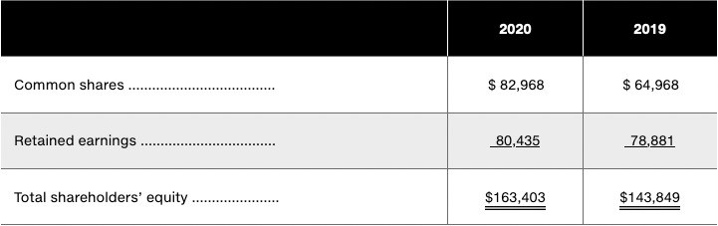
Short Exercise S8-5
On December 31, 2020, shareholders’ equity accounts of Green Products Inc. (GPI) had the balances shown below. GPI paid dividends of $4,096 on December 1, 2020.

Slide 35
Short Exercise S8-5
GPI sold 10,000 common shares on June 30, 2020. What was the average selling price of these shares if this was the only common-shares transaction during 2020?
Journalize GPI’s sale of the common shares on June 30, 2020.
Based only on the above information, did GPI earn a profit or suffer a loss during 2020? Calculate the profit or loss.

Slide 36
Learning Objective Five
Evaluate a company’s return on equity
Notes:
The fifth learning objective is to evaluate a company’s return on equity.

Slide 37
Return on Assets
Notes:
To compare profitability of companies of different size, investors use some standard profitability measures, including return on assets and return on equity. Return on assets (ROA) is the product of two drivers: net income and asset usage. Net income measures how effectively the company has earned revenue while controlling costs. Average total assets measures how efficiently the company has managed its assets.

Slide 38
Return on Equity
$$\frac{Net income ― Preferred dividends}{Average common shareholders equity}$$
Notes:
ROE shows the relationship between net income and common shareholders’ equity. Return on equity is computed only on common shares because the return to preferred shareholders is usually limited to a specified dividend. The numerator of ROE is net income minus preferred dividends, if any. The denominator is average common shareholders’ equity —total shareholders’ equity minus preferred equity, if any. Since most companies do not have preferred shares, adjustments for preferred dividends and preferred equity are usually not necessary.

Slide 39
Learning Objective Six
Report equity transactions and events in the financial statements
Notes:
The sixth learning objective is to report equity transactions and events in the financial statements.

Slide 40
Statement of Changes in Shareholders’ Equity
National Hardware Ltd.
Consolidated Statement of Changes in Shareholders’ Equity
For the Year Ended December 31, 2022
(in millions) | Share Capital | Contri-buted Surplus | Accumulated Compre-hensive Income | Retained Earnings | Non-Controlling Interests | Total
Balance as per December 31, 2021 | $ 587.0 | $ 2.4 | $ 47.4 | $ 4,526.7 | $ 286.4 | $5,449.9
Net income |  |  |  | 639.3 |  | 639.3
Other comprehensive income (loss) |  |  | 34.6 | (13.1) |  | 21.5
Issuance of Class A non-voting shares | 6.9 |  |  |  |  | 6.9
Repurchase of Class A non-voting shares | (322.2) |  |  |  |  | (322.2)
Excess of repurchase price over avg cost | 423.8 |  |  | (423.8) |  | 0.0
Dividends |  |  |  | (154.0) |  | (154.0)
Issuance of redeemable financial instrumts |  |  |  | (500.0) |  | (500.0)
Contributed surplus, sale of property |  | 0.5 |  |  |  | 0.5
Changes in non-controlling interests |  |  |  |  | 488.9 | 488.9
Balance as at December 31, 2022 | $695.5 | $ 2.9 | $ 82.0 | $ 4,075.1 | $ 775.3 | $5,630.8
Notes:
The statement of changes in shareholders’ equity reports the details of all the changes in the shareholders’ equity section of the balance sheet during the period. This slide presents National Hardware’s equity during 2022. The statement contains a column for each major element of equity, starting with Share Capital on the left and ending with a column summarizing the total changes for the period. The top row reports the beginning balance for each element as at December 31, 2021, while the next nine rows detail the causes of the changes in each element during the fiscal year.

Slide 41
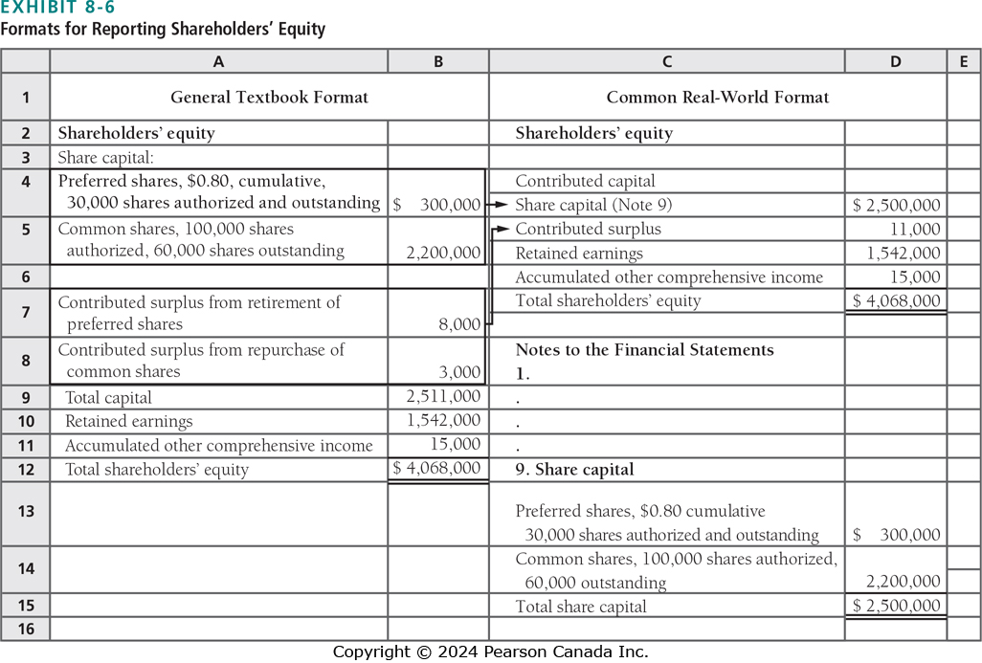
Shareholders’ Equity on the Balance Sheet
Notes:
Businesses often use terminology and formats in reporting shareholders’ equity that differ from our examples. We use a more detailed format in this book to help you learn the main components of shareholders’ equity. One of the most important skills you will take from this textbook is the ability to understand the financial statements of real companies. This slide presents a side-by-side comparison of our general textbook format for reporting shareholders’ equity and a format you will commonly encounter in the real world.

Slide 42
Shareholders’ Equity on the Balance Sheet, Statement of Changes in Owners’ Equity, or the Notes
Required Equity Information:
Number of authorized, issued, and outstanding shares, and changes during the year; their par value, if any; dividend rights and preferences; and other restrictions and features
Contributed surplus
Accumulated other comprehensive income (IFRS only)
Retained earnings
Notes:
In general, the following are a few of the key pieces of equity information that must be disclosed in the balance sheet, statement of changes in owners’ equity, or the notes:
• Number of authorized, issued, and outstanding shares, and changes in these amounts during the year, for each class of share capital; their par value, if any; dividend rights and preferences; and other restrictions and features.
• Contributed surplus.
• Accumulated other comprehensive income (IFRS only)
• Retained earnings

Slide 43
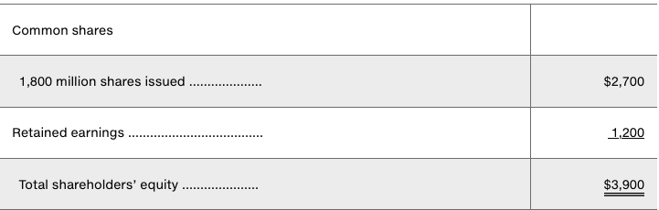
E8-23
At December 31, 2019, Blumenthall Corporation reported the shareholders’ equity accounts shown here (as adapted, with dollar amounts in millions):
Blumenthall’s 2020 transactions included the following:
Issuance of 6 million common shares for $12.50 per share
Declared cash dividends of $25 million.
Paid the dividends declared in (b).

Slide 44
E8-23 - Required
Journalize Blumenthall’s transactions. Explanations are not required.
Assuming Blumenthall earned $350 million in net income in 2020, prepare the Shareholder’s Equity section of the company’s Balance Sheet at December 31, 2020.

Slide 45
E8-28
Identify the effects—both the direction and the dollar amount—of the following assumed transactions on the total shareholders’ equity of a large corporation. Each transaction is independent.
Declaration of cash dividends of $80 million
Payment of the cash dividend declared
10% stock dividend. Before the dividend, 69 million common shares were outstanding; the market price was $7.625 at the time of the dividend.
A 50% stock dividend. Before the dividend, 69 million common shares were outstanding; the market price was $13.75 at the time of the dividend.
Sale of 600 common shares for $5.00 per share
A 3-for-l stock split. Prior to the split, 69 million common shares were outstanding.

Slide 46
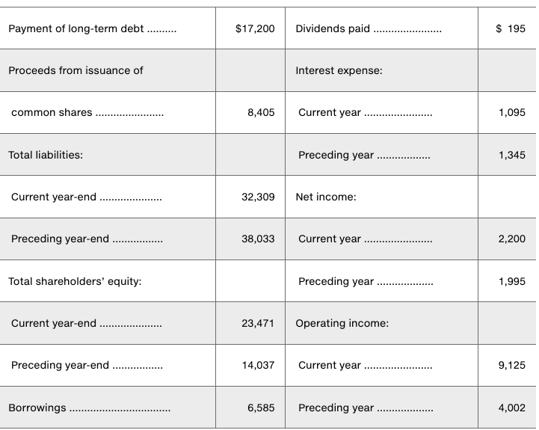
E8-32
Easton Company included the following items in its financial statements for 2020, the current year (amounts in millions):
Evaluate Easton’s return on assets and return on equity for 2020.

Slide 47
End of Chapter Eight
Slides adapted from Pearson Canada Inc. 2024
Notes:
This concludes Chapter Seven.

