Slide 1
Chapter 2
Recording Business Transactions

Slide 2
Chapter 2 Learning Objectives
Recognize a business transaction and describe the various types of accounts in which it can be recorded
Determine the impact of business transactions on the accounting equation
Analyze business transactions using T-accounts
Record business transactions in the journal and post them to the ledger
Prepare and use a trial balance

Slide 3
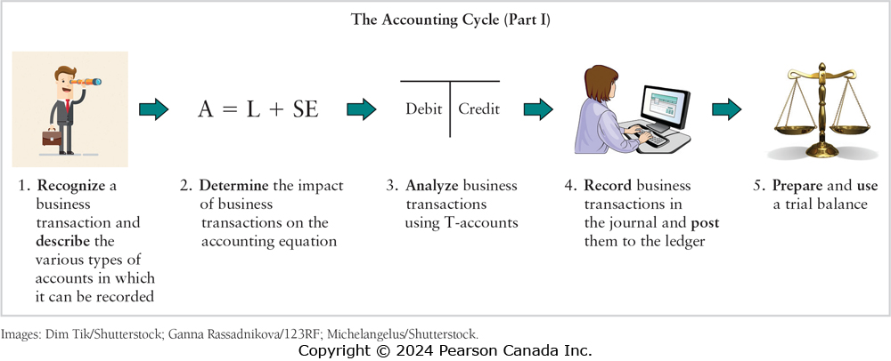
First 5 Steps of the Accounting Cycle

Slide 4
Learning Objective One
Recognize a business transaction and describe the various types of accounts in which it can be recorded
Notes:
The first learning objective is to recognize a business transaction and describe the various types of accounts in which it can be recorded.

Slide 5
The Account
Assets = Liabilities + Shareholders’ Equity
Account is a record of each asset, liability, and shareholders’ equity element
  Basic summary device of accounting
Notes:
The accounting equation expresses the basic relationships of accounting. For each asset, each liability, and each element of shareholders’ equity, we use a record called the account. An account is the record of all the changes in a particular asset, liability, or shareholders’ equity during a period. The account is the basic summary device in accounting.

Slide 6
Assets (1 of 2)
Economic resources that provide future benefit
Cash
Accounts Receivable
Prepaid Expenses
Inventory
Notes:
Assets are economic resources that provide a future benefit for a business. Most firms use the following asset accounts:
Cash: money and any medium of exchange including bank account balances, paper currency, coins, certificates of deposit, and cheques.
Accounts receivable: a company sells its goods and services and receives a promise for future collection of cash. The agreement to allow customers to pay in the future is informal and usually for a short period of time. The Accounts Receivable account holds these amounts.
Inventory: Often a company’s most important asset is its inventory—the products it sells to customers. Other titles for this account include Merchandise and Merchandise Inventory.
Prepaid expenses: Companies pay certain expenses in advance, such as insurance and rent. A prepaid expense is an asset because the payment provides a future benefit for the business. Prepaid Rent, Prepaid Insurance, and Supplies are prepaid expenses.

Slide 7
Assets (2 of 2)
Land
Buildings
Equipment, Furniture, and Fixtures
Notes:
Land: The Land account shows the cost of the land a company uses in its operations.
Buildings: The costs of office buildings, manufacturing plants, and the like appear in the Buildings account.
Equipment, Furniture, and Fixtures: These asset accounts include items such as computers, office furniture, and store shelving.
The assets Land, Buildings, Equipment, and Furniture and Fixtures are examples of those assets referred to in chapter one as property, plant, and equipment. Notice that even though they are reported on the balance sheet in one amount, they are tracked in separate accounts.

Slide 8
Liabilities
Accounts Payable
Loans Payable
Accrued Liabilities
Notes:
Recall that a liability is a debt. A payable is always a liability. The most common types of liabilities include:
Accounts payable: the direct opposite of Accounts Receivable. A company’s promise to pay a debt arising from a credit purchase of inventory or from a utility bill appears in the Accounts Payable account.
Loans payable: a loan payable is the amount a company must pay because it borrowed money from a bank or other creditor.
Accrued liabilities: an accrued liability is a liability for an expense you have not yet paid. Interest Payable and Salary Payable are accrued liability accounts for most companies. Income Tax Payable is another accrued liability.

Slide 9
Shareholders’ Equity
Owners’ claim to assets
Common Shares
Retained Earnings
Dividends
Revenues and Expenses
Notes:
The owners’ claims to the assets of a corporation are called shareholders’ equity or simply owners’ equity. A corporation uses Common Shares, Retained Earnings, and Dividends accounts to record changes in the company’s shareholders’ equity. Revenues increase shareholders' equity, and expenses and dividends decrease shareholders' equity.

Slide 10
Shareholders’ Equity Accounts
Common Shares | Owners’ investment in the corporation
Retained Earnings | Cumulative net income (loss) less dividends
Dividends | Distributions to owners
Revenues | Income from providing goods and services
Expenses | Costs of operating a business
Notes:
Common Shares: this account shows the owners’ investment in the corporation. The corporation receives cash and issues common shares to its shareholders. A company’s common shares are its most basic element of equity. All corporations have common shares.
Retained Earnings: this account shows the cumulative net income earned by a corporation over its lifetime, minus its cumulative net losses and dividends.
Dividends: after profitable operations, the board of directors of a corporation may (or may not) declare and pay a cash dividend. Dividends are optional; they are decided by the board of directors. The corporation may keep a separate account titled Dividends, which indicates a decrease in retained earnings.
Revenues: the increase in shareholders’ equity from delivering goods or services to customers is called revenue. The company uses as many revenue accounts as needed. Companies that sell merchandise use a Sales Revenue account for revenue earned by selling its products. Companies that provide services have a Service Revenue account for the revenue it earns by providing services to customers. A business that loans money to an outsider needs an Interest Revenue account. If the business rents a building to a tenant, the business needs a Rent Revenue account.
Expenses: the cost of operating a business is called expense. Expenses decrease shareholders’ equity, the opposite effect of revenues. A business needs a separate account for each type of expense, such as Cost of Goods Sold, Salary Expense, Rent Expense, Advertising Expense, Insurance Expense, Utilities Expense, and Income Tax Expense. Businesses strive to minimize expenses and thereby maximize net income.

Slide 11
Learning Objective Two
Determine the impact of business transactions on the accounting equation
Notes:
The second learning objective is to determine the impact of business transactions on the accounting equation.
.

Slide 12
Accounting for Business Transactions (1 of 13)
A transaction is an event that both affects
the financial position of the business entity
and can be reliably measured.
Notes:
Business activity is all about transactions. A transaction is any event that has a financial impact on the business and can be measured reliably. But not all events qualify as transactions. For example, a transaction for a retail store would be when a customer buys a product or the store purchases inventory. Transactions provide objective information about the financial impact on a company.

Slide 13
Accounting for Business Transactions (2 of 13)
Transaction 1:
Booth, Savard, and several fellow engineers invest $50,000 to begin
Tara Inc., and the business
issues common shares.
 | ASSETS |  |  |  | LIABILITIES | + | SHAREHOLDERS’ EQUITY |  | TYPE OF SHAREHOLDERS’ EQUITY TRANSACTION
 | Cash |  | = |  |  |  | Common Shares
(1) | + 50,000 |  |  |  |  |  | +50,000 |  | Issued common shares
Notes:
To demonstrate transaction analysis, we will use the events in used in the text starting on page 63. We will start with the accounting equation and then increase and or/decrease the appropriate accounts. Notice as each transaction is recorded, the accounting equation stays in balance by making sure that each transaction is balanced. Each side of the equation will be changed in the same direction, or the same side of the equation will be changed in opposite directions.
J.J. Booth, Marie Savard, and several fellow engineers opened a consulting company called Tara Inc. During the first month of operation (April), the business experienced the following events:
The owners invested $50,000 in the business, which in turn issued its common shares to them. This would increase Cash, an asset, and increase Common Shares, an equity account.

Slide 14
Accounting for Business Transactions (3 of 13)
Transaction 2:
Tara Inc. purchases land and
pays $40,000 in cash.
 | ASSETS |  |  |  |  |  | LIABILITIES |  | + |  | SHAREHOLDERS’ EQUITY
Cash | Cash | + | Land |  |  |  |  |  |  |  | Common Shares
Balance | 50,000 |  |  |  | = |  |  |  |  |  | 50,000
(2) | −40,000 |  | +40,000
Bal. | 10,000 |  | 40,000 |  |  |  |  |  |  |  | 50,000
 | 50,000 |  |  |  |  |  |  |  |  |  | 50,000
Notes:
The business then paid cash for land costing $40,000. This transaction increases one asset – Land, and decreases another – Cash. The accounting equation still balances. Assets equal $50,000 (10,000 cash + 40,000 land) and equity equals $50,000.

Slide 15
Accounting for Business Transactions (4 of 13)
Transaction 3:
The business buys stationery and other office
supplies on account, agreeing to pay $3,700 within 30 days.
 | ASSETS |  |  |  |  |  |  |  | LIABILITIES | + | SHAREHOLDERS’ EQUITY
 | Cash | + | Office Supplies | + | Land |  |  |  | Accounts Payable | + | Common Shares
Bal. | 10,000 |  |  |  | 40,000 |  | = |  |  |  | 50,000
(3) |  |  | +3,700 |  |  |  |  |  | +3,700
Bal. | 10,000 |  | 3,700 |  | 40,000 |  |  |  | 3,700 |  | 50,000
 | 53,700 |  |  |  |  |  |  |  | 53,700
Notes:
The business purchased supplies for $3,700 on account. This transaction increases Supplies, an asset, and increases a liability, Accounts Payable. Assets of $53,700 ($10,000 + $40,000 + $3,700) equal Liabilities ($3,700) Equity ($50,000) of $53,700.

Slide 16
Accounting for Business Transactions (5 of 13)
Transaction 4:
Tara Inc. earns service revenue of
$7,000 and collects this amount in cash.
 | ASSETS |  |  |  |  |  |  |  | LIABILITIES | + |  | SHAREHOLDERS’ EQUITY
 | Cash | + | Office Supplies | + | Land |  |  |  | Accounts Payable | + |  | Common Shares | + | Retained Earnings
Bal. | 10,000 |  | 3,700 |  | 40,000 |  |  |  | 3,700 |  |  | 50,000
(4) | + 7,000 |  |  |  |  |  | = |  |  |  |  |  |  | 7,000
Bal. | 17,000 |  | 3,700 |  | 40,000 |  |  |  | 3,700 |  |  | 50,000 |  | 7,000
 |  |  | 60,700 |  |  |  |  |  |  |  |  | 60,700
Notes:
Tara Inc. earned service revenue of $7,000, receiving cash. Revenue would increase and an asset account, Cash, would also increase. The accounting equation is still balanced with both sides equal to $60,700.

Slide 17
Accounting for Business Transactions (6 of 13)
Transaction 5:
Tara Inc. performs service
and earns $3,000 on account.
 | ASSETS |  |  |  |  |  |  |  |  |  | LIABILITIES | + | SHAREHOLDERS’ EQUITY
 | Cash | + | Accounts Receivable | + | Office Supplies | + | Land |  |  |  | Accounts Payable | + | Common Shares | + | Retained Earnings
Bal. | 17,000 |  |  |  | 3,700 |  | 40,000 |  | = |  | 3,700 |  | 50,000 |  | 7,000
(5) |  |  | + 3,000 |  |  |  |  |  |  |  |  |  |  |  | +3,000
Bal. | 17,000 |  | 3,000 |  | 3,700 |  | 40,000 |  |  |  | 3,700 |  | 50,000 |  | 10,000
 | 63,700 |  |  |  |  |  |  |  |  |  | 63,700
Notes:
Tara Inc. again earned service revenue; this time it earned $3,000, but did not receive cash. Rather, the customer agreed to pay in the future. Tara will receive cash in the future, but until then it calls the customer’s promise to pay an accounts receivable. Revenue would increase and an asset account, Accounts Receivable, would also increase. The accounting equation is still balanced with both sides equal to $63,700.

Slide 18
Accounting for Business Transactions (7 of 13)
Transaction 6:
Tara Inc. pays $2,700 for the following expenses:
office rent $1,100, employee salary $1,200
and utilities $400
 | ASSETS |  |  |  |  |  |  |  |  |  | LIABILITIES | + | SHAREHOLDERS’ EQUITY
 | Cash | + | Accounts Receivable | + | Office Supplies | + | Land |  |  |  | Accounts Payable | + | Common Shares | + | Retained Earnings
Bal. | 17,000 |  | 3,000 |  | 3,700 |  | 40,000 |  |  |  | 3,700 |  | 50,000 |  | 10,000
(6) | –1,100 |  |  |  |  |  |  |  | = |  |  |  |  |  | –1,100
 | –1,200 |  |  |  |  |  |  |  |  |  |  |  |  |  | –1,200
 | – 400 |  |  |  |  |  |  |  |  |  |  |  |  |  | – 400
Bal. | 14,300 |  | 3,000 |  | 3,700 |  | 40,000 |  |  |  | 3,700 |  | 50,000 |  | 7,300
 | 61,000 |  |  |  |  |  |  |  |  |  | 61,000
Notes:
The business paid cash expenses: office rent, $1,100; employee salaries, $1,200; utilities, $400. These expenses decrease equity and decrease Cash. Both sides of the equation now equal $61,000.

Slide 19
Accounting for Business Transactions (8 of 13)
Transaction 7:
Tara pays $1,900 on account for supplies purchased
in Transaction 3.
 | ASSETS |  |  |  |  |  |  |  |  |  | LIABILITIES | + | SHAREHOLDERS’ EQUITY
 | Cash | + | Accounts Receivable | + | Office Supplies | + | Land |  |  |  | Accounts Payable | + | Common Shares | + | Retained Earnings
Bal. | 14,300 |  | 3,000 |  | 3,700 |  | 40,000 |  | = |  | 3,700 |  | 50,000 |  | 7,300
(7) | –1,900 |  |  |  |  |  |  |  |  |  | –1,900
Bal. | 12,400 |  | 3,000 |  | 3,700 |  | 40,000 |  |  |  | 1,800 |  | 50,000 |  | 7,300
 | 59,100 |  |  |  |  |  |  |  |  |  | 59,100
Notes:
Tara pays $1,900 cash on account for supplies purchased in Transaction 3. That decreases both an asset, Cash, and a liability, Accounts Payable. The accounting equation is balanced at $59,100.

Slide 20
Accounting for Business Transactions (9 of 13)
Transaction 8:
J.J. Booth pays for the re-modeling of
his home at a cost of $30,000.
This event is a transaction of the
personal entity, not the business entity.
No transaction is recorded for Tara Inc.
Notes:
One of the shareholders pays for the re-modeling of his home at a cost of $30,000. This event is a transaction of the personal entity, not the business entity. No transaction is recorded for Tara Inc.

Slide 21
Accounting for Business Transactions (10 of 13)
Transaction 9:
The business collects $1,000
from a customer on account.
 | ASSETS |  |  |  |  |  |  |  |  |  | LIABILITIES | + | SHAREHOLDERS’ EQUITY
 | Cash | + | Accounts Receivable | + | Office Supplies | + | Land |  |  |  | Accounts Payable | + | Common Shares | + | Retained Earnings
Bal. | 12,400 |  | 3,000 |  | 3,700 |  | 40,000 |  | = |  | 1,800 |  | 50,000 |  | 7,300
(9) | +1,000 |  | –1,000
Bal. | 13,400 |  | 2,000 |  | 3,700 |  | 40,000 |  |  |  | 1,800 |  | 50,000 |  | 7,300
 | 59,100 |  |  |  |  |  |  |  |  |  | 59,100
Notes:
The business collects $1,000 from a customer on account from transaction 5. $2,000 is still owing. An asset, Cash is increased, and another asset, Accounts Receivable is decreased. Both sides of the accounting equation now equal $59,100.

Slide 22
Accounting for Business Transactions (11 of 13)
Transaction 10:
Tara Inc. sells part of the land purchased in
Transaction 2 for $22,000 (the land’s cost) in cash.
 | ASSETS |  |  |  |  |  |  |  |  |  | LIABILITIES | + | SHAREHOLDERS’ EQUITY
 | Cash | + | Accounts Receivable | + | Office Supplies | + | Land |  |  |  | Accounts Payable | + | Common Shares | + | Retained Earnings
Bal. | 13,400 |  | 2,000 |  | 3,700 |  | 40,000 |  | = |  | 1,800 |  | 50,000 |  | 7,300
(10) | +22,000 |  |  |  |  |  | –22,000
Bal. | 35,400 |  | 2,000 |  | 3,700 |  | 18,000 |  |  |  | 1,800 |  | 50,000 |  | 7,300
 | 59,100 |  |  |  |  |  |  |  |  |  | 59,100
Notes:
Tara Inc. sells part of the land purchased in Transaction 2 for $22,000 in cash, which was the cost of the land. An asset account, Cash, increases by $22,000, and another asset account, Land, decreases by $22,000. Both sides of the equation still equal $59,100.

Slide 23
Accounting for Business Transactions (12 of 13)
Transaction 11:
The corporation declares a dividend and pays
$2,100 cash to the shareholders.
 | ASSETS |  |  |  |  |  |  |  |  |  | LIABILITIES | + | SHAREHOLDERS’ EQUITY
 | Cash | + | Accounts Receivable | + | Office Supplies | + | Land |  |  |  | Accounts Payable | + | Common Shares | + | Retained Earnings
Bal. | 35,400 |  | 2,000 |  | 3,700 |  | 18,000 |  | = |  | 1,800 |  | 50,000 |  | 7,300
(11) | –2,100 |  |  |  |  |  |  |  |  |  |  |  |  |  | –2,100
Bal. | 33,300 |  | 2,000 |  | 3,700 |  | 18,000 |  |  |  | 1,800 |  | 50,000 |  | 5,200
 | 57,000 |  |  |  |  |  |  |  |  |  | 57,000
Notes:
The corporation declares a dividend and pays $2,100 cash to the shareholders. An asset account, Cash, decreases and Shareholders’ Equity also decreases by $2,100. Both sides of the equation now equal $57,000.

Slide 24
Accounting for Business Transactions (13 of 13)
ASSETS |  |  |  |  | LIABILITIES + SHAREHOLDER’S EQUITY
Trans | Cash | AR | Supplies | Land | AP | Common Shares | Retained Earnings
1 | 50,000 |  |  |  |  | 50,000
2 | (40,000) |  |  | 40,000
3 |  |  | 3,700 |  | 3,700
4 | 7,000 |  |  |  |  |  | 7,000
5 |  | 3,000 |  |  |  |  | 3,000
6 | (2,700) |  |  |  |  |  | (1,100)
 |  |  |  |  |  |  | (1,200)
 |  |  |  |  |  |  | (400)
7 | (1,900) |  |  |  | (1,900)
9 | 1,000 | (1,000)
10 | 22,000 |  |  | (22,000)
11 | (2,100) |  |  |  |  |  | (2,100)
Bal | 33,300 | 2,000 | 3,700 | 18,000 | 1,800 | 50,000 | 5,200
Totals |  | 57,000 |  |  |  | 57,000
Notes:
It’s now the end of the month and time to determine the ending totals for the month. As you can see, the four assets (Cash, Accounts Receivable, Office Supplies, and Land) total $57,000.
The liability account, Accounts Payable, equals $1,800. Add this amount to the Common Shares ($50,000) and Retained Earnings ($5,200). Total liabilities and equity equal $57,000.

Slide 25
Transactions and Financial Statements
Income Statement data appear as revenues and expenses under Retained Earnings. The revenues increase retained earnings; the expenses decrease retained earnings.
Balance Sheet data are composed of the ending balances of the assets, liabilities, and shareholders’ equity
Statement of Retained Earnings repeats net income (or net loss) from the income statement. Dividends are subtracted. Ending retained earnings is the final result.

Slide 26
Income Statement
Tara Inc.
Income Statement
For the Month Ended April 30, 20XX
Revenues
Service revenue ($7,000 + $3,000) |  | $ 10,000
Expenses
Salary expense | $ 1,200
Rent expense | 1,100
Utilities expense | 400
Total expenses |  | 2,700
Net income |  | $ 7,300

Slide 27
Statement of Retained Earnings
Tara Inc.
Statement of Retained Earnings
For the Month Ended April 30, 20XX
Retained earnings, April 1, 20XX |  | $ 0
Add: Net income for the month |  | 7,300
Subtotal |  | 7,300
Less: Dividends declared |  | (2,100)
Retained earnings, April 30, 20XX |  | $5,200

Slide 28
Balance Sheet
Tara Inc.
Balance Sheet
As at April 30, 20XX
Assets |  | Liabilities
Cash | $ 33,300 | Accounts payable | $ 1,800
Accounts receivable | 2,000 | Shareholders’ Equity
Office supplies | 3,700 | Common shares | 50,000
Land | 18,000 | Retained earnings | 5,200
 |  | Total shareholders’ equity | 55,200
Total assets | $ 57,000 | Total liabilities and shareholders’ equity | $ 57,000

Slide 29
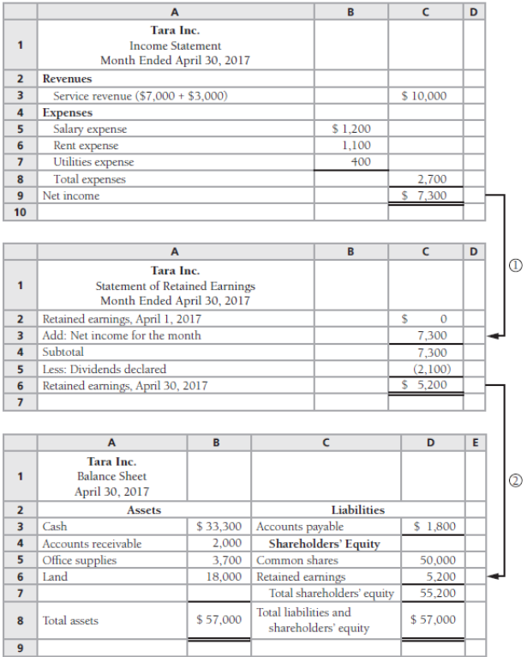
Exhibit 2-2 illustrates the three financial statements that are prepared from the 11 transactions summarized in Exhibit 2-1.
Note the flow of data from Income Statement to Statement of Retained Earnings to Balance Sheet.

Slide 30
What “on account” means?
There are four ways “on account” is used in transactions:
  Performed services on account ➔ means A/R increases
  Collected on account means ➔ A/R decreases
  Purchased on account means ➔ A/P increases
  Paid on account means ➔ A/P decreases

Slide 31
Learning Objective Three
Analyze business transactions using T-accounts
Notes:
The third learning objective is to analyze business transactions using T-accounts.

Slide 32
Tara Inc. Chart of Accounts
BALANCE SHEET ACCOUNTS:
Assets | Liabilities | Shareholders’ Equity
101 Cash | 201 Accounts Payable | 301 Common Shares
111 Accounts Receivable | 231 Notes Payable | 311 Dividends
141 Office Supplies |  | 312 Retained Earnings
151 Office Furniture
191 Land
INCOME STATEMENT ACCOUNTS
(PART OF SHAREHOLDERS’ EQUITY):
Revenues | Expenses
401 Service Revenue | 501 Rent Expense
 | 502 Salary Expense
 | 503 Utilities Expense
Notes:
An organization uses a chart of accounts to keep track of all its accounts. The chart of accounts lists the name of every account and its unique account number, but it does not provide the account balances.

Slide 33
Double-Entry Accounting
Double-entry system of accounting uses
debits and credits to record the dual effects
of each business transaction.
Assets = Liabilities + Shareholders' Equity
Notes:
Each transaction affects at least two accounts. The accounting equation must be equal after all transactions are recorded.

Slide 34
The T-Account
KEY CONCEPT!!!
Account Title
LEFT SIDE | RIGHT SIDE
Debit | Credit
Notes:
An account can be represented by the letter T. We call them T-accounts. The vertical line in the letter divides the account into its two sides: left and right. The account title appears at the top of the T. The left side of each account is called the debit side, and the right side is called the credit side. Often, students are confused by the words debit and credit. Just remember that debit means “left side”, and credit means “right side.” Every business transaction involves both a debit and a credit.

Slide 35
The Rule of Debit & Credit
MORE KEY CONCEPTS…
Debits | = | Credits
(Left side) |  | (Right side)
Assets = Liabilities + Shareholders’ Equity
Notes:
Assets are on the left or debit side of the equation. Liabilities and Shareholders’ Equity are on the right or credit side of the equation. The exceptions are expenses and dividends. Expenses and dividends are part of Shareholders’ Equity, but they decrease the owners’ claims on the assets. See next slide.

Slide 36
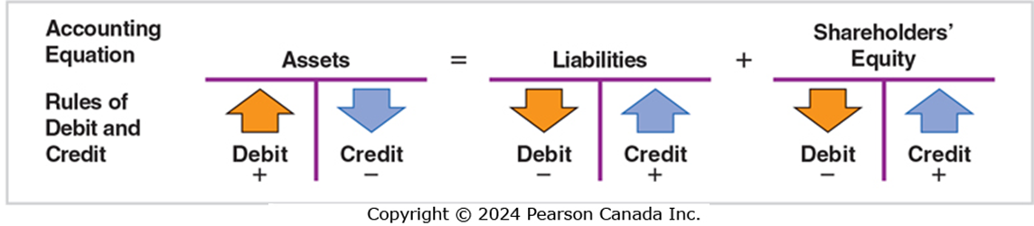
Increases and Decreases in the Accounts
A FEW MORE KEY CONCEPTS…
Notes:
The type of account determines how we record increases and decreases. The rules of debit and credit are shown above.
■ Increases in assets are recorded on the left (debit) side of the account. Decreases in assets are recorded on the right (credit) side. You receive cash and debit the Cash account. You pay cash and credit the Cash account.
■ Conversely, increases in liabilities and shareholders’ equity are recorded by credits.
■ Expenses and dividends are the exceptions. Because they decrease shareholders’ equity, they behave opposite to the “positive” components of shareholders’ equity. In other words, debits increase expenses and dividends and credits decrease those two accounts.

Slide 37
Rules of Debit and Credit (1 of 3)
Assets = Liabilities + Shareholders’ Equity
Common Shares
Debit | Credit
− | +
Retained Earnings
Debit | Credit
− | +
Debit | Credit
+ | −
Debit | Credit
− | +
Revenue
Debit | Credit
− | +
KEY CONCEPTS SUMMARIZED…
Dividends
Debit | Credit
+ | −
Expenses
Debit | Credit
+ | −
Notes:
We can now express the final form of the rules of debit and credit, as shown above. You should not proceed until you have learned these rules. For example, you must remember that:
■ A debit increases an asset account.
■ A credit decreases an asset.
Liabilities and shareholders’ equity are the opposite:
■ A credit increases a liability or shareholders’ equity account.
■ A debit decreases a liability or shareholders’ equity account.
Dividends and Expense accounts are exceptions to the rule. Dividends and Expenses are equity accounts that are increased by a debit. Dividends and Expense accounts are negative (or contra) equity accounts. Revenues and Expenses are often treated as separate account categories because they appear on the income statement.

Slide 38
Rules of Debit and Credit (2 of 3)
Tara Inc. received $50,000 and issued shares.
Assets = Liabilities + Shareholders’ Equity
Cash
Debit for Increase, 50,000
Common Shares
 | Credit for Increase, 50,000
Notes:
To illustrate the ideas shown in the previous slide, let’s looks at a transaction. In slide 12, Tara Inc. received $50,000 and issued common shares. Which accounts are affected? The Cash account and the Common Shares account will hold these amounts. The amount remaining in an account is called its balance. This first transaction gives Cash a $50,000 debit balance and Common Shares a $50,000 credit balance.

Slide 39
Rules of Debit and Credit (3 of 3)
Tara Inc. purchases land for $40,000 cash.
Assets = Liabilities + Shareholders’ Equity
Cash
Bal. 50,000 | Credit for Decrease, 40,000
Common Shares
 | Bal. 50,000
Land
Debit for Increase, 40,000
Notes:
The transaction is a $40,000 cash purchase of land. This transaction decreases Cash with a credit and increases Land with a debit, as shown in the above T-accounts. After this transaction, Cash has a $10,000 debit balance, Land has a debit balance of $40,000, and Common Shares has a $50,000 credit balance. Debits ($10,000 + $40,000) = Credits ($50,000).

Slide 40
Normal Balances of Accounts
If you remember that Assets are normally DEBITS (assets are increased on the Debit side of the T-Account)…
… then it should make sense that Liabilities and Equity are normally CREDITS because they are on the other side of the accounting equation
Assets | Debit
Liabilities |  | Credit
Shareholders’ Equity—overall |  | Credit
Common Shares |  | Credit
Retained Earnings |  | Credit
Dividends | Debit
Revenues |  | Credit
Expenses | Debit
Once you understand why the normal balance of Liabilities and Equity is on the CREDIT side, think about where Dividends, Revenue and Expenses are in the expanded accounting equation…
Notes:
An account’s normal balance falls on the side of the account—debit or credit—where increases are recorded. The normal balance of assets is on the debit side, so assets are debit-balance accounts. Conversely, liabilities and shareholders’ equity usually have a credit balance, so these are credit-balance accounts. As explained earlier, shareholders’ equity usually contains several accounts. Dividends and expenses carry debit balances because they represent decreases in shareholders’ equity. In total, the equity accounts show a normal credit balance.

Slide 41
Additional Shareholders’ Equity Accounts: Revenues, Expenses, and Dividends
Assets
Liabilities
Common Shares
+
Retained Earnings
−
Dividends
+
Revenues
−
Expenses
Shareholders’ Equity
Notes:
Shareholders’ equity also includes the two categories of income statement accounts, Revenues and Expenses:
■ Revenues are increases in shareholders’ equity that result from delivering goods or services to customers.
■ Expenses are decreases in shareholders’ equity due to the cost of operating the business.
Therefore, the accounting equation may be expanded. Revenues minus expenses equals net income, which increases shareholders’ equity. If expenses exceed revenues, there is a net loss, which decreases shareholders’ equity.

Slide 42
Learning Objective Four
Record business transactions in the journal and post them to the ledger
Notes:
The fourth learning objective is to record business transactions in the journal and post them to the ledger.

Slide 43
The Journal
Chronological record of transactions
Three steps
  Specify each account affected by the transaction
  Determine if each account is increased or decreased
    Use rules of debit and credit
  Record in journal
Notes:
Accountants use a chronological record of transactions called a journal. The journalizing process follows three steps:
1. Specify each account affected by the transaction.
2. Determine whether each account is increased or decreased by the transaction. Use the rules of debit and credit to increase or decrease each account. Remember that the amount of the debits must equal the amount of the credits.
3. Record the transaction in the journal, including a brief explanation. The debit side is entered on the left margin, and the credit side is indented to the right.
Step 3 is also called “making the journal entry” or “journalizing the transaction.”

Slide 44
Journal Entry
JOURNAL
Date | Accounts and explanation | Debit | Credit
Apr. 1 | Cash | 50,000
 | Common Shares |  | 50,000
 | Issued common shares
Notes:
Let’s apply the steps to journalize a transaction in which a company issues share for $50,000 cash from slide 12.
Step 1 The business receives cash and issues common shares. Cash and Common Shares are affected. Cash is an asset, and Common Shares is equity.
Step 2 Both Cash and Common Shares increase. Debit Cash to record an increase in this asset. Credit Common Shares to record an increase in this equity account.
Step 3 Journalize the transaction as shown above.

Slide 45
The Ledger
Cash
Individual asset accounts
Ledger
Common Shares
Individual equity accounts
Accounts Payable
Individual liability accounts
Notes:
The journal is a chronological record of all company transactions listed by date. But the journal does not indicate how much cash or accounts receivable the business has. The ledger is a grouping of all the T-accounts, with their balances. For example, the balance of the Cash T-account shows how much cash the business has. The balance of Accounts Receivable shows the amount due from customers. Accounts Payable shows how much the business owes suppliers on open account, and so on. In the phrase “keeping the books,” books refers to the journals as well as the accounts in the ledger. In most accounting systems, the ledger is computerized. The figure above shows how the asset, liability, and shareholders’ equity accounts are grouped in the ledger.

Slide 46
Copying Information (Posting) from the Journal to the Ledger
JOURNAL
Date | Accounts and explanation | Debit | Credit
Apr. 2 | Cash | 50,000
 | Common Shares |  | 50,000
 | Issued common shares
Cash
50,000
Common Shares
 | 50,000
Notes:
Entering a transaction in the journal does not get the data into the ledger. Data must be copied to the ledger—a process called posting. Debits in the journal are always posted as debits in the accounts, and likewise for credits.

Slide 47
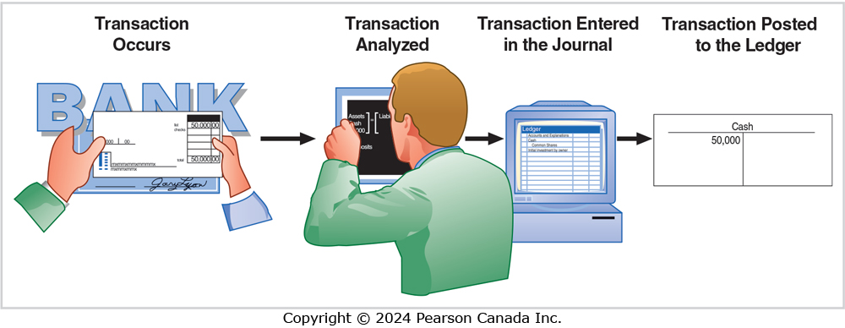
Flow of Accounting Data
Notes:
The flow of accounting data is as follows: a transaction occurs and then is analyzed to see its effect on the company’s accounts. Next, a journal entry is made to record the transaction. Periodically, amounts from the journal are posted to the ledger to determine the account balances.

Slide 48
Accounts After Posting (1 of 2)
Assets = Liabilities
Cash
(1) 50,000 | (2) 40,000
(4) 7,000 | (6) 2,700
(9) 1,000 | (7) 1,900
(10) 22,000 | (11) 2,100
Bal. 33,300
Accounts Payable
(7) 1,900 | (3) 3,700
 | Bal. 1,800
Accounts Receivable
(5) 3,000 | (9) 1,000
Bal. 2,000
Office Supplies
(3) 3,700
Bal. 3,700
Land
(2) 40,000 | (10) 22,000
Bal. 18,000
Notes:
This slide and the next show the previous transactions posted to the ledger.

Slide 49
Accounts After Posting (2 of 2)
+ Shareholders’ Equity
Dividends
(11) 2,100
Bal. 2,100
Common Shares
 | (1) 50,000
 | Bal. 50,000
EXPENSES Rent Expense
(6) 1,100
Bal. 1,100
REVENUE Service Revenue
 | (4) 7,000
 | (5) 3,000
 | Bal. 10,000
Salary Expense
(6) 1,200
Bal. 1,200
Utilities Expense
(6) 400
Bal. 400

Slide 50
Learning Objective Five
Prepare and use a trial balance
Notes:
The fifth learning objective is prepare and use a trial balance.

Slide 51
Trial Balance
Lists all accounts with their balances
Assets listed first, then liabilities and shareholders’ equity
Shows that debits equal credits
Usually prepared at the end of the period
Facilitates preparation of the financial statements
Notes:
A trial balance lists all accounts with their balances—assets first, then liabilities and shareholders’ equity. The trial balance summarizes all the account balances for the financial statements and shows whether total debits equal total credits. A trial balance may be taken at any time, but the most common time is at the end of the period. The trial balance facilitates the preparation of the financial statements. It is possible to prepare an income statement, statement of retained earnings, and balance sheet from the data shown in a trial balance.

Slide 52
Tara Inc. Trial Balance
Tara Inc.
Trial Balance
April 30, 20XX
 | Balance
Account Title | Debit | Credit
Cash | $33,300
Accounts receivable | 2,000
Supplies | 3,700
Land | 18,000
Accounts payable |  | $1,800
Common shares |  | 50,000
Dividends | 2,100
Service revenue |  | 10,000
Rent expense | 1,100
Salary expense | 1,200
Utilities expense | 400
Total | $61,800 | $61,800
Notes:
This is the trial balance for Tara Inc. The first four accounts are assets and their balances are debits. The next account, accounts payable, is a liability and its balance is a credit. After accounts payable comes common shares, which is again a credit. All those accounts are found on the Balance Sheet. Dividends are next, with a debit balance. The remaining accounts are found on the Income Statement. First service revenue with a credit balance, and then all of the expenses listed separately with debit balances. The sum of the debits, $61,800 equals the sum of the credits.

Slide 53
Learning Objective Six
Describe machine learning and its applications in accounting and business
Notes:
The sixth learning objective is describe machine learning and its applications in accounting and business.
.

Slide 54
Artificial Intelligence and Machine Learning
Artificial intelligence (AI): the science that studies ways to build programs and machines that can creatively solve problems in a humanlike manner
Examples: ride-sharing apps, plagiarism checkers
Machine learning: a subset of AI where data are provided to machines and the machines learn for themselves without explicitly programming them

Slide 55
Supervised and Unsupervised Machine Learning
Examples using supervised machine learning:
Spam filters
Advertisement placements
Examples using unsupervised machine learning:
Recommendation systems
Product improvement

Slide 56
Machine Learning in Accounting
Machine learning in accounting will provide opportunities to:
Expand sales
Increase profits
Reduce processing errors

Slide 57
End of Chapter Two
Notes:
This concludes Chapter Two.

