Slide 1
Chapter 3
Accrual Accounting and the Financial Statements

Slide 2
Chapter 3’s Learning Objectives
Explain how accrual accounting differs from cash-basis accounting
Apply the revenue and expense recognition principles
Record adjusting journal entries
Prepare the financial statements
Record closing journal entries
Analyze and evaluate a company’s debt-paying ability
Identify patterns and trends using data visualization
.

Slide 3
Accounting Cycle – Timeline
Ch. 2
Ch. 3
Unadj.
Trial Balance
Apply AJEs
Adjusted
Trial Balance
Prepare Closing Entries
JEs to record transactions
Prepare F/S
Start of Accounting
Period
End of
Accounting
Period
After Year End

Slide 4
Learning Objective One
Explain how accrual accounting differs from cash-basis accounting
Notes:
The first learning objective is to explain how accrual accounting differs from cash-basis accounting.

Slide 5
Accrual vs. Cash-Basis Accounting
ACCRUAL ACCOUNTING
CASH-BASIS ACCOUNTING
Records impact of transactions when they occur
Required by IFRS and ASPE
Records:
  Revenue when earned
  Expenses when incurred
Records only cash transactions
  Cash receipts
  Cash payments
Ignores important information
Results in incomplete financial statements
Notes:
Managers want to earn a profit. Investors search for companies whose share prices will increase. Banks seek borrowers who’ll pay their debts. Accounting provides the information these people use for decision making. Accounting can be based on either the accrual basis or the cash basis.
Accrual accounting records the impact of a business transaction as it occurs. When the business performs a service, makes a sale, or incurs an expense, the accountant records the transaction even if the business receives or pays no cash. Cash-basis accounting records only cash transactions—cash receipts and cash payments. Cash receipts are treated as revenues, and cash payments are handled as expenses.
Both IFRS and ASPE require accrual accounting. The business records revenues as the revenues are earned and expenses as the expenses are incurred—not necessarily when cash changes hands. The basic defect of cash-basis accounting is that the cash basis ignores important information that makes the financial statements incomplete.
Companies that use the cash basis of accounting do not follow IFRS nor ASPE. Their financial statements omit important information.

Slide 6
Accrual Accounting
Records both cash and noncash transactions
Cash transactions | Noncash transactions
Collecting payments from customers | Sales on account
Receiving interest earned | Purchases on account
Borrowing money | Accrual of expenses not yet paid
Paying expenses | Depreciation expense
Paying off loans | Usage of prepaid expenses
Issuing shares | Earning of revenue when cash was collected in advance
Notes:
Accrual accounting is more complex—and more complete—than cash-basis accounting.
Accrual accounting records cash transactions, such as:
■ Collecting cash from customers
■ Receiving cash from interest earned
■ Paying salaries, rent, and other expenses
■ Borrowing money
■ Paying off loans
■ Issuing shares
Accrual accounting also records noncash transactions, such as
■ Sales on account
■ Purchases of inventory on account
■ Accrual of expenses incurred but not yet paid
■ Depreciation expense
■ Usage of prepaid rent, insurance, and supplies
■ Earning of revenue when cash was collected in advance

Slide 7
Accrual vs. Cash-basis Accounting – Example 1
ABC Inc. makes a $20K sale on account and the product is delivered to the customer.
  CASH-BASIS
  ABC Inc. does not record this transaction until cash is received from the customer.
  ACCRUAL ACCOUNTING, What matters is whether ABC Inc. has acquired an asset, earned revenue, taken on a liability, or incurred an expense. In this example, ABC Inc. earned $20K in revenue because it fulfills its obligation (delivered the product to customer), and acquired $20K in asset (A/R) in return.➔ Since this transaction results in an asset (A/R) and revenue, ABC Inc. records it under Accrual Accounting.
  (receipt of cash is irrelevant)

Slide 8
Accrual vs. Cash-basis Accounting – Example 2
ABC Inc. purchased $50K of inventory on account from supplier and received the inventory items.
  CASH-BASIS
  ABC Inc. does not record this transaction until it pays $50K to its suppliers.
    ACCRUAL ACCOUNTING, What matters is whether it has acquired an asset, earned revenue, taken on a liability, or incurred an expense. In this example, ABC Inc. acquired $50K in assets (inventory) that can sell and took on $50K in liability (A/P) ➔ Since this transaction results in an asset and liability, ABC Inc. records it under Accrual Accounting
    (receipt of cash is irrelevant)

Slide 9
Exercise 3-13 (page 161)
During 2020, Valley Sales Inc. (VSI) earned revenues of $500,000 on account. VSI collected $410,000 from customers during the year. Expenses totalled $420,000 and the related cash payments were $400,000.
Compute VSI’s net income using both the cash basis and the accrual basis of accounting.
If you were thinking of investing in VSI, which basis would you want the company to use to determine its net income and why?

Slide 10
Learning Objective Two
Apply the revenue and expense recognition principles
Notes:
The second learning objective is to apply the revenue and expense recognition principles.

Slide 11
Accrual Accounting – Two Principles
Revenues are recognized when they are earned.
Expenses are recognized when they are incurred.
There are 2 accrual accounting principles that determine when revenues and expenses are recognized:
  Revenue recognition principle
  Matching principle

Slide 12
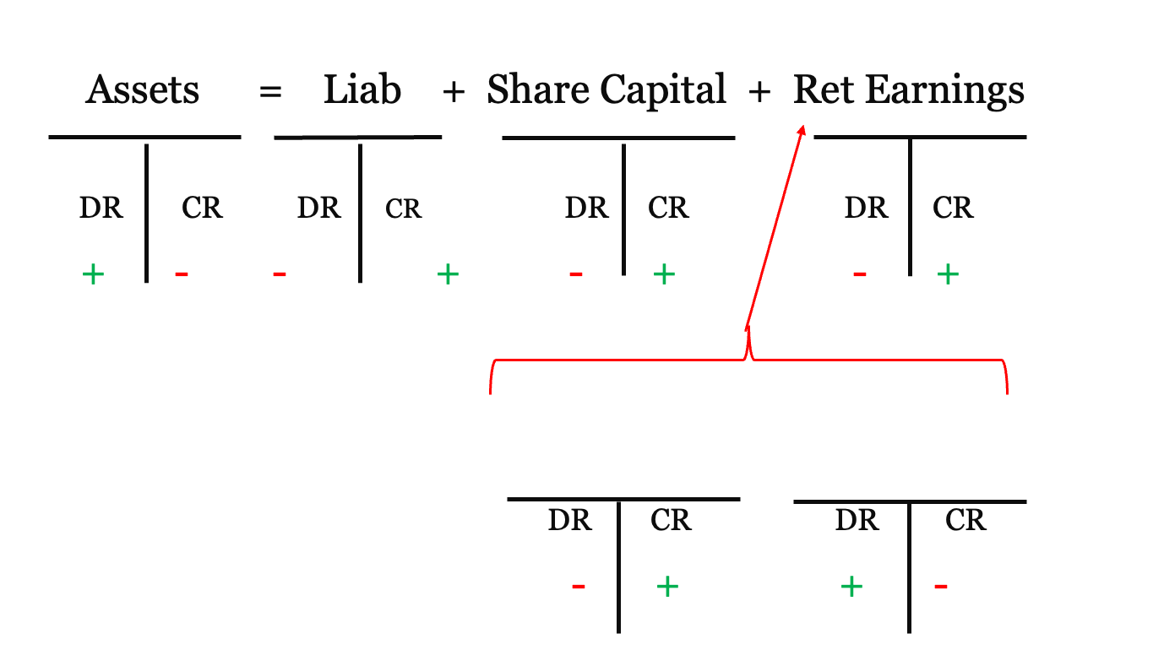
Expanded Accounting Equation - Recap
Reminder:
Revenue increase RE
Expense decrease RE
Revenue
Expenses

Slide 13
Revenue Definition based on accounting equation
  Revenue is earned when ordinary business activities results in increases in both (1) assets and (2) SE, other than when shareholders contribute capital to the business.
Example 1: When ABC Inc. delivers goods to John who pays cash
  ABC Inc.’s Cash asset increases
  ABC Inc.’s SE increases (via Retained Earnings)
  ABC Inc. has earned revenue ✓
Example 2: What about when a shareholder purchases additional shares of ABC Inc.?

Slide 14
Revenue Recognition Principle – 3 Conditions
The revenue recognition principle deals with 2 issues:
  When to record revenue (make a journal entry)? After it has been earned (goods or service delivered) and NOT before
  Amount of revenue to record? Cash value of goods or services transferred to the customer
All 3 conditions below must be met to recognize revenue:
  The business has delivered the goods or service to its customer.
  The amount of revenue can be reliably measured.
  It is probable the revenue will be received.
Revenue Recognition Principle
Notes:
The revenue recognition principle deals with two issues:
1. When to record revenue (make a journal entry)
2. The amount of revenue to record
When should you record revenue? After it has been earned—and not before. In most cases, revenue is earned when the business has delivered a good or service to a customer. It has done everything required to earn the revenue by transferring the good or service to the customer. The amount of revenue can be reliably measured, and it is probable the revenue will be received. The amount of revenue to record is the cash value of the goods or services transferred to the customer.

Slide 15
Revenue Recognition Principle – Example 1
You purchase a TV from Costco for $500 and you pay cash and take the TV home. Can Costco recognize revenue for this transaction? Check if all 3 revenue recognition conditions are met:
The business has delivered the goods or service to its customer | Costco delivered the TV (i.e., you own the TV and the benefit of using it) | ✓
The amount of revenue can be reliably measured | The TV have a price of $500 | ✓
It is probable the revenue will be received | Costco received $500 in cash from you | ✓
Yes, Costco can recognize revenue since all 3 conditions are met.

Slide 16
Revenue Recognition Principle – Example 2
Now, suppose Costco does not have the TV you want in stock. Costco orders it for you and asks you to come back in 4 days to pick it up (at which point you will pay for it). Can Costco recognize revenue for this transaction?
The business has delivered the goods or service to its customer | Costco has not delivered the TV yet | X
The amount of revenue can be reliably measured | The TV have a price of $500 | ✓
It is probable the revenue will be received | Costco received $500 in cash from you | X
No, Costco cannot recognize revenue since condition 1 &3 are not met

Slide 17
Expenses Definition
Expenses are costs incurred to purchases goods and services a company needs to run its business on a day-to-day basis.
Expenses are costs incurred to generate revenues.
Typical expenses:
  cost of sales wages expense
  utilities expense rent expense
  depreciation expense

Slide 18
The Matching Principle
Resources consumed to earn revenues in an accounting period should be recorded in that period, regardless of when cash is paid.
Costs incurred to generate revenues must be recognized in the same period — a matching of costs with benefits.

Slide 19
Expense Recognition Conditions
The expense recognition principle deals with 3 issues:
  Identify expenses incurred in generating revenue
  Measure these expenses
  Recognize them with related revenues
The 2 conditions below must be met to recognize an expense:
  There has been a decrease in future economic benefit caused by a decrease in as asset or an increase in a liability.
  The expense can be reliably measured.
Expense Recognition Conditions
Notes:
The expense recognition principle is the basis for recording expenses. Expenses are the costs of assets used up, and of liabilities created, in the earning of revenue. Expenses have no future benefit to the company. The expense recognition principle, also known as the matching principle, has two criteria that must be satisfied before an expense can be recognized:
1. There has been a decrease in future economic benefit
2. The expense can be reliably measured
To recognize expenses along with related revenues means to subtract expenses from revenues to compute net income or net loss.

Slide 20
Matching Principle – Example 1
You purchased a TV from Costco for $500 in cash and took it home. Costco recognized Revenue and the cost of the TV sold was $100 . The matching principle says costs incurred to generate revenue must be recognized in the same period. Let’s check if the 2 Expense Recognition conditions are met:
You took the TV home, Costco’s TV inventory (an asset) decreased | Condition 1 ✓
Costco’s inventory records determine the cost of the TV sold to you (Cost of Goods Sold); The expense can be reliably measured | Condition 2 ✓
Recognize Revenue:
DR Cash (+A) $500
CR Revenue (+R,+SE) $500
Recognize related expenses:
DR Cost of goods sold (+E, -SE) $100
CR Inventory (-A) $100
Matching Principle (more in Chapter 5 on COGS and Inventory)
Revenue Recognition Principle
Notes:
The expense recognition principle is the basis for recording expenses. Expenses are the costs of assets used up, and of liabilities created, in the earning of revenue. Expenses have no future benefit to the company. The expense recognition principle, also known as the matching principle, has two criteria that must be satisfied before an expense can be recognized:
1. There has been a decrease in future economic benefit
2. The expense can be reliably measured
To recognize expenses along with related revenues means to subtract expenses from revenues to compute net income or net loss.

Slide 21
Matching Principle – Example 2
Costco does not have the TV you want in stock. Costco orders it for you and asks you to come back in 4 days to pick it up. We determined previously that Costco cannot recognize Revenue.
Costco cannot recognize an expense(Cost of Goods Sold) as Costco’s TV inventory (an asset) will not decrease until you purchase the TV ➔ Condition 1 not met
Notes:
The expense recognition principle is the basis for recording expenses. Expenses are the costs of assets used up, and of liabilities created, in the earning of revenue. Expenses have no future benefit to the company. The expense recognition principle, also known as the matching principle, has two criteria that must be satisfied before an expense can be recognized:
1. There has been a decrease in future economic benefit
2. The expense can be reliably measured
To recognize expenses along with related revenues means to subtract expenses from revenues to compute net income or net loss.

Slide 22
Exercise 3-15 (page 161)
During the year, Dish Networks Inc. earned revenues of $700 million. Expenses totalled $540 million. Dish collected all but $20 million of the revenues and paid $530 million on its expenses (assume Dish uses accrual accounting).
  What amount of revenue should the company report for the year?
  What amount of total expense should the company report for the year?
  Which financial statement reports revenues and expenses? Which statement reports cash receipts and cash payments?

Slide 23
Learning Objective Three
Record adjusting journal entries
Notes:
The third learning objective is to record adjusting journal entries.

Slide 24
Adjusting the Accounts
Financial statements issued at end of period
Several accounts on trial balance need to be brought up-to-date
  Certain transactions have not been recorded
Notes:
At the end of the period, the business reports its financial statements. This process begins with the trial balance introduced in Chapter 2. We refer to this trial balance as unadjusted because the accounts are not yet ready for the financial statements. In most cases, the simple label “Trial Balance” means “unadjusted.”
The shareholders need to know how well the corporation they’ve invested in is performing. The financial statements report this information, and all accounts must be up-to-date. That means some accounts must be adjusted. Accounts such as Cash, Equipment, Common Shares, and Dividends are up-to-date and need no adjustment at the end of the period. Why? Because the day-to-day transactions provide all the data for these accounts.
Accounts such as Accounts Receivable, Accounts Payable, Supplies, Prepaid Rent, and the other accounts are another story. These accounts are not often up-to-date at the end of the year. Why? Because certain transactions have not yet been recorded.

Slide 25
Categories of Adjustments
Deferrals
Depreciation
Accruals
Notes:
Accounting adjustments fall into three basic categories: deferrals, depreciation, and accruals. Depreciation is called amortization under ASPE.

Slide 26
Deferrals
Business has paid or received cash in advance
Prepaid expense
Unearned revenue
Recorded as an asset when purchased
Expensed when used or expired
Recorded as a liability when payment is received
Recorded as revenue when earned
Notes:
A deferral is an adjustment for an item in which the business paid or received cash in advance. Companies purchase supplies for use in their operations. During the period, some supplies (assets) are used up and become expenses. At the end of the period, an adjustment is needed to decrease the Supplies account for the supplies used up. This is Supplies Expense. Prepaid rent, prepaid insurance, and all other prepaid expenses require deferral adjustments. There are also deferral adjustments for liabilities. Companies may collect cash from a customer in advance of earning the revenue. When a company receives cash up front, it has a liability to provide goods or services for the customer. This liability is called Unearned Sales Revenue. Then, when the company delivers the goods to the customer, it earns Sales Revenue. This earning process requires an adjustment at the end of the period. The adjustment decreases the liability and increases the revenue for the revenue earned.

Slide 27
Prepaid Expenses (1 of 2)
Recorded as assets when paid in advance
JOURNAL
Date | Accounts | Debit | Credit
Jun 1 | Prepaid Rent | 3,000
 | Cash |  | 3,000
Jun 2 | Supplies | 700
 | Cash |  | 700
Notes:
Prepaid expense is an expense paid in advance. Therefore, prepaid expenses are assets because they provide a future benefit for the owner. Over time, these benefits expire or are used. Examples include prepaid rent and supplies. When these items are purchased, an asset is recorded. The adjustment records an expense for the used portion and decreases the asset. Let’s say a company paid for three months’ rent in advance ($1,000 per month) on June 1. Then, on June 2 it purchased $700 of supplies. At the time of these purchases, assets are recorded.

Slide 28
Prepaid Expenses (2 of 2)
Expensed when expired or used
JOURNAL
Date | Accounts | Debit | Credit
Jun 30 | Rent Expense | 1,000
 | Prepaid Rent |  | 1,000
Jun 30 | Supplies Expense | 300
 | Supplies |  | 300
Notes:
Over time, the benefits of a prepaid expense expire and the assets are used. The adjustment records an expense for the used portion and decreases the asset. At June 30, one month of the rent has expired. $1,000 of the expired rent is transferred from Prepaid Rent to Rent Expense. For the supplies, only $400 of supplies are on hand at the end of the month. This means $300 of supplies were used. Supplies Expense is recorded for this amount and the asset account is reduced.

Slide 29
Prepaid Rent
Prepaid Rent
Jun 1 3,000 | 1,000 Jun 30
2,000
Rent Expense
Jun 30 1,000
Amount remaining
Amount expired
Balance Sheet
Income Statement
Notes:
The T-accounts for Prepaid Rent and Rent Expense show how the purchase and adjustment of the accounts impact the financial statements.

Slide 30
Supplies
Supplies
Jun 2 700 | 300 Jun 30
400
Supplies Expense
Jun 30 300
Amount on hand
Amount used
Balance Sheet
Income Statement
Notes:
The T-accounts for Supplies and Supplies Expense show how the purchase and adjustment of the accounts impact the financial statements.

Slide 31
Unearned Revenue (1 of 2)
Receive cash before revenue is earned
Creates a liability
JOURNAL
Date | Accounts | Debit | Credit
Jun 15 | Cash | 400
 | Unearned Revenue |  | 400
Notes:
Some businesses collect cash from customers before earning the revenue. This creates a liability called Unearned Revenue. Only when the job is completed does the business earn the revenue. Suppose a real estate management firm engages a company to clean its office building, agreeing to pay the company $400 monthly, beginning immediately. If the cleaning company collects the first amount on June 15, then it records this transaction as shown on this slide.

Slide 32
Unearned Revenue (2 of 2)
When revenue is earned
  Liability is reduced
  Revenue is increased
JOURNAL
Date | Accounts and explanation | Debit | Credit
Jun 30 | Unearned Revenue | 200
 | Service Revenue |  | 200
Notes:
Unearned Revenue is a liability because the company is obligated to perform services for the real estate management firm. During the last 15 days of the month, the company will earn one-half of the $400, or $200. On June 30, the company makes the adjustment shown in this slide. This adjusting entry shifts $200 of the total amount received ($400) from liability to revenue.

Slide 33
Depreciation (1 of 3)
Allocates cost of long-term, tangible assets to expense over useful lives
Represents wear-and-tear and obsolescence
Examples of long-term, tangible assets:
  Buildings
  Equipment
  Furniture
Notes:
Depreciation allocates the cost of a long-term, tangible asset to expense over the asset’s useful life. Depreciation is the most common long-term deferral. Many businesses own buildings and equipment. As a company uses the assets, it records depreciation for wear-and-tear and obsolescence. The accounting adjustment records Depreciation Expense and decreases the asset’s book value over its life. The process is identical to a deferral-type adjustment; the only difference is the type of asset involved. Plant assets are long-lived tangible assets, such as land, buildings, furniture, and equipment. All plant assets but land decline in usefulness, and this decline is an expense. Accountants spread the cost of each plant asset, except land, over its useful life.

Slide 34
Depreciation (2 of 3)
JOURNAL
Date | Accounts | Debit | Credit
Jun 3 | Equipment | 24,000
 | Accounts Payable |  | 24,000
Jun 30 | Depreciation Expense | 400
 | Accumulated Depreciation |  | 400
 | $24,000/5 = $4,800 annual depreciation $4,800/12 = $400 monthly depreciation
Notes:
Plant assets are long-lived tangible assets, such as land, buildings, furniture, and equipment. All plant assets except land decline in usefulness, and this decline is an expense. Depreciation is the process of allocating cost to expense for a long-term plant asset. To illustrate depreciation, let’s say a company purchased equipment on account on June 3 for $24,000. The company records an asset when it purchases equipment. Then, as the asset is used, a portion of the asset’s cost is transferred to Depreciation expense. The machine is being used to produce revenue. The cost of the machine should be allocated (matched) against that revenue. This is another illustration of the expense recognition principle.
The equipment will remain useful for five years and then be worthless. One way to compute the amount of depreciation for each year is to divide the cost of the asset ($24,000 in our example) by its expected useful life (five years). For our example, this equals $4,800. Since we are adjusting for one month, divide this amount by 12 for monthly depreciation of $400.

Slide 35
Depreciation (3 of 3)
Equipment
Jun 3 24,000
Depreciation Expense
Jun 30 400
Balance Sheet
Accumulated Depreciation
 | 400 Jun 30
Income Statement
Notes:
The T-accounts for Equipment, Accumulated Depreciation, and Depreciation Expense show the impact of the journal entries. Notice the Equipment account is not affected by the adjusting entry.

Slide 36
Accumulated Depreciation
Sum of all depreciation expense
  Increases over asset’s life
Contra-asset
  Normal credit balance
  Companion account is asset
Carrying amount
  Cost of long-term, tangible asset less accumulated depreciation
Notes:
Accumulated Depreciation account shows the sum of all depreciation expense from using the asset. Therefore, the balance in the Accumulated Depreciation account increases over the asset’s life. Accumulated Depreciation is a contra-asset account—an asset account with a normal credit balance. A contra account has two distinguishing characteristics:
1. It always has a companion account.
2. Its normal balance is opposite that of the companion account.
The net amount of a plant asset (cost minus accumulated depreciation) is called that asset’s carrying amount, or book value (of a plant asset).

Slide 37
Carrying Amount
Partial Balance Sheet June 30, 2020
Equipment | $24,000
Less: Accumulated Depreciation | (400)
Carrying amount |  | $23,600
Notes:
On the balance sheet, plant assets are shown at their carrying amount – the cost of the asset minus the accumulated depreciation.

Slide 38
Accruals
Accrued expenses
Accrued revenues
Record expense before paying cash
Salaries, interest, and income taxes
Record revenue before collecting cash
Earned and will collect in a future period
Notes:
An accrual is the opposite of a deferral. For an accrued expense, a company records the expense before paying cash. For an accrued revenue, a company records the revenue before collecting cash.
Salary expense, for example, can create an accrual adjustment when employees have worked, but won’t be paid for that work until after the current accounting period. Other examples of expense accruals include interest expense and income tax expense.
An accrued revenue is a revenue that the business has earned and will collect in a future period. The adjustment debits a receivable and credits a revenue.
For example, accrual of interest revenue debits Interest Receivable and credits Interest Revenue.

Slide 39
Accrued Expenses
Expenses incurred before cash is paid
Results in a liability
Examples:
  Salaries
  Interest
Notes:
Businesses may incur expenses before they pay cash. Consider an employee’s salary. A company’s expense and payable grow as the employee works, so the liability is said to accrue. Another example is interest expense on a note payable. Interest accrues as the clock ticks. The term accrued expense refers to a liability that arises from an expense that has not yet been paid. Companies don’t record accrued expenses daily or weekly. Instead, they wait until the end of the period and use an adjusting entry to update each expense (and related liability) for the financial statements.

Slide 40
Accrued Salaries (1 of 3)
September
Sun. | Mon. | Tues. | Wed. | Thur. | Fri. | Sat.
 |  |  |  |  |  | 1
2 | 3 | 4 | 5 | 6 | 7 | 8
9 | 10 | 11 | 12 | 13 | 14 | 15
16 | 17 | 18 | 19 | 20 | 21 | 22
23 | 24 | 25 | 26 | 27 | 28 | 29
30
Pay day
Pay day
Notes:
Most companies pay their employees at set times. Suppose a company pays its employees a monthly salary of $1,800, half on the 15th and half on the last day of the month.

Slide 41
Accrued Salaries (2 of 3)
JOURNAL
Date | Accounts | Debit | Credit
Sept 15 | Salary Expense | 900
 | Cash |  | 900
Sept 30 | Salary Expense | 900
 | Salary Payable |  | 900
Notes:
During September, the company paid its employees the first half-month salary of $900 and made the first entry in this slide. Because September 30, the second payday of the month, falls on a Sunday, the second half-month amount of $900 will be paid on Monday, October 1. At September 30, therefore, the company adjusts for additional salary expense and salary payable of $900.

Slide 42
Accrued Salaries (3 of 3)
Salary Payable
 | 900 Sept 30
 | 900
Salary Expense
Sept 15 900
Sept 30 900
1,800
Amount owed
Sept’s salary
Balance Sheet
Income Statement
Notes:
After posting, the Salary Payable and Salary Expense accounts appear as follows. The accounts now hold all of September’s salary information. Salary Expense has a full month’s salary, and Salary Payable shows the amount owed at September 30. All accrued expenses are recorded this way—debit the expense and credit the liability.

Slide 43
Accrued Revenue
Revenue earned but not yet received
Increases receivables and revenue
JOURNAL
Date | Accounts | Debit | Credit
Jun 30 | Accounts Receivable | 300
 | Service Revenue |  | 300
Notes:
Businesses often earn revenue before they receive the cash. A revenue that has been earned but not yet collected is called an accrued revenue. All accrued revenues are accounted for similarly—debit a receivable and credit a revenue. Let’s say a company is hired on June 15 to clean equipment for $600 per month, receiving the first payment on July 15. As of June 30, half of the fee will be earned. The entry to record the revenue that has been earned is shown above.

Slide 44
Prepaids and Accruals
PREPAIDS – CASH FIRST
 | FIRST | LATER
Prepaid expenses | Prepaid expense | Expense
 | Cash | Prepaid expense
Unearned revenues | Cash | Unearned revenue
 | Unearned revenue | Revenue
ACCRUALS – CASH LATER
 | FIRST | LATER
Accrued expenses | Expense | Payable
 | Payable | Cash
Accrued revenues | Receivable | Cash
 | Revenue | Receivable
Notes:
This table diagrams the distinctive timing of prepaids and accruals. With prepaids the cash comes first. Then an adjusting entry is needed to update the accounts. Accruals start with an adjusting entry. Then, the cash transaction comes later.

Slide 45
Summary of the Adjusting Process
Two purposes of adjusting process
  Measure income
  Update balance sheet
Every adjusting entry affects at least one:
  Revenue or expense
  Asset or liability
Notes:
Two purposes of the adjusting process are to (1) measure income, and (2) update the balance sheet. Therefore, every adjusting entry affects at least one revenue or expense—to measure income, and one asset or liability—to update the balance sheet.

Slide 46
Summary of Adjusting Entries
 | Type of Account
Category of Adjustment | Debit | Credit
Prepaid expense | Expense | Asset
Depreciation | Expense | Contra asset
Accrued expense | Expense | Liability
Accrued revenue | Asset | Revenue
Unearned revenue | Liability | Revenue
Notes:
Each category of adjustment has its own pattern. Notice that each involves a balance sheet account and an income statement account.

Slide 47
Exercise 3-20 (page 162)
Clark Motor Ltd. faced the following situations. Journalize the adjusting entry needed at December 31, 20X1, for each situation.
Consider each fact separately.
  The business has interest expense of $9,000 that it must pay early in January 20x2 ➔ Accrued Expense (+E)
  Interest revenue of $3,000 has been earned but not yet received ➔ Accrued Revenue (+R, +SE)
  When the business collected $12,000 in advance, it debited Cash and credited Unearned Revenue. The client was paying for two cars, one delivered in December and one to be delivered in February ➔ Deferred Revenue (+L)

Slide 48
Exercise 3-20 (cont’d)
Salary expense is $1,000 per day—Monday through Friday—and the business pays employees each Friday. This year, December 31 falls on a Tuesday ➔ Accrued Expense (+E)
The unadjusted balance of the Supplies account is $3,100. Total cost of supplies on hand is $800 ➔ Deferred Expense (+E)
Equipment was purchased at the beginning of this year at a cost of $60,000. The equipment’s useful life is five years. There is no residual value. Record depreciation for this year and then determine the equipment’s carrying amount ➔ Depreciation (long-term deferred expense)

Slide 49
The Adjusted Trial Balance
Prepared after adjustments are journalized and posted
See Exhibit 3-5 on page 134
Ch. 2
Ch. 3
Unadjusted
Trial Balance
Apply AJEs
Adjusted
Trial
Balance
Prepare Closing Entries
JEs to record transactions
Prepare F/S
Start of Accounting
Period
End of
Accounting
Period
After Year End
Notes:
After the adjustments are journalized and posted, a useful step in preparing the financial statements is to list the accounts, along with their adjusted balances, on an adjusted trial balance. This document lists all the accounts and their final balances in a single place.

Slide 50
Learning Objective Four
Prepare the financial statements
Notes:
The fourth learning objective is to prepare the financial statements.

Slide 51
The Financial Statements
Income Statement
  Lists revenues and expenses
  Reports net income (or net loss)
Statement of Retained Earnings
  Shows changes in retained earnings
Balance Sheet
  Reports assets, liabilities, and shareholders’ equity
See Exhibit 3-6, 7 and 8 on page 136 for examples
Notes:
The financial statements can be prepared from the adjusted trial balance. The income statement lists the revenue and expenses. The statement of retained earnings shows the changes in retained earnings. The balance sheet reports assets, liabilities, and shareholders’ equity.

Slide 52
Flow of Data in Financial Statements
Why is the Income Statement prepared first and the Balance Sheet last?
  The Income Statement is prepared first because it reports net income or net loss (revenues-expenses), which is needed to prepare the statement of Retained Earnings.
  The Balance Sheet is prepared last because it needs the ending balance from the Statement of Retained Earnings to complete the Shareholders’ Equity section of the Balance Sheet.
Note that statement of cash flow is not prepared from the Adjusted Trial Balance. Why? We will cover this in Ch. 10!
Notes:
Why is the income statement prepared first and the balance sheet last? The income statement reports net income or net loss, the result of revenues minus expenses. Revenues and expenses affect shareholders’ equity, so net income must be determined first because it is then transferred to retained earnings.

Slide 53
Flow of Data in Financial Statements (1 of 2)
Income Statement
Revenues | $$,$$$
Less: Expenses | ($$,$$$)
Net Income | $$,$$$
Statement of Retained Earnings
Retained earnings, beginning balance | $$,$$$
Plus: Net income | $$,$$$
Less: Dividends | ($,$$$)
Retained earnings, ending balance | $$,$$$
Notes:
Why is the income statement prepared first and the balance sheet last? The income statement reports net income or net loss, the result of revenues minus expenses. Revenues and expenses affect shareholders’ equity, so net income must be determined first because it is then transferred to retained earnings.

Slide 54
Flow of Data in Financial Statements (2 of 2)
Statement of Retained Earnings
Retained earnings, beginning balance | $$,$$$
Plus: Net income | $$,$$$
Less: Dividends | ($,$$$)
Retained earnings, ending balance | $$,$$$
Balance Sheet
Current assets | $$,$$$ | Liabilities | $$,$$$
Plant assets | $$,$$$ | Common shares | $$,$$$
Other assets | $$,$$$ | Retained earnings | $$,$$$
Total assets | $$$,$$$ | Total liabilities & shareholders’ equity | $$$,$$$
Notes:
The Statement of Retained Earnings shows the computation of the ending balance of the account. Retained earnings is the final balancing element of the balance sheet.

Slide 55
Balance Sheet Formats
Report Format
Account Format
Assets listed at the top
Liabilities and equity beneath
Most popular
Assets on the left
Liabilities and equity on the right
Notes:
Balance Sheet Formats: The report format lists the assets at the top, followed by the liabilities and shareholders’ equity below. The report format is more popular, with approximately 60% of large companies using it. The account format lists the assets on the left and the liabilities and shareholders’ equity on the right in the same way that a T-account appears, with assets (debits) on the left and liabilities and equity (credits) on the right.

Slide 56
Classifying Assets and Liabilities (1 of 2)
Classified as current or long-term based on liquidity
  How quickly an item can be converted to cash
Cash | Most liquid
Accounts receivable | Very liquid
Inventory | Somewhat liquid
Non-current assets | Not liquid
Notes:
On the balance sheet, assets and liabilities are classified as current or long term to indicate their relative liquidity. Liquidity measures how quickly an item can be converted to cash. Cash is the most liquid asset. Accounts receivable is relatively liquid because cash collections usually follow quickly. Inventory is less liquid than accounts receivable because the company must first sell the goods. Equipment and buildings are even less liquid because these assets are held for use and not for sale. A balance sheet lists assets and liabilities in the order of relative liquidity.

Slide 57
Classifying Assets and Liabilities (2 of 2)
Current assets | Converted to cash, sold or consumed in the next year
Non-current assets | Held for longer than one year Include long-term, tangible assets
Current liabilities | Must be paid within one year
Non-current liabilities | Due date more than one year from balance sheet date
Notes:
Current assets are the most liquid assets. They will be converted to cash, sold, or consumed during the next 12 months or within the business’s normal operating cycle if longer than a year. The operating cycle is the time span during which cash is paid for goods and services, and these goods and services are sold to bring in cash. For most businesses, the operating cycle is a few months. Cash, Short-term investments, Accounts Receivable, Merchandise Inventory, and Prepaid Expenses are the current assets.
Non-current assets are all assets not classified as current assets. One category of non-current assets is long-term, tangible assets, often labeled Property, plant, and equipment or Fixed assets. Land, Buildings, Furniture and fixtures, and Equipment are long-term, tangible assets. Long-term investments, Intangible assets, and Other assets (a catch-all category for assets that are not classified more precisely) are also non-current.
Current liabilities are debts that must be paid within one year or within the entity’s operating cycle if longer than a year. Accounts Payable, Notes Payable due within one year, Salary Payable, Unearned Revenue, Interest Payable, and Income Tax Payable are current liabilities. Bankers and other lenders are interested in the due dates of an entity’s liabilities. The sooner a liability must be paid, the more pressure it creates. Therefore, the balance sheet lists liabilities in the order in which they must be paid.
All liabilities that are not current are classified as non-current liabilities. Many notes payable are non-current. Some notes payable are paid in installments, with the first installment due within one year, the second installment due the second year, and so on. The first installment is a current liability and the remainder is non-current.

Slide 58
Classified Balance Sheet
Categorizes and subtotals assets and liabilities
Assets | Liabilities
Current assets | Current liabilities
Long-term investments | Non-current liabilities
Property, plant, and equipment
Intangible assets
Other assets
Notes:
A classified balance sheet separates current assets from non-current assets and current liabilities from non-current liabilities.

Slide 59
Income Statement Formats
Single-Step
Multi-Step
All revenues grouped together
All expenses grouped together
Shows subtotals to emphasize relationships
Includes
  Gross profit
  Income from operations
  Income before taxes
  Net income
Notes:
Income Statement Formats: A single-step income statement lists all the revenues together under a heading such as Revenues, or Revenues and Gains. The expenses are listed together in a single category titled Expenses, or Expenses and Losses. There is only one step, the subtraction of Expenses and Losses from the sum of Revenues and Gains, in arriving at net income. A multi-step income statement reports a number of subtotals to highlight important relationships between revenues and expenses. These include gross profit, income from operations, income before tax, and net income.

Slide 60
Learning Objective Five
Record closing journal entries
Notes:
The fifth learning objective is to record closing journal entries.

Slide 61
Closing Entries (1 of 2)
Prepares the accounts for next period
Sets revenues, expenses, and dividends to zero
Notes:
Closing journal entries prepare the accounts for the next fiscal year. The closing entries set the revenue, expense, and dividends balances back to zero at the end of the period. The idea is the same as setting the scoreboard back to zero after a game.

Slide 62
Closing Entries (2 of 2)
Temporary Accounts
Permanent Accounts
Closed
Expenses and revenues that are reported on the income statement are closed at the end of each reporting period.
Dividend account is also closed at the end of each reporting period
NOT closed
Assets, liabilities, and equity accounts that are reported on the balance sheet are never closed.
Their balances carry forward from one reporting period to another (balances at the end of one period are the beginning balances of the next period).
Notes:
Because revenues and expenses relate to a limited period, they are called temporary accounts. The Dividends account is also temporary. The closing process applies only to temporary accounts (revenues, expenses, and dividends).
Permanent accounts consist of assets, liabilities, and shareholders’ equity. The permanent accounts are not closed at the end of the period because they carry over to the next period. Consider Cash, Receivables, Equipment, Accounts Payable, Common Shares, and Retained Earnings. Their ending balances at the end of one period become the beginning balances of the next period.

Slide 63
Closing Journal Entries
Close Revenues
Debit each revenue account | Credit Retained Earnings
Close Expenses
Debit Retained Earnings | Credit each expense account
Close Dividends
Debit Retained Earnings | Credit Dividends
Notes:
Closing entries transfer the revenue, expense, and dividends balances to Retained Earnings. Here are the steps to close the books of a company:
Debit each revenue account for the amount of its credit balance. Credit Retained Earnings for the sum of the revenues. Now the sum of the revenues is in Retained Earnings.
Credit each expense account for the amount of its debit balance. Debit Retained Earnings for the sum of the expenses. The sum of the expenses is now in Retained Earnings.
3) Credit the Dividends account for the amount of its debit balance. Debit Retained Earnings. This entry places the dividends amount in the debit side of Retained Earnings. Remember that dividends are not expenses. Dividends never affect net income.

Slide 64
Exercise 3-26 (page 164)
Prepare the required closing entries for the following accounts from the records of SouthWest Transport Inc. at Dec. 31, 20XX
Cost of services sold $11,600
Accumulated depreciation $17,800
SG&A Expenses $6,900
Retained earnings, opening $,900
Service Revenue $23,600
Depreciation Expense $4,100
Other revenue $600
Income tax expense $400
Dividends $400
Income tax payable $300

Slide 65
Learning Objective Six
These slides are here for your information only at this point in the course.
We will look at these ratios in detail in Chapter 10.
Analyze and evaluate a company’s debt-paying ability
Notes:
The sixth learning objective is to analyze and evaluate a company’s debt-paying ability.

Slide 66
Net Working Capital
Measures a company’s liquidity
Notes:
Net working capital is computational data that represents operating liquidity. Its computation is simple—total current assets minus total current liabilities. Generally, to be considered sufficiently liquid, entities should have a sufficient excess of current assets over current liabilities. The amount of that excess is usually expressed in terms of the current ratio discussed next, and the amount considered “sufficient” varies with the industry.

Slide 67
Current Ratio
Measures ability to pay current liabilities
Strong current ratio = 1.50
Notes:
Another means of expressing operating liquidity through the relationship between current assets and current liabilities is the current ratio, which divides total current assets by total current liabilities. The current ratio measures the company’s ability to pay current liabilities with current assets. A company prefers a high current ratio, which means that the business has plenty of current assets to pay current liabilities. An increasing current ratio from period to period indicates improvement in financial position. As a rule of thumb, a strong current ratio is 1.50, which indicates that the company has $1.50 in current assets for every $1.00 in current liabilities. A company with a current ratio of 1.50 would probably have little trouble paying its current liabilities. Most successful businesses operate with current ratios between 1.20 and 1.50. A current ratio of less than 1.00 is considered quite low.

Slide 68
Debt Ratio
Measures ability to pay all liabilities
Low debt ratio is safer than high debt ratio
Notes:
Still another measure of debt-paying ability is the debt ratio, which is the ratio of total liabilities to total assets. The debt ratio indicates the proportion of a company’s assets that is financed with debt. This ratio measures a business’s ability to pay both current and long-term debts (total liabilities). A low debt ratio is safer than a high debt ratio. Why? Because a company with few liabilities has low required debt payments. This company is unlikely to get into financial difficulty. By contrast, a business with a high debt ratio may have trouble paying its liabilities, especially when sales are low and cash is scarce.

Slide 69
Transaction Effects on Ratios
Increase revenue and decrease costs
  Results in increase in current assets and net income
Sell shares
  Increases cash and equity
Borrow less money
  Decreases liabilities
Notes:
Companies are keenly aware of how transactions affect their ratios. Lending agreements often require that a company’s current ratio not fall below a certain level. Another loan requirement is that the company’s debt ratio may not rise above a threshold, such as 0.70. When a company fails to meet one of these conditions, it is said to default on its lending agreements. The penalty can be severe: the lender can require immediate payment of the loan. To help keep debt ratios within normal limits, companies might adopt one or more of the strategies shown.

Slide 70
Learning Objective Seven
These slides are here for your information only at this point in the course.
We will look at these ratios in detail in Chapter 10.
Identify patterns and trends using data visualization
Notes:
The seventh learning objective is to identify patterns and trends using data visualization

Slide 71
Data Visualization Makes It Easier to Spot Patterns and Trends (1 of 5)
As of the 20X5 fiscal year-end, the current ratios for companies in the hospitality industry are:
Premium Hotels International, Inc.: 0.73
Khan Worldwide Holdings Inc.: 0.73
Fulton Hotels Corporation: 1.57
Harriett International, Inc.: 0.4

Slide 72
Data Visualization Makes It Easier to Spot Patterns and Trends (2 of 5)
We can see that Fulton’s current ratio is the highest of the four companies. While we can scan those ratios to find the highest, we can also prepare a bar chart (or column chart) to compare the data.

Slide 73
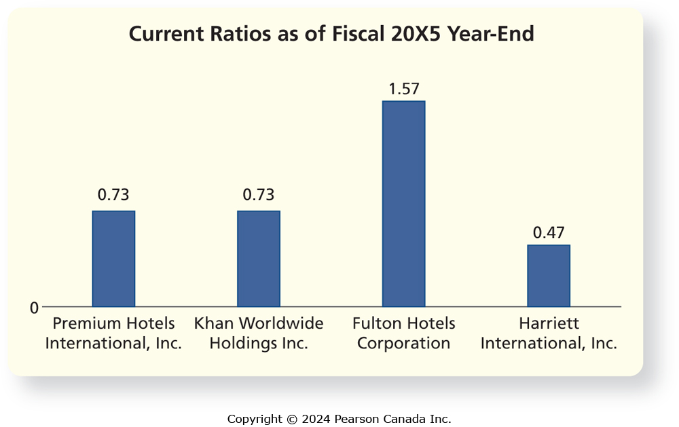
Data Visualization Makes It Easier to Spot Patterns and Trends (3 of 5)
On the bar chart, Fulton’s current ratio easily stands out as the highest of the group, with a value more than double the next highest.

Slide 74
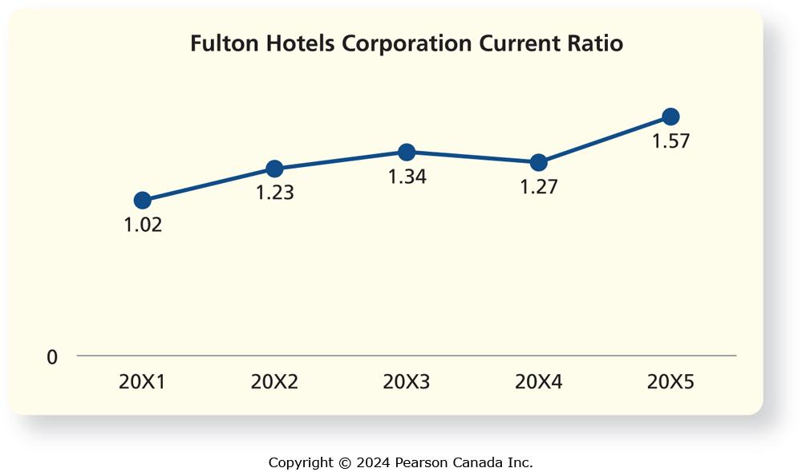
Data Visualization Makes It Easier to Spot Patterns and Trends (4 of 5)
Line charts make trends or patterns more easily recognizable than rows or columns of numbers. Here is a line chart of Fulton’s current ratios for the past five years:
We can see that Fulton’s current ratio has been trending up over the past five years, with a slight dip down in 20X4.

Slide 75
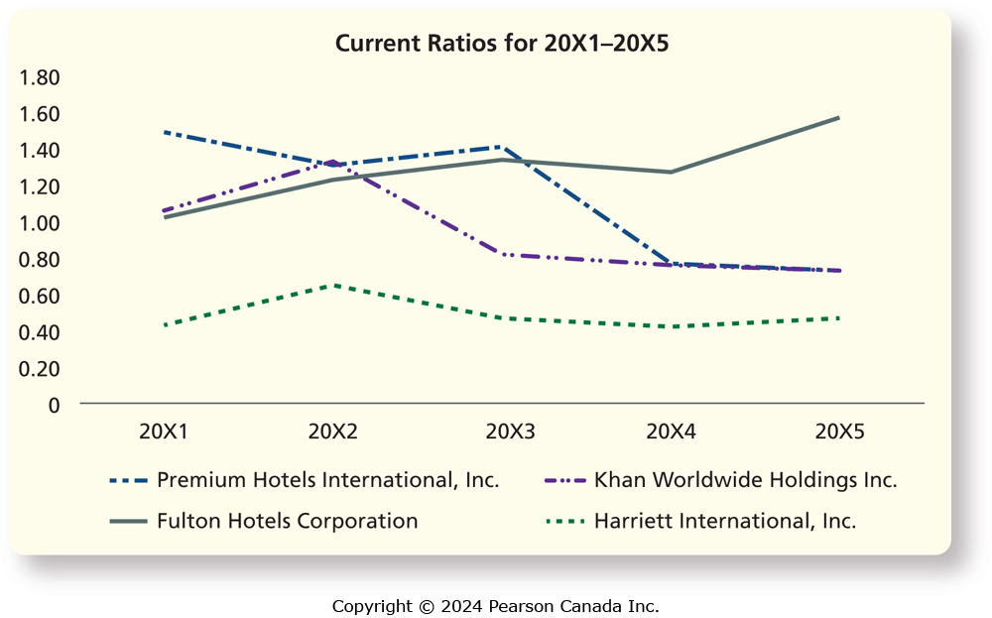
Data Visualization Makes It Easier to Spot Patterns and Trends (5 of 5)
Line charts are also a good way of seeing trends over time for more than one company, allowing for easier comparison.
Fulton’s liquidity is by far the best of the group, both at the end of 20X5 and over the preceding five years.

Slide 76
End of Chapter Three
Notes:
This concludes Chapter Three.

