Slide 1
Chapter 6
Property, Plant, and Equipment, and Intangible Assets
Notes:
This chapter covers the measurement and reporting principles for tangible long-lived assets (also known as property, plant
and equipment) as well as intangible assets.
If this PowerPoint presentation contains mathematical equations, you may need to check that your computer has the following installed:
1) MathType Plugin
2) Math Player (free versions available)
3) NVDA Reader (free versions available)

Slide 2
Chapter 6’s Learning Objectives
Explain how to account for the cost of property, plant, and equipment
Explain how to account depreciation on property, plant, and equipment
Explain additional topics in accounting for long-lived tangible assets
Explain how to account for intangible assets and goodwill
Analyze a company’s return on assets
Analyze the cash flow impact of long-lived asset transactions
Calculate depreciation expense using Excel functions
.

Slide 3
Learning Objective One
Explain how to account for the cost of property, plant, and equipment
Notes:
The first learning objective is to explain how to account for the cost of property, plant, and equipment.

Slide 4
Long-Lived Assets (1 of 2)
Asset Account (Balance Sheet) |  | Related Expense Account (Income Statement)
Tangible assets
 | Land | None
 | Buildings, Machinery, and Equipment | Depreciation
 | Furniture and Fixtures | Depreciation
 | Computers | Depreciation
Notes:
Businesses use several types of long-lived assets, as shown in this table. The table also shows the expense that applies to each asset. For example, buildings, airplanes, and equipment depreciate.
Property, plant and equipment assets (PPE) are long-lived assets that are tangible, meaning they have physical substance. The expense associated with these assets is called depreciation. Of the PPE assets, land is unique. Land is not expensed through depreciation over time because its usefulness does not decrease.

Slide 5
Long-Lived Assets (2 of 2)
Asset Account (Balance Sheet) |  | Related Expense Account (Income Statement)
Intangible assets
 | Copyrights | Amortization
 | Patents | Amortization
 | Goodwill | Impairment losses
Notes:
Businesses use several types of long-lived assets, as shown in this table. The table also shows the expense that applies to each asset. For example, intangible assets are generally amortized.
Intangible assets are useful because of the special rights they carry. They have no physical form. Patents, copyrights, and goodwill are intangible assets. Accounting for intangibles other than goodwill is similar to accounting for PPE assets.

Slide 6
Measuring the Cost of a PPE Asset
Sum of all the costs incurred to bring the asset to its location and intended use
Notes:
Here is a basic working rule for determining the cost of an asset—the cost of any asset is the sum of all the costs incurred to bring the asset to its location and intended use. The cost of a property, plant and equipment (PPE) asset includes purchase price, plus any taxes, commissions, and other amounts paid to make the asset ready for use.

Slide 7
Land (1 of 3)
Purchase price
Commissions
Survey and legal fees
Back property taxes paid
Grading and removing unwanted buildings
Notes:
The cost of land includes its purchase price (cash plus any note payable given), brokerage commission, survey fees, legal fees, and any back property taxes that the purchaser pays. Land cost also includes expenditures for grading and clearing the land and for removing unwanted buildings. The cost of land does not include the cost of fencing, paving, security systems, and lighting. These are separate plant assets—called land improvements—and they are subject to depreciation.

Slide 8
Land (2 of 3)
A business signs a $300,000 note payable to purchase land for a new production facility.
It pays $10,000 in real estate commission, $8,000 in back property tax, $5,000 for removal of an old building, a $1,000 survey fee, and $260,000 to pave the parking lot.
What is the cost of the land?
Notes:
In addition to the “sticker price” of the land, there are other costs that must be paid in order to get the land into the position that the owners want. Some of these costs are part of the land cost, some are part of the land improvements costs. Land costs are not depreciated, land improvements are.

Slide 9
Land (3 of 3)
Purchase price of land |  | $300,000
Add related costs:
Real estate commission | $10,000
Back property tax | 8,000
Removal of buildings | 5,000
Survey fees | 1,000 | 24,000
Total cost of land |  | $324,000
Notes:
The $260,000 for paving is a land improvement expense and is not part of the land cost. The above costs are one-time expenditures, whereas the paving will likely have to be done again at sometime in the future when the initial paving wears out.

Slide 10
Buildings
Constructed
  Architectural fees, building permits, and contractors’ charges
  Materials, labour, and overhead
  Interest on funds borrowed
Purchased
  Purchase price
  Broker’s commission
  Taxes paid
  Costs to repair and renovate
Notes:
The cost of constructing a building includes architectural fees, building permits, contractors’ charges, and payments for material, labour, and overhead. If the company constructs its own building, the cost will also include the cost of interest on money borrowed to finance the construction. When an existing building (new or old) is purchased, its cost includes the purchase price, brokerage commission, sales and other taxes paid, and all expenditures to repair and renovate the building for its intended purpose.

Slide 11
Equipment
Purchase price (after discounts)
Transportation
Insurance in transit
Sales and other taxes
Purchase commission
Installation and testing
Notes:
The cost of equipment includes its purchase price (less any discounts), plus transportation from the seller, insurance while in transit, sales and other taxes, purchase commission, installation costs, and any expenditures to test the asset before it’s placed in service. The equipment cost will also include the cost of any special platforms. Then after the asset is up and running, insurance, taxes, and maintenance costs are recorded as expenses, not as part of the asset’s cost.

Slide 12
Land and Leasehold Improvements
Land Improvements
Leasehold Improvements
Parking lots
Driveways
Signs
Fences
Sprinkler systems
Improvements to leased property
Depreciated or amortized over lease term
Notes:
The cost to pave a parking lot is recorded in a separate account entitled Land Improvements. This account includes costs for such other items as driveways, signs, fences, and sprinkler systems. Although these assets are located on the land, they are subject to decay, and their cost should therefore be depreciated. Companies often lease equipment or property and customize these assets for their special needs. Such improvements to leased assets are capitalized. The cost of leasehold improvements should be depreciated over the term of the lease.

Slide 13
Lump-Sum (Basket) Purchases
Several assets purchased in a group at one price
Total cost is allocated based on their market values
Asset | Market value | Total market value | % of total market value | Total cost | Cost of each asset
Land | $300,000 ÷ | $3,000,000 | = 20% × | $2,800,000 | $280,000
Building | $2,700,000 ÷ | $3,000,000 | = 80% × | $2,800,000 | $2,520,000
 | $3,000,000 |  | 100% |  | $2,800,000
Notes:
Businesses often purchase several assets as a group, or a “basket,” for a single lump-sum amount. For example, a business may pay one price for land and a building. The company must identify the cost of each asset. The total cost is divided among the assets according to their relative sales (or market) values. This technique is called the relative-sales-value method.
In the above table, assume a company purchased land and a building for a combined price of $2,800,000. The values of the individual assets are shown in the market value column. This column is totaled. Then the market value of each asset is divided by the total market to determine a percent. This percent is multiplied by the cost. The end result is that land is allocated $280,000 (20%) of the cost, and building is allocated $2,520,000 (80%) of the cost.

Slide 14
Capital Expenditures versus Expenses
CAPITAL EXPENDITURES
EXPENSES
Increase capacity or extend useful life
Cost is added to an asset account
Do not extend capacity or useful life
Maintain or restore working order
Cost is recorded as an expense
Distinction between the two requires professional judgment
Notes:
When a company spends money on a PPE asset, it must decide whether to record an asset or an expense. Expenditures that increase the asset’s capacity to produce or extend its useful life are called capital expenditures. For example, the cost of a major overhaul that extends the useful life of a truck is a capital expenditure. Capital expenditures are said to be capitalized, which means the cost is added to an asset account and not expensed immediately.
Costs that do not extend the asset’s capacity or its useful life, but merely maintain the asset or restore it to working order, are recorded as expenses. For example, Repair Expense is reported on the income statement and matched against revenue. The costs of repainting a delivery truck, repairing a dented fender, and replacing tires are also expensed immediately.
The distinction between a capital expenditure and an expense requires judgment: Does the cost extend the asset’s usefulness or its useful life? If so, record an asset. If the cost merely repairs the asset, keeps it in normal operating condition, or returns it to its prior condition, then record an expense. Most companies expense all small costs, say, below $1,000. For higher costs, they follow the rule we gave above: Capitalize costs that extend the asset’s usefulness or its useful life, and expense all other costs. A conservative policy is one that avoids overstating assets and profits.

Slide 15
Leased Assets
Should leases be capitalized as fixed assets or should lease payments be expensed?
Typically, lease agreements for fixed assets usually result in both the “right-to-use asset” and the obligation (liability) for the future lease payments being recorded on the balance sheet
Notes:
Leasing allows a business to acquire the use of needed fixed assets (property and equipment) without having to make the large up-front payment that purchases of these assets usually require, thus conserving cash. How should leased assets be accounted for? Should they be capitalized as fixed assets, with the corresponding obligations for future payments listed as liabilities, or should the money paid for lease payments be listed merely as an expense on a company’s income statement? In short, lease agreements for fixed assets usually result in both the “right-to-use asset” and the obligation (liability) for the future lease payments being recorded on the balance sheet. More details on accounting for leased assets and liabilities are covered in Chapter 7 (Liabilities).

Slide 16
Learning Objective Two
Explain how to account for depreciation on property, plant, and equipment
Notes:
The second learning objective is to explain how to account for depreciation on property, plant, and equipment.

Slide 17
Depreciation
Allocation of property, plant, and equipment (PPE) asset’s cost to expense over its life
Follows expense recognition principle
Causes:
  Physical wear and tear
  Obsolescence
Land is NOT depreciated
  Unlimited useful life
Notes:
PPE assets wear out, grow obsolete, and lose value over time. To account for this process, we allocate a PPE asset’s cost to expense over its life—a process called depreciation. The depreciation process matches the asset’s expense against revenue to measure income, as the matching principle directs. Recall that depreciation expense (not accumulated depreciation) is reported on the income statement. Land is the only PPE asset that has an unlimited life and is not depreciated for accounting purpose. For most PPE assets, depreciation is caused by:
■ Physical wear and tear. For example, physical deterioration takes its toll on the usefulness of furniture, equipment, delivery trucks, and buildings.
■ Obsolescence. Computers and other electronic equipment may become obsolete before they deteriorate. An asset is obsolete when another asset can do the job more efficiently. An asset’s useful life may be shorter than its physical life. Companies may depreciate their computers over a short period of time—perhaps four years—even though the computers will remain in working condition much longer.

Slide 18
Depreciation is NOT:
Valuation process
A fund to replace assets
Notes:
Depreciation is not a process of valuation. Businesses do not record depreciation based on changes in the fair value of their plant assets. Instead, businesses allocate the asset’s cost to the period of its useful life.
2. Depreciation does not mean setting aside cash to replace assets as they wear out. Any cash fund is entirely separate from depreciation.

Slide 19
Amounts Needed for Depreciation
Cost
Useful life
Residual value
Notes:
To measure depreciation for a PPE asset, we must know three things about the asset:
Cost
Estimated useful life
Estimated residual value
We have discussed cost, which is a known amount. The other two factors must be estimated. Estimated useful life is the length of service expected from using the asset. Useful life may be expressed in years, units of output, kilometres, or some other measure. For example, the useful life of a building is stated in years. The useful life of a delivery truck may be expressed as the number of kilometres the vehicle is expected to travel. Companies base estimates on their experience and trade publications.
Estimated residual value—also called scrap value or salvage value—is the expected cash value of an asset at the end of its useful life. For example, a company may believe that a machine will be useful for seven years. The amount the company believes it can get for the machine at the end of 7 years is the estimated residual value. In computing depreciation, the estimated residual value is not depreciated because the company expects to receive this amount from selling the asset. If there’s no expected residual value, the full cost of the asset is depreciated.

Slide 20
Depreciation Methods (1 of 2)
Straight-line
Units-of-production
Diminishing-balance
Notes:
There are three main depreciation methods:
Straight-line
Units-of-production
Diminishing-balance—an accelerated depreciation method
These methods allocate different amounts of depreciation to each period. However, they all result in the same total amount of depreciation over the life of the asset, which is the asset’s depreciable cost.

Slide 21
With Depreciation:
Accumulated depreciation increases
Carrying Amount decreases
Asset’s final carrying amount = Residual value
Notes:
As an asset is used in operations,
■ accumulated depreciation increases.
■ the carrying amount of the asset decreases.
An asset’s final carrying amount is its residual value. At the end of its useful life, the asset is said to be fully depreciated.

Slide 22
Straight-Line (SL)
Notes:
Using the straight-line (SL) method, an equal amount of depreciation is assigned to each year (or period) of asset use. Depreciable cost is divided by useful life in years to determine the annual depreciation expense.

Slide 23
Units-of-Production (UOP)
Notes:
In the units-of-production (UOP) method, a fixed amount of depreciation is assigned to each unit of output, or service, produced by the asset. Depreciable cost is divided by useful life—in units of activity or production—to determine this amount. This per-unit depreciation expense is then multiplied by the number of units of activity or units produced each period to compute depreciation. The amount of UOP depreciation varies with the number of units the asset produces.

Slide 24
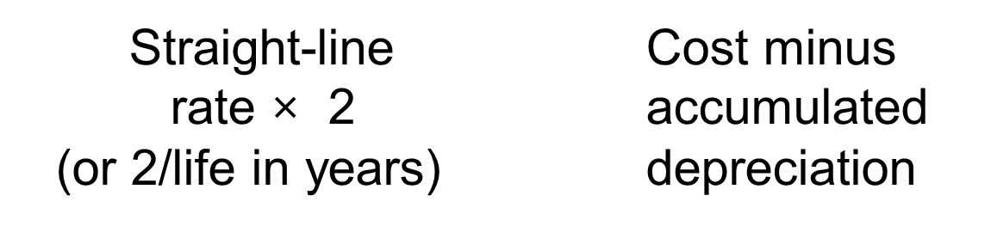
Double-Diminishing-Balance (DDB)
Notes:
An accelerated depreciation method writes off a larger amount of the asset’s cost near the start of its useful life than the straight-line method does. Double-diminishing-balance is the main accelerated depreciation method. Double-diminishing-balance (DDB) depreciation computes annual depreciation by multiplying the asset’s declining carrying amount by a constant percentage, which is two times the straight-line depreciation rate. DDB amounts are computed as follows:
■ First, compute the straight-line depreciation rate per year. A 5-year truck has a straight-line depreciation rate of 1/5, or 20% each year. A 10-year asset has a straight-line rate of 1/10, or 10%, and so on.
■ Second, multiply the straight-line rate by 2 to compute the DDB rate. For a 5-year asset, the DDB rate is 40% (20% × 2). A 10-year asset has a DDB rate of 20% (10% × 2). The formula 2/Life in years shown on the slide is a short-cut way of combining these two steps.
■ Third, multiply the DDB rate by the period’s beginning asset carrying amount (cost less accumulated depreciation). In the first year of the asset’s life, the book value is equal to the cost. Under the DDB method, ignore the residual value of the asset in computing depreciation, except during the last year.

Slide 25
Residual Value: DDB
Final year depreciation | = | Carrying amount at the beginning of the final year | − | Residual value
Notes:
Fourth, determine the final year’s depreciation amount—that is, the amount needed to reduce asset book value to its residual value.
The residual value should not be depreciated but should remain on the books until the asset is disposed of.

Slide 26
DDB differences from other methods
First-year depreciation is based on asset’s full cost
Final year depreciation is a “plug” amount needed to reduce carrying amount to residual value
Notes:
The DDB method differs from the other methods in two ways:
1. Residual value is ignored initially; first-year depreciation is computed on the asset’s full cost.
2. Depreciation expense in the final year is the “plug” amount needed to reduce the asset’s carrying amount to the residual amount.

Slide 27
Comparing Depreciation Methods (1 of 2)
Straight-line
  Best for assets that generate revenue evenly
Units-of-production
  Best for assets that wear out because of use
Double-diminishing-balance
  Best for assets that generate revenue early in useful life
Notes:
IFRS directs a business to choose a depreciation method that reflects the pattern in which the asset will be used. For a plant asset that generates revenue evenly over time, the straight-line method best meets the matching principle. The units-of-production method best fits those assets that wear out because of physical use rather than obsolescence. The accelerated method (DDB) applies best to assets that generate more revenue earlier in their useful lives and less in later years.

Slide 28
Depreciation Methods (2 of 2)
Data Items | Amount
Cost of van | $41,000
Less: Estimated residual value | − 1,000
Depreciable cost | $40,000
Estimated useful life | 5 years
Units of production | 100,000 units (kilometres)
Notes:
The information in this slide will be used to demonstrate the three different depreciation methods.

Slide 29
Straight-Line Method
(Cost – Residual value) ÷ Years of useful life
($41,000 − $1,000) ÷ 5 = $8,000
Year 1 depreciation: | $ 8,000
Year 2 depreciation: | 8,000
Year 3 depreciation: | 8,000
Year 4 depreciation: | 8,000
Year 5 depreciation: | 8,000
Total depreciation: | $40,000
Notes:
The total cost ($41,000) less the estimated residual value ($1,000), or $40,000 is divided by the estimated life of 5 years to give an annual rate of $8,000. Total depreciation over the life of the asset is $40,000.

Slide 30
Units-of-Production Method
($41,000 − $1,000) ÷ 100,000 km = $0.40/km
Year 1: 20,000 km × $0.40 = | $ 8,000
Year 2: 30,000 km × $0.40 = | 12,000
Year 3: 25,000 km × $0.40 = | 10,000
Year 4: 15,000 km × $0.40 = | 6,000
Year 5: 10,000 km × $0.40 = | 4,000
Total depreciation: | $40,000
Notes:
The total cost ($41,000) less the estimated residual value ($1,000), or $40,000 is divided by the estimated life of 100,000 kms to give a rate of $0.40/km. That rate is then multiplied by the number of kms driven each year. Total depreciation over the life of the asset is $40,000.

Slide 31
Diminishing-Balance Method
Straight-line rate per year: 100% ÷ 5 = 20%
Double-declining balance:
2 times the straight-line rate = 40%
Carrying amount of truck at end of first year:
$41,000 × 40% = $16,400
$41,000 − $16,400 = $24,600
Notes:
The estimated life of the asset is 5 years. Therefore one year would be 1/5 or 20%. This percentage is then doubled to give the double-diminishing rate of 40%.
The carrying amount of the asset in the first year is the cost of the asset, or $41,000. That amount is multiplied by the 40% to give a depreciation expense of $16,400.
The carrying amount of the asset is reduced by the depreciation expense to give a carrying amount of $24,600. That amount would then be multiplied by 40% to give the depreciation expense for the second year.

Slide 32
Comparing Depreciation Methods (2 of 2)
Amount of Depreciation per Year
Year | SL | UOP | DDB
1 | $ 8,000 | $ 8,000 | $16,400
2 | 8,000 | 12,000 | 9,840
3 | 8,000 | 10,000 | 5,904
4 | 8,000 | 6,000 | 3,542
5 | 8,000 | 4,000 | 4,314
Total | $40,000 | $40,000 | $40,000
Notes:
The amount of the depreciation expense per year varies depending on the depreciation method used, but the total depreciation expense over the life of the asset is the same for all three methods.

Slide 33
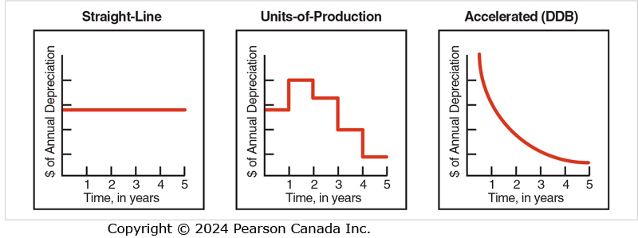
Depreciation Patterns
Notes:
This slide shows the amount of depreciation expense recorded by each depreciation method each year. The straight-line method records a consistent amount each year. The units-of-production varies, and the accelerated method records a large amount initially, but quickly declines to a small amount each year.

Slide 34
Chapter 6 Example
A company purchases a truck for $15,000 and expect to drive it for 120,000 Kilometers in 5 years. The expect millage is as follows:
 | Mileage (KM)
Year 1 | 10,000
Year 2 | 30,000
Year 3 | 40,000
Year 4 | 20,000
Year 5 | 20,000
The residual value of a 5-year-used-truck is $3000.
What is the annual depreciation cost if the company uses:
a) Straight-line method, b) Double-declining method, c) Units of Production method

Slide 35
Learning Objective Three
Explain additional topics in accounting for long-lived tangible assets
Notes:
The third learning objective is to explain additional topics in accounting for long-lived tangible assets

Slide 36
Depreciation for Partial Years (1 of 3)
Notes:
Companies purchase plant assets whenever they need them, not just at the beginning of the year. Therefore, companies must compute depreciation for partial years. First, compute depreciation for a full year. Second, multiply full-year depreciation by the fraction of the year that the company held the asset.

Slide 37
Depreciation for Partial Years (2 of 3)
Suppose a calendar-year business purchases a building on April 1 for $500,000 with an estimated life of 20 years and an estimated residual value of $80,000.
What is the current year’s depreciation using the straight-line method?
Notes:
Suppose a calendar-year business purchases a building on April 1 for $500,000 with an estimated life of 20 years and an estimated residual value of $80,000.
What is the current year’s depreciation using the straight-line method?

Slide 38
Depreciation for Partial Years (3 of 3)
Full-year depreciation:
($500,000 − $80,000) ÷ 20 = $21,000
Partial-year depreciation:
$21,000 × 9/12 = $15,750
Notes:
Full-year depreciation:
($500,000 – $80,000) ÷ 20 = $21,000
Partial-year depreciation from April 1 to December 31 (9 months):
$21,000 × 9/12 = $15,750

Slide 39
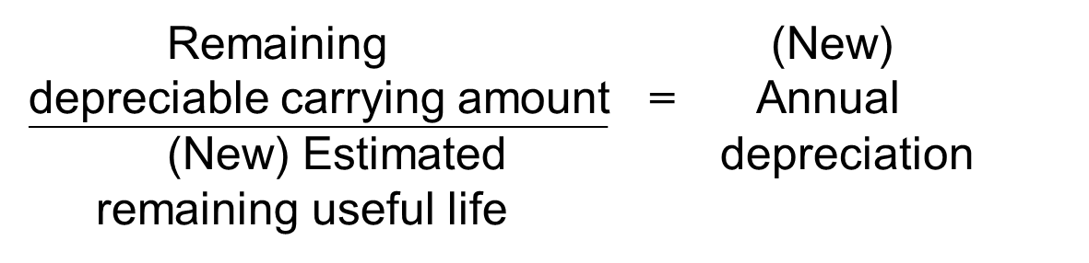
Changing Useful Life
Notes:
After an asset is in use, managers may change its useful life on the basis of experience and new information. This is called a change in accounting estimate. Depreciation is revised as shown in the formula above.

Slide 40
Changing the Useful Life of a Depreciable Asset (1 of 2)
Assume an asset cost of $40,000, an eight-year useful life with no residual value, and the straight-line method.
$40,000 ÷ 8 = $5,000 depreciation per year
What is the carrying amount after two years?
$40,000 − (2 × $5,000) = $40,000 − $10,000 = $30,000
Notes:
Assume an asset cost of $40,000, an eight-year useful life with no residual value, and the straight-line method.
Depreciation expense is $40,000 / 8-years or $5,000 per year. Therefore after two years accumulated depreciation is 2 X $5,000 or $10,000. Therefore the carrying amount would be $40,000 - $10,000 or $30,000.

Slide 41
Changing the Useful Life of a Depreciable Asset (2 of 2)
Management believes the asset will remain useful for an additional ten years.
$30,000 ÷ 10 = $3,000
(new depreciation per year)
Notes:
If management changes it estimate of useful life after two years, the remaining undepreciated cost should be averaged over the remaining estimated 10-year life of the asset.

Slide 42
S6-8
Canada’s Wonderland paid $60,000 for a concession stand.
Depreciation was recorded with the straight-line method over 10 years with no residual value.
Assume that after using the concession stand for 4 years the asset will remain useful for only 3 more years.
How will this affect depreciation on the concession stand for year 5?

Slide 43
Fully Depreciated Assets
An asset can be used after it is fully depreciated.
The asset and its depreciation account remain in the ledger with no additional depreciation entries.
Notes:
An asset can be used after it is fully depreciated.
The asset and its depreciation account remain in the ledger with no additional depreciation entries.

Slide 44
Derecognition of PPE
Derecognition is an IFRS term for PPE that is no longer useful or has been sold.
Bring depreciation up to date to:
  Measure asset’s final carrying amount
  Record expense up to date of sale
Remove asset and related accumulated depreciation account from the books
Notes:
Eventually, a property, plant and equipment asset ceases to serve a company’s needs. The asset may wear out or become obsolete. Before accounting for the disposal of the asset, the business should bring depreciation up to date to:
■ measure the asset’s final carrying amount and
■ record the expense up to the date of sale.
To account for disposal, remove the asset and its related accumulated depreciation from the books.

Slide 45
Disposing of Asset for No Proceeds
JOURNAL
Date | Accounts and explanation | Debit | Credit
 | Accumulated Depreciation
 | Equipment
 | Disposed of fully depreciated asset
Notes:
If a PPE asset is fully depreciated and is estimated to have zero residual value, there is no gain or loss on the disposal. The accumulated depreciation account is debited and the PPE asset account is credited. If assets are disposed of for no proceeds before being fully depreciated, the company incurs a loss on the disposal in the amount of the asset’s net carrying amount. The Loss on Disposal of Equipment is reported as Other income (expense) on the income statement. Losses decrease net income exactly as expenses do. Gains increase net income the same as revenues.

Slide 46
Selling PPE
If cash received is greater than carrying amount
GAIN
If cash received is less than carrying amount
LOSS
Notes:
When PPE assets are sold for cash, a gain or loss can be incurred. If the cash received is greater than the carrying amount of the asset at the time of the sale, a gain is recorded. If the cash received is less than the carrying amount, a loss is recorded.

Slide 47
Accounting for Disposal of Property, Plant and Equipment: Example
Fixtures cost: | $10,000
Accumulated depreciation: | $ 3,750
Carrying amount: | $ 6,250
Proceeds of sale > carrying amount, resulting in a gain on disposal.
Cash | 7,000
Accumulated Depreciation | 3,750
Gain on Disposal | 750
Store Fixtures | 10,000
To dispose of store fixtures
Notes:
Assume that on January 1, 20X1, a company purchased fixtures for $10,000 cash, expecting the fixtures to remain in service for ten years. As of year-end 20X3, depreciation of $3,000 has been recorded as depreciated the fixtures on a straight-line basis, with $7,000 estimated residual value. On September 30, 20X4, the company sold the fixtures for $7,000 cash.
The accumulated depreciation account needs to be updated to record the depreciation from December 31, 20X3 through to September 30, 20X4. That is an additional $1,000 x 9/12 or $750. The entire accumulated depreciation account is then debited to reduce the balance to zero. The cash of $7,000 received on the sale is also debited. Store fixtures are credited with the amount originally spent when the fixtures were purchased. The gain on disposal, $7,000 - $6,250, is credited.

Slide 48
T-Accounts for Analyzing PPE
Example: Suppose you started the year with buildings that cost $100,000. During the year, you bought another building for $150,000 and ended the year with buildings that cost $180,000.
What was the cost of the building you sold?
Building
100,000
150,000
 | Cost of assets sold ? 70,000
180,000
Notes:
You can perform similar analyses using T accounts to answer other questions about what the business did during the period.

Slide 49
S6-9
On Jan. 1, 2021, Big Rock Brewery bought a van for $45,000.
Big Rock uses straight-line depreciation, they expect the van to have a useful life of 5 years and a residual value of $5,000.
On December 31, 2024, the van was sold for $15,000 cash.
Required:
  What was the carrying amount of the van on the date of sale?
  Record the journal entry for the sale of the van on December 31, 2024.

Slide 50
Special Issues in Accounting for Property, Plant, and Equipment
Long-lived assets are complex because:
Depreciation affects income taxes
Significant components of PPE should be depreciated separately
Assets should be tested regularly for impairment
Revaluation method could be used to measure PPE

Slide 51
Depreciation for Tax Purposes
Many businesses use the straight-line method for reporting property, plant and depreciation expense on the income statement.
The Income Tax Act permits taxpayers to use accelerated depreciation (up to specified CCA maximums) for tax purposes.
Notes:
Many businesses use the straight-line method for reporting property, plant and depreciation expense on the income statement.
The Income Tax Act permits taxpayers to use accelerated depreciation (up to specified CCA maximums) for tax purposes.
In other words, a taxpayer can use one method for accounting purposes and another method for tax purposes.

Slide 52
Depreciating Significant Components
IFRS require that significant components of an item of property, plant, and equipment be depreciated separately.
Notes:
IFRS require that significant components of an item of property, plant, and equipment be depreciated separately. What does this mean? Take, for example, Air Canada or WestJet, which buy aircraft for use in their operations. Air Canada depreciates its aircraft and engines over 20-25 years, while the cabin and interior equipment are depreciated over the lesser of 5 years or the remaining useful life of the aircraft. In the private sector, depreciating separate components is done only when practicable.

Slide 53
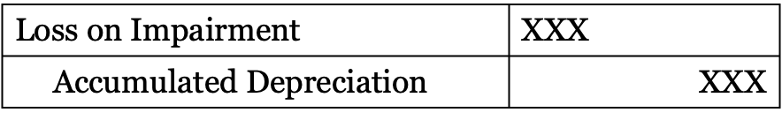
Impairment
At each reporting date, a company should review its property, plant, and equipment to see if an asset is impaired.
Impairment occurs when the carrying amount exceeds its recoverable amount.
Impairment may be caused by many factors including obsolescence, physical damage, and loss in market value.
The journal entry to record impairment is:
Notes:
At each reporting date, a company should review its property, plant, and equipment to see if an asset is impaired. Impairment occurs when the carrying amount exceeds its recoverable amount. Recoverable amount is determined to be the higher of an asset’s fair value (less costs to sell) and its value in use. Value in use is the present value of estimated future cash flows expected to be earned from the continuing use of an asset and from its disposal at the end of its useful life.

Slide 54
Learning Objective Four
Explain how to account for intangible assets and goodwill
Notes:
The fourth learning objective is to explain how to account for intangible assets and goodwill.

Slide 55
Intangible Assets
No physical form
  Carry special rights
  Include patents, copyrights, and franchises
Two categories
  Finite lives
    Amortization recorded
      Straight-line method usually used, but…
      Other amortization methods are allowed
  Indefinite lives
    Tested for loss in value (impairment)
Notes:
Intangible assets are long-lived assets with no physical form. Intangibles are valuable because they carry special rights from patents, copyrights, trademarks, franchises, leaseholds, and goodwill. Like buildings and equipment, an intangible asset is recorded at its acquisition cost. Intangibles are the most valuable assets of high-tech companies and those that depend on research and development. The residual value of most intangibles is zero.
Intangible assets fall into two categories:
■ Intangibles with finite lives that can be measured. We record amortization for these intangibles. Amortization expense is the title of the expense associated with intangibles. Amortization works like depreciation and is usually computed on a straight-line basis.
■ Intangibles with indefinite lives. Record no amortization for these intangibles. Instead, check them annually for any loss in value (impairment), and record a loss when it occurs. Goodwill is the most prominent example of an intangible asset with an indefinite life. It results when a company purchases the net assets of another company for more than their fair market value.

Slide 56
Accounting for Specific Intangibles
Patents
Copyrights
Trademarks and trade names
Franchises and licences
Goodwill
Notes:
Let’s look at five intangible assets in more detail: patents, copyrights, trademarks and trade names, franchises and licences, and goodwill.

Slide 57
Patents
Granted by federal government and give holder exclusive right to produce and sell an invention
Last for 20 years
January 1
Patents | 170,000
Cash |  | 170,000
To acquire a patent
December 31
Amortization Expense | 34,000
Accumulated Amortization |  | 34,000
To amortize the cost of a patent
Notes:
Patents are federal government grants that give the holder the exclusive right for 20 years to produce and sell an invention. The invention may be a product or a process—for example, IMAX’s projection process. Like any other asset, a patent may be purchased.
This slide shows the journal entries that are required to record the purchase of a patent on January 1, and the amortization expense on December 31. You can calculate that the owners anticipate that the patent will have a useful life of $170,000 / $34,000 or 5 years. By law the patent is good for 20 years, but its useful life is expected to last only five years.

Slide 58
Copyrights©
Granted by the federal government
Give holder exclusive rights to reproduce and sell a book, musical composition, film, or other work of art
Extend 50 years after creator’s life
  Useful life is usually very short
Notes:
Copyrights are exclusive rights to reproduce and sell a book, musical composition, film, or other work of art. Copyrights also protect computer software programs. Issued by the federal government, copyrights extend 50 years beyond the author’s (composer’s, artist’s, or programmer’s) life. The cost of obtaining a copyright from the government is low, but a company may pay a large sum to purchase an existing copyright from the owner. For example, a publisher may pay the author of a popular novel $1 million or more for the book copyright. Because the useful life of a copyright is usually no longer than two or three years, each period’s amortization amount is a high proportion of the copyright cost. Owners of a copyright must use judgment in determining a reasonable life over which to amortize the asset.

Slide 59
Trademarks and Trade Names ^{TM or ®}
Distinctive identification of a product or service
  Also include advertising slogans
Useful life may be set by contract
  Or indefinite life
Notes:
Trademarks and trade names (or brand names) are distinctive identification of a product or service. You are probably familiar with McDonald’s golden arches or Apple Inc.’s famous apple. Tim Hortons and Roots are names we all recognize. Advertising slogans, such as “Red Bull gives you wings,” are also protected.
These are distinctive identifications of products or services, marked with the symbol ™ or ®. Some trademarks may have a definite useful life set by contract. We should amortize this trademark’s cost over its useful life. But a trademark or a trade name may have an indefinite life and not be amortized.

Slide 60
Franchises and Licences
Granted by private business or government
Give purchaser the right to sell a product or service with specified conditions
Include restaurant chains and sports organizations
Have indefinite life
Notes:
Franchises and licenses are privileges granted by a private business or a government to sell a product or service in accordance with specified conditions. The Edmonton Oilers hockey organization is a franchise granted to its owner by the National Hockey League. Swiss Chalet restaurants and Canadian Tire are popular franchises. Businesses purchase the rights to sell particular goods or services and in turn agree to operate under the standards and limitations imposed by the franchising corporation. The useful lives of many franchises and licenses are indefinite and, therefore, are not amortized.

Slide 61
Goodwill
Only recorded when an entire company is purchased
Defined as the excess of the purchase price of the company over the market value of its net assets
Represents earning power of company purchased
Not amortized
Notes:
In accounting, goodwill has a very specific meaning. Goodwill is defined as the excess of the cost of purchasing another company over the sum of the market values of the acquired company’s net assets (assets minus liabilities). A purchaser is willing to pay for goodwill when the purchaser buys another company that has exceptional earning power.
Goodwill in accounting has special features, as follows:
Goodwill is recorded only when it is purchased in the acquisition of another company. A purchase transaction provides objective evidence of the value of goodwill. Companies never record goodwill that they create for their own business.
According to generally accepted accounting principles (GAAP), goodwill is not amortized because the goodwill of many entities increases in value. However, if the value of goodwill is impaired, it must be written down.
Goodwill impairment losses cannot be reversed in future years.

Slide 62
Intangible Assets: Goodwill Example
Canadian Tire’s Purchase of Party City (PC)
All in million $
PC’s assets at market value | $ 204.5
Less: PC’s liabilities | 74.9
Market value of PCs net assets | $ 129.6
Purchase price paid for PC | $ 178.0
Goodwill ($178.0 − $129.6) | $ 48.4
Notes:
Canadian Tire paid $178.0 million for the purchase of Party City (PC) in 2019. At that time, the fair market value of all of PC’s assets was $204.5 million. PC owed $74.9 million, however, meaning its net assets were only $129.6 million. Therefore Canadian Tire paid $48.4 million more for the assets than they were valued at. That extra was classified as goodwill.

Slide 63
Asset Impairment
Both tangible and intangible assets must be tested yearly for impairment
Occurs when expected future cash flows are less than asset’s carrying amount
Carrying value adjusted to fair value
Notes:
Generally accepted accounting principles require that management of companies test both tangible and intangible long-term assets for impairment yearly. Impairment occurs when the expected future cash flows (which approximate the expected future benefits) from a long-term asset fall below the asset’s carrying amount (cost minus accumulated depreciation or amortization). If an asset is impaired, the company is required to adjust the carrying amount downward from its carrying amount to its fair value. In this case, fair value is based not on the expected future cash flows, but on the asset’s estimated market value at the date of the impairment test.

Slide 64
S6-11
Consider the purchase of a supplier by Canadian Tire.
Suppose the fair value of the net assets on Feb 1, 2021 was $180.3 million
Required:
What would the goodwill have been if Canadian Tire had paid $200 million?
Explain how Canadian Tire will have been accouting for this goodwill up to Feb 1, 2023.

Slide 65
Learning Objective Five
Analyze a company’s return on assets
Notes:
The fifth learning objective is to analyze a company’s return on assets.

Slide 66
Return on Assets (ROA)
(Beginning total assets + Ending total assets)/2
Net income ¹
Average total assets
¹ For companies with a significant amount of debt, some analysts may add interest expense to net income
Notes:
Evaluating company performance is a key goal of financial statement analysis. Shareholders entrust managers with the responsibility of developing a business strategy that utilizes company assets in a manner that both effectively and efficiently generates a profit. The most basic framework for this purpose is return on assets (ROA), which measures how profitably management has used the assets that shareholders and creditors have provided the company. The basic formula for the ROA ratio is shown in this slide. ROA measures how much the entity earned for each dollar of assets invested by both shareholders and creditors. Companies with high ROA have both selected assets and managed them more successfully than companies with low ROA.

Slide 67
Learning Objective Six
Analyze the cash flow impact of long-lived asset transactions
Notes:
The sixth learning objective is to analyze the cash flow impact of long-lived asset transactions.

Slide 68
Long-Lived Asset Transactions on the Cash Flow Statement
Item | Section | Description
Depreciation and amortization | Operating | Added to net income as a reconciling item
Sales of long-lived assets | Investing | Cash proceeds from sales of long-lived assets (inflow)
Acquisition of long-lived assets | Investing | Cash purchases (outflow)
Notes:
Three main types of long-lived asset transactions appear on the statement of cash flows:
■ acquisitions
■ sales
■ depreciation (including amortization)
Acquisitions and sales of long-term assets are investing activities. The payments for equipment and buildings are investing activities that appear on the statement of cash flows. The sale of long-lived assets results in a cash receipt. Also, “Depreciation and amortization” are listed as positive items under Adjustments to reconcile net income to cash provided by operating activities.

Slide 69
Learning Objective Seven
Calculate depreciation expense using Excel functions
Notes:
The seventh learning objective is to calculate depreciation expense using Excel functions.

Slide 70
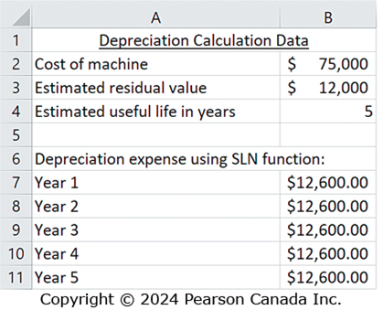
Depreciation Expense Using Excel Functions (1 of 2)
A manger can use the SLN function in Excel to calculate straight-line depreciation expense for any or all of the years of an asset’s estimated life.
Notes:
The manager can use an Excel function to make quick depreciation calculations.
Excel has two functions that calculate depreciation expense. The SLN function calculates straight-line depreciation expense, while the DDB function calculates double-declining-balance depreciation expense. To use either of the two Excel depreciation functions, the manager needs the asset’s cost, its estimated useful life, and its estimated residual value.

Slide 71
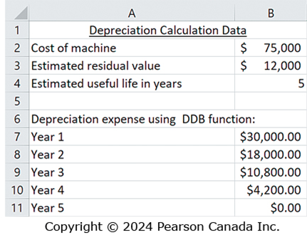
Depreciation Expense Using Excel Functions (2 of 2)
If the company uses the double-diminishing-balance method, the manger would use the DDB function to calculate depreciation expense for any or all of the years of an asset’s estimated life.
Notes:
While companies are more likely to use specialized software systems to calculate and maintain their property, plant, and equipment acquisition, depreciation, and disposal records, the Excel SLN and DDB functions can be useful for quick analyses.

Slide 72
End of Chapter Six
Notes:
This concludes Chapter Six.

Slide 73
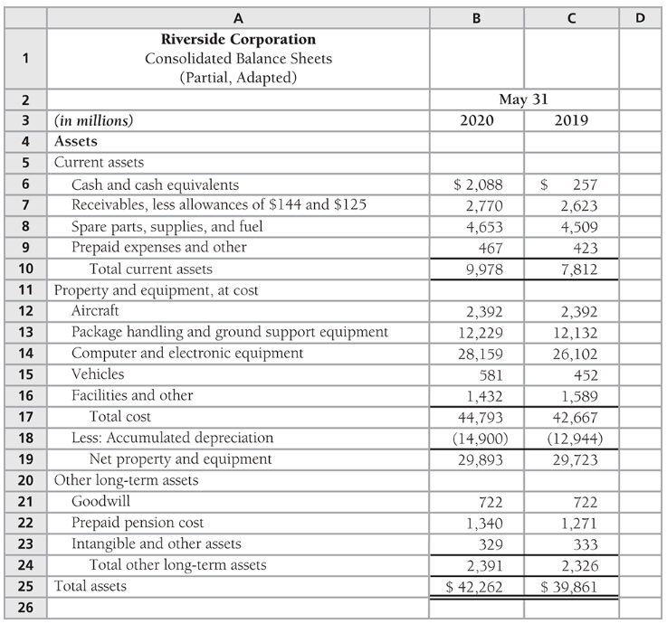
Classroom Problem S6-1
1. What is Riverside's largest category of assets?
List all 2020 assets in the largest category and their amounts as reported by Riverside.
2. What was Riverside's cost of property and equipment on May 31, 2020?
What was the carrying amount of property and equipment on this date?
Why is carrying amount less than cost?

