Slide 1
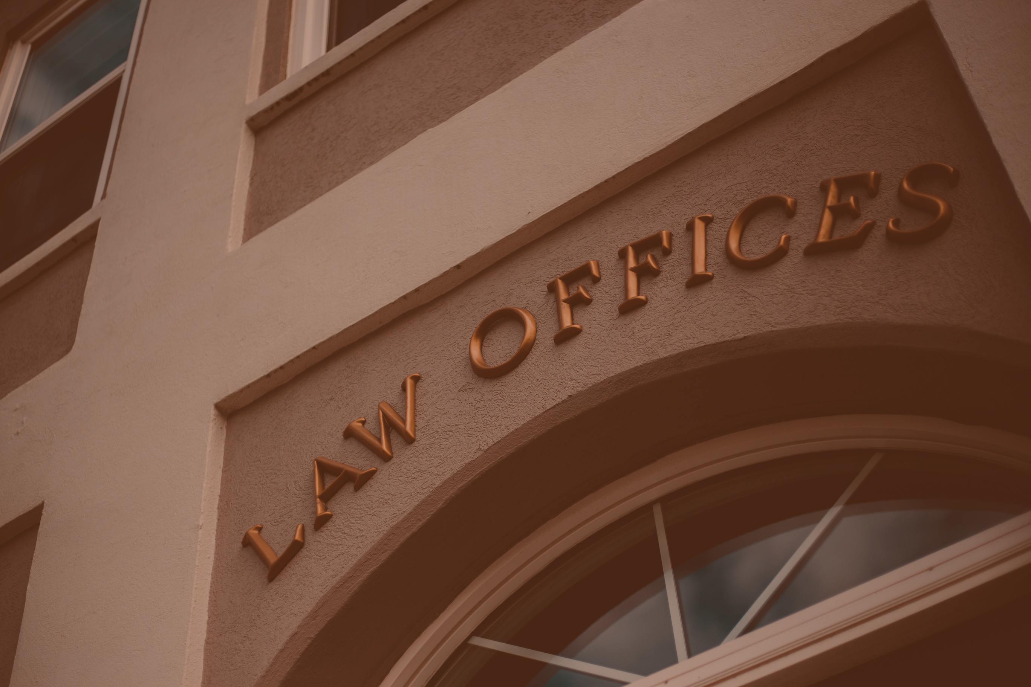
LEGALVISION
A Knowledge-Driven AI Framework for Legal Understanding and Trust Assessment

Slide 2
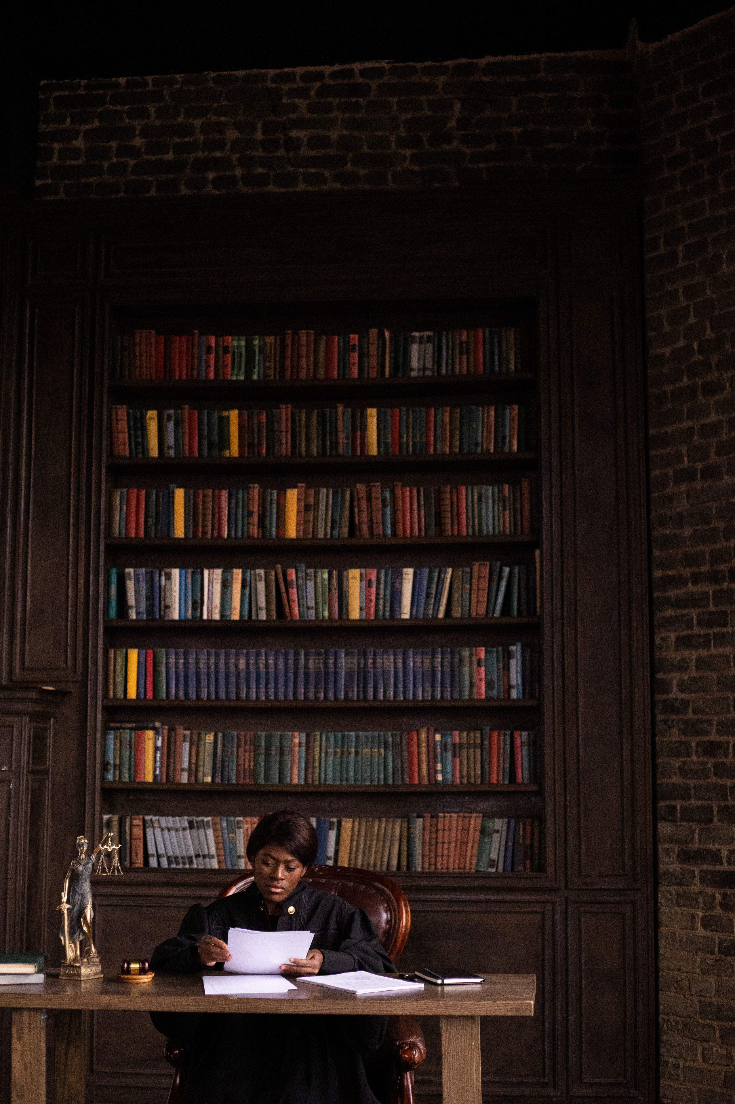
IT4010
Final Evaluation
25-26J-127

Slide 3
PP2 COMMENTS & ACTIONS TAKEN
IT number | PP2 Comment | Actions Taken
IT22732736 | Validate the model whether nodes are being formed correctly | Validated Neo4j node and relationship creation using sample deed records. Checked key nodes such as Instrument, Party, Property, Plan, Statute, Legal Principle, and Requirement. Verified relationship mapping and improved graph consistency.
IT22348784 | Try to compare with legalbert along with RAG based system | Reviewed LegalBERT as an alternative model and compared it with the proposed LLaMA-based RAG approach. Since our module requires explainable answer generation rather than only text classification, the fine-tuned LLaMA model with Neo4j-based RAG was selected as the most suitable approach.
IT22113504 | Try to compare your appraoch with a llm | Compared with Chatgpt and gemini Our System (Correct), ChatGPT (Incomplete + Hallucination), and Gemini (Hallucination)

Slide 4
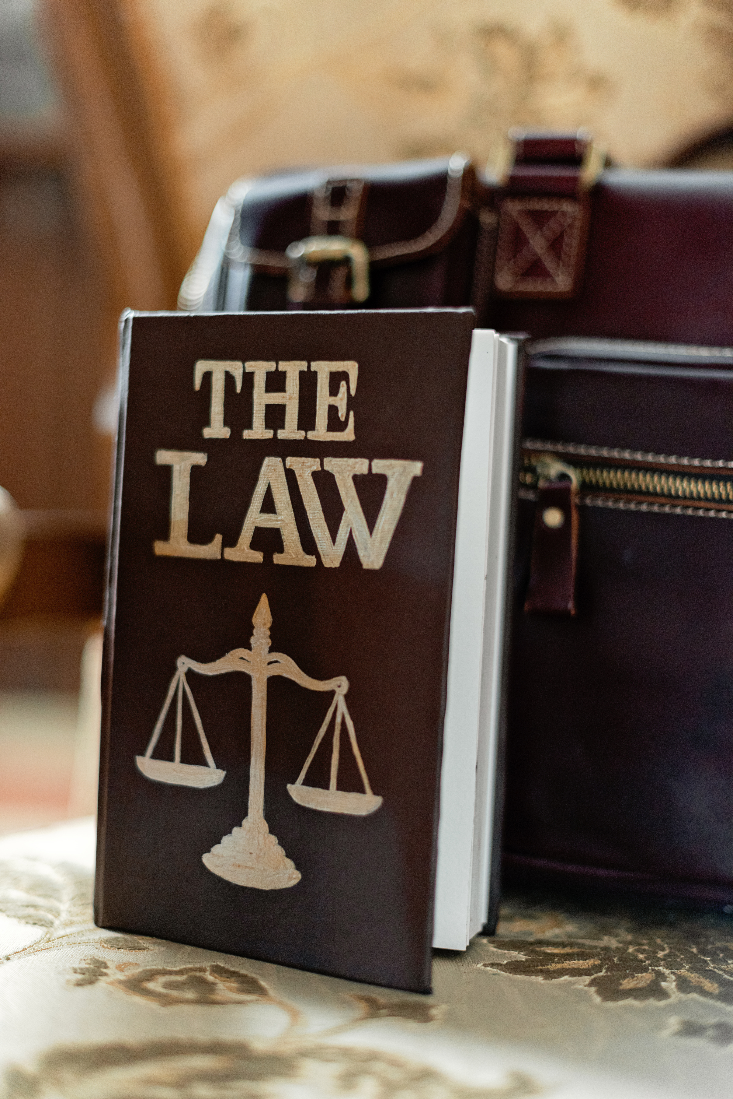
PROBLEM OVERVIEW
Problem: Legal documents are complex and time-consuming to analyze. Users need an automated system to understand legal content without consulting legal professionals for minor tasks, while ensuring traceability.
SOLUTION OVERVIEW
Solution: An AI-powered platform for analyzing Sri Lankan property law documents through summarization, explainable reasoning, risk evaluation, and knowledge graph support.

Slide 5

Visual INTEGRATED MULTI PERSPECTIVE LEGAL SUMMARIZER It22113504 | wicramasinghe d a t n
This component develops a system that simplifies complex property law documents by generating multi-perspective summaries with visualizations and traceability, improving understanding for both experts and non-experts.
IT22113504 | WICRAMASINGHE D A T N | 25-26J-127

Slide 6

Explainable Legal Reasoning Module IT22348784 | Sivanuja S
Explainable Legal Reasoning Module generates structured IRAC-based, citation-backed legal explanations for Sri Lankan property law, enabling accurate, transparent, and trustworthy guidance, outperforming general and legal LLMs in evaluation.
IT22348784 | Sivanuja S| 25-26J-127

Slide 7

Bias & Risk Evaluator IT22344892 | Maxwell L Y
Bias & Risk Evaluator analyzes property agreements using NLP to detect biased clauses and risk severity, generating a confidence-based Trust Score and interactive report for clearer, user-friendly legal risk assessment.
IT22344892 | Maxwell L Y | 25-26J-127

Slide 8

Legal Knowledge Graph IT22732736 | Sharan K
Dynamic Legal Knowledge Graph converts Sri Lankan deed PDFs into structured graph data using NER and hybrid extraction, enabling ownership tracking, encumbrance analysis, and natural-language legal queries through GraphRAG.
IT22732736 | Sharan K| 25-26J-127

Slide 9

RESULTS & TESTIMONIALS
The system was successfully accepted by our external supervisor & get future enhancement suggestions
Additionally, this research has been accepted for publication at the CICN Conference
Limitations of the System - Currently limited to the property law domain only
Future Improvements - Expand system to support multiple legal domains, & Integrate AI-based validation for identifying forged or suspicious documents

Slide 10
THANK YOU

