Slide 1
Invisi-Breaker
By Lucas McCollum & Vincent Daugherty

Slide 2
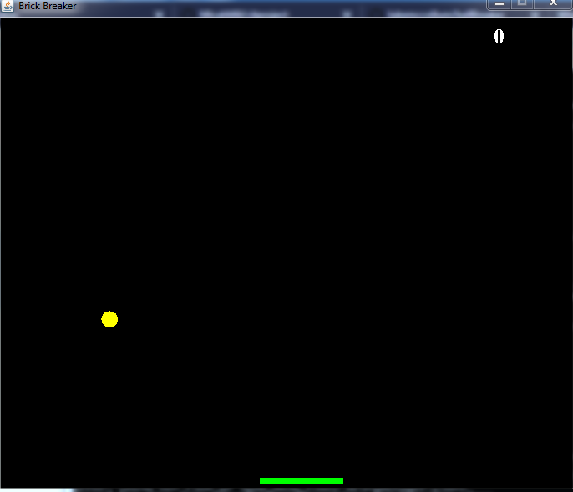
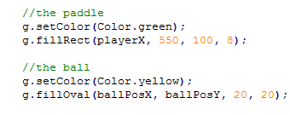
Paddle and Ball
The first step was to make a functioning ball and paddle.

Slide 3
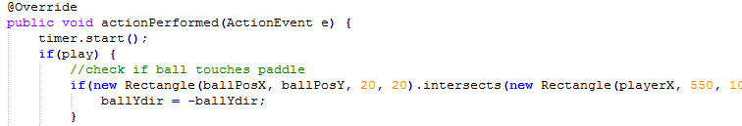
Collision
Next, The ball must actually move and collide with the paddle.

Slide 4
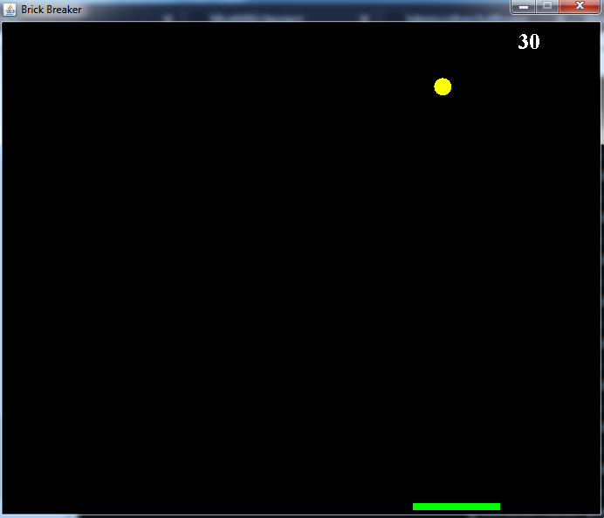
Generating Bricks
Next, we need bricks and their collision and vanishing, and a scoring system.

Slide 5
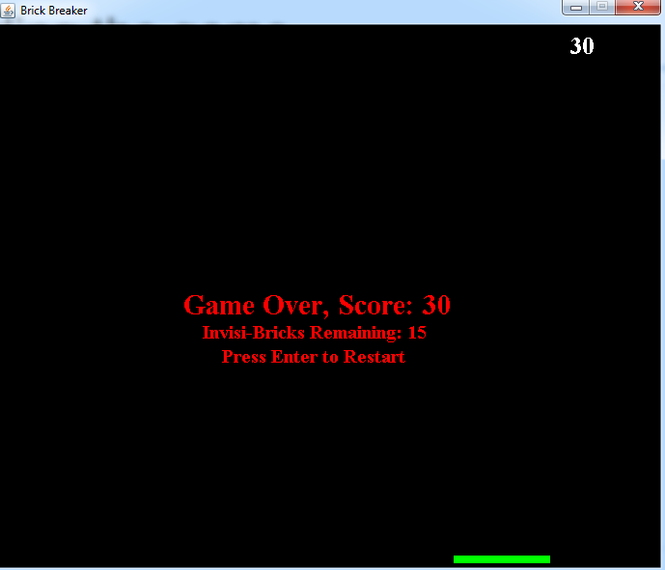
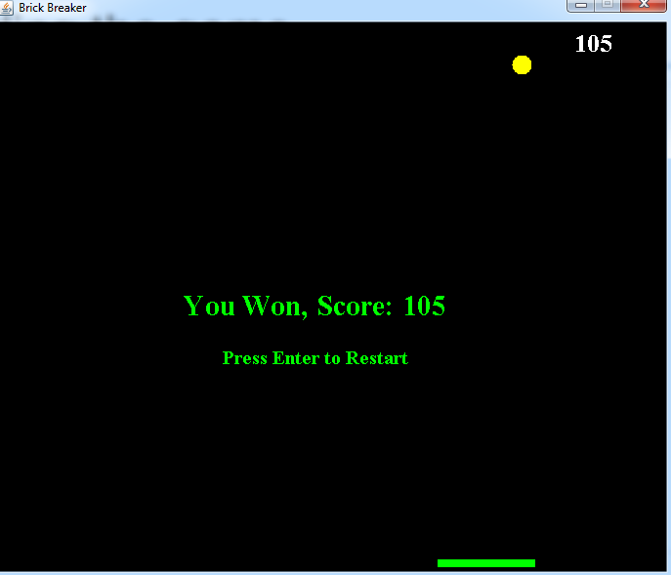
Ending the game
Game over screens and the ability to restart

