Slide 1
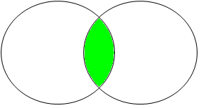
INNER JOIN Visualization
Consultant_id | First_Name | Last_Name
3 | Simon | Adebisi
4 | Penelope | Barber
7 | Augustus | Hill
Assignment_ID | Consultant_id
2 | 4
5 | 7
19 | NULL
Consultants
Assignments
Consultant_Id | First_Name | Last_Name | Assignment_ID
4 | Penelope | Barber | 2
7 | Augustus | Hill | 5
Matches Only

Slide 2
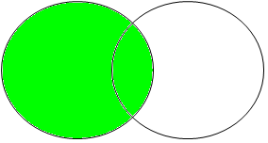
LEFT OUTER JOIN Visualization
Consultant_id | First_Name | Last_Name
3 | Simon | Adebisi
4 | Penelope | Barber
7 | Augustus | Hill
?
Assignment_ID | Consultant_id
2 | 4
5 | 7
19 | NULL
Consultants
Assignments
Consultant_Id | First_Name | Last_Name | Assignment_ID
3 | Simon | Adebisi | NULL
4 | Penelope | Barber | 2
7 | Augustus | Hill | 5
All Left and Matches

Slide 3
RIGHT OUTER JOIN Visualization
Consultant_id | First_Name | Last_Name
3 | Simon | Adebisi
4 | Penelope | Barber
7 | Augustus | Hill
Assignment_ID | Consultant_id
2 | 4
5 | 7
19 | NULL
?
Consultants
Assignments
Consultant_Id | First_Name | Last_Name | Assignment_ID
4 | Penelope | Barber | 2
7 | Augustus | Hill | 5
NULL | NULL | NULL | 19
All Right and Matches

Slide 4
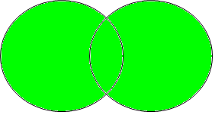
FULL OUTER JOIN Visualization
Consultant_id | First_Name | Last_Name
3 | Simon | Adebisi
4 | Penelope | Barber
7 | Augustus | Hill
?
Assignment_ID | Consultant_id
2 | 4
5 | 7
19 | NULL
?
Consultant_Id | First_Name | Last_Name | Assignment_ID
4 | Penelope | Barber | 2
7 | Augustus | Hill | 5
3 | Simon | Adebisi | NULL
NULL | NULL | NULL | 19
Consultants
Assignments
Matches, Left and Right

