Slide 1
Lesson 9 – UNION, INTERSECT, MINUS

Slide 2
Lesson Objectives
After completing this lesson you will be able to:
Use UNION, INTERSECT, and MINUS to put the results of two queries into a single result set
Understand the difference between using JOINs and using UNION, INTERSECT or MINUS

Slide 3
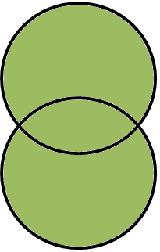
UNION
UNION - Joins two result sets together and returns the distinct rows
SELECT
first_name, last_name
FROM broker
UNION
SELECT
first_name, last_name
FROM consultant
;
Brokers
Consultants
Remove duplicates

Slide 4
UNION ALL
UNION ALL - Joins two result sets together and returns all rows
SELECT
first_name, last_name
FROM broker
UNION ALL
SELECT
first_name, last_name
FROM consultant
;
Brokers
Consultants
Keep duplicates

Slide 5

INTERSECT
INTERSECT - Joins two result sets together and returns only the matches
SELECT
first_name, last_name
FROM broker
INTERSECT
SELECT
first_name, last_name
FROM consultant
;
Brokers
Consultants
Keep only matches

Slide 6
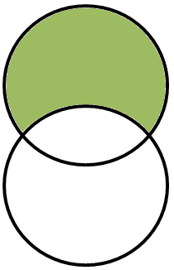
MINUS
MINUS – Returns all results from the first query except those that also appear in the second query
SELECT
first_name, last_name
FROM broker
MINUS
SELECT
first_name, last_name
FROM consultant
;
Brokers
Consultants

Slide 7
Compare JOIN to UNION (next slide)
A JOIN puts columns from one table together with columns from another table (and aligns the rows).
First_Name | Addess_ID | Last_Name
Bill | 10 | Sykes
Susan | 2 | Schillinger
Simon | 3 | Adebisi
Addess_ID | Town
2 | Linlithgow
3 | Bathgate
10 | Falkirk
First_Name | Last_Name | Town
Bill | Sykes | Falkirk
Susan | Schillinger | Linlithgow
Simon | Adebisi | Bathgate

Slide 8
Compare JOIN (previous slide) to UNION
UNION puts rows from one query together with rows from another query (and aligns the columns)
First_Name | Last_Name
Bill | Sykes
Susan | Schillinger
Simon | Adebisi
Output
First_Name | Last_Name
Bill | Sykes
Susan | Schillinger
Simon | Adebisi
John | Smith
Herbert | Jackson
Richard | Bradley
First_Name | Last_Name
John | Smith
Herbert | Jackson
Richard | Bradley
Column data types have to match and the number of columns have to match

Slide 9

Questions?

Slide 10
Lesson Objectives
Having completed this lesson you should now be able to:
Use UNION, INTERSECT, and MINUS to put the results of two queries into a single result set
Understand the difference between using JOIN and using UNION

