Slide 1

Network troubleshooting with Azure Network Monitoring

Slide 2
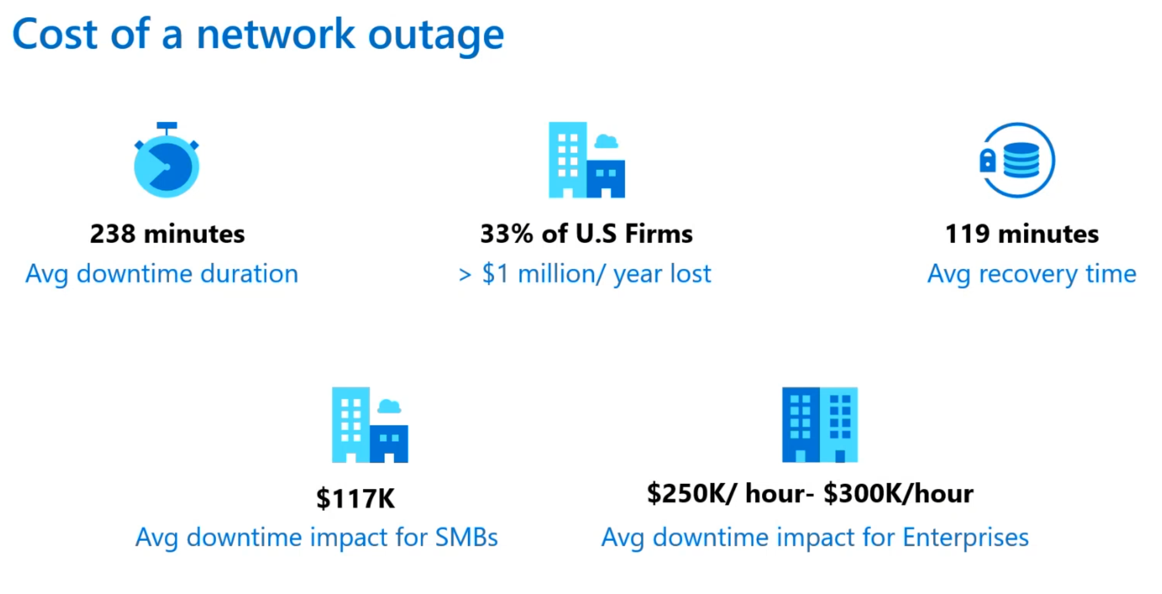
Source: Gartner

Slide 3
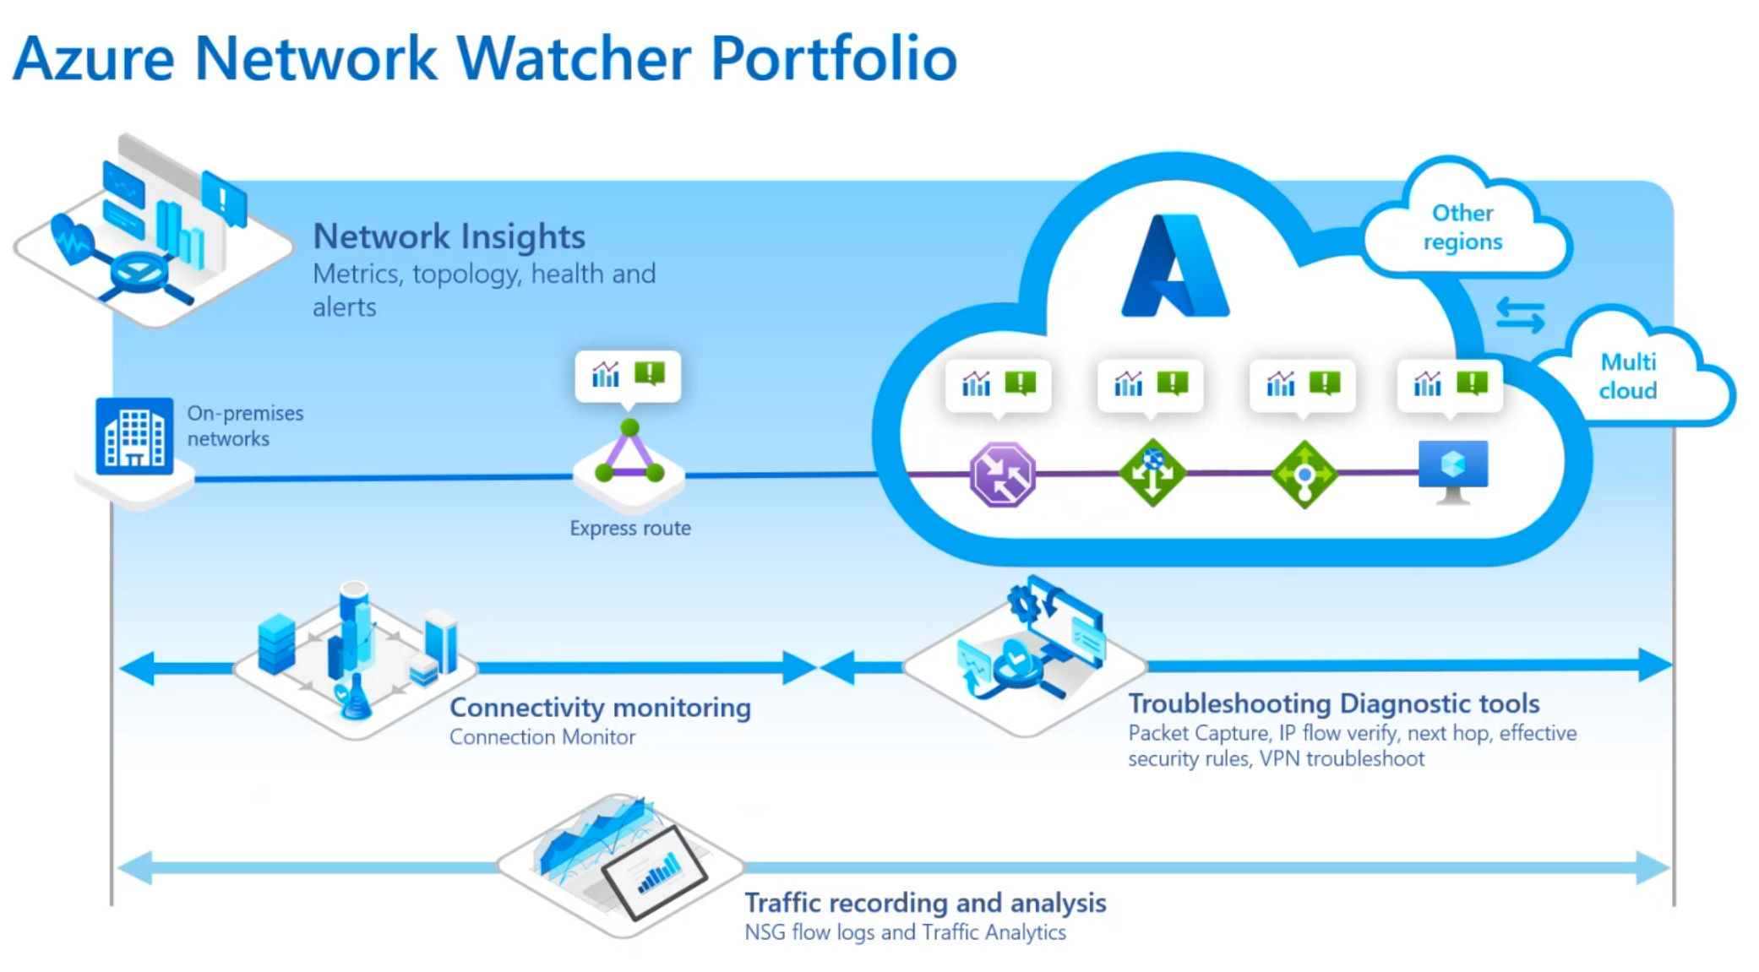

Slide 4
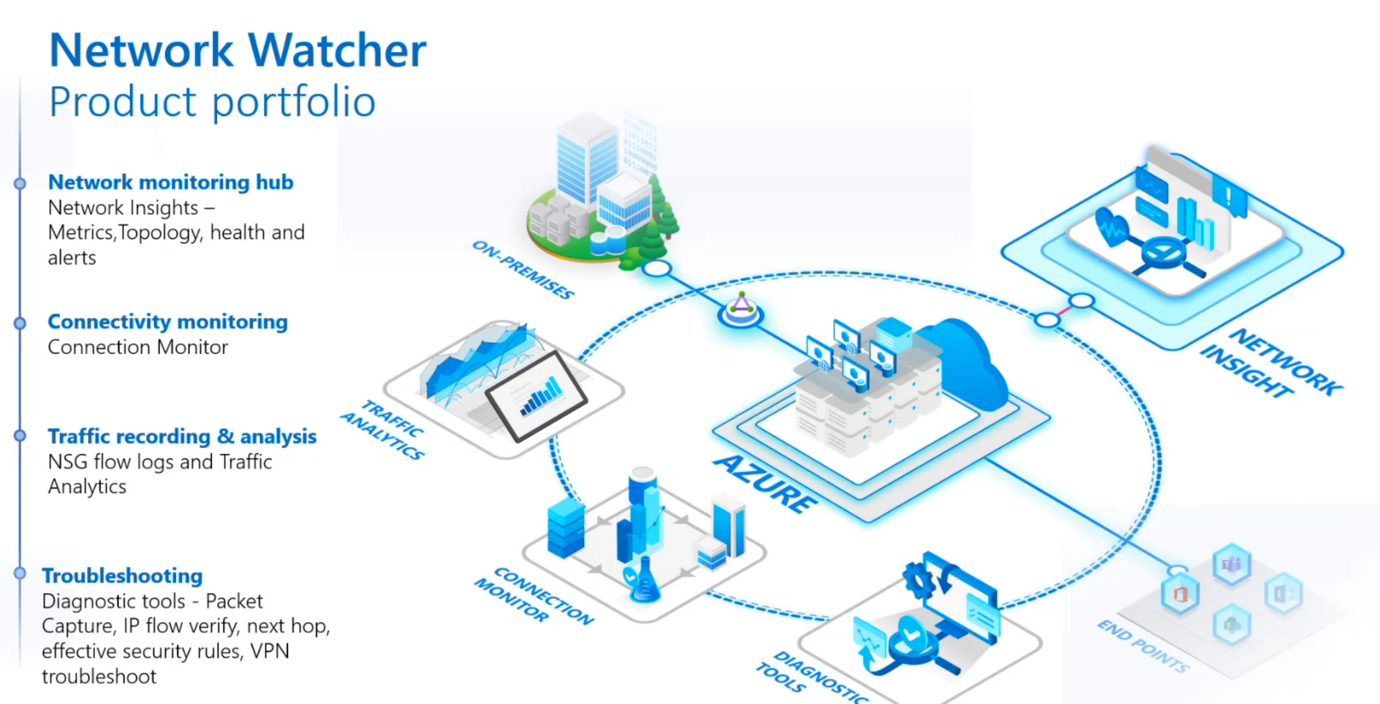

Slide 5
Lab

Slide 6
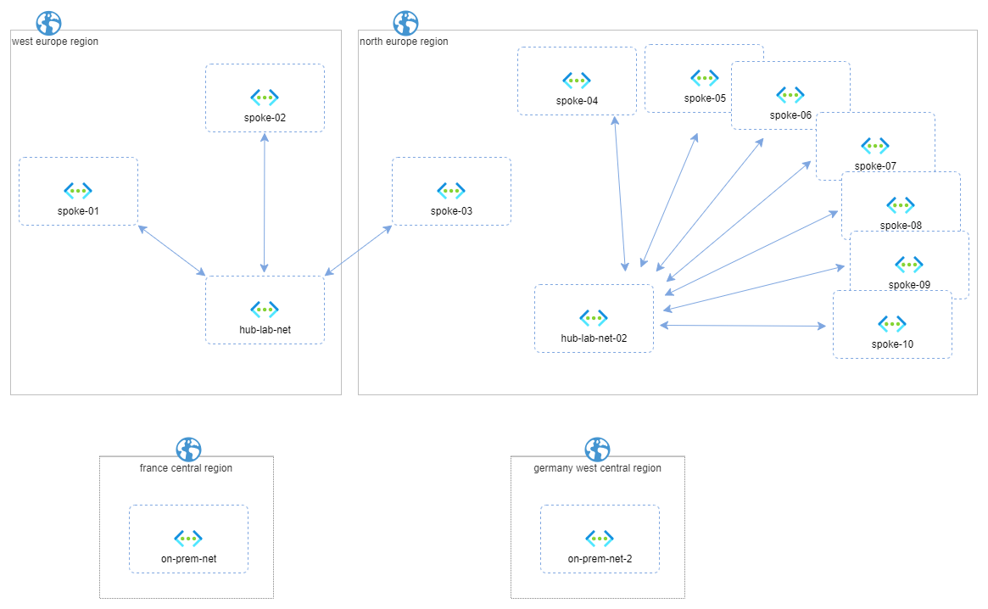
https://github.com/nicolgit/hub-and-spoke-playground

Slide 7
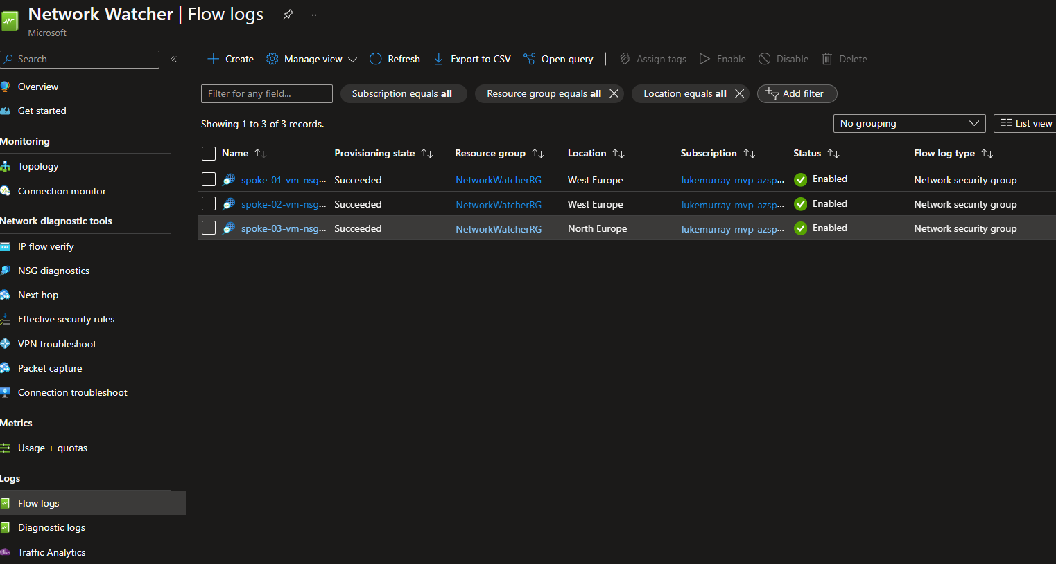
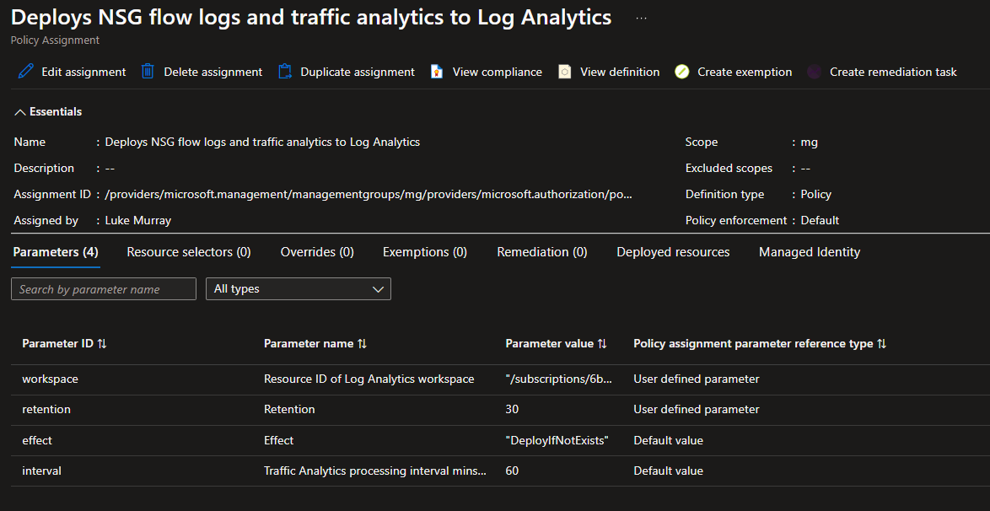

Slide 8
Network Insights

Slide 9
Network Watcher
VPN Troubleshoot

Slide 10
Connection Monitor

Slide 11
NSG Diagnostics

Slide 12
Flow Logs

Slide 13
Traffic Analytics
KQL Search

Slide 14
IP Flow Verify

Slide 15
Connection Troubleshoot

Slide 16
Packet Capture

Slide 17
Thank you!

