Slide 1

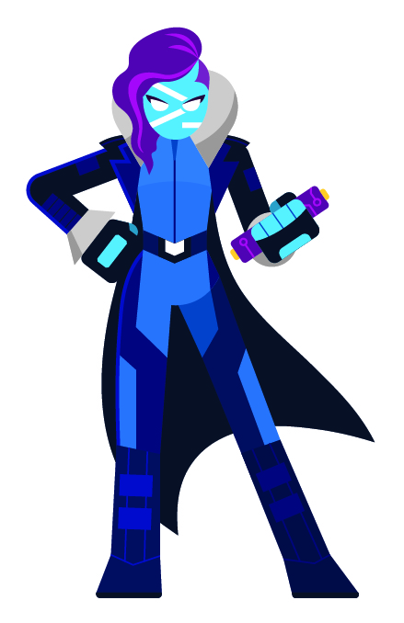
Microsoft Azure Management with PowerShell Introduction

Slide 2

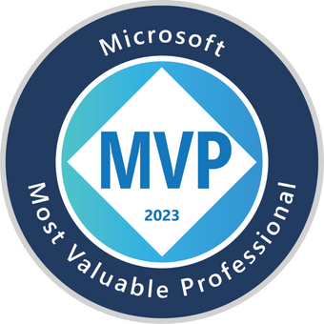


So, who am I?
My name is Luke Murray
He/Him
Senior Consultant in Hamilton, New Zealand.
Feel free to reach out on Social Media, if you need any help: https://linktr.ee/lukemurray
Introduction
Azure Cloud
Commanders

Slide 3
Today, we'll be using PowerShell, to connect to Azure, and modify and create Azure resources.
Agenda

Slide 4
What do I need to get started?
Notes:
Codespace, and Notebook, Azure subscription/.

Slide 5
Azure subscription

Slide 6
GitHub account

Slide 7
I need a little bit more info?
Notes:
Codespace, and Notebook, Azure subscription/.

Slide 8
Codespace

Slide 9
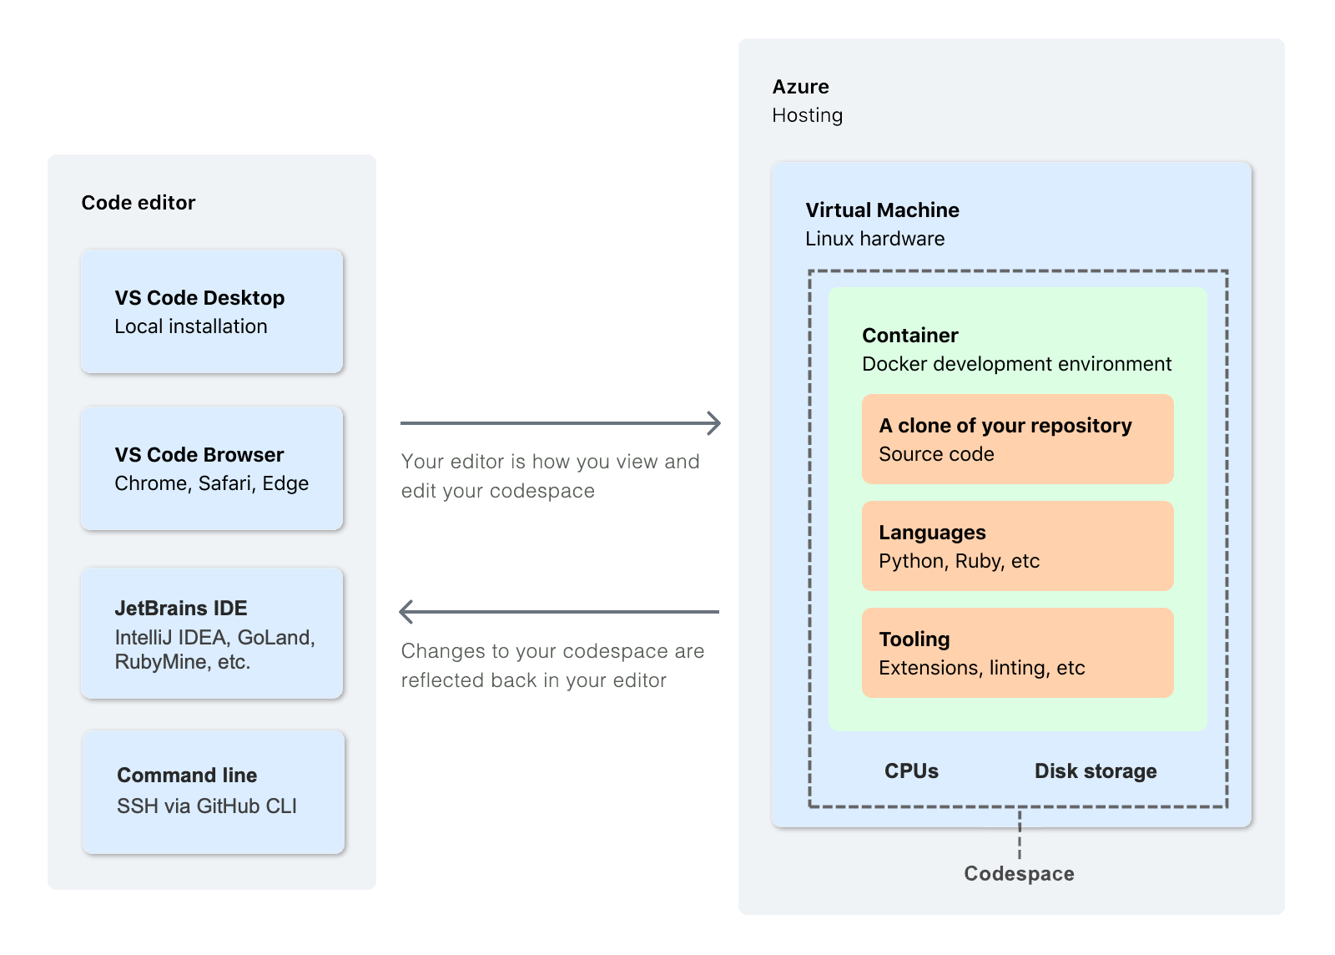
Notes:
Use a preconfigured development environment - You can work in a development environment that has been specifically configured for the repository. It will have all of the tools, languages, and configurations you need to work on that project. Everyone who works on that repository in a codespace will have the same environment. This reduces the likelihood of environment-related problems occurring and being difficult to debug. Each repository can have settings that will give contributors a ready-to-use, fit-for-purpose environment, and the environment on your local machine will be unchanged.
Access the resources you need - Your local computer may not have the processing power, or storage space, you need to work on a project. GitHub Codespaces allows you to work remotely on a machine with adequate resources.
Work anywhere - All you need is a web browser. You can work in a codespace on your own computer, on a friend's laptop, or on a tablet. Open your codespace and pick up from where you left off on a different device.
Choose your editor - Work in the browser in the VS Code web client, or choose from a selection of desktop-based applications.
Work on multiple projects - You can use multiple codespaces to work on separate projects, or on different branches of the same repository, compartmentalizing your work to avoid changes made for one piece of work accidentally affecting something else you're working on.
Pair program with a teammate - If you work on a codespace in VS Code, you can use Live Share to work collaboratively with other people on your team. For more information, see "Working collaboratively in a codespace."
Publish your web app from a codespace - Forward a port from your codespace and then share the URL, to allow teammates to try out the changes you've made to the application before you submit those changes in a pull request.
Try out a framework - GitHub Codespaces reduces the setup time when you want to learn a new framework. Just create a codespace from one of the quickstart templates.

Slide 10
Notebook
Notes:
Computational notebook
Support for interactive data visualization and use of GUI toolkits.
Jupyter Notebooks were the original data science notebook experience that mixed together code and markdown cells using a kernel running either Julia, Python, or R (leading to the name Jupyter from the names of these 3 languages).
Polyglot Notebooks is built on top of Jupyter Notebooks and runs using a custom notebook kernel called .NET Interactive
Polyglot Notebooks allows you to create notebooks composed of multiple cells. These cells can be either markdown cells for documentation or code cells containing code in either C#, F#, PowerShell, SQL, KQL, HTML, JavaScript, or mermaid markdown for diagramming.
Interactive Documentation where you want to illustrate something complex and embed code samples that others can interact with and modify to experiment and understand your objects.
Teaching and Independent Guided Learning where you share notebooks with learners who can interact with prepared documentation and code examples in small task-based scenarios.
Analytics Workloads that allow you to sift through data sources and gain insight from the data via statistical distributions and data visualizations.
Prototyping External API Interactions where you create the objects required by external APIs, make a REST request to the API, and explore the resulting object.
Machine Learning where you train and fit a machine learning model using something like ML .NET, evaluate its effectiveness, and then possibly deploy the trained model.
Artificial Intelligence experimentation with computer vision, language analysis, or things like OpenAI on Azure.
Running Infrequent Tasks that require configuration. This one is more of a catch-all, but might include PowerShell tasks you need to run very infrequently and might need to provide custom configuration settings before running it each time.

Slide 11

KEEP
CALM
AND
AUTOMATE AZURE
Let's get started
https://github.com/lukemurraynz/AzurePowerShellNotebook

Slide 12

THANK YOU!

