Slide 1
A 1.29GHz 705.77 fJ
6-bit Absolute-Value Detector
Chenyu Liu
Yunhui Ma
Emmanuel Hidalgo Gonzalez

Slide 2
Design Summary
A) Circuit topology, B) Circuit Style
Mixed Logic using CMOS-Custom(MUX + Carry-out adder)
C) WHY: about Area, about Delay, other
(moderate, moderate)
Note: t_{p} = max {All Inputs → Out}
Area (A) = X[µm] × Y[µm]
Delay | Layout size | Energy | Verfication
Sch. t_{p} = [759.84]ns | X= [22.8], Y= [31] | Sch. E = [505.825]fJ | Func: Y
Lay. t_{p} = [773.869]ns | A = [961]µm² | Lay. E = [705.77]fJ | DRC: Y
Critical Input = X_{[3]} | AR = [1.359] | Lay. V_{DD} = [0.848]V | LVS: Y
ECE115C – Winter 2020

Slide 3
Critical Path Analysis
Highlight critical path: From X3 to Out
Path elements: Inveter+Adders+Mux+Inverter+AND+NOR+AND+OR+OR
Totally: 2Inverters+Adders+3And+2OR+NOR
tcritical = 2 tinv + tadd + 3tand + 2tor + tnor
ECE115C – Winter 2020

Slide 4
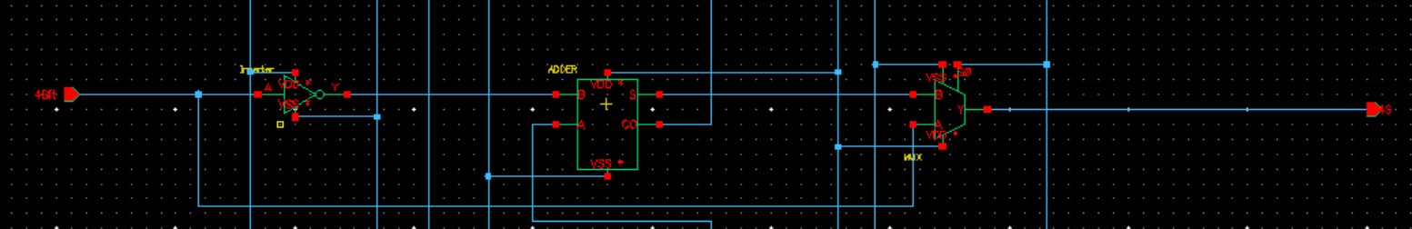
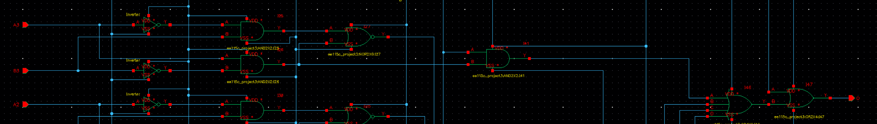
Design Optimization
Gate level critical path
MOS detail of gates, sizing, and optimization strategy
Critical path: from the 4-bit (X3) to output O.
Using MUX to select positive number which no need to go through the ADDER
Increase size of gates which are close to output significantly reduce the delay.
Select the optimized size of gates to reduce delay as well as energy by experimenting different size of gate.
ECE115C – Winter 2020

Slide 5
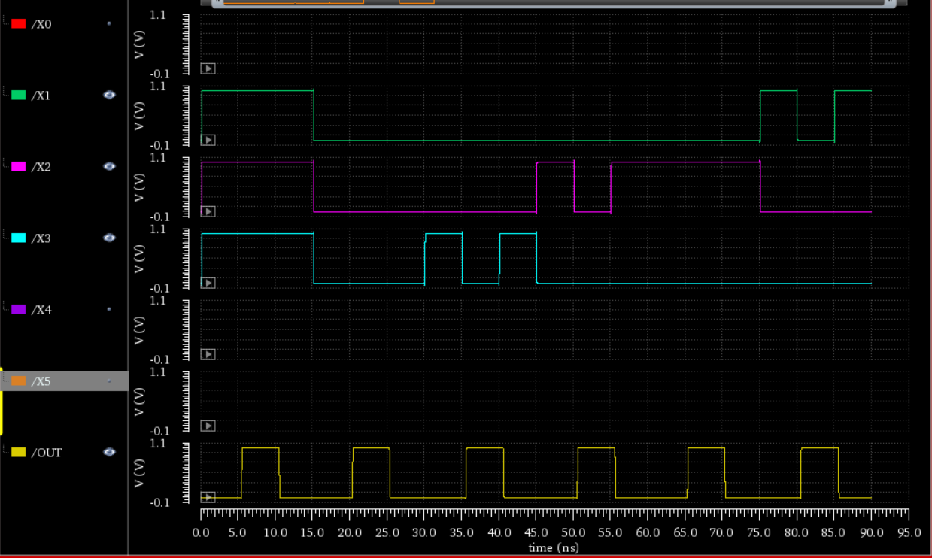
Functionality Check
Waveforms of the three inputs with the highest delay
Delay: (3)
Delay: (2)
Critical Path
Delay:
ECE115C – Winter 2020

Slide 6
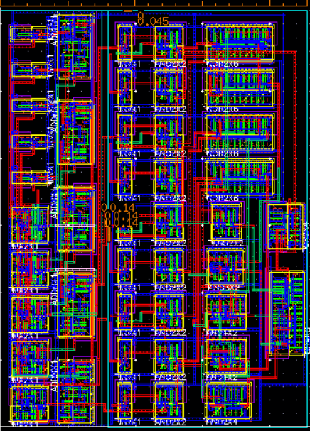
Absolute-Value Detector Layout
Final layout
4
AR
1
INPUT BUFFER
NOR GATE
STAGE
Aspect ratio:
1.359
INPUT OF TWO BITS TO COMPARE
5
Area
2
critical path
Shown with
Blue arrow
ADDER BLOCK
Area:
961μm²
AND GATE STAGE
OUTPUT
3
Layout
size
Density
MUX SELECTOR
6
X = 22.8μm
Density: 90%
Y = 31.0μm
ECE115C – Winter 2020

Slide 7
Discussion
Advantages of the design
  Gate sizing was optimized to reduce delay
  Complex layout useful to reduce area which in turn reduces layout space
  Simple logic that may require more transistors but less time coming up with a more complex topology
Improvements of the design
  Reducing the number of transistors used will reduce the area and delay
  Come up with a more optimal layout that will reduce wire length and spacing and have a higher density.
  implement some transmission gate to reduce more energy and delay. For this design, no transmission gate is used.
ECE115C – Winter 2020

