Slide 1


Should you Buy or Lease your Next Car
Luke Newman

Slide 2
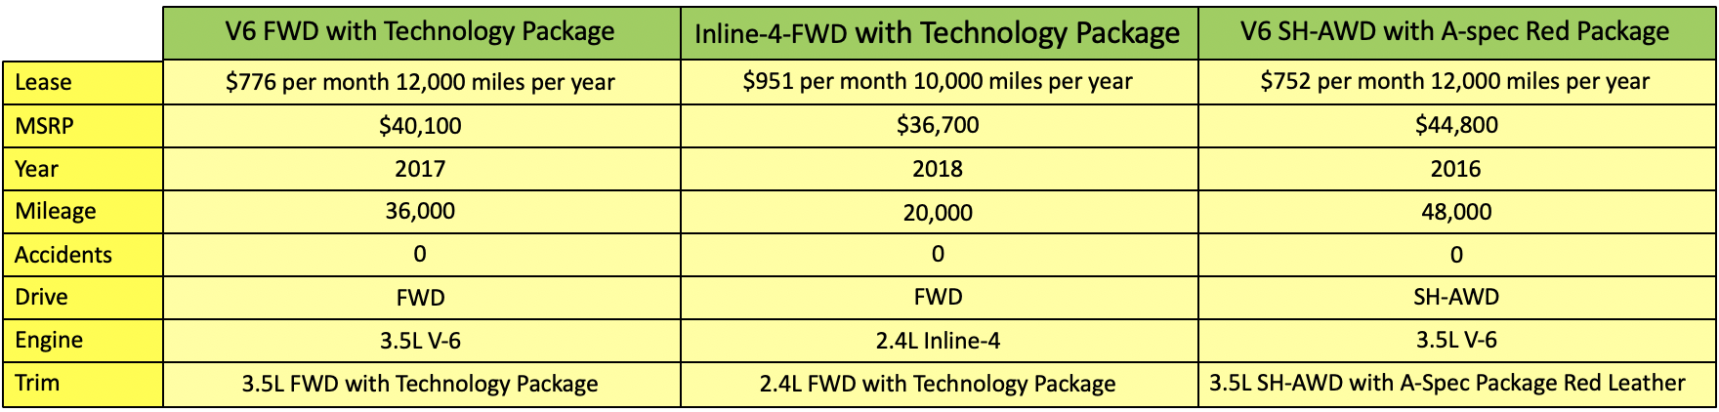
Introduction
We examine the cost of leasing a car with predicted depreciation cost.
We use Acura TLX because it is rated as one of the best cars to lease.
Three lease agreements and their specs are shown below:

Slide 3
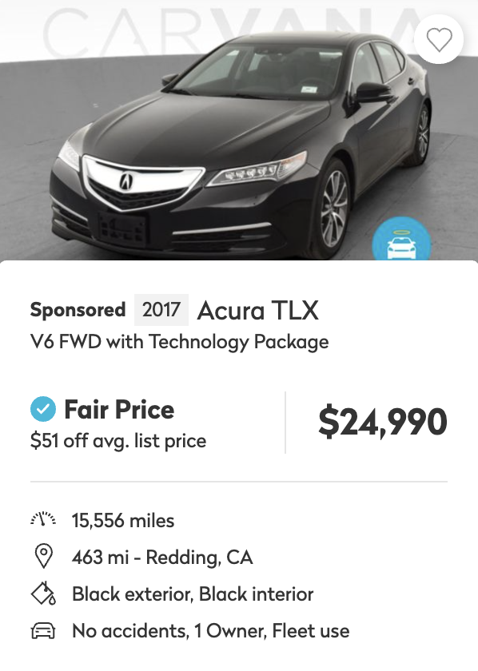
Methodology
Data collected from online car marketplace Truecar.com.

Slide 4





Methodology
Data collected from online car marketplace Truecar.com.
Tools

Slide 5
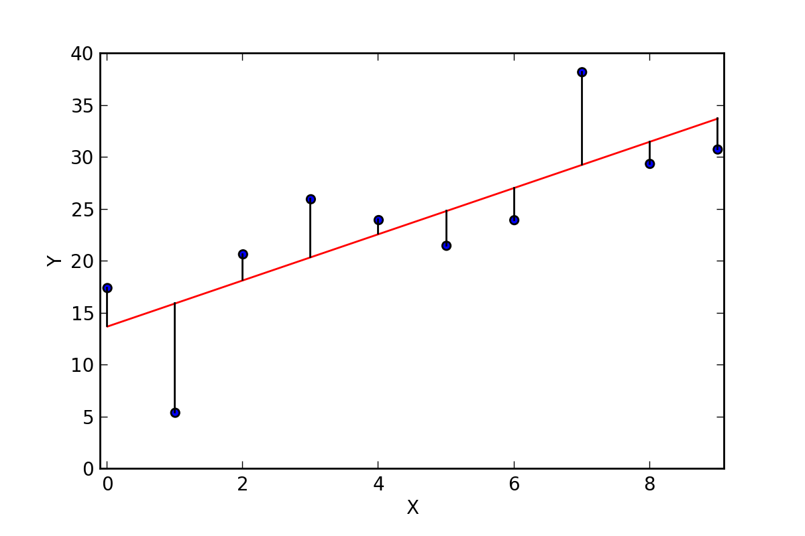
Methodology
Data collected from online car marketplace Truecar.com.
Tools
Metric
RMSE

Slide 6
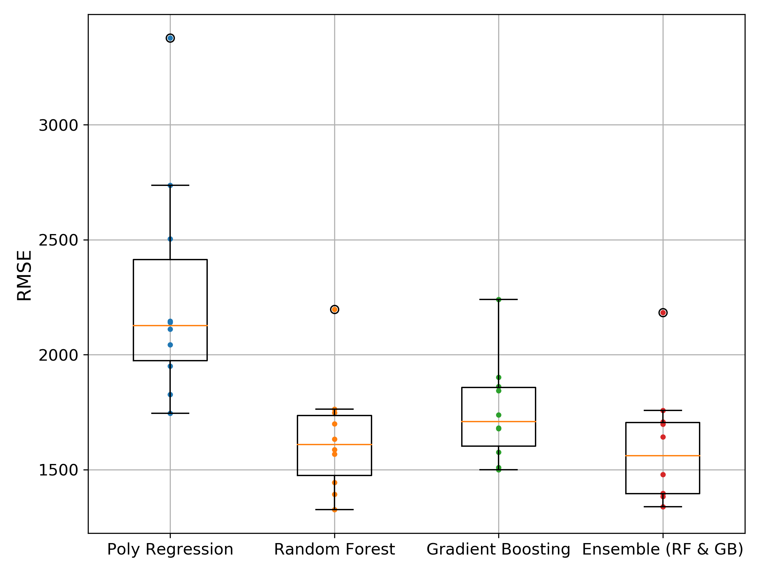
Results
The scores of the best models scored on 10 fold cross-validation are shown here (lower score is better).
The best model was obtained through an ensemble of optimized Random Forest and Gradient Boosting tree models.

Slide 7
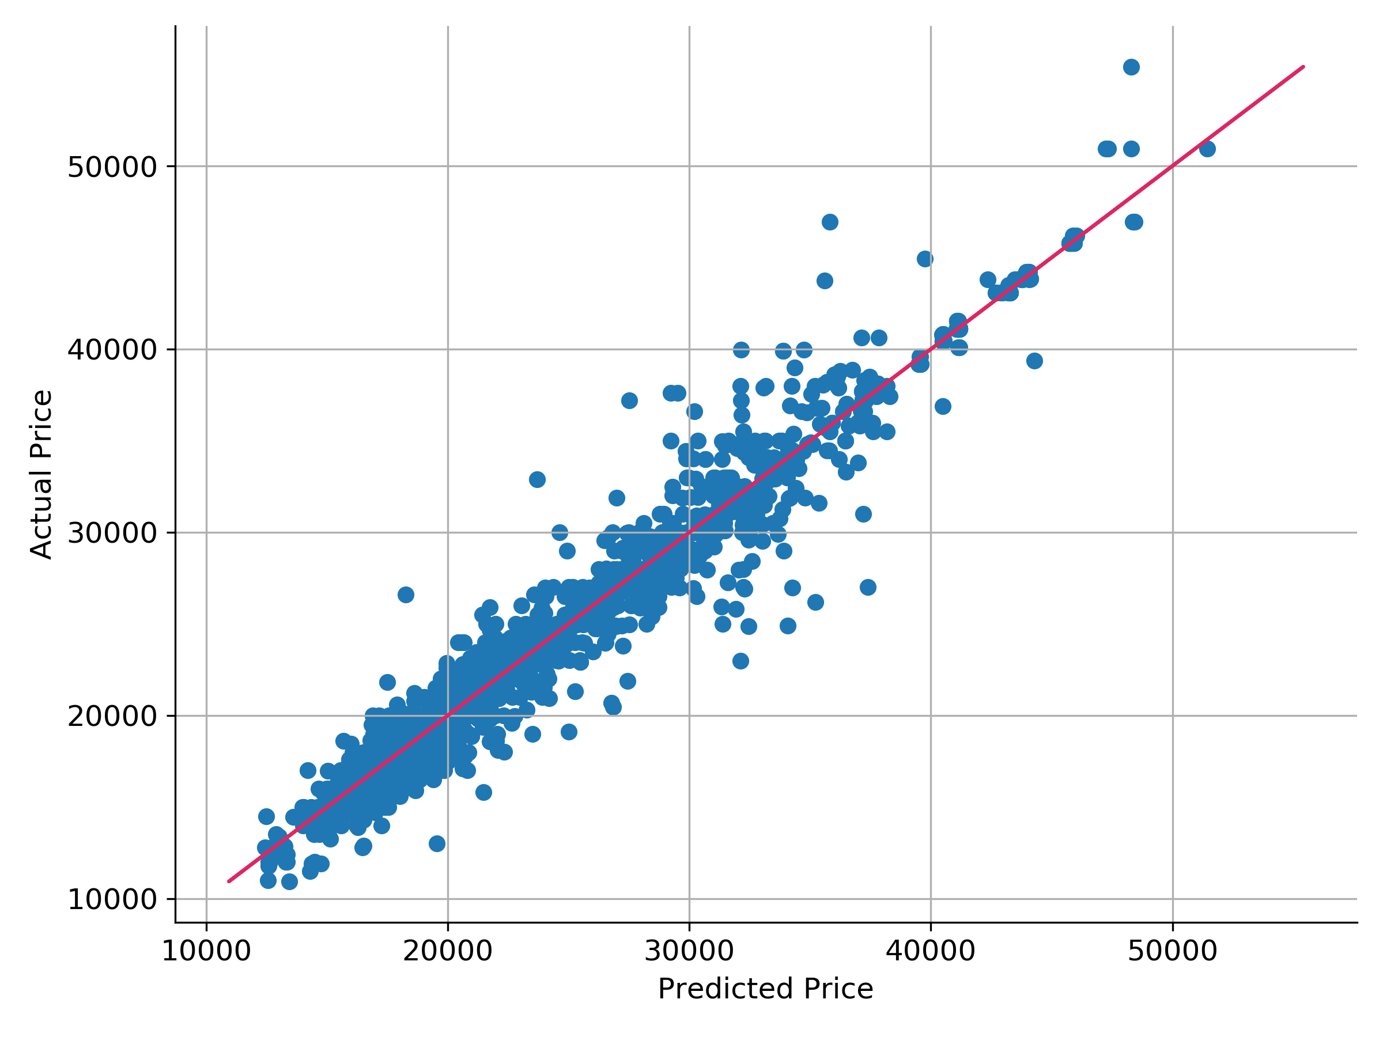
Results
Plotting actual price vs predicted price shows us how well our model predicts across the range of values of our target.
We are looking for red flags (missing high for one range and low for another).
The final test set RMSE was 2207.82.

Slide 8
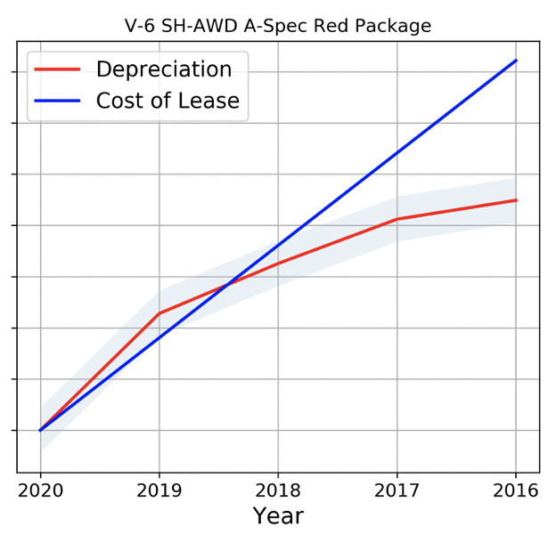
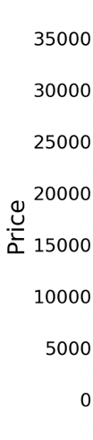
Conclusions
The red line represents the predicted depreciation while the shaded area surrounding represents the 95% confidence intervals.
The cost to lease is $12,000 more expensive.

Slide 9
Future Work
We can model different cars who also have high rated leases and see by how much can you finance a new car that it will still be worth buying and reselling.
Take this problem further and try to model multiple car makes and models that can still accurately predict the value of a car.

Slide 10
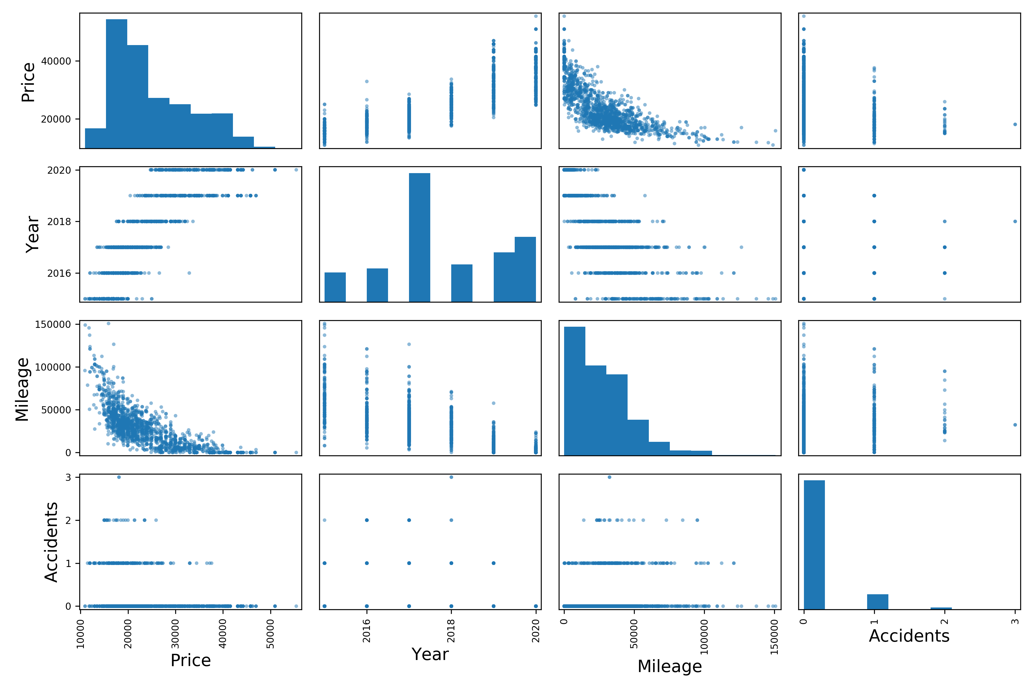
Appendix

Slide 11
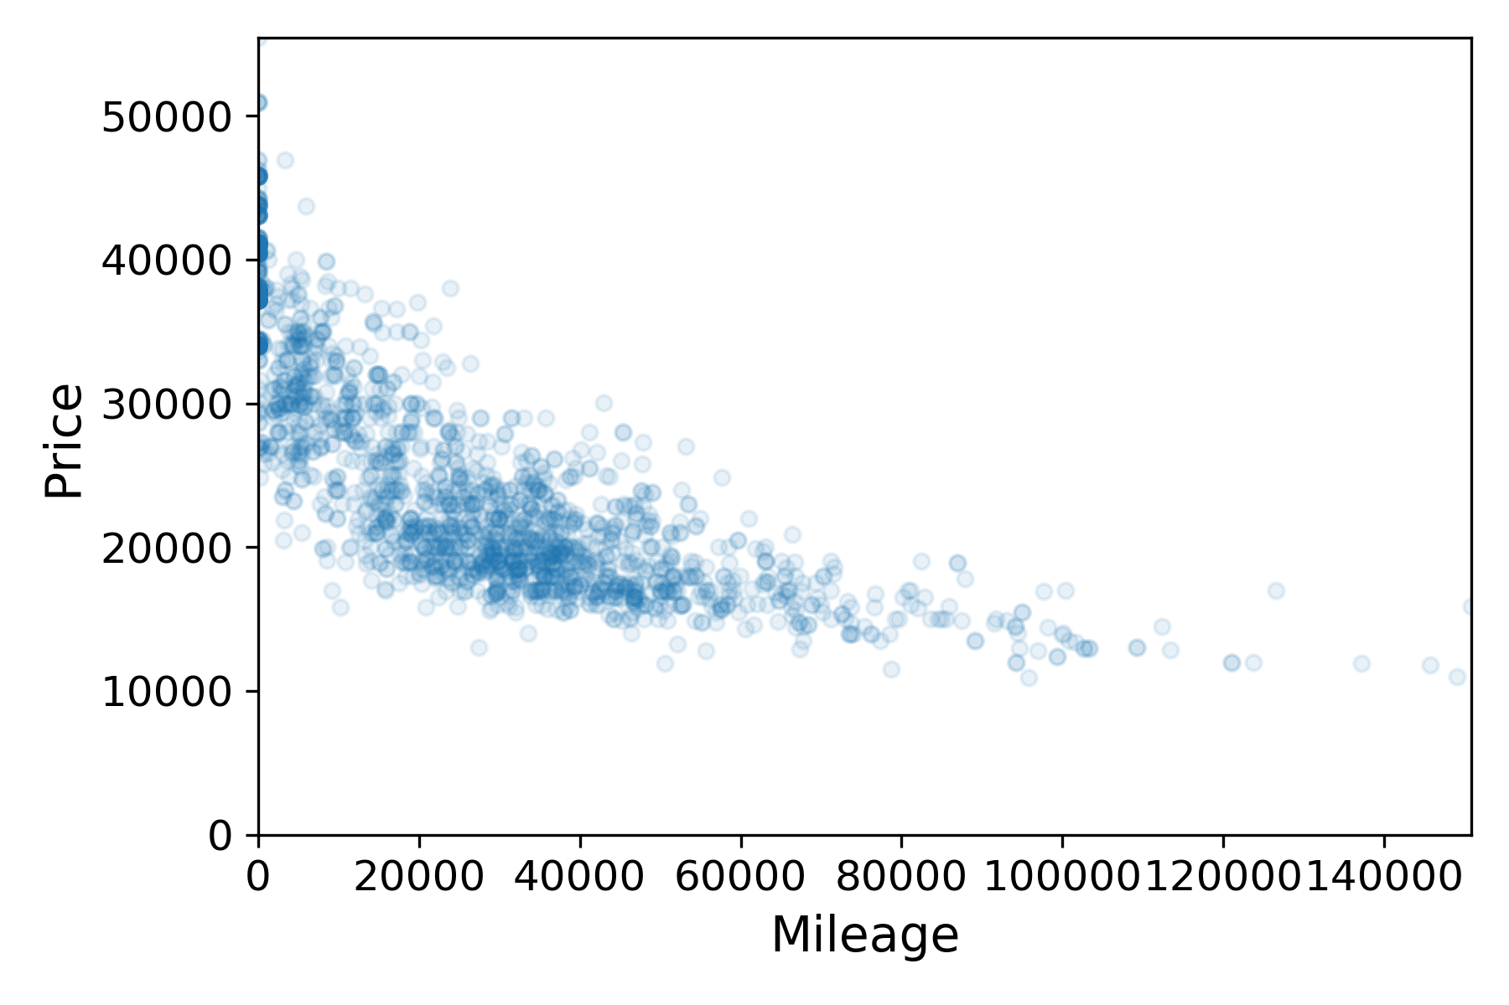
Appendix
The correlation between mileage and price was strong up until about 70,000 miles.
Reconfirms belief that cars depreciate less each year they get older.

Slide 12
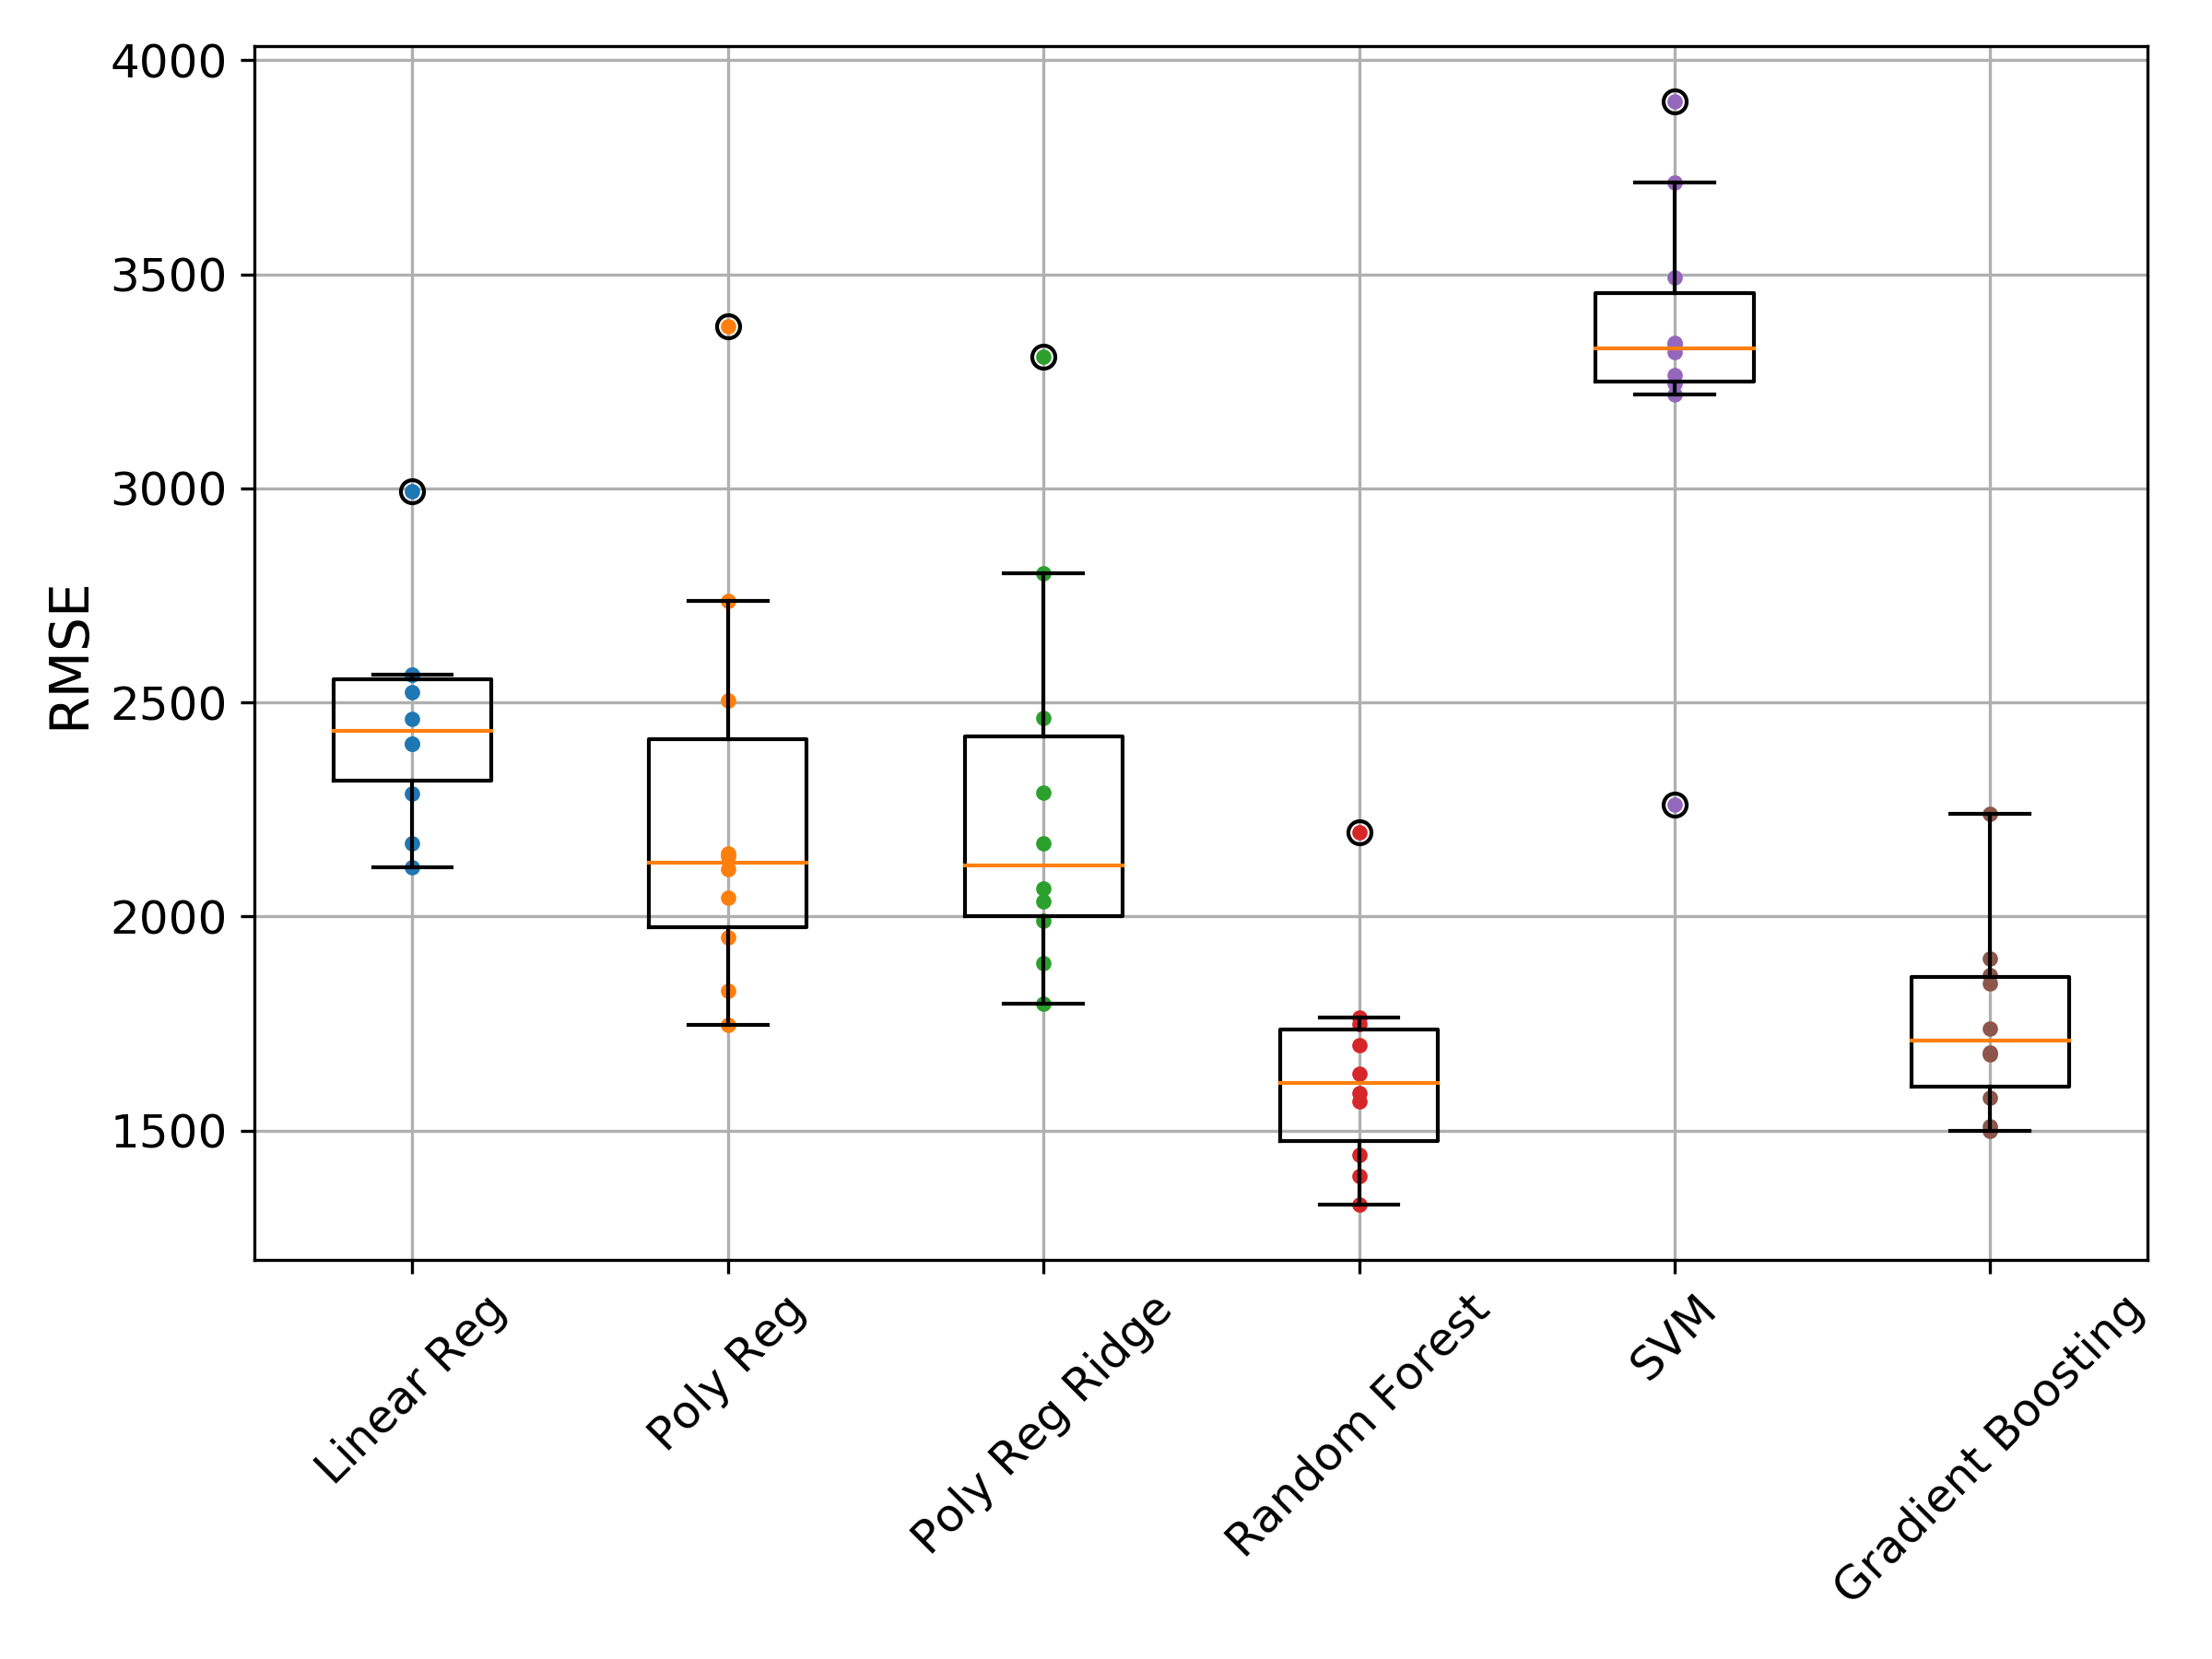
Appendix
We tried 6 different base models to see which algorithms generally performed the best.
Each model was trained with base hyperparameters.

Slide 13
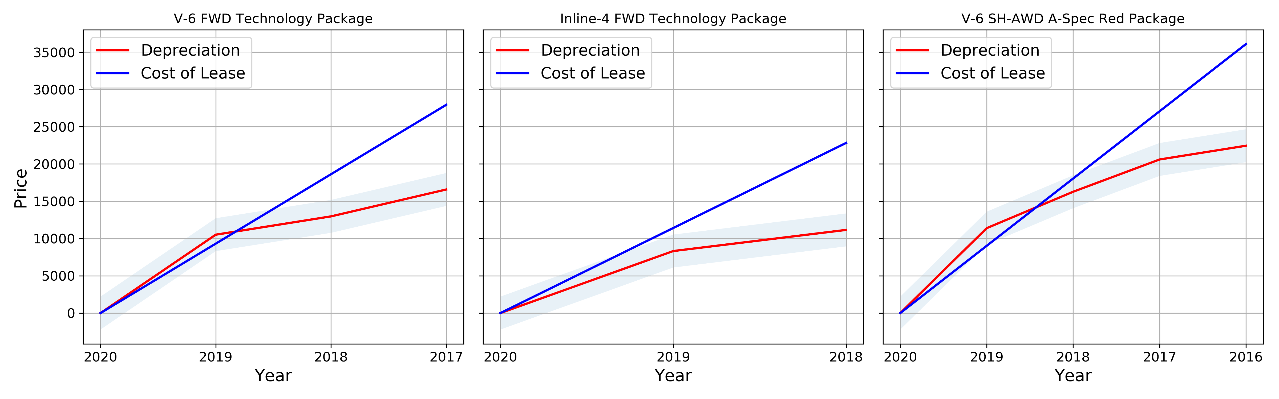
Appendix
With our final model we predict the depreciation of three cars with different specs and compare with their respective leasing cost.

