Slide 1
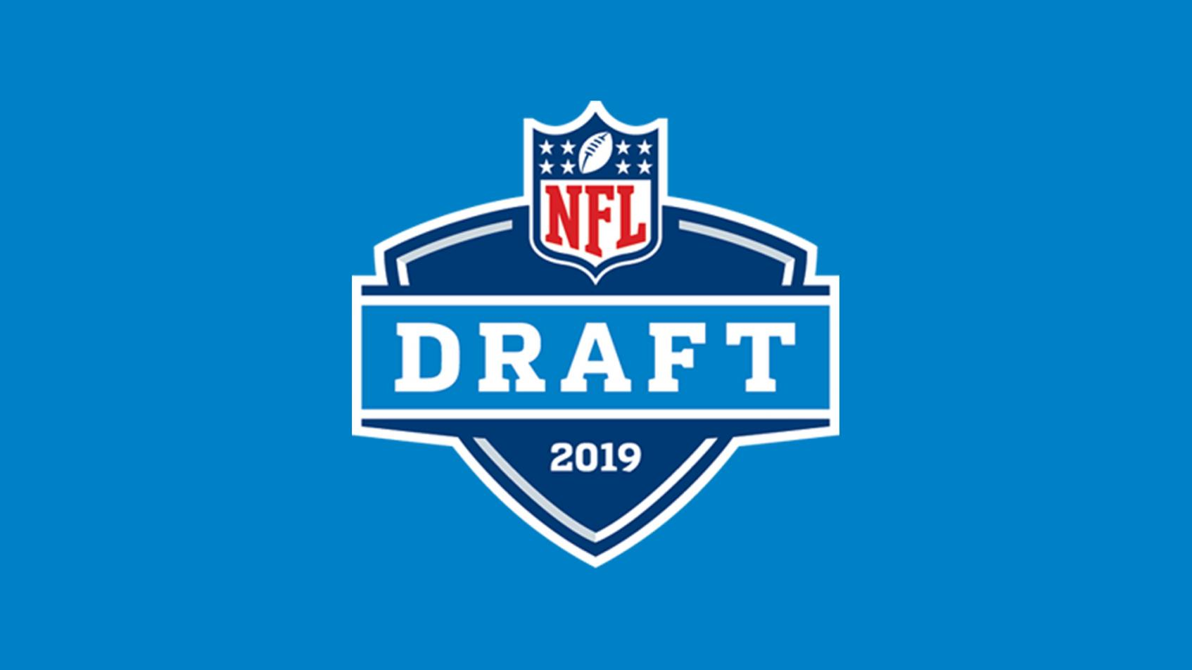
Machine Learning and the NFL Draft
Luke Newman
Notes:
Hello everyone, my name is Luke and I’m going to tell you about the benefits machine learning can have in the NFL DRAFT

Slide 2
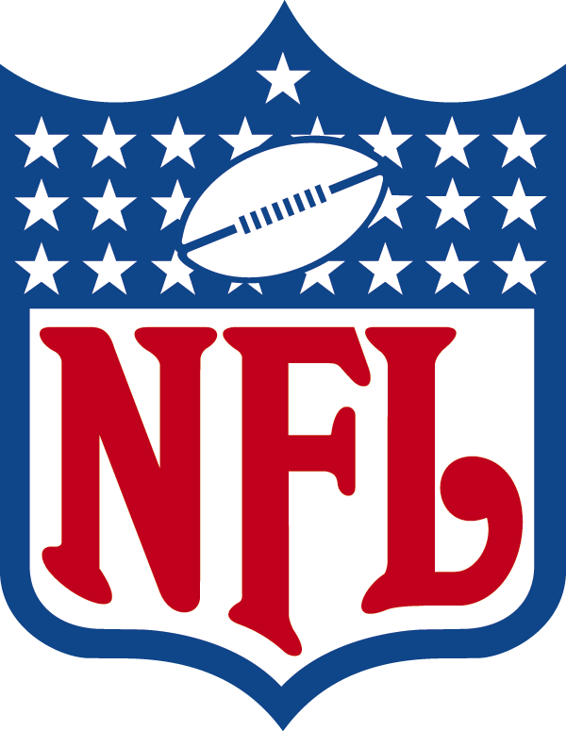
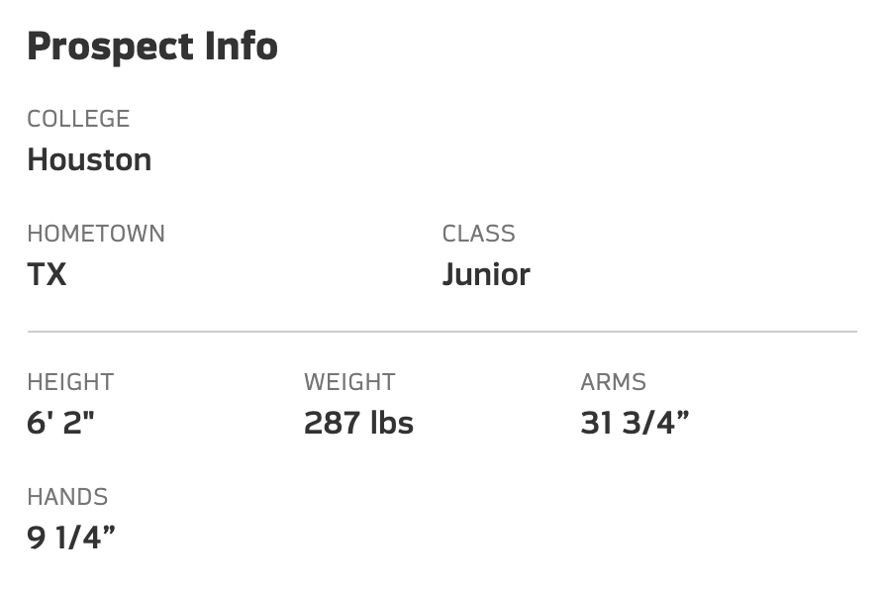
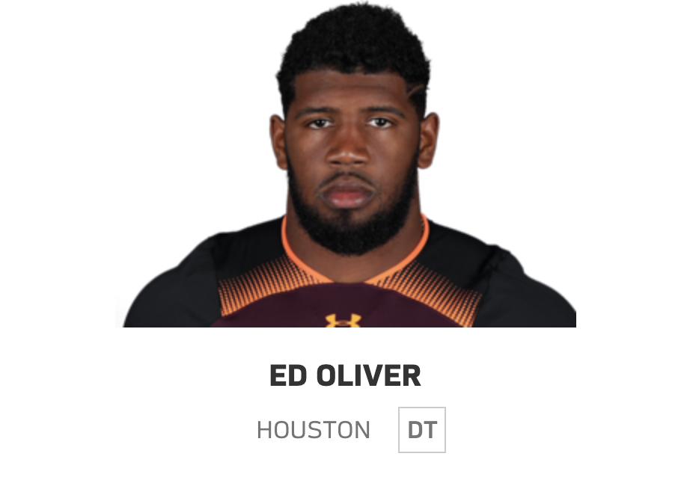
Introduction
Use machine learning to predict college players with good probability of being drafted
Notes:
So every year the NFL draft happens and about 250 college football players will be recruited to a team during one of seven rounds. The first round being the more desired players and the seventh round being less noticed players. My goal is to predict which college players will be drafted based on their stats.

Slide 3
Methodology
Webscraped data
Cfbstats.com
Pro-Football-Reference.com
Used ROC AUC score to measure performance of models
Pandas, numpy, sklearn, imblearn, xgboost
Notes:
My data came from two websites. One with every college football players stats and the other with whether they got drafted. I used ROC AUC score to measure performance of models which has a score of 1 for models which predict perfectly and 0.5 for models which predict right half the time. Tools.

Slide 4
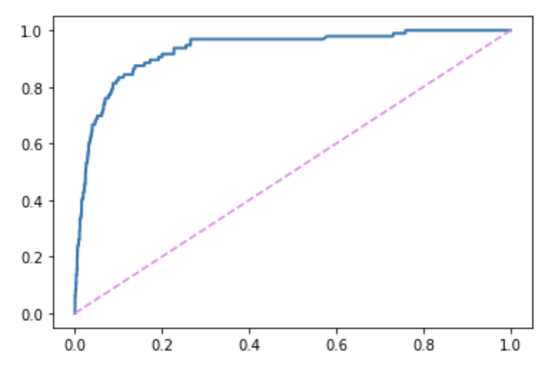
ROC Curve
True Positive Rate
XGBClassifier
ROC AUC Score | 0.935
False Positive Rate
Notes:
This is the ROC curve for my final model. I chose to use gradient boosting which gave me a score of 0.935.

Slide 5
Confusion Matrix
 | Predicted Undrafted | Predicted Drafted
Actual Undrafted | 3607 | 219
Actual Drafted | 39 | 85
Notes:
This is the confusion matrix for my model. The boxes in blue show my model predicted 3607 not drafted players correctly and 85 drafted players correctly out of unseen data consisting of 3800 undrafted and 120 drafted

Slide 6
False Negatives
Drafted Players
Drafted players who were predicted Undrafted
Typically higher round draft picks
Notes:
Now looking at just the false negatives, players who got drafted but my model predicted wouldn’t. They tended to be higher round draft picks.

Slide 7
False Positives
Jr | 43
Sr | 174
Undrafted players who were predicted drafted
Potential late round draft picks
Young future prospects
Notes:
Now looking at the false positives, players who were not drafted but my model predicted they would be. These players consist of your potential late round draft picks and juniors who might have the skill to go pro or are worth to keep an eye out for next years drafted.

Slide 8
Conclusions
Machine learning can help recruiters narrow down search
Late round draft picks can be very crucial
Tom Brady was a 6th round draft pick

Slide 9
Further Work
Gather more data including new features
College
Conference
Wins
Build models based on a given position

Slide 10
Questions?

Slide 11
Appendix
Hyper parameter tuning can take a long time but is very important for
models that don’t come with good default settings. Using
RandomizedSearchCV and GridSearchCV boosted performance
Dealing with imbalanced data can be arduous. Using oversampling
techniques help a lot but require a lot more model testing

