Slide 1
Predicting Short-Term AQI with Weather and Pollutant Data
Aaryaveer Somani, Jeenay Dedhia, Ian Schmitz, Luke Nobrega
11/23/25
Notes:
We’re Group 7, and our project is focused on predicting short-term air quality index—or AQI—using weather and pollution data.
We chose this topic because air pollution is a major issue affecting public health, and being able to forecast AQI even an hour ahead can help authorities issue timely health alerts and guide urban planning decisions.
We’ll walk you through our project goals, the data we used, our analysis, the models we built, and our final insights and recommendations.”

Slide 2
Project Goal
Objective: Predict next-hour NO₂ based on recent pollutants and meteorological features.
Why this matters: Enables earlier public warnings and smarter city planning.
Models Used: Linear Regression (baseline), Random Forest, Gradient Boosting.
Evaluation Metrics: RMSE, MAE, R² on chronological 80/20 train-test split.
Data Cleaning Steps: Handled missing values (–200), converted commas to dots, merged Date + Time, interpolated gaps.
Found around the house!
Notes:
Our purpose is clear — forecast near-term NO₂. We structured the pipeline around supervised regression. We standardized data preparation to make results reliable and reproducible. The three chosen models give a good balance: interpretability, non-linearity, and robustness.

Slide 3
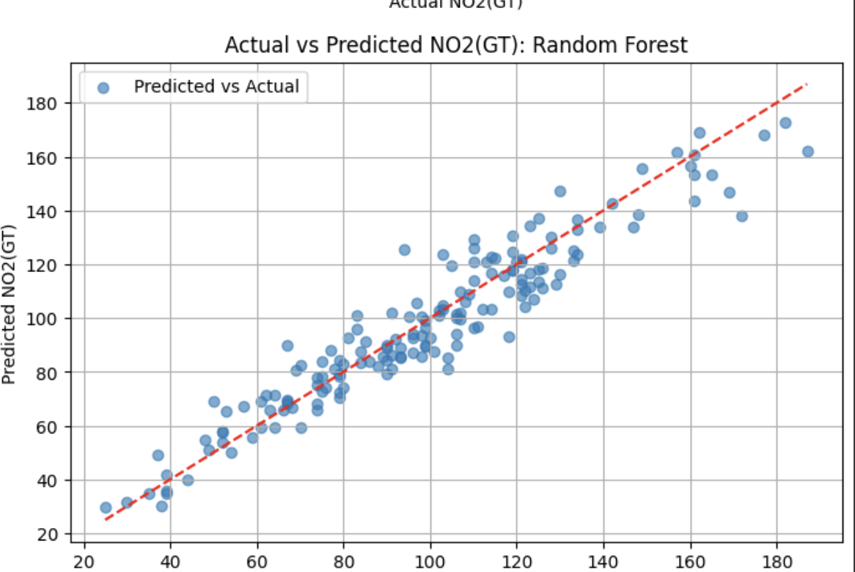
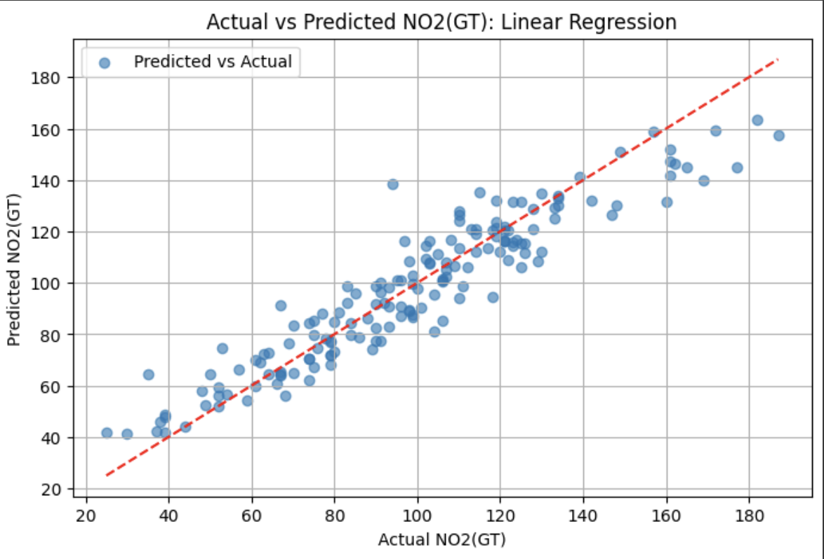
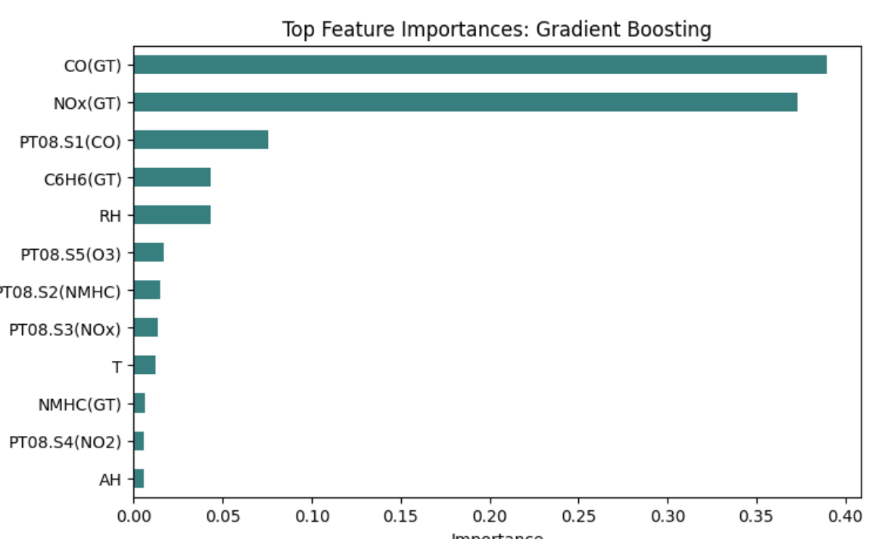
Data Summarization & Visualization
Data Preparation and Steps:
Removed invalid readings (-200)
Converted commas to decimal points
Merged date + time field into single timestamps
Interpolated small gaps in the Data
Key Insights From Data:
NOx(GT) and CO(GT) show the strongest relationship with NO₂
Temperature also coll with NO₂ levels
Pollution shows spike patterns - indicates nonlinear behavior
Helps explain why tree-based models perform better
Notes:
Luke

Slide 4
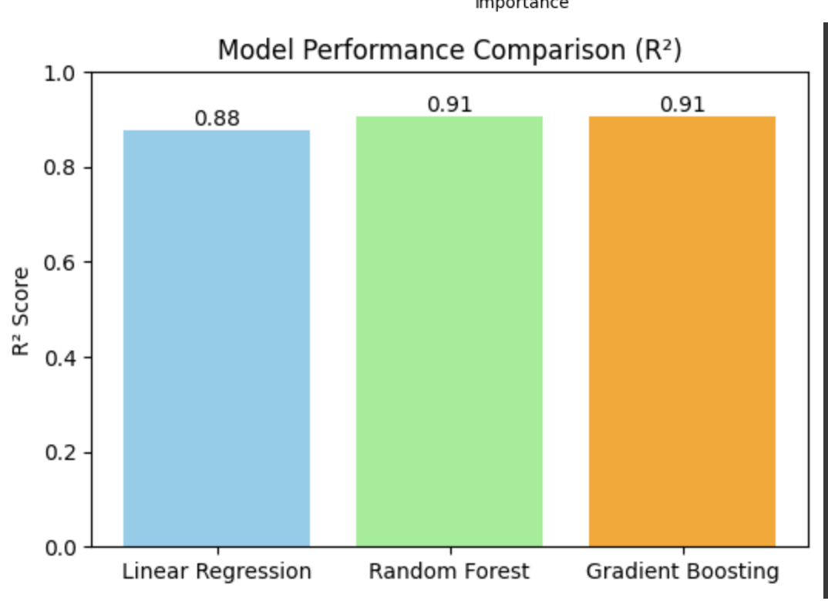
Performance Trend (Bar Chart Insight):
Linear Regression: R² = 0.876
Random Forest: R² = 0.907
Gradient Boosting: R² = 0.906
Key Takeaways:
All three models performed exceptionally well, suggesting your dataset is strong and well-structured.
Random Forest slightly outperformed others and is the recommended final model for stability and interpretability.
Gradient Boosting provides nearly identical accuracy but with higher complexity.
Linear Regression remains useful as an interpretable benchmark.
Data Mining Modeling
Notes:
Ian - “All three models achieved R² values above 0.87, which is excellent for real-world pollution data. Random Forest slightly edges out the others, offering a great balance of accuracy and interpretability. These results confirm ensemble methods’ superiority for air quality prediction, while still validating the strength of our linear baseline.”

Slide 5
CONCLUSION
Model Summary:
Model R2 RMSE MAE
0 Linear Regression 0.876278 11.560298 8.946636
1 Random Forest 0.907493 9.996158 7.711486
2 Gradient Boosting 0.905679 10.093707 7.825863
Key Insights
NOx(GT) and CO(GT) are the main drivers of NO₂ levels.
Linear Regression (R² = 0.876) shows strong linear predictability.
Random Forest (R² = 0.907) captures nonlinear effects and yields the best balance of accuracy & stability.
Gradient Boosting (R² = 0.906) matches RF accuracy and excels at short-term fluctuation tracking.
Implications & Recommendations
Predictive models can forecast pollution spikes and aid early-warning systems.
Use Random Forest for ongoing NO₂ monitoring and decision support.
Integrate live traffic + weather data to enhance real-time accuracy.
Retrain models seasonally to adapt to changing conditions.
Notes:
“Gradient Boosting matched Random Forest’s accuracy with an R² of about 0.91. It’s particularly good at capturing the short-term peaks in NO₂, showing responsiveness to rapid changes. The residuals are tightly centered, confirming balanced predictions. This model refines the performance but is computationally more intensive.”

