Slide 1
Spirits Industry Data Analysis

Slide 2
Executive Summary
Questions the Graphs help answer:
Is the market growing because of more volume or higher value per case?
How do each category if liquor compare?
Which countries are fastest-growing or have the most value per case?
Main Idea:
US market shifting from volume-based growth to value-based growth.
Premiumization and higher-value categories are becoming more important than cases sold
Key Points on graphs:
Min, Max, 2019(pre-pandemic), 2026 and 2030 forecast

Slide 3
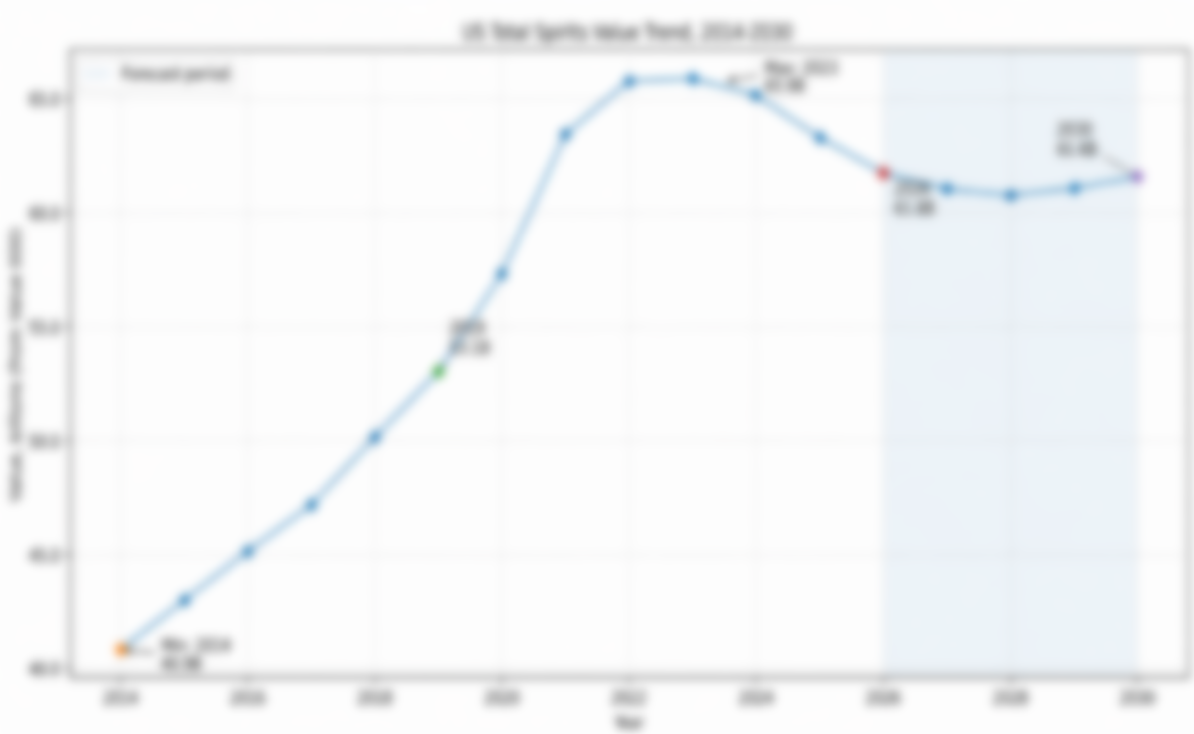
Us Market baseline: Total Spirits value trend
Shows scale and direction of U.S. spirits market as a whole
Insights: although the total value is currently falling, it should level out soon and has shown an overall upward trend

Slide 4
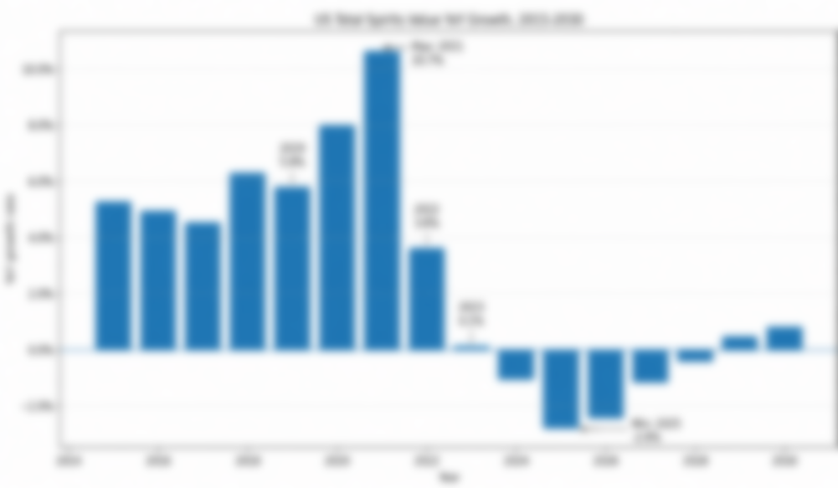
Us market baseline: Total Spirits value Yoy growth
Highlights volatility.
Questions:
Is growth sustainable?
Insights:
Since 2023, we haven’t seen much growth

Slide 5
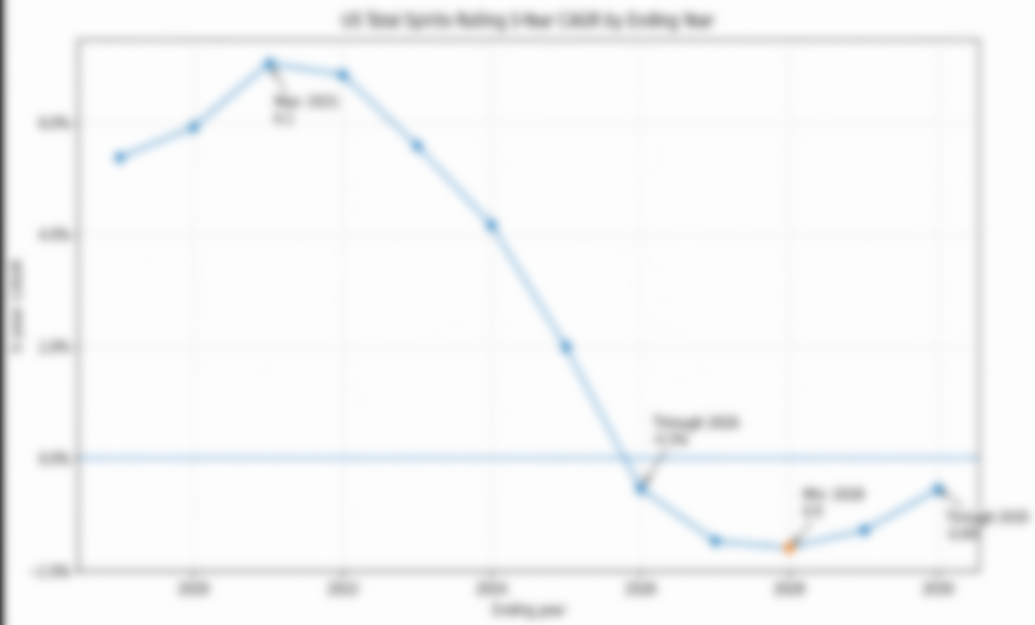

Us market baseline: Total Spirits 5-year cagr
CAGR smooths annual swings.
Questions:
Is growth sustainable?
Note: max value .1 due to rounding. Looks to be around 7.4%. Min around -1.6%

Slide 6
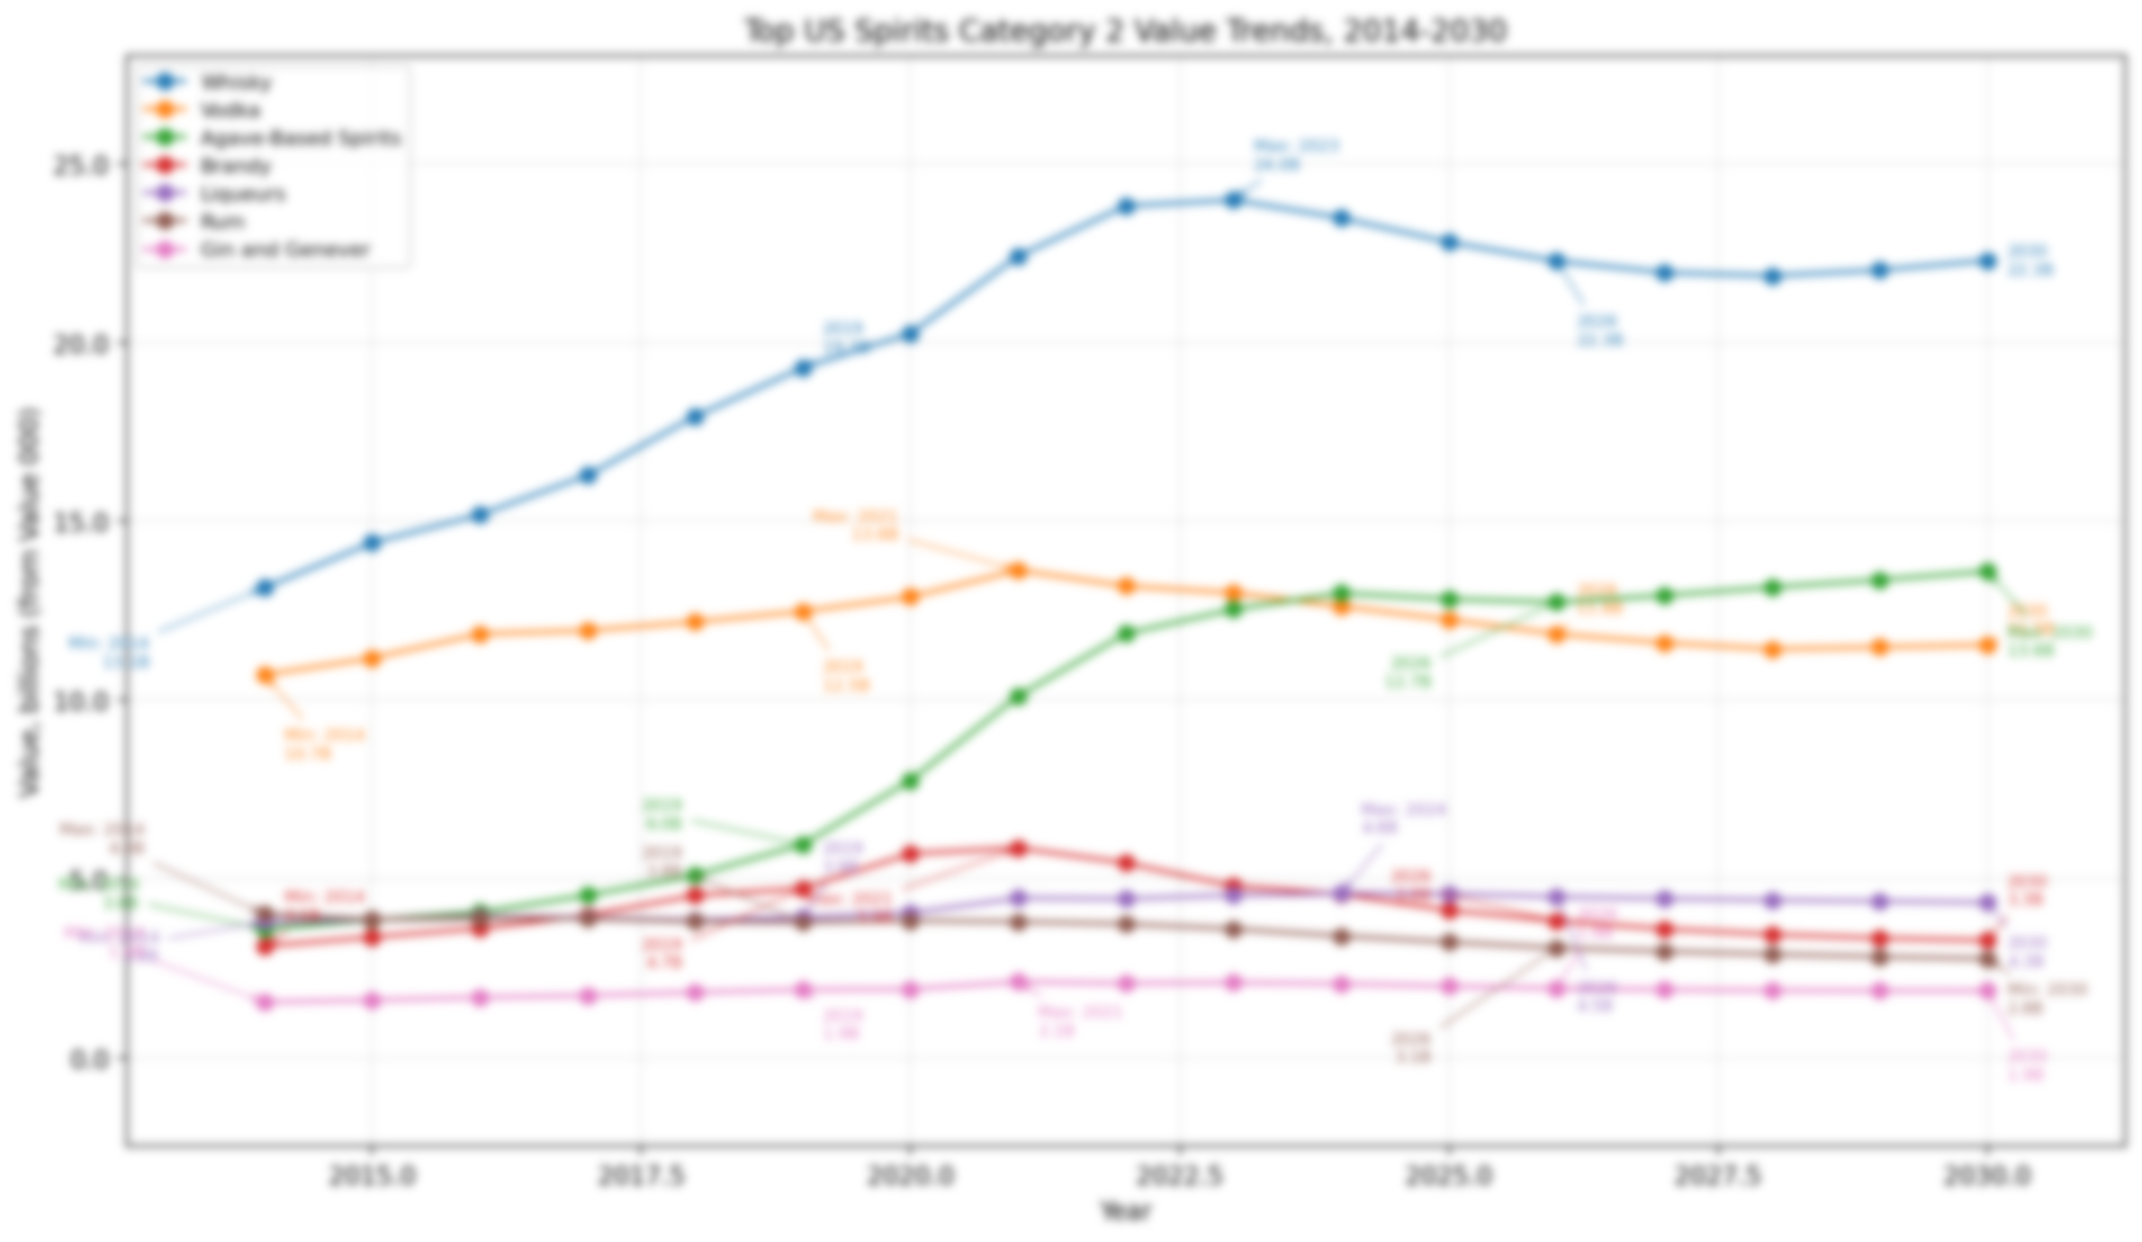

US Categories: Value Trends
Compares trajectory of each category.
Agave is main outlier in downward trend. Whisky also seems healthy.

Slide 7
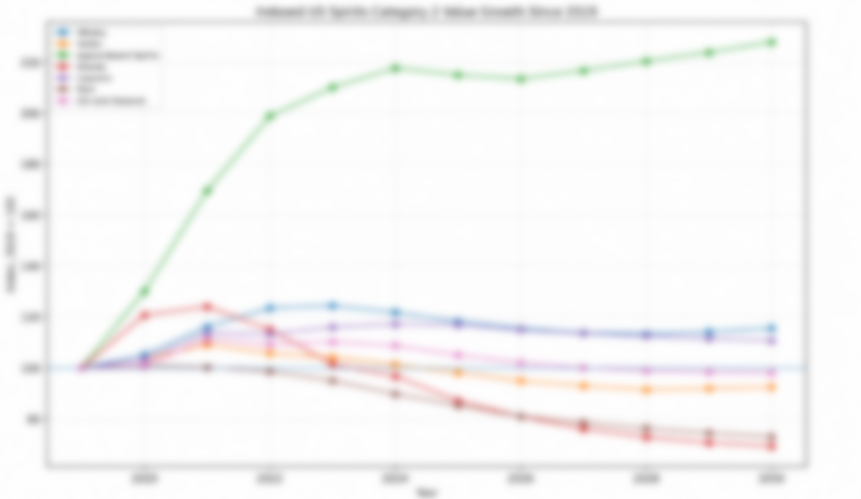
Us Categories: Indexed Category Growth
Starts every category at one point to show how each category grew/declined since 2019.
100-120 = 20% growth
Agave has had explosive growth while whisky and liqueurs are steady

Slide 8
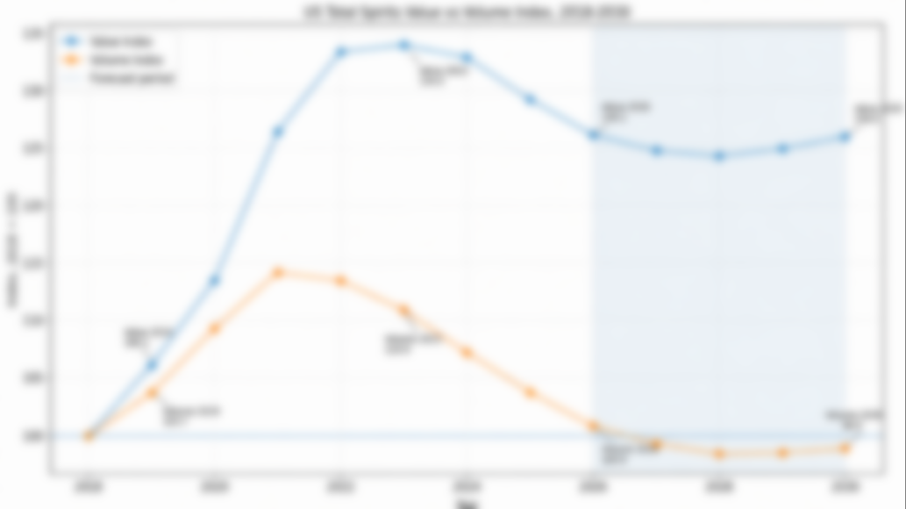
value vs volume: US index
Shows if growth is coming from cases or value per case.
Based on the index, we can see the value is growing at a higher rate than volume.
By 2030, Value will grow by 26% while volume drops 1.1%

Slide 9
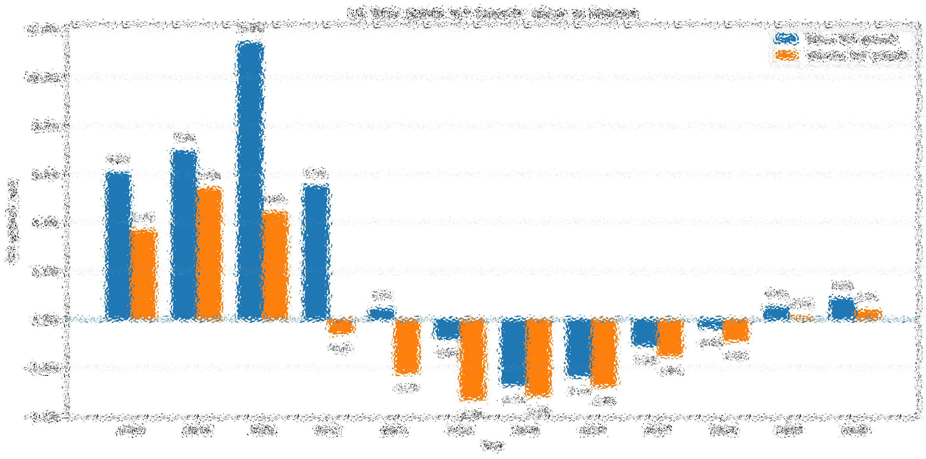
Value vs Volume: US Yoy growth
Should we focus on volume or value-lead positioning in each period?
Value outperforms volume in YoY growth every time.

Slide 10
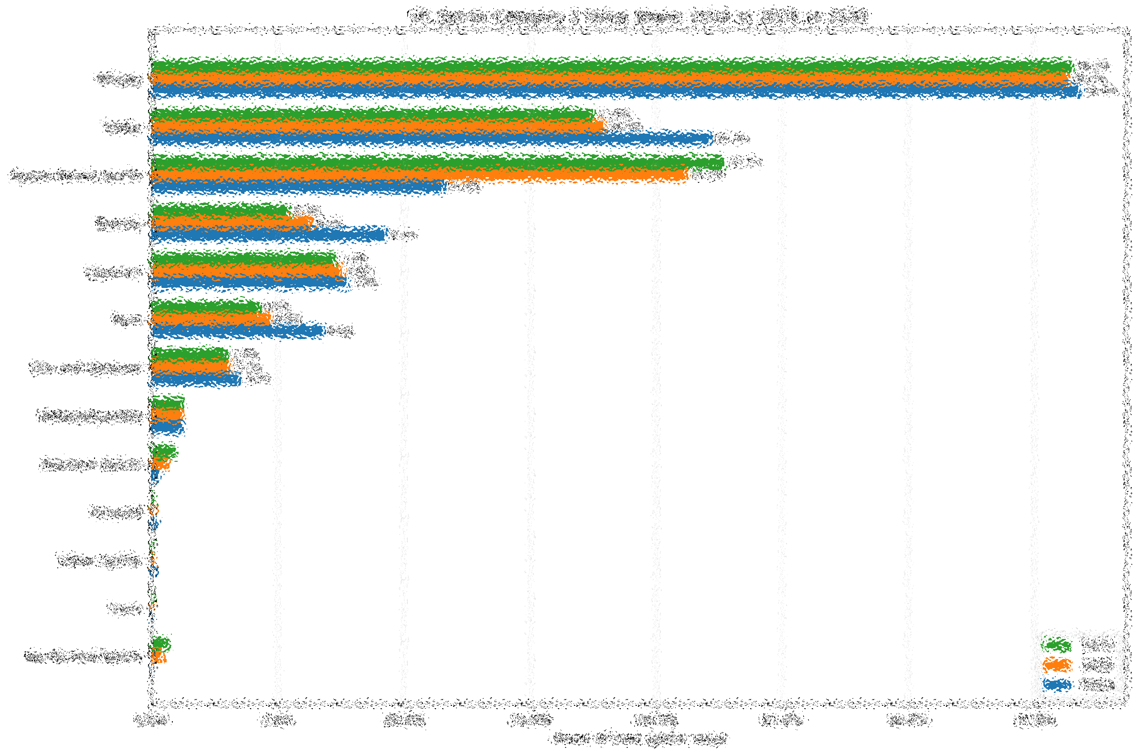
Us category Value Share
Benchmarks of each category against each other.
Agave seems to be the biggest grower while Vodka, Brandy, and Rum seem to be going the wrong direction

Slide 11
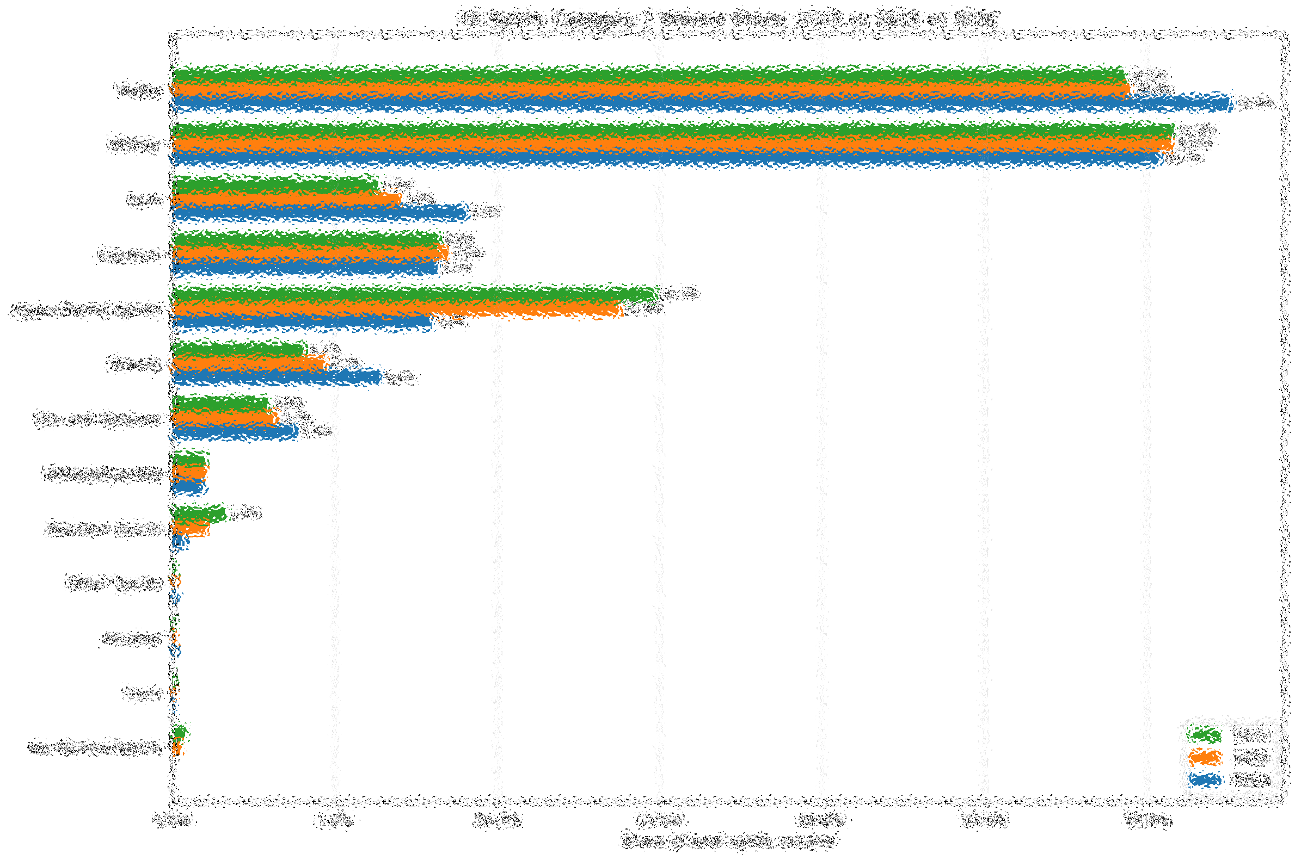
Us category Volume Share
Volume share for comparison with value
This shows that Vodka has a very high volume share but lacks value. Whiskey has high value as well as volume.

Slide 12
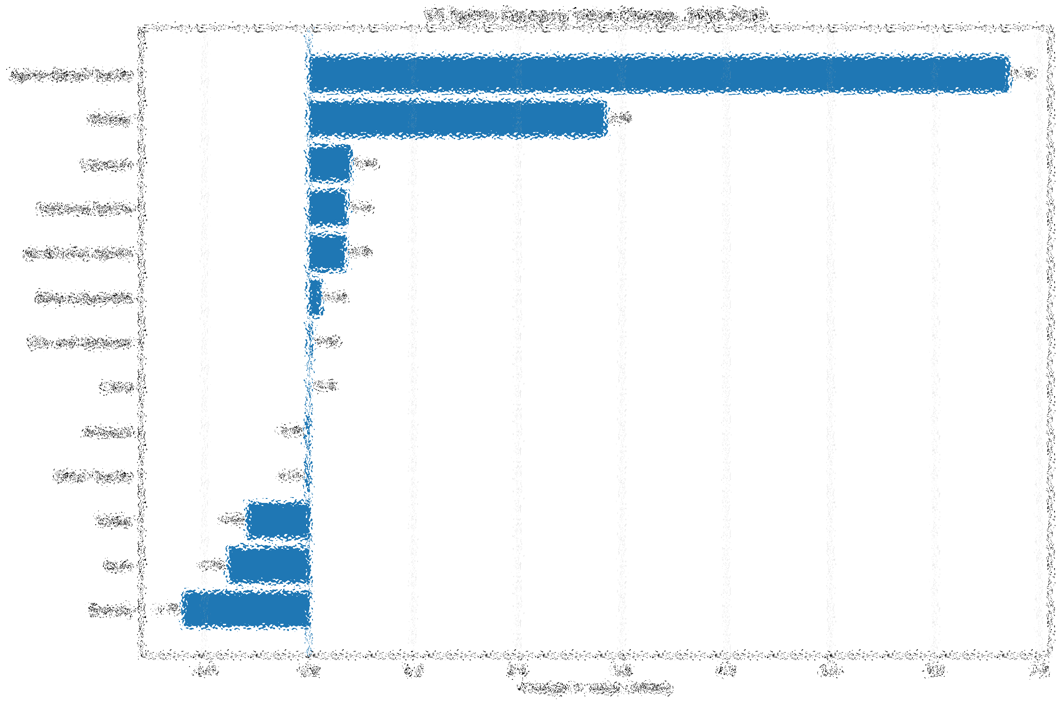
Us Category Value Change
Shows which categories are gaining the most value from 2019-2030
Agave has changed the most while whisky is also looking healthy

Slide 13
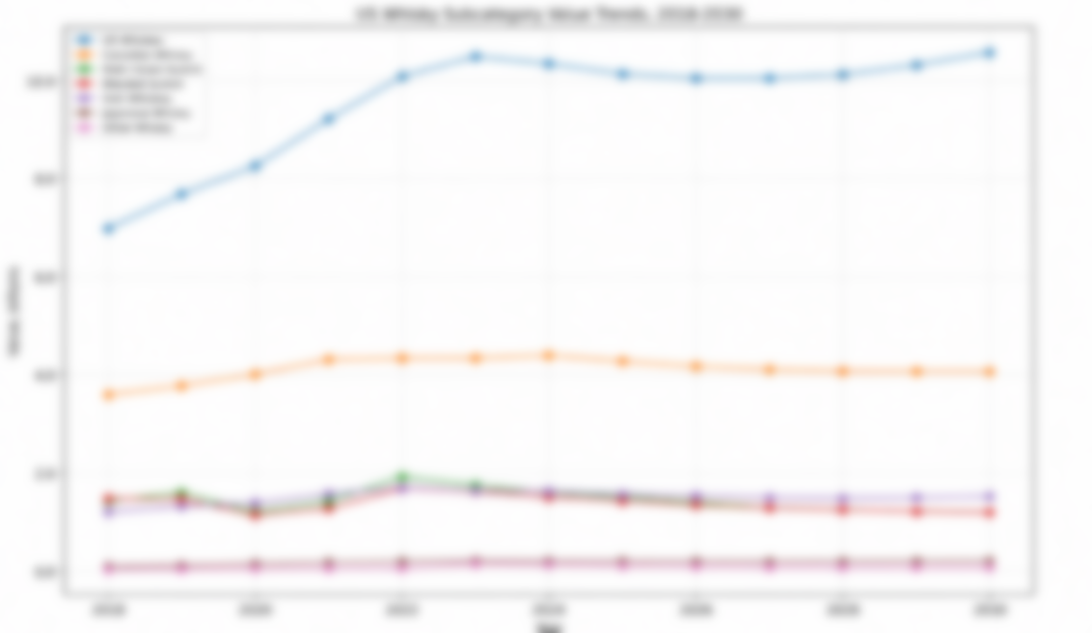
Us whisky subcategory trends
More useful for Sagamore. The U.S. Whiskey outperforming the others looks promising.

Slide 14
Global Data

Slide 15
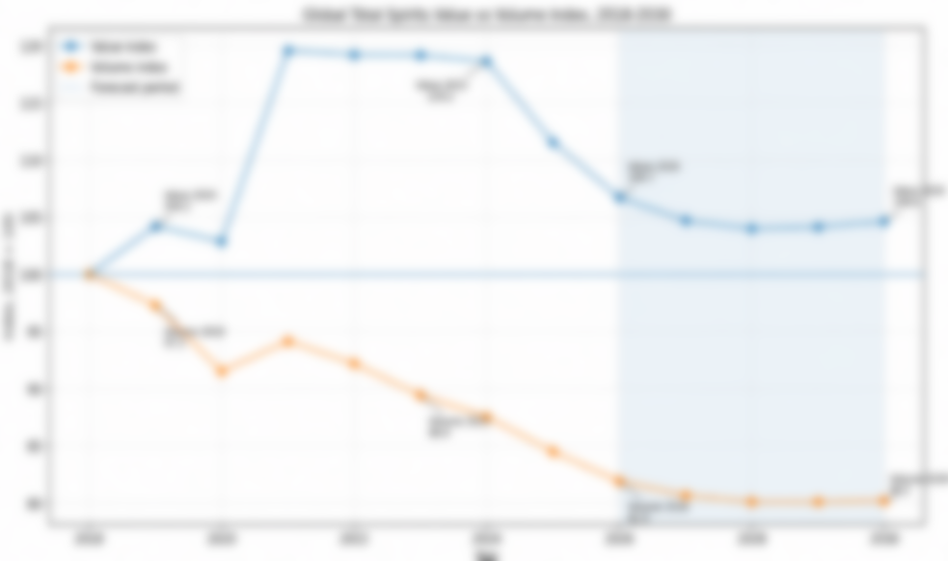
Global Value vs Volume index
Shows global premiumization
Globally, the value has increased less compared to the U.S., and the volume has decreased more as well
(U.S. is beating global market)

Slide 16
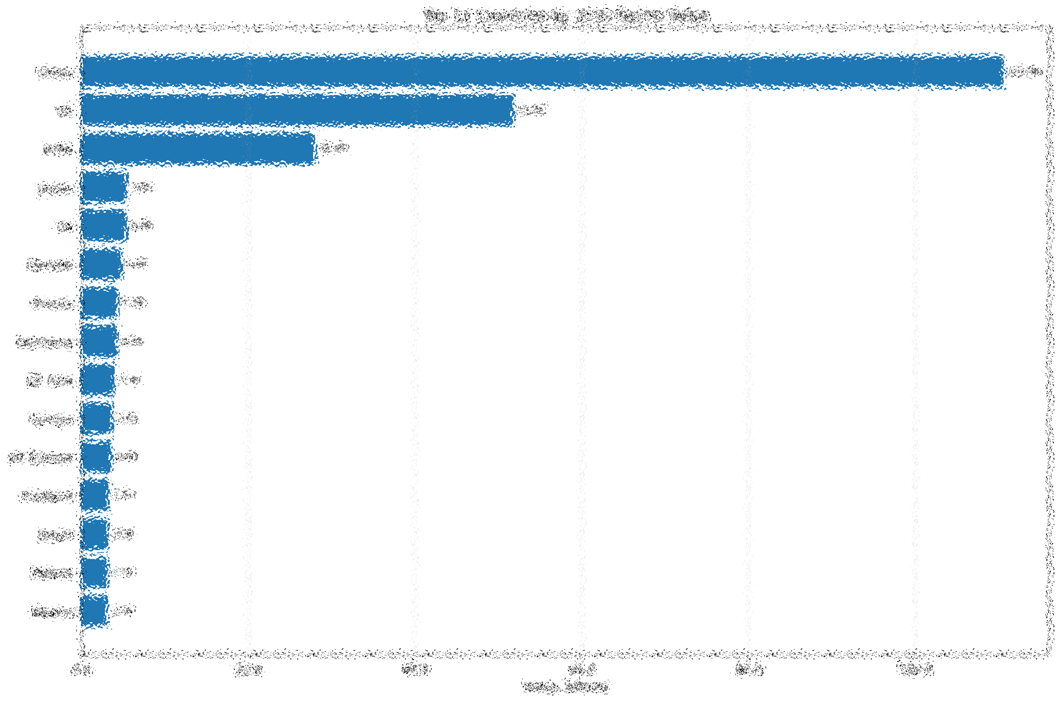
Top 15 countries by 2030 volume
Identifies largest value pools for distribution

Slide 17
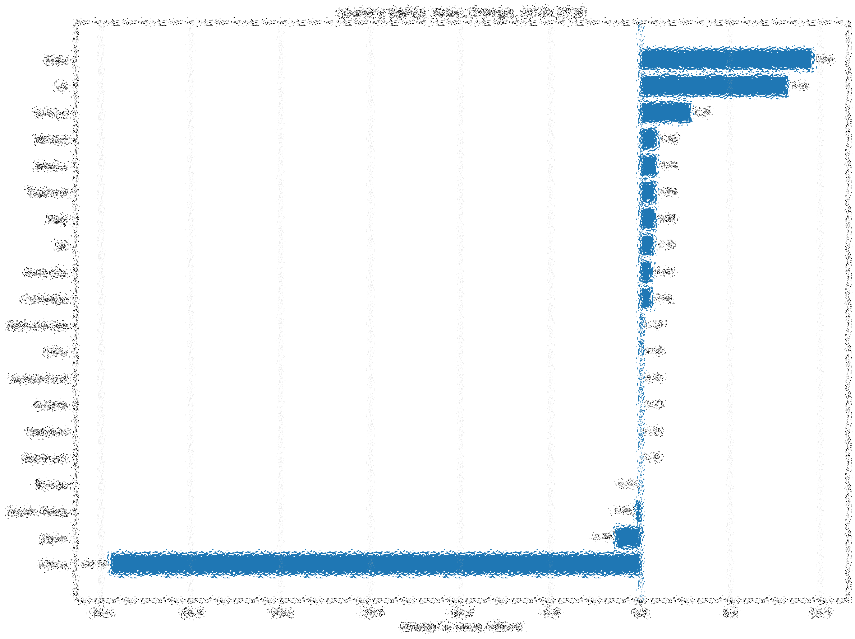
Country Value Change 2019-2030
Shows where largest incremental value is expected.
Although China is the largest market, it is shrinking the fastest.

Slide 18
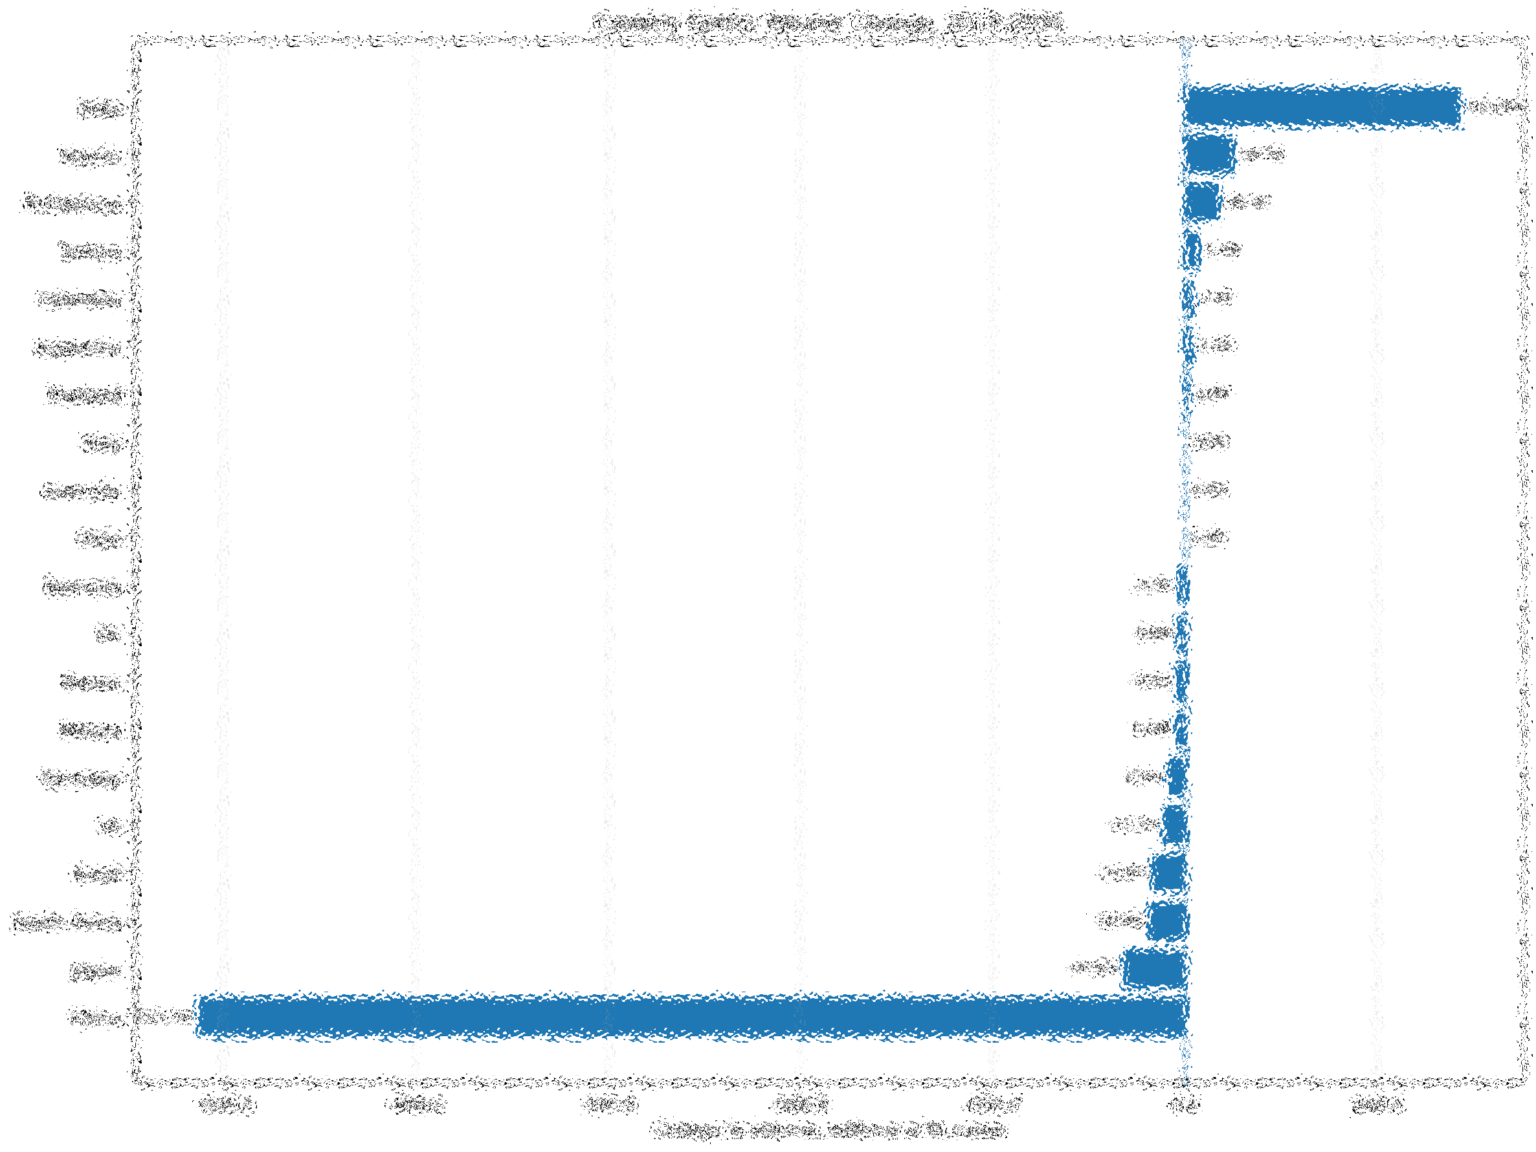
Country Volume Change 2019-2030
Shows whether market growth is relative to more cases or mainly value.

Slide 19
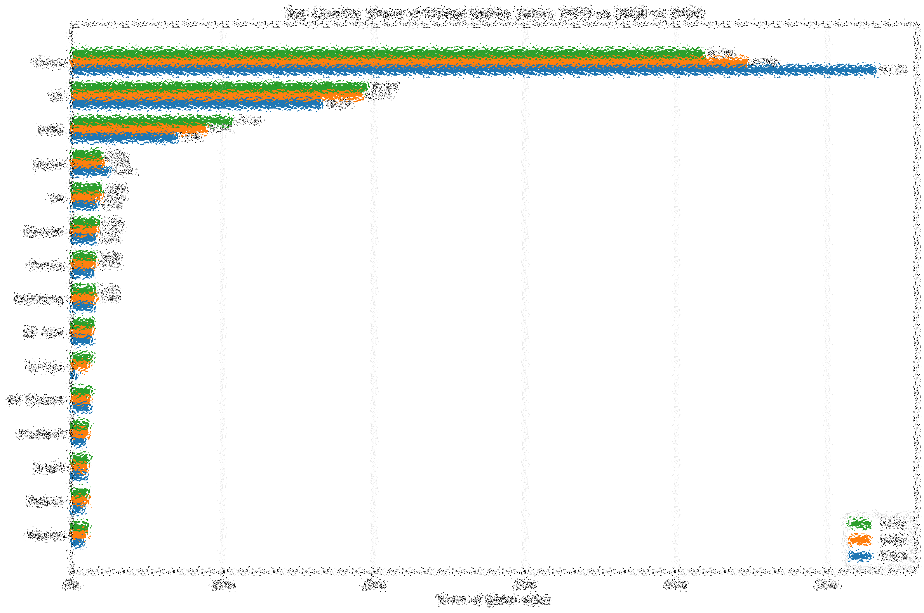
Country share of global value
Shows markets gain/loss of relevance.
China is still dominating the market but will continue to shrink.

Slide 20
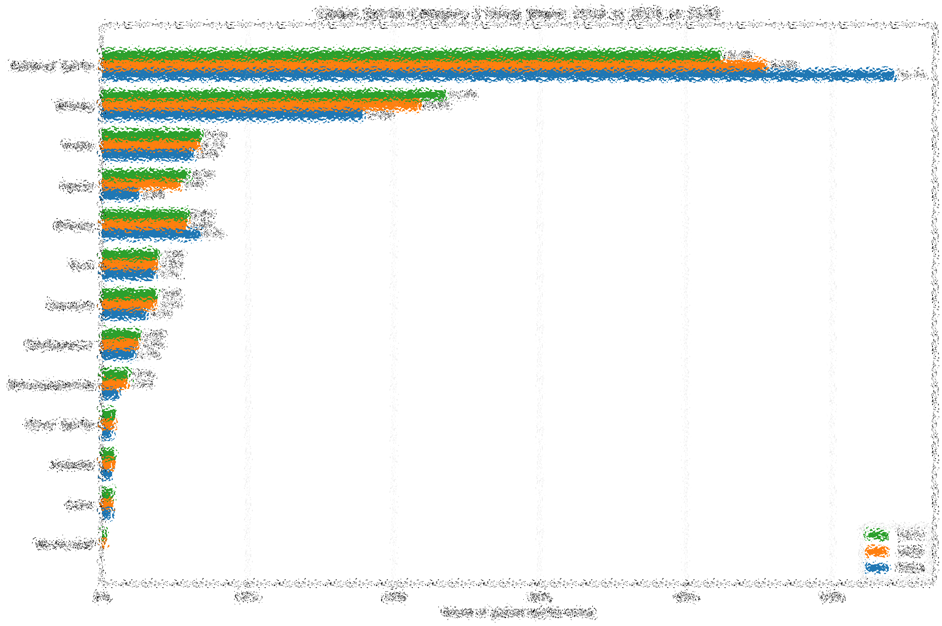
Global Categories: Value Share
Shows categories value share across the world rather than just U.S.
Both whisky and liqueurs are gaining traction; good news for us

Slide 21
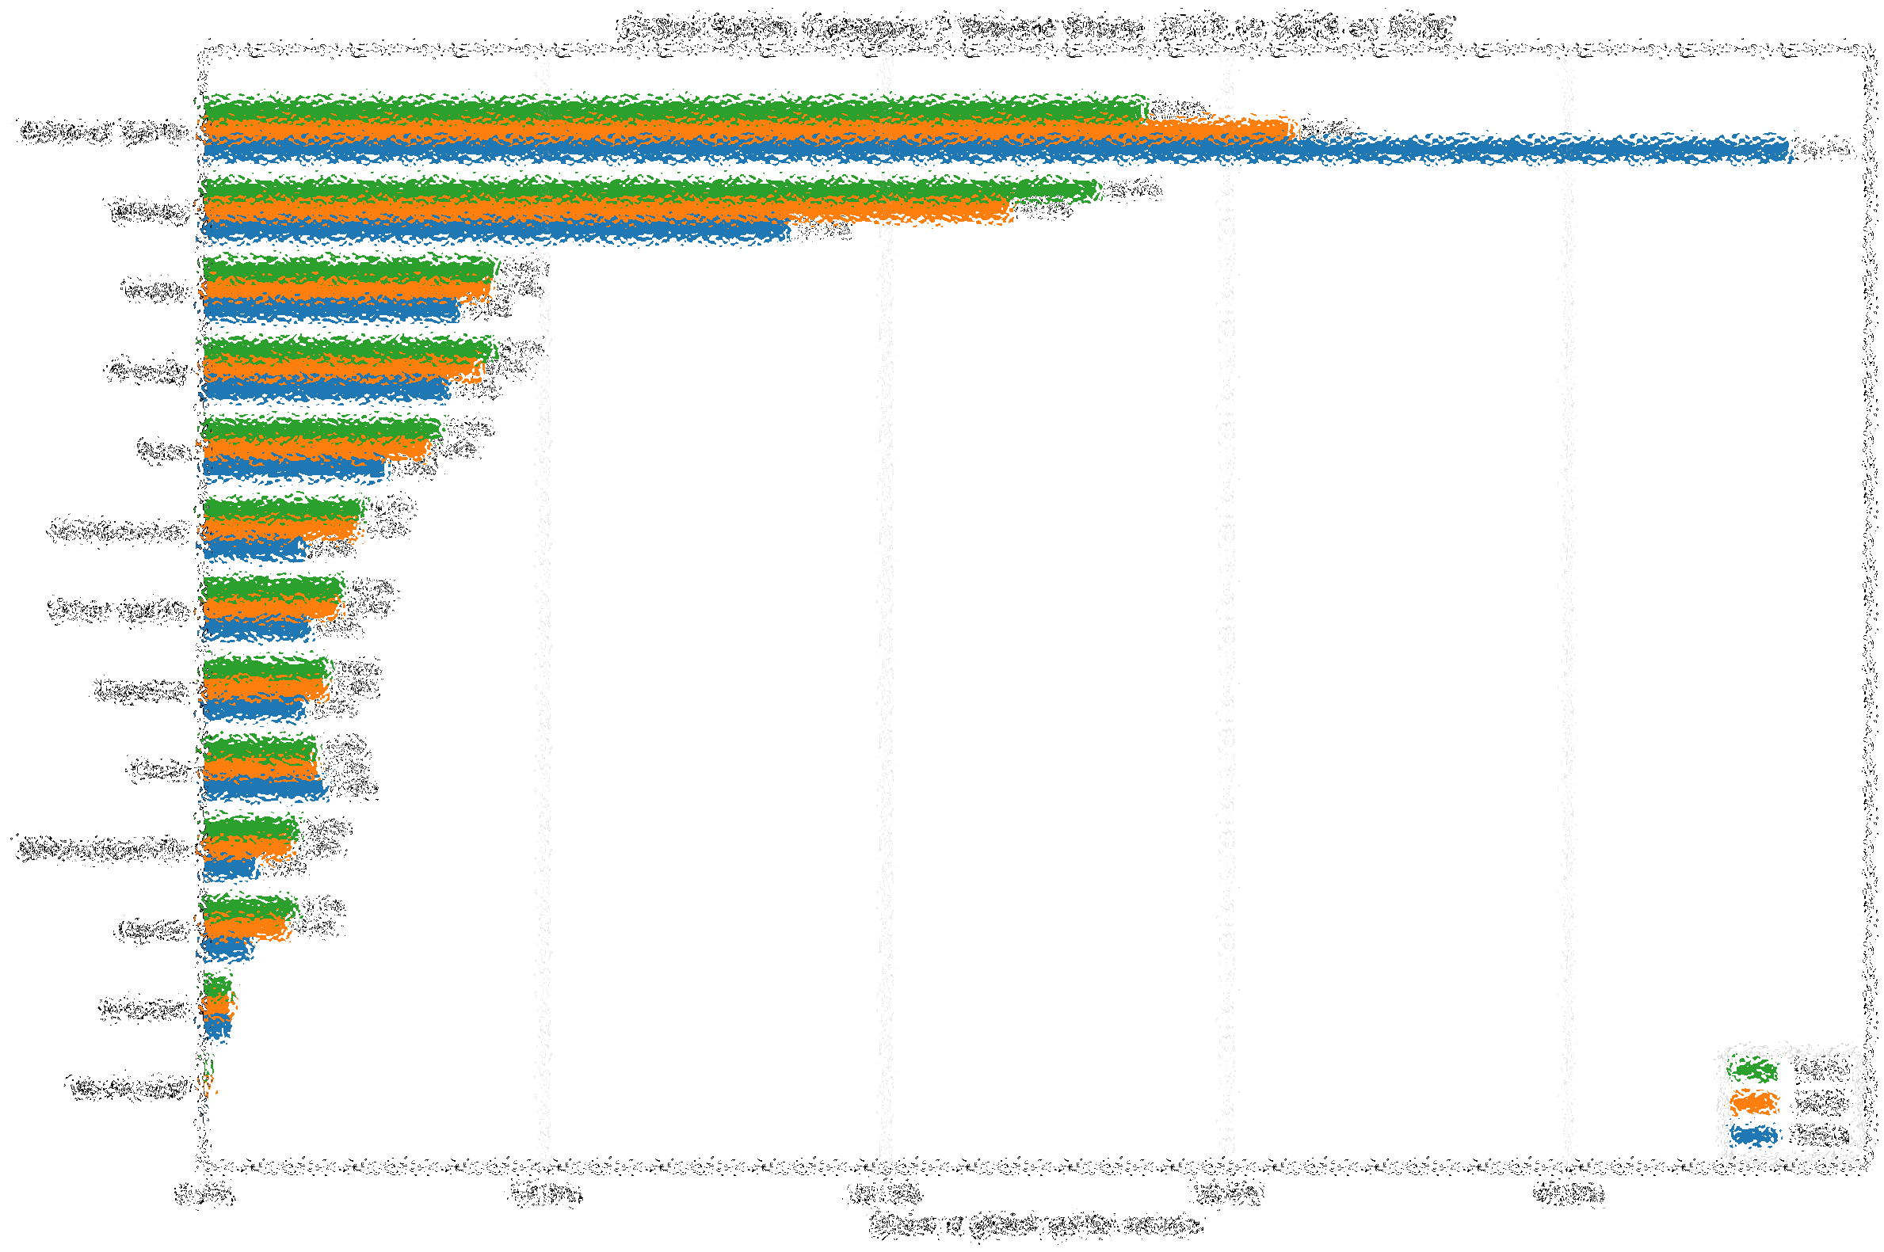
Global Categories: Volume Share
Shows categories volume share across the world rather than just U.S.

Slide 22
Conclusion
The main takeaway is that although we see the volume of the spirits industry shrinking, there is still a slight increase in value overall. This may mean that it is a good idea to focus on margins per case, rather than emphasize sales quantity. It also seems like the whiskey market is the safest market that we have in our portfolio, with both U.S. (Sagamore) and Irish (The Busker) whisky being safe subcategories.
New venture opportunities: TEQUILA!!!!!

