Slide 1
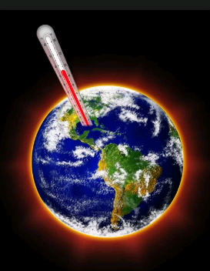
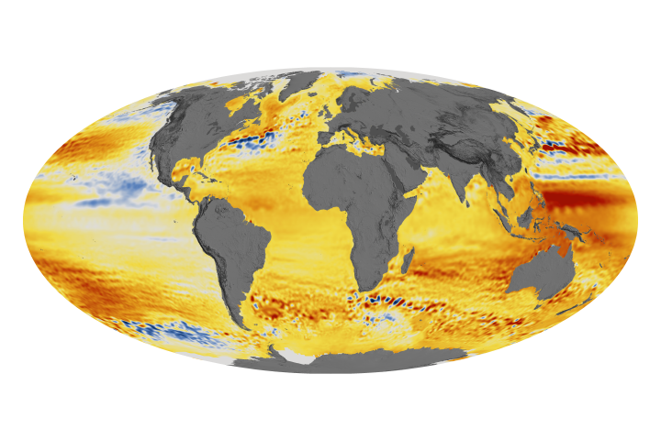
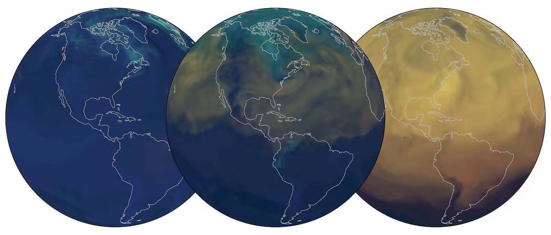
Global Trends in Temperature, Water Level, and CO2 Emissions
- Gabriela Aparcana Contreras
- Jake Altom
- Kaden Evans
- Luke Nobrega

Slide 2
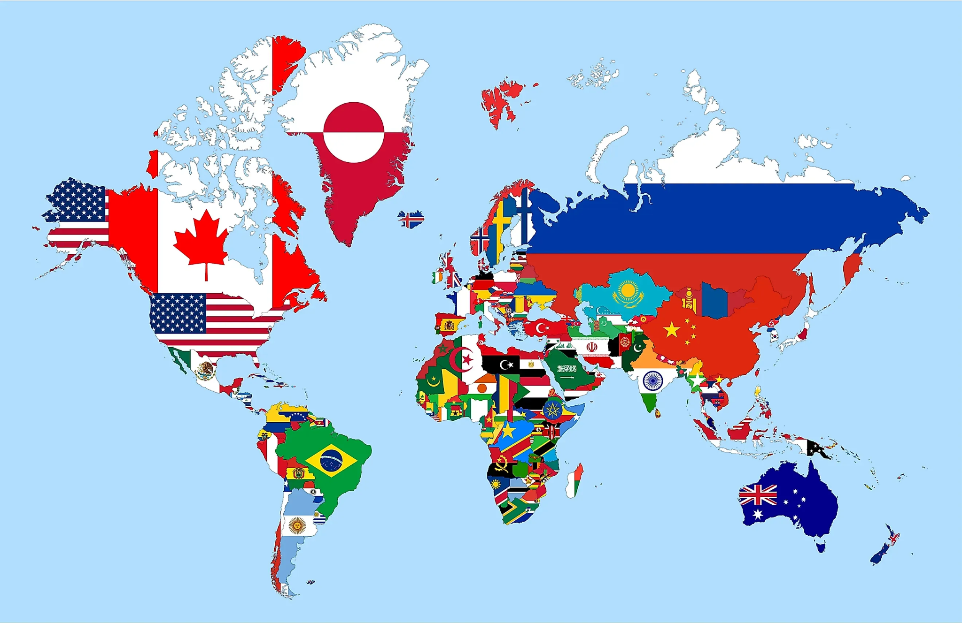
What information we were looking for →
Countries:
USA
China
France
Italy
Germany
Turkey
India
Brazil
Sweden
Egypt
Years:
1993-2021
Data:
Temperature change
CO2 emissions
Global Sea level

Slide 3
Overview of Global Climate Change
Global climate change refers to long-term shifts in temperatures and weather patterns, largely driven by human activities—especially the burning of fossil fuels like coal, oil, and gas. These activities increase greenhouse gases in the atmosphere, trapping heat and warming the planet.
Key Impacts:
Rising global temperatures – Earth's average temperature has increased by over 1°C since the late 19th century
Melting ice caps & rising sea levels – Threatening coastal areas and island nations
Ecosystem disruption – Endangering biodiversity and altering habitats
Human health & economy – Increases in heat-related illnesses, food insecurity, and economic losses
Main Causes:
Carbon dioxide (CO₂) from fossil fuel combustion
Methane (CH₄) from agriculture and landfills
Deforestation, reducing Earth's ability to absorb CO₂
Industrial processes and unsustainable land use

Slide 4
Dataset 1 – Temperature Change
We found this dataset on kaggle.com. It contains the average temperature for every month of every year for every country from 1961 to 2023. We filtered the dataset for our target countries and years.
This is a summary of what we found: 🔍KEY INSIGHTS (1993–2021):
Highest average temperature change: Germany (1.32°C) (2.38°F)
Lowest average temperature change: India (0.47°C) (0.85°C)
Most variable temperature change: Sweden (Std Dev: 1.74)
Overall trend: From 0.25°C in 1993 to 1.54°C in 2019

Slide 5
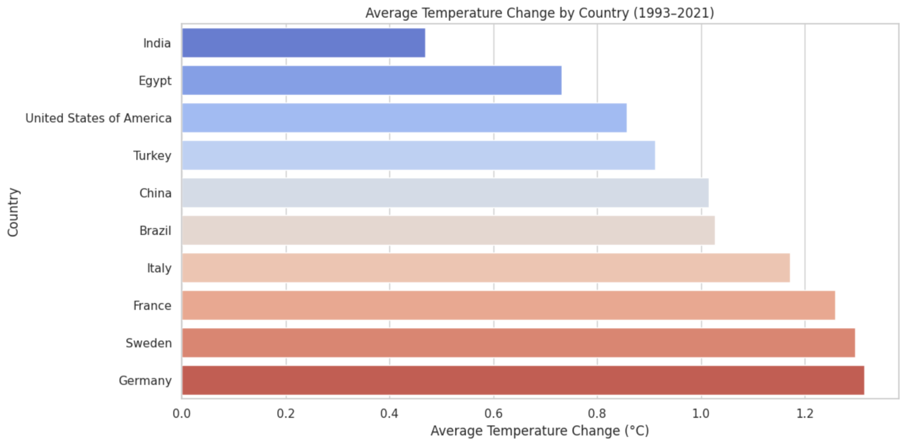
Dataset 1- Bar Chart & Line chart
This bar chart shows the average temperature change by country in the given timeframe. We can use this information to see if these countries share similar patterns with the other datasets.

Slide 6
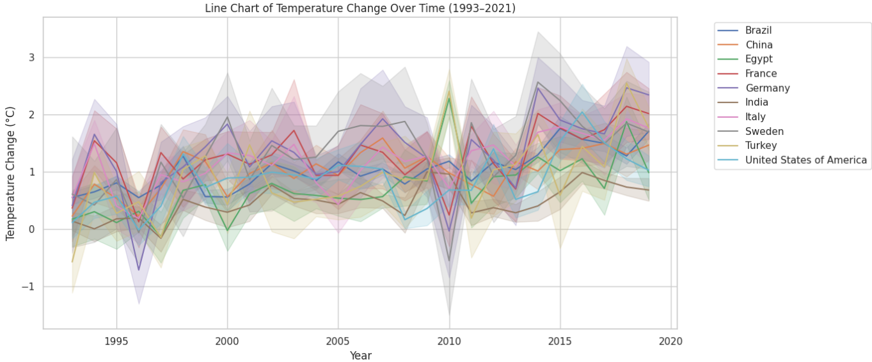
Dataset 1- Bar Chart & Line chart
The line chart shows the temperature change over time for each country. We can see that over time, the temperature change seems to be slowly increasing.

Slide 7
Dataset 2 - CO2 Emissions
We found this dataset on kaggle.com. This contains the average CO2 emissions for each country yearly from 1750 - 2022. We filtered the dataset for our target countries and years.
This is a summary of what we found: KEY INSIGHTS (1993–2021):
Highest average CO₂ emissions: United States (342,071,428,571 tons)
Lowest average CO₂ emissions: Egypt (3,630,361,035 tons)
Most variable CO₂ emissions: China (Std Dev: 57,507,837,752 tons)
Overall trend: From 45,428,775,265 tons in 1993 to 90,190,058,976 tons in 2020

Slide 8
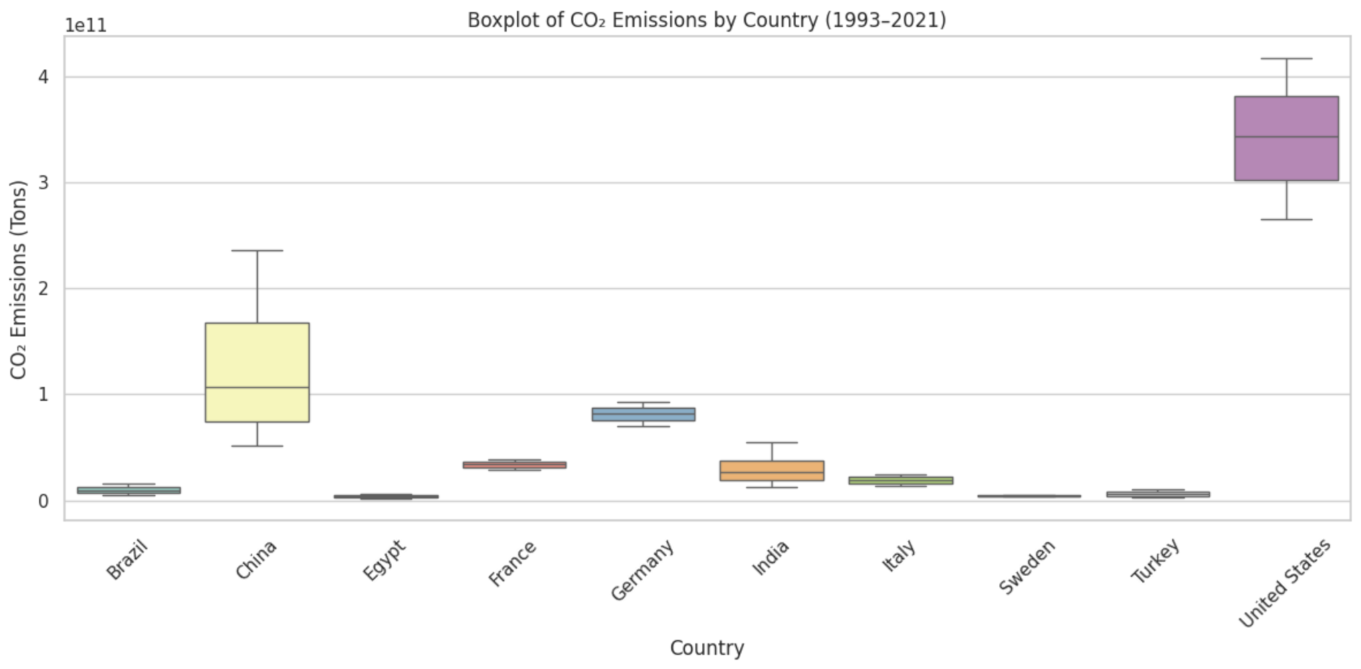
Dataset 2 - Boxplot
The box plot shows the carbon dioxide emission in tons by each country throughout our target years. The United States and China can be seen to have the largest amounts of emissions and greater fluctuations in amounts

Slide 9
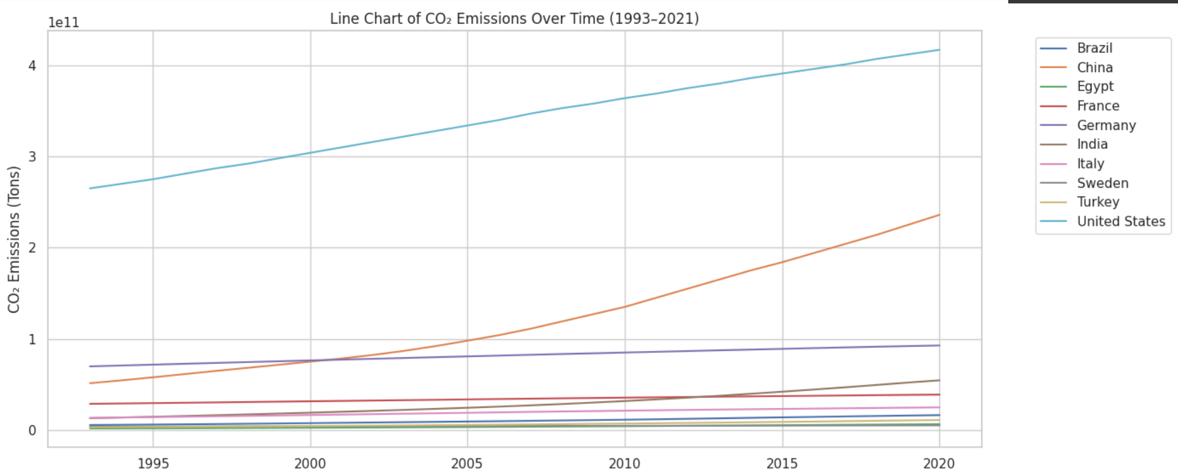
Dataset 2 - Line Chart
We can see that as time advances, the CO2 emissions increase for most countries. Countries with larger economies like the US and China increased in carbon emissions faster than others.

Slide 10
Dataset 3 - Sea Level
This dataset shows global sea levels from 1993 to 2021 via satellites. It includes the global mean sea level (GMSL), filtered and adjusted versions (Gaussian filter, GIA, signal-removed), and their standard deviations.
This is a summary of what we found: KEY INSIGHTS: Global Sea Level (2000–2020) (mm)
Sea level rose from -17.98 mm in 2000 to 50.91 mm in 2020.
Highest sea level: 64.39 mm in 2019
Lowest sea level: -23.15 mm in 2000
Standard deviation in sea level: 22.63 mm

Slide 11
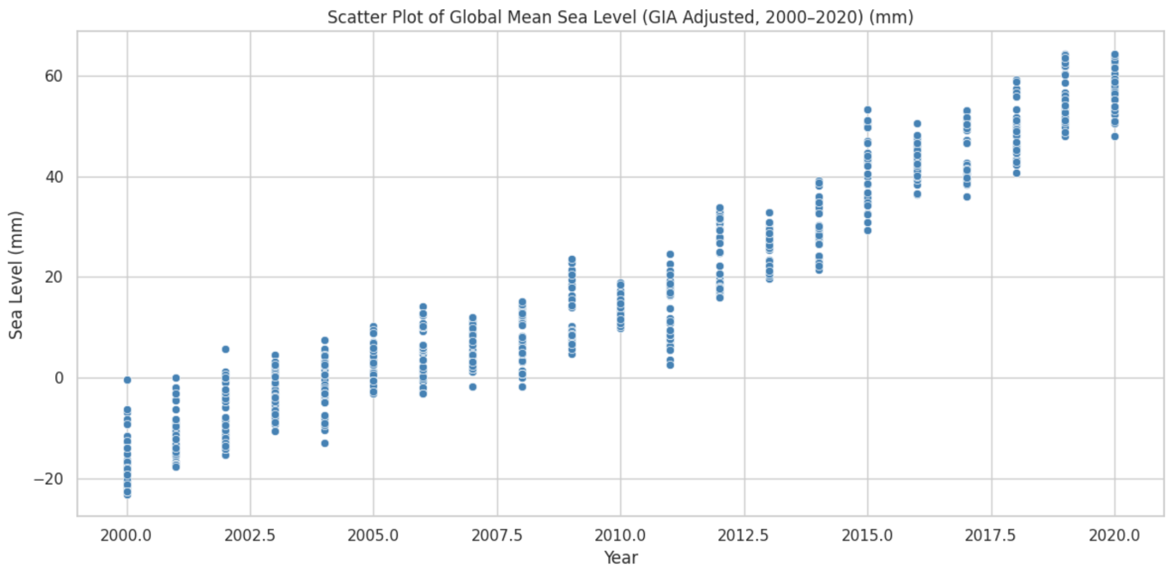
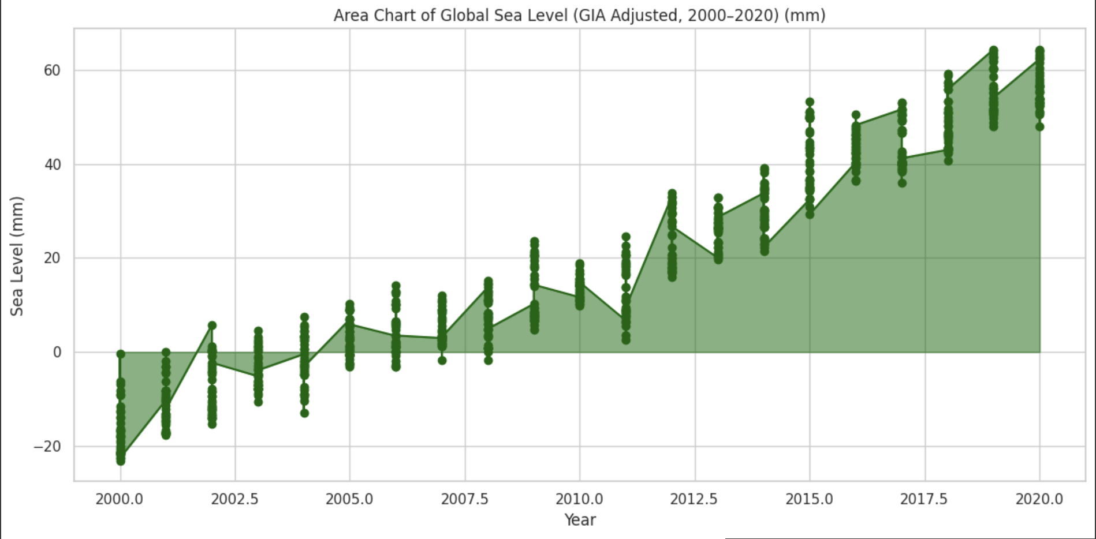
Dataset 3 - Scatter Plot & Area Chart
Both of these charts show the increase in sea level over time. We can see a steady increase from the year 2000 until 2020.

Slide 12
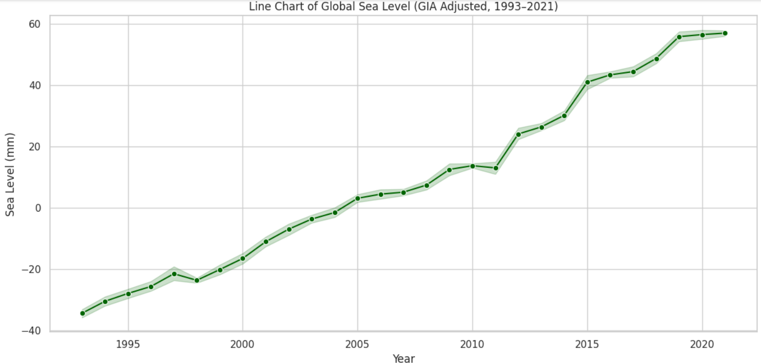
Comparing the datasets

Slide 13
Comparing the datasets cont.
Based on the graphs, it's clear that rising CO₂ levels, rising global temperatures, and rising sea levels are all connected. As the CO₂ levels go up in the graphs, the temperature and sea level graphs also show an increase. This shows a positive correlation between all three.

Slide 14
Conclusion
Comparing the data sets we used, highlights the complex nature of global climate change. Countries such as Germany, Sweden and France have the highest average temperature increases, but do not contribute as much to CO2 emissions, where the US and China have over 10x the emissions of most countries. Global sea levels have shown a constant rise since 1993, which shows a direct correlation from the temperature changes and increasing CO2 emissions. Climate Change is a Global issue that is being felt worldwide, and needs a coordinated attack to be reduced.

