Slide 1
Cascading Style Sheets

Slide 2
https://www.w3schools.com/css/css_intro.asp

Slide 3
CSS handles the look and feel part of a web page.
Using CSS, you can control the
colour of the text,
the style of fonts,
the spacing between paragraphs,
how columns are sized and laid out,
what background images or colours are used,
layout designs,
variations in display for different devices and s
creen sizes as well as a variety of other effects.

Slide 4
Advantages of CSS
CSS saves time − You can write CSS once and then reuse same sheet in multiple HTML pages. You can define a style for each HTML element and apply it to as many Web pages as you want.
Pages load faster − If you are using CSS, you do not need to write HTML tag attributes every time. Just write one CSS rule of a tag and apply it to all the occurrences of that tag. So less code means faster download times.
Easy maintenance − To make a global change, simply change the style, and all elements in all the web pages will be updated automatically.
Superior styles to HTML − CSS has a much wider array of attributes than HTML, so you can give a far better look to your HTML page in comparison to HTML attributes.
Multiple Device Compatibility − Style sheets allow content to be optimized for more than one type of device. By using the same HTML document, different versions of a website can be presented for handheld devices such as PDAs and cell phones or for printing.
Global web standards − Now HTML attributes are being deprecated and it is being recommended to use CSS. So its a good idea to start using CSS in all the HTML pages to make them compatible to future browsers.

Slide 5
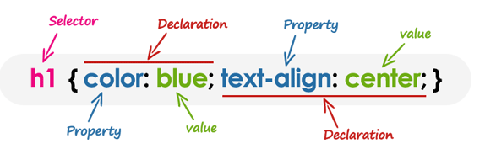
CSS - Syntax
A CSS comprises of style rules that are interpreted by the browser and then applied to the corresponding elements in your document. A style rule is made of three parts −
Selector − A selector is an HTML tag at which a style will be applied. This could be any tag like <h1> or <table> etc.
Property − A property is a type of attribute of HTML tag. Put simply, all the HTML attributes are converted into CSS properties. They could be colour, border etc.
Value − Values are assigned to properties. For example, colour property can have value either red or #F1F1F1 etc.

Slide 6
CSS Selectors
Used to "find" (or select) HTML elements based on their element name, id, class, attribute, and more.
The class selector selects elements with a specific class attribute
.center { text-align: center; color: red; }
The id selector uses the id attribute of an HTML element to select a specific element.
#para1 { text-align: center; color: red; }
The element Selector- selector selects elements based on the element name.
p { text-align: center; color: red; }

Slide 7
Grouping Selectors-You can apply a style to many selectors if you like. Just separate the selectors with a comma, as given in the following example −
h1, h2, p { text-align: center; }
The Universal Selectors-Rather than selecting elements of a specific type, the universal selector quite simply matches the name of any element type −
*{ text-align: center; }

Slide 8
Good Practice
Combine the various id selectors
#content, #footer, #supplement {
position: absolute;
left: 510px;
width: 200px;
}
Multiple Style Rules
h1 {
color: #36C;
font-weight: normal;
letter-spacing: .4em;
margin-bottom: 1em;
text-transform: lowercase;
}

Slide 9
CSS Rules Overriding
Any inline style sheet takes highest priority. So, it will override any rule defined in <style>...</style> tags or rules defined in any external style sheet file.
Any rule defined in <style>...</style> tags will override rules defined in any external style sheet file.
Any rule defined in external style sheet file takes lowest priority, and rules defined in this file will be applied only when above two rules are not applicable.

Slide 10
What would be the font-size
p {
font-size: 20px;
}
p {
font-size: 30px;
}
What would be the paragraph colour
div p {
color: blue;
}
p {
color: red;
}

Slide 11
Three Ways to Insert CSS
External style sheet
<link rel="stylesheet" type="text/css" href="mystyle.css">
Internal style sheet
Inline style

Slide 12
<!DOCTYPE html>
<html>
<head>
<title>Exercise link css</title>
<link rel="stylesheet" type="text/css" href="main.css">
</head>
<body>
<header>
<h1>Hi there</h1>
</header>
<div>
<h3>Some more stuff here...</h3>
<p>Some more stuff here..,</p>
<p>Some more stuff here..,</p>
<h3>Comment below...</h3>
<p>Some more stuff here..,</p>
</div>
<footer>Copyright 2019</footer>
</body>
</html>
*{
margin: 0;
padding: 0;
box-sizing: border-box;
font-family: Verdana;
}
body{
background: #eee;
}
div, header, footer{
padding: 50px 10px;
}
header, footer{
background: #333;
color: #eee;
}
h1, h2, h3, h4, h5, h6{
color: orange;
}
div *:not(:first-child){
margin-top: 20px;
}

Slide 13
@import
The @import rule allows you to import a style sheet into another style sheet.
The @import rule must be at the top of the document (but after any @charset declaration).
The @import rule also supports media queries, so you can allow the import to be media-dependent.
Example:
Import the "printstyle.css" style sheet ONLY if the media is print:
@import "printstyle.css" print
Import the "mobstyle.css" style sheet ONLY if the media is screen and the viewport is maximum 768 pixels:
@import "mobstyle.css" screen and (max-width: 768px);
Read : https://www.lifewire.com/using-import-in-css-3464234

Slide 14
Website fonts using CSS
The font of a web page is one of the most important choices, as it affects how all content is displayed. Poor font choice can have horrible effects on a websites appearanceWhen choosing a font for a web page there are a few points to consider:
Does it look good
Is it easy to read
Does it suit the web page content
Is it supported by all computers
The points above are mostly self-explanatory. Always choose a font that looks good on the web page and is appropriate to its content. For example you would not use a comic or swirly font on a professional website, however a comic font may be a good choice for a children’s website, but then it must also be easy to read.

Slide 15
Safe fonts
The last point in the list ‘is it supported by all browsers’ is an important one. If a web page uses a font that is not supported on a computer, that computer will use a default font (set by the browser). Sometimes this may be Arial, which is not so bad, other times it may be Times New Roman! (It’s ugly).
Luckily CSS provides a system that lets us provide several different fonts for our web pages. This allows us to provide a list of preferred fonts, if the first is not available, the second will be used, if the second is not available, another fall back font can be used and so on. This list of preferred fonts should always end with a generic font. These fonts are available on all computers, they are:
serif
sans-serif
monospace
cursive
fantasy
So when specifying web fonts, your font setting should at least have one fallback, e.g.:
Specify one preferred font and one fallback: Font-family: Arial, Serif;
Two preferred fonts and one fallback: Font-family: Arial, Verdana, sans-serif;
Usually the fallback font will be of the same family as your preferred fonts, but it does not have to be.

Slide 16
Font families
These five basic font types can be referred to as families. Almost all other fonts belong to one of these families
Serif- Serif fonts are normal fonts that contain serifs. Serifs are extra details on the end of some fonts. Some examples of serif fonts are:
Batang
Times New Roman
Rockwell
Sans-serif -Sans serif fonts are normal fonts without serifs (extra details). Serif fonts tend to give a cleaner look. Some examples of serif fonts are:
Calibri
Arial
Verdana
Monospace -Monospace fonts are fixed width fonts. This means that each letter occupies the same amount of space as all others. Monospace fonts were first created for typewriters, which could only move the same distance across a piece of paper after each keystroke. Examples of Monospace fonts are:
Courier New
Lucida Sans Typewriter
Cursive
Cursive fonts tend to emulate hand-writing. Calligraphy fonts are found in this family. Examples of cursive fonts are:
Blackadder ITC
Lucida HandWriting
Segoe Script
Fantasy -Fonts in the fantasy family are usually very decorative or outlandish. Fantasy fonts often have very specific uses. A lot of custom created fonts fall into this family. Examples of fantasy fonts are:
Impact
Castellar
Old English Text MT

Slide 17
Styling elements with CSS - Text
Property | Purpose | Example
text-align | Sets the horizontal alignment of text | text-align: left;
text-transform | Sets the case of the text (capitalize, uppercase, lowercase, none) | text-transform: uppercase;
vertical-align | Aligns text according to the baseline | vertical-align: top;
text-indent | Sets the amount of indent for the first line in a paragraph. | text-indent: 10px;
line-height | Specifies the distance between the base line of each line of text in a paragraph or division | line-height: 15pt;
word-spacing | Sets the space between words in a paragraph | word-spacing: 1px;
letter-spacing | Sets the space between letters in a word | letter-spacing: 2px;
text-decoration | Gives text a decoration, (underline, overline, line-through, blink, none) | text-decoration: underline;
color | Sets the text colour of the element. Colours can be words, hex codes or RGB colour values. | color: #fff000; color: White;

Slide 18
Styling elements with CSS - font
Property | Purpose | Example
font-size | Sets the size of the font in relative or absolute measurements | font-size: 10pt;
font-family | Sets the type of font (Arial, Verdana) | font-family: Arial;
font-style | Sets the font style (italic, normal, oblique) | font-style: italic;
font-variant | Lets you use small-caps if available for the chosen font-family | font-variant:small-caps;
font-weight | Sets the boldness of the font | font-weight: bold;
font | This is the shorthand method of setting all font properties at once in this order: Font-style, font-variant, font-weight, font-size/line-height, font-family. | font: italic bold small-caps 11pt/14pt Arial,sans-serif;

Slide 19
Styling elements with CSS - Background
Property | Purpose | Example
background-color | Sets the background colour of an element. Colours can be words, hex codes or RGB colour values. | background-color: Fuchsia;
background-image | Specifies the image to be used as a background for an element, e.g.: | background-image: url(‘images/bg.jpg’);
background-position | This sets where the background should first appear in an element. Options are: top (left/right), bottom (left/right), left, right, center, horizontal % and vertical %. | background-position: top left;
background-repeat | Specifies any background repeat options, these are: repeat-x (across), repeat-y (down), repeat (both directions), none. | background-repeat: repeat-x;
background-attachment | This lets you attach a background image so that it does not move when the page is scrolled (scroll, fixed). | background-attachment: fixed;
background | This is the shorthand background property and allows you to set all background properties at once in the following order: Color, image, repeat, attachment, position | background: #000000 url(‘bg.jpg’) repeat-x, fixed top left; background: #00ff00 url('mypic.gif') no-repeat scroll center;

Slide 20
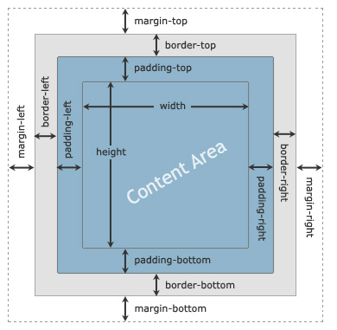
CSS Box Model
The CSS box model is essentially a box that wraps around every HTML element. It consists of: margins, borders, padding, and the actual content.
Explanation of the different parts:
Content - The content of the box, where text and images appear
Padding - Clears an area around the content. The padding is transparent
Border - A border that goes around the padding and content
Margin - Clears an area outside the border. The margin is transparent
Note: In CSS box model; content area of the element's box is the area, where text, images, lists, tables, forms, videos, etc. appears.

Slide 21
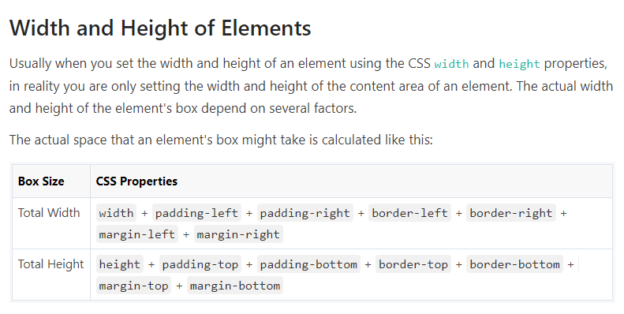
CSS Box Model

Slide 22
Border Style
The border-style property specifies what kind of border to display
The following values are allowed:
dotted - Defines a dotted border
dashed - Defines a dashed border
solid - Defines a solid border
double - Defines a double border
groove - Defines a 3D grooved border. The effect depends on the border-color value
ridge - Defines a 3D ridged border. The effect depends on the border-color value
inset - Defines a 3D inset border. The effect depends on the border-color value
outset - Defines a 3D outset border. The effect depends on the border-color value
none - Defines no border
hidden - Defines a hidden border

Slide 23
CSS Margins
The CSS margin properties are used to create space around elements, outside of any defined borders
Margin - Individual Sides
CSS has properties for specifying the margin for each side of an element:
margin-top
margin-right
margin-bottom
margin-left
All the margin properties can have the following values:
auto - the browser calculates the margin
length - specifies a margin in px, pt, cm, etc.
% - specifies a margin in % of the width of the containing element
inherit - specifies that the margin should be inherited from the parent element

Slide 24
CSS Padding
The CSS padding properties are used to generate space around an element's content, inside of any defined borders
Padding - Individual Sides
CSS has properties for specifying the padding for each side of an element:
padding-top
padding-right
padding-bottom
padding-left
All the padding properties can have the following values:
length - specifies a padding in px, pt, cm, etc.
% - specifies a padding in % of the width of the containing element
inherit - specifies that the padding should be inherited from the parent element

Slide 25
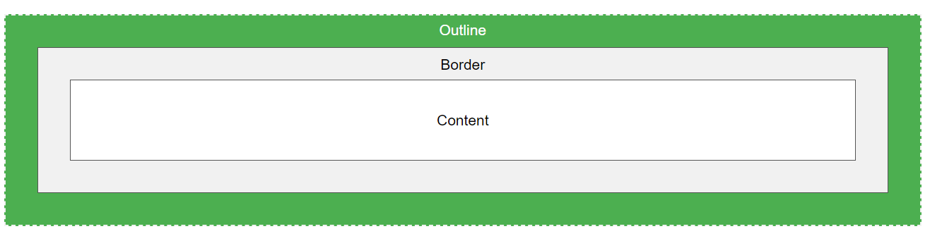
CSS Outline
An outline is a line that is drawn around elements, OUTSIDE the borders, to make the element "stand out“.
Outline differs from borders! Unlike border, the outline is drawn outside the element's border, and may overlap other content. Also, the outline is NOT a part of the element's dimensions; the element's total width and height is not affected by the width of the outline.
dotted - Defines a dotted outline
dashed - Defines a dashed outline
solid - Defines a solid outline
double - Defines a double outline
groove - Defines a 3D grooved outline
ridge - Defines a 3D ridged outline
inset - Defines a 3D inset outline
outset - Defines a 3D outset outline
none - Defines no outline
hidden - Defines a hidden outline

Slide 26
Outlines Vs Borders
The outlines are generally used to highlight elements. An outline at a glance looks very similar to the border, but it differs from border in the following ways:
Outlines do not take up space, because they always placed on top of the box of the element which may cause them to overlap other elements on the page.
Unlike borders, outlines won't allow us to set each edge to a different width, or set different colors and styles for each edge. An outline is the same on all sides.
Outlines don't have any impact on surrounding elements apart from overlapping.
Unlike borders, outlines don't change the size or position of the element.
Outlines may be non-rectangular.

Slide 27
Margins, padding and positioning
Property | Purpose | Example
margin-(placement) | The margin property is used to set space outside of an element. You can set margin-top, bottom, left and right. | margin-left: 2px; margin-top: 2px;
margin shorthand | You can specify all four margins for an element in one shorthand margin property, the order of the margins is: top, right, bottom, left (clockwise from top). | margin: 2px 5px 2px 5px; margin: 2px; (sets all sides to 2px)
padding-(placement) | The padding property is used to set space inside of an element. It is useful for spacing text away from the edge of its parent element. You can set padding-top: bottom, left and right. | padding-right: 20px; padding-bottom: 5px;
padding shorthand | You can specify all four padding spaces for an element in one shorthand padding property, the order of the padding spaces is: top, right, bottom, left. | padding: 4px; padding: 4px 5px 2px 3px;
position | The position property lets you specify how an element should be placed on a page: you can the options of relative, absolute, fixed and static. | position: absolute;
top, left, bottom, right | The top, left bottom and right properties are used when positioning elements. They determine the amount of space that should be between an elements edge and its containing element. These spaces will have different effects depending in the positioning method in use. | top: 20px; left: 220px;
float | Floating tells an element to go either as far left or as far right as it can on the current line and allows content to flow around itself. Your options are left, right and none. | float: left;
clear | Clear lets you remove any previously set floating effects. Your options are left, right and none. | clear: left; clear: both;

Slide 28
Block elements vs Inline elements
Block elements will span the full width of the space available to them, and so will start on a new line in the flow of HTML. The flow will continue on a new line after the block element (you can think of this as placing a line break before and after them if you wish). Block elements appearance can be changed by the height and width attributes, as well as positioning attributes such as float and position etc. Elements that display as blocks include:
div
h1 – h6
p
Lists (li, ul, ol) and list items (li)
table
pre
blockquote
form
-Inline elements do not affect the design of a page (flow of HTML). So they do not insert any line breaks. Inline elements are not affected by width and height, padding or margin attributes. They can be positioned however using float and position. Inline elements include:
span
a (anchor)
br (adds a new line but is not a block)
em
Input
abbr (abbreviation)

Slide 29
Changing the display property
If you feel the need, you can set a block element to behave like an inline element, and set inline elements to behave like block elements using the CSS property display. For example:
<span style=”display: block”>Block text</span>
<div style=”display: inline”>Inline text</div>
In the example above we have set a span tag to behave like a block element. This means that I can apply the width, height, margin and padding attributes.
We have also changed the divider to behave like an inline element, meaning that it will not affect the flow of HTML on the page.
Reference
https://www.bitdegree.org/learn/css-display#display-inline-block-method

Slide 30
CSS Measurements
CSS supports many different units of measurement, each with its own uses. The two basic types of measurement unit are absolute and relative. These measurements are used to set the size and dimensions of elements styled with CSS. The measurement units available to you when using CSS are:
Centimeters (cm) (absolute)
Inches (in) (absolute)
Millimeters (mm) (absolute)
Points (pt) which are equal to 1/72 of an inch (absolute)
Picas (pc) which are equal to 1/6 of an inch (absolute)
Pixels (px)
Em
Percentage
Absolute measurements maintain their length across different browsers and screen resolutions because it is assumed that one centimeter is one centimeter in all browsers.
Relative measurements depend on some other value to get their size, such as screen resolution or another font-size.

Slide 31
Absolute measurements The absolute measurement units available in CSS are centimeters, Inches, Millimeters, Points and Picas. Being New Zealanders we will almost never use Inches or Picas.
Absolute isn’t absolute
You will be surprised to learn that computers measure inches (inches, points and picas) based on pixels. Windows defines one inch as equal to 96 Pixels. Because the size of each pixel is difficult to know (because you have the option to change your screen resolution, which changes the size of the pixel) one inch isn't really 96 pixels. To complicate things further some operating systems, such as Mac OS X, define one inch as 72 pixels!
What’s the point in absolute measurements?
Absolute measurements are excellent for printed work. For web designers this means that when a user wants to print a web page, it would be a good idea to use absolute measurements to size text and other elements. It is a good idea to use a different ‘print’ style sheet that web pages can use before being printed, but only if the web page has lots of printable pages, as this sort of CSS can take a long time to implement correctly.

Slide 32
Relative measurements
Em- Using the em measurement is a relative size based on the font size of the containing element. Basically an em is the size of the letter ‘M’. If the size of the text is 10pt a measurement unit of 1 em means that the item will be 10pt. A value of 2 em means that the item will be 20pt the size and so on. If the font is made bigger in the browser, the size of the object will get bigger too.
Percentage is a great measurement unit to use for relative page designs. For example, you could set a div tag to have a width of 100%, meaning that it would take up 100% of the screen no matter the screens width.
Pixels
--The pixel measurement is relative to the users screen resolution. The higher the screen resolution, the more pixels on the screen.
The best use of the pixel measurement unit is for positioning and layout of elements. This means attributes such as margins, padding, sizing, height etc. Pixels are extremely accurate to measure with, and can easily be used to measure in CSS and when drawing and creating web designs in Photoshop or similar programs.
Font sizes
Some designers prefer the accuracy of the pixel measurement. However this can change the font size wildly in different resolutions. Setting the font size to a slightly smaller size (.8em, 80%, 10pt …) is common on web sites.

Slide 33
CSS Positioning
Using CSS you have the ability to position both inline and block elements using the CSS position property. Position has the following possible values:
Absolute – Positions elements in one fixed place which does not change
Relative – Places elements relative to where they SHOULD have been
Static – Elements are placed normally
Fixed – Elements are positioned relative to the browser window. Scrolling does not affect their position
Left, bottom, right, top
The absolute, relative and fixed positions use the top, left, right and bottom attributes to position them accordingly. These position attributes have different effects on the element being styled depending on the type of position being used and the elements container (either another block or the browser window).
Left and top are used when the styled element is closer to the top left of its parent container (whatever that might be). Bottom and right are used when the element is closer to the bottom right of its parent container and so on.

Slide 34
Absolute
The absolute position is used to place elements in a very precise location. Absolute elements have no effect what so ever on the position of elements around them. Absolute elements are positioned relative to any parent containers that are positioned using relative, absolute or fixed. If no parent container matches these criteria then the element will be positioned relative to the browser window. For instance the following code places the div exactly 100px from the top, and 150px left of the browser window.
<div style=”position: absolute; left: 150px; top: 100px;”></div>
The following code places an absolutely positioned element 40px from the top, and 20px from the left of a relatively positioned container:
<div style=”position: relative; left: 150px; top: 100px;”>
<div style=”position: absolute; left: 20px; top: 40px;”></div>
</div>
Absolute positioning can be extremely useful when you wish to place elements on a page in one specific place, and have the advantage of not affecting any other elements. Absolute positioning can also be used to easily re-create complicated designs without floating.

Slide 35
Fixed
Fixed positioning operates in the same way as the absolute position, except for two points of difference. Fixed elements use the browser window as their point of reference, and when the browser window is scrolled they maintain their location. This is similar to the fixed background images sometimes seen. The following code fixes a div element in place, even when scrolling:
<div style=”position: fixed; left: 150px; top: 100px;”></div>
The following code can be used to position a fixed element at the bottom of a web page, regardless of height etc:
<div style="position: fixed; left: 0px, right: 0px; bottom: 0px; top: auto;">footer</div>

Slide 36
Relative
Relative positioned elements are positioned according to the normal flow of HTML elements; they are then offset or positioned using top, left, bottom and right. Relative elements take their position from the next parent container that has the position attribute of relative, absolute or fixed. If no parent element has one of these position attributes, then the browser window is used.
Relative elements are always positioned according to where they SHOULD have been on the web page. Even if an element before them has been moved using position relative, they still take their cue from where they would have originally appeared as if the element were still there.
The following code positions two elements away from their normal positions, using the browser window as the parent container:
<div style=”position: relative; left: 150px; top: 100px; width: 40px; height: 20px;”></div>
<div style=”position: relative; left: 150px; top: 100px; width: 40px; height: 20px;”></div>

Slide 37
Z-Index
You may find that several positioned elements float on top of, or underneath one another. You can decide which elements are on top via the z-index property. The z-index property only works on elements that are positioned using absolute, fixed or relative.
To use the z-index property you simply assign a stack order to each element. For example:
<div style="z-index: 1;">Text</div>
An element with a stack number will always appear on top of an element without one (positive numbers only). The z-index allows negative values.

Slide 38
Practice the positioning
<!DOCTYPE html>
<html>
<head>
<style>
div {
padding: 70px;
border: 1px solid #4CAF50;
}
</style>
</head>
<body>
<div style="position: absolute; left: 20px; top: 40px;">
<div style="position: relative; left: 10px; top: 50px; width: 40px; height: 20px;"></div>
<div style="position: relative; left: 10px; top: 50px; width: 40px; height: 20px;"></div>
</div>
</body>
</html>

Slide 39
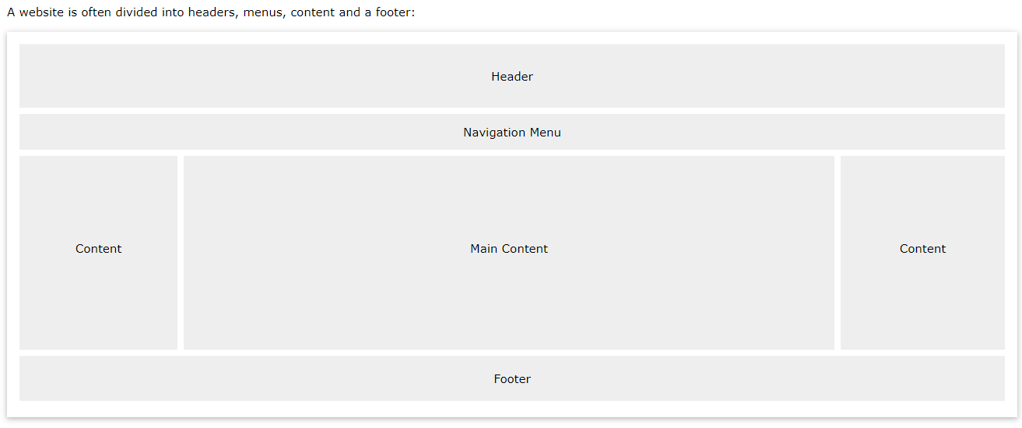
Website Layout

Slide 40
Page layout with CSS
CSS is perfect for designing and laying out web pages. You can use the position attribute with the relative, absolute and fixed values, or the float attribute.
Most commonly web pages are designed using a combination of floating, positioning, margins, padding, borders and backgrounds.
Floating The float attribute allows content to flow up and around block elements. It has two possible values, left and right. Left will tell a block element to go as far left on a web page as it can, and allow content to float on its right hand side. Float right will have the opposite effect. style="float: left;
Clearing You may find that some web page content sits next to a floated object when you don’t want it to. To avoid this behaviour you can cancel floating effects using the float property. Clear can cancel right, left or both sides of a floating element. style="clear: left;

Slide 41
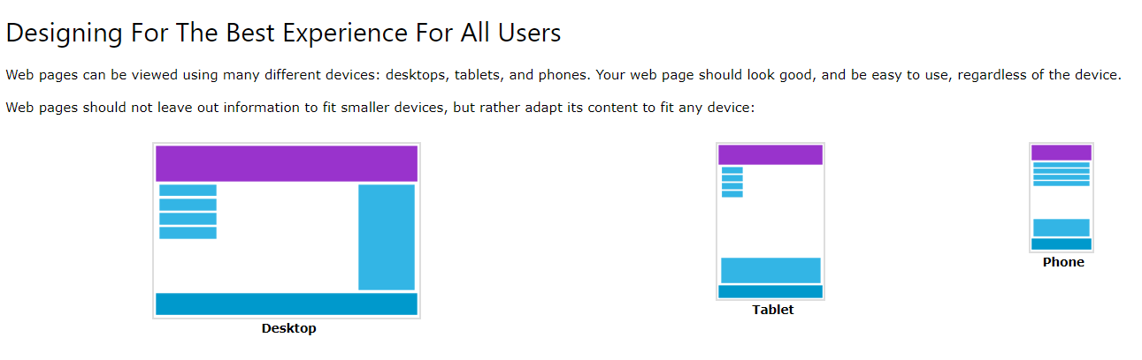
Responsive Web Design

Slide 42

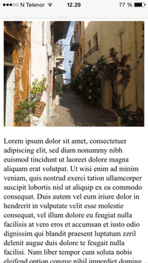
Viewport
The viewport is the user's visible area of a web page.
The viewport varies with the device, and will be smaller on a mobile phone than on a computer screen.
HTML5 introduced a method to let web designers take control over the viewport, through the <meta> tag.
<meta name="viewport" content="width=device-width, initial-scale=1.0">
A <meta> viewport element gives the browser instructions on how to control the page's dimensions and scaling.
The width=device-width part sets the width of the page to follow the screen-width of the device (which will vary depending on the device).
The initial-scale=1.0 part sets the initial zoom level when the page is first loaded by the browser.

Slide 43
Resources
https://www.lifewire.com/learn-how-css-4160699
https://www.bitdegree.org/learn/css-basics

Slide 44
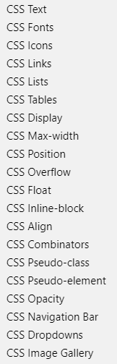
Activity
Research and practice how to import Google fonts. https://developers.google.com/fonts/docs/getting_started
Design an animated page, responsive Navigation Bar, Dropdown menu
Practice

