Slide 1
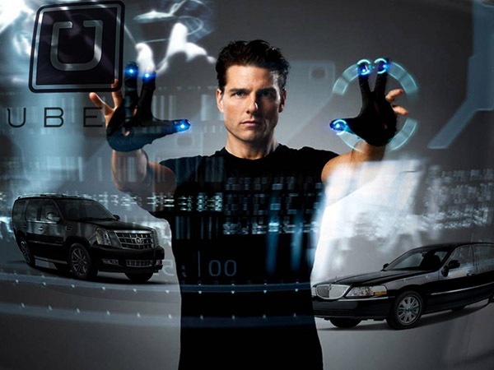
Interface analysis & design

Slide 2
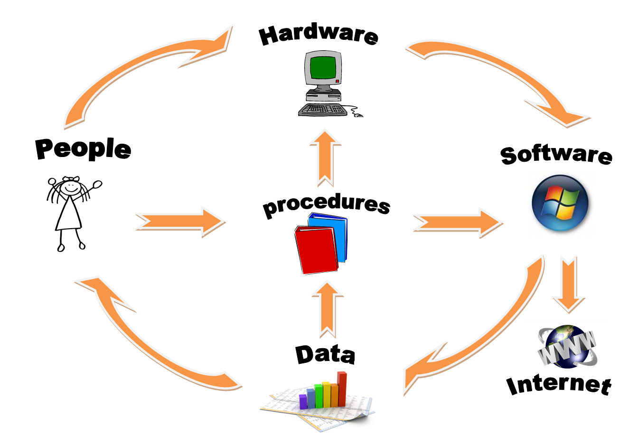
Information system
Notes:
There are 6 parts to an information system:
Hardware including the System unit (that houses CPU, RAM, Secondary storage) and other hardware includes input and output devices
Software including system software (such as Operating systems and Utilities) and application software (or programs)
Procedures; which are the rules or guidelines for people to follow when using hardware, software etc…
Data; the raw unprocessed facts such as text, numbers etc.. When processed we call it information.
Internet; Almost all information systems provide a way to connect to other people and computers typically using the internet.
People; The are the most important part of an information system. We developed them and we are what computers are all about. Making people (end-users) like me and you more productive.

Slide 3
Exercise
Give an example (or name for) each of the following computer HARDWARE technologies:
Input device
Output device
Primary storage
Secondary storage
Microprocessor
Communication/connectivity
SOFTWARE technologies:
System software
Application software

Slide 4
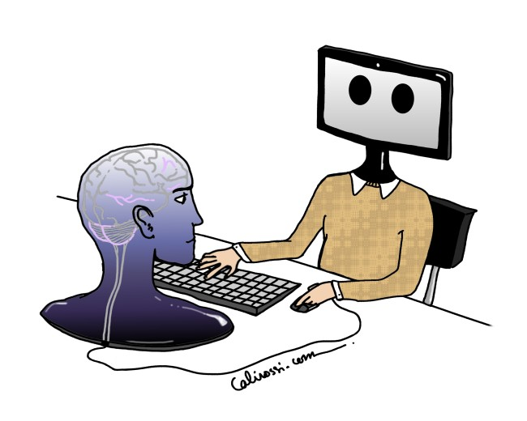
HCI
- Human Computer Interaction
Webopedia: “A user interface, such as a GUI, is how a human interacts with a computer, and HCI goes beyond designing screens and menus that are easier to use and studies the reasoning behind building specific functionality into computers and the long-term effects that systems will have on humans.”
Wikipedia: “HCI researches the design and use of computer technology, focused on the interfaces between people (users) and computers. Researchers in the field of HCI both observe the ways in which humans interact with computers and design technologies that let humans interact with computers in novel ways.”
Notes:
Webopedia: “A user interface, such as a GUI, is how a human interacts with a computer, and HCI goes beyond designing screens and menus that are easier to use and studies the reasoning behind building specific functionality into computers and the long-term effects that systems will have on humans.”
Wikipedia: “HCI researches the design and use of computer technology, focused on the interfaces between people (users) and computers. Researchers in the field of HCI both observe the ways in which humans interact with computers and design technologies that let humans interact with computers in novel ways.”
The primary discipline contributing to being human-centred in design is human–computer interaction (HCI).
HCI arose during the early 1980s, evolving into a subject ‘concerned with the design, evaluation, and implementation of interactive computing systems for human use and with the study of major phenomena surrounding them’
HCI drew on cognitive psychology for its theoretical base and on software engineering for its design approach.
HCI is about how to design for these experiences in a human-centred way that takes account of human abilities and preferences and ensures that systems are accessible, usable and acceptable.

Slide 5

UI
- User interface
Webopedia: UI is the junction between a user and a computer program.
Wikipedia: The UI is the space where interactions between humans and machines occur. The goal of this interaction is to allow effective operation and control of the machine from the human end, whilst the machine simultaneously feeds back information that aids the operators' decision-making process.
Notes:
Webopedia: UI is the junction between a user and a computer program.
Wikipedia: The UI is the space where interactions between humans and machines occur. The goal of this interaction is to allow effective operation and control of the machine from the human end, whilst the machine simultaneously feeds back information that aids the operators' decision-making process.

Slide 6

UX
- User Experience
Wikipedia: UX refers to a person's emotions and attitudes about using a articular product, system or service. It includes the practical, experiential, affective, meaningful and valuable aspects of human–computer interaction and product ownership. Additionally, it includes a person’s perceptions of system aspects such as utility, ease of use and efficiency.
Notes:
Wikipedia: UX refers to a person's emotions and attitudes about using a articular product, system or service. It includes the practical, experiential, affective, meaningful and valuable aspects of human–computer interaction and product ownership. Additionally, it includes a person’s perceptions of system aspects such as utility, ease of use and efficiency.

Slide 7
Being Digital
Spot the technology in this scenario
This is the world we are living in and the world that designers of interactive systems are designing for.
The huge range of interactions that we engage in and the interfaces that we use offer an exciting if daunting challenge.
Moreover, increasingly designers are having to deal with the issue of people engaged in multiple interactions with different devices in parallel.
Notes:
In the morning you get woken up by a digital alarm clock which automatically turns on the radio. To change the radio station you press a button that searches for another signal.
You pick up your mobile phone and check for text messages and Facebook notifications. You go to your computer and download some new songs onto your ipod. As you leave the house you set the alarm.
In the car you adjust the heating, use the stereo which connects via Bluetooth to your ipod and check the various warning and information symbols on the dash that detect whether doors are open, or seat belts are buckled.
Arriving at the parking building, you scan your season ticket through the car parking machine and get money from an automated teller machine (ATM).
You get on a bus and scan your student ID card. You then use a stylus to write notes on your tablet of things you need to remember to do during the day.
Arriving at your class, you log onto the computer network, check your e-mail, use various computer packages, browse the Web and perhaps watch a couple of YouTube clips.
During the day you make texts on your mobile phone and reply to some messages via Facebook messenger. You add some new class mates names and numbers to your contacts, download a new ring tone, photograph your timetable on the noticeboard and video a band that you see at lunchtime. You upload the photo of your timetable to cloud storage. At home that night you spend an hour or so on a games machine, watch sky TV and then a movie online through your computer that is plugged into to play on your television, with the sound playing through the stereo system.

Slide 8
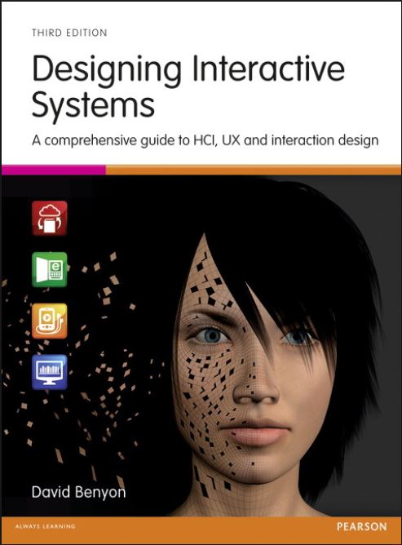
Text book

Slide 9
WHAT IS AN INTERACTIVE SYSTEM?
Interactive system is the term we use to describe the technologies that interactive system designers work with.
The term is intended to cover devices, products and software systems that are primarily concerned with processing information for people.
Interactive systems are things that deal with the transmission, display, storage or transformation of information.
They respond dynamically to people’s actions.
And includes things such as mobile phones, websites, computer game controllers etc..
Increasingly, interactive components are being included in all manner of other products (such as clothes, buildings and cameras).
Notes:
Firstly…. What is an INTERACTIVE SYSTEM?
Interactive system is the term we use to describe the technologies that interactive system designers work with.
This term is intended to cover devices, products and software systems that are primarily concerned with processing information for people.
Interactive systems are things that deal with the transmission, display, storage or transformation of information.
They respond dynamically to people’s actions.
This definition is intended to exclude things such as tables, chairs and doors (since they do not process information) but to include things such as
mobile phones (since they transmit, store and transform information),
websites (since they store and display information and respond to people’s actions),
computer game controllers etc..
Increasingly, interactive components are being included in all manner of other products (such as clothes, buildings and cameras).

Slide 10
Designing interactive systems
Is concerned with developing high quality interactive systems, products and services that fit with people and their way of living.
We carry and wear technologies that are far more powerful than the computers of just a few years ago.
Notes:
Designing interactive systems is concerned with developing high quality interactive systems, products and services that fit with people and their way of living.
Computing and communication devices are embedded in all sorts of everyday devices from washing machines to jewellery.
We carry and wear technologies that are far more powerful than the computers of just a few years ago.
This course will give you a comprehensive introduction to the practical issue of creating interactive systems, services and products from a human-centred perspective.
We will look at the principles and methods of HCI and ID to deal with the demands of 21st century computing and the demands for improved UX
UX and ID are concerned with the design of websites, desktop applications, smart phone apps, ubiquitous computing systems, mobile systems, wearable systems and systems to support cooperation between people.
HCI is about how to design for these experiences in a human-centred way that takes account of human abilities and preferences and ensures that systems are accessible, usable and acceptable.

Slide 11
The variety of interactive systems
Designing interactive systems is concerned with many different types of products.
It is about designing Programs, websites, games, interactive products such as MP3 players, digital cameras and applications for personal digital assistants (PDAs) and tablets and much more.
It is about designing whole environments where these devices communicate with one another and through which people interact with one another.
It is about designing interactive systems, products and services for the home, for work, or to support communities.
EXERCISE: What are the similarities and differences between a PDA and a Tablet?
Notes:
Designing interactive systems is concerned with many different types of products.
It is about designing Programs, websites, games, interactive products such as MP3 players, digital cameras and applications for personal digital assistants (PDAs) and tablets.
It is about designing whole environments where these devices communicate with one another and through which people interact with one another.
It is about designing interactive systems, products and services for the home, for work, or to support communities.
EXERCISE: What are the similarities and differences between a PDA and a Tablet?

Slide 12
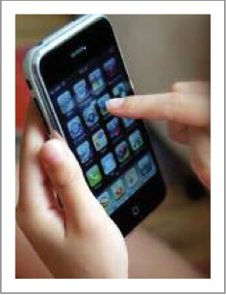
Example: The iPhone
Notes:
In 2007 Apple change the face of mobile technologies when they introduced the iPhone.
The iPhone had carefully crafted, purpose-designed interface to make use of the finger as the input device, with a revolutionary touch-sensitive screen that allowed for multi-touch input.
The iPhone also included sensors that could register how the phone was being held and whether it was vertical, horizontal or sloping.
For example the display would automatically adjust from portrait style to landscape.
In 2008 the ‘app store’ was launched turning the iPhone into an open platform for developers to design and produce their own software.
Combined with the iTunes delivery service, this turned the iPhone into a versatile, multimedia device with literally thousands of applications from sophisticated games to trivial pieces of entertainment to useful information applications.
This created new experiences and new services for a new set of customers.
Most recently IPhone has introduced a speech recognition system called Siri that allows people to call or text their friends, or search the web just by speaking into the phone.

Slide 13
A designer of interactive systems need to be concerned with
Design
Technologies
People
Activities and contexts
Notes:
Design – what is design and how should you do it?
Technologies – the interactive systems, products, devices and components themselves
People – who will use the systems and whose lives we would like to make better through our designs
Activities and contexts – what people want to do and the contexts within which those activities take place.

Slide 14
Design
It’s where you stand with a foot in two worlds – the world of technology and the world of people and human purposes – and you try to bring the two together’.
The term ‘design’ refers both to the creative process of specifying something new and to the representations that are produced during the process.
Notes:
It’s where you stand with a foot in two worlds – the world of technology and the world of people and human purposes – and you try to bring the two together’. Mitch Kapor in Winograd (1996), p. 1
The term ‘design’ refers both to the creative process of specifying something new and to the representations that are produced during the process.

Slide 15
What is design?
A website a designer may produce and evaluate various designs such as:
a design of the page layout,
a design of the colour scheme,
a design for the graphics
and a design of the overall structure.
Design involves much iteration and exploration of both requirements and design solutions.
Notes:
So, for example, to design a website a designer will produce and evaluate various designs such as a design of
the page layout,
a design of the colour scheme,
a design for the graphics
and a design of the overall structure.
Design is rarely a straightforward process and typically involves much iteration and exploration of both requirements (what the system is meant to do and the qualities it should have) and design solutions.

Slide 16
The Interface
The interface to an interactive system is all those parts of the system with which people come into contact with;
Physically
Perceptually
Conceptually
The interface needs to provide some mechanisms for input
It also needs to provide some mechanisms for output
This might be in the form of information, pictures, movies, animations and so on.
EXERCISE: TAKE ONE OF THE INTERACTIVE SYSTEMS (i.e. the Wii or Xbox) AND DISCUSS HOW YOU INTERACT WITH IT: Physically, Perceptually, Conceptually
Notes:
The interface to an interactive system is all those parts of the system with which people come into contact with; physically, perceptually and conceptually.
Physically we might interact with a device by pressing buttons or moving levers and the interactive device might respond by providing feedback through the pressure of the button or lever.
Perceptually (via senses) the device might display things on a screen which we can see, or make noises which we can hear.
Conceptually (conceived in the mind-ability to understand a problem by identifying patterns) when we interact with a device we try to work out what it does and what we should be doing. A device could provide messages and other displays which are designed to help us do this.
The interface needs to provide some mechanisms so that people can provide instructions and enter data into the system: ‘input’.
It also needs to provide some mechanisms for the system to tell people what is happening by providing feedback and mechanisms for displaying the content: ‘output’.
This might be in the form of information, pictures, movies, animations and so on.
EXERCISE: TAKE ONE OF THE INTERACTIVE SYSTEMS WE LISTED IN THE LAST CLASS (i.e. the Wii or Xbox) AND DISCUSS HOW YOU INTERACT WITH IT: Physically, Perceptually, Conceptually

Slide 17
The Bigger picture
Designing interactive systems is not just a question of designing interfaces, however.
The whole human–computer interaction needs to be considered.
Interactive systems consist of many interconnected devices, some worn by people, some embedded in the fabric of buildings, some carried.
Interactive systems designers are concerned with connecting people through devices and systems; they need to consider the whole environment they are creating.
Notes:
Designing interactive systems is not just a question of designing interfaces, however.
The whole human–computer interaction needs to be considered.
Increasingly these days, interactive systems consist of many interconnected devices, some worn by people, some embedded in the fabric of buildings, some carried.
Interactive systems designers are concerned with connecting people through devices and systems; they need to consider the whole environment they are creating.

Slide 18
Being human centred
Interactive systems design is ultimately about creating interactive experiences for people.
Being human-centred is about putting people first,
Being human-centred is about thinking about what people want to do rather than what the technology can do.
Designing new ways to connect people with people,
And involving people in the design process.
Notes:
Interactive systems design is ultimately about creating interactive experiences for people.
Being human-centred is about putting people first; it is about designing interactive systems to support people and for people to enjoy.
Being human-centred is about thinking about what people want to do rather than what the technology can do
Designing new ways to connect people with people,
And involving people in the design process.

Slide 19
PEOPLE
People are social beings, so it is important that the approaches and techniques adopted in the social sciences are used to understand people and technologies. Such techniques as:
Sociology
Anthropology
Cultural studies
Psychology
Ergonomics
In designing interactive systems, the designer will borrow much from each of these disciplines, including methods to help understand and design for people.
Notes:
People are social beings, so it is important that the approaches and techniques adopted in the social sciences are used to understand people and technologies. Such techniques as:
Sociology
Anthropology
Cultural studies
Psychology
Ergonomics
In designing interactive systems, the designer will borrow much from each of these disciplines, including methods to help understand and design for people.

Slide 20
Exercise
As interactive systems designers it is very important to understand people.
Find a definition for each of these disciplines:
Sociology
Anthropology and/or ethnography
Cultural studies
Psychology
Ergonomics
Notes:
FYI
Sociology is the study of the relationships between people in society, the social, political and other groups that they participate in, and the settings in which such relationships take place.
Anthropology is similar but focuses also on the study of culture, biology and language and on how these have evolved and changed over time.
Also related is cultural studies, which looks at people and their relationship with cultural issues such as identity, but also much more prosaic cultural activities such as shopping, playing computer games or watching TV.
Psychology is the study of how people think, feel and act. In particular, cognitive psychology seeks to understand and describe how the brain functions, how language works and how we solve problems.
Ergonomics is the study of the fit between people and machines.

Slide 21
Technologies
Interactive systems designers need to know about BOTH software and hardware.
Software engineering has developed methods for making computer programs.
Designers need to be aware of hardware for sensing different types of data (sensors) and for bringing about some change (actuators, or effectors).
Communication between devices uses various communication ‘protocols’.
Designers need to know how different devices can communicate.
Notes:
The technologies that interactive systems designers need to know about include both software and hardware.
Software engineering has developed methods for making computer programs. Programming languages are used to issue instructions to any programmable device such as a phone, computer, robot dog etc.
Designers need to be aware of hardware for sensing different types of data (sensors) and for bringing about some change (actuators, or effectors).
Communication between devices uses various communication ‘protocols’.
Designers need to know how different devices can communicate.

Slide 22
Why being human-centred is important
Being human-centred in design is expensive and time consuming.
William, Bias and Mayhew (2008) provide details of a number of case studies looking at the costs of taking a human-centred approach to interactive systems design and at the benefits that arise.
Paying attention to the needs of people, to the usability of the product, results in reduced calls to customer help lines, fewer training materials, increased throughput, increased sales and so on.
Involving people closely in the design of their systems will help to ensure acceptability.
Systems will be more effective if they are designed from a human-centred perspective and people will be more productive.
Notes:
Being human-centred in design is expensive. It involves observing people, talking to people and trying ideas out with people, and all this takes time.
Being human-centred is an additional cost to any project, so businesses rightly ask whether taking so much time to talk to people, produce prototype designs and so on is worthwhile.?
The answer is a fundamental ‘yes’.
Taking a human-centred approach to the design of interactive systems is advantageous for a number of reasons
William, Bias and Mayhew (2008) provide details of a number of case studies looking at the costs of taking a human-centred approach to interactive systems design and at the benefits that arise.
Paying attention to the needs of people, to the usability of the product, results in reduced calls to customer help lines, fewer training materials, increased throughput, increased sales and so on.
Involving people closely in the design of their systems will help to ensure acceptability.
Systems will be more effective if they are designed from a human-centred perspective and people will be more productive.

Slide 23
Safety, Ethics & Sustainability
Systems have to be designed for people and for contexts. They must consider all safety issues
Designers also need to consider Ethics
And Sustainability
Notes:
In the early 1980s there was an accident at a nuclear power plant in the USA at Three Mile Island that almost resulted in a ‘meltdown’.
Reportedly one of the problems was that the control panel indicated that a valve was closed when it was in fact open, and another indicator was obscured by a tag attached to another control
Two fundamental design errors – one technical and one organizational – that human-centred design techniques would help to avoid.
Other classic horror tales include a number of plane and train disasters that have been attributed to faulty displays or to operators not understanding or interpreting displays correctly.
Systems have to be designed for people and for contexts.
It is no good claiming ‘human error’ if the design was so bad in the first place that an accident was waiting to happen.
Designers also need to consider Ethics - People need to trust systems and be in a position to make choices about privacy and how they are represented. Intellectual property is another aspect
and Sustainability - Interactive systems have a big impact on the world, and designers should approach interaction design from the perspective of what is sustainable.
Millions of mobile phones and other devices are thrown away each year and they contain metals that are potentially dangerous to the environment.
Large displays and projectors gobble up power.

Slide 24
Summary
Designing interactive systems is a challenging and fascinating discipline because it draws upon and affects so many features of people’s lives.
Designing interactive systems is concerned with designing for people using technologies to undertake activities in contexts.
Designing interactive systems needs to be human-centred.
Notes:
Designing interactive systems is a challenging and fascinating discipline because it draws upon and affects so many features of people’s lives.
Designing interactive systems is concerned with designing for people using technologies to undertake activities in contexts.
Designing interactive systems needs to be human-centred.

