Slide 1
TESTING FOR ADVERSE SELECTION IN THE MARKETS FOR MEDICARE ADVANTAGE AND MEDICARE PART D
BY LUKE PULASKI

Slide 2
RESEARCH QUESTION
ARE UNHEALTHIER INDIVIDUALS (OR INDIVIDUALS WITH HIGHER EXPECTED HEALTHCARE COSTS DUE TO POORER HEALTH) MORE LIKELY TO ENROLL IN MEDICARE ADVANTAGE (MA) AND MEDICARE PART D (PART D)?

Slide 3
DATA
Sourced from National Health Interview Survey (NHIS)
NHIS: nationwide survey designed to gauge health, healthcare utilization, and insurance status of US population aged 18+
Collects data on each respondents’ enrollment status in MA and Part D; each respondent’s self-reported diagnosed health conditions
Pooled cross-sectional data from survey years 2019-2023 (150,220 total observations)
Includes NHIS survey weights to adjust for nonresponse

Slide 4


ENDOGENEITY ISSUE
Risk_{i,t - 1} → Coverage_{i,t}
Coverage_{i,t - 1} → Risk_{i,t}
By limiting the sample to individuals aged 65 and 66, we essentially get rid of the effect that prior Medicare coverage might have on health risk.
FINAL SAMPLE SIZES:
5,480 obs. in MA sample
5,532 obs. in Part D sample

Slide 5
VARIABLE DEFINITIONS
HEALTH CONDITIONS
HEALTH RISK SCORES
A respondent has ___ if told by a doctor they had the condition ____:
Hypertension; within the previous 12 months
High cholesterol; within the previous 12 months
Diabetes; within the previous 5 years
Asthma; within the previous 12 months
Coronary artery disease (CAD); ever
Chronic obstructive pulmonary disorder (COPD); ever
Arthritis; ever
Cancer (any of 25 different types); within the previous 5 years
Personally measured using Center for Medicare and Medicaid Services Hierarchical Condition Category (HCC) risk adjustment model
Each health condition an individual has results in a number, calculated by CMS, being added to an individual’s score
Additional factors based on individual’s age/gender
Scores normalized so that 1 is the mean for all beneficiaries (for ease of interpretation)
RxHCC model used to calculate how costly an individual will be to the Medicare Part D program

Slide 6
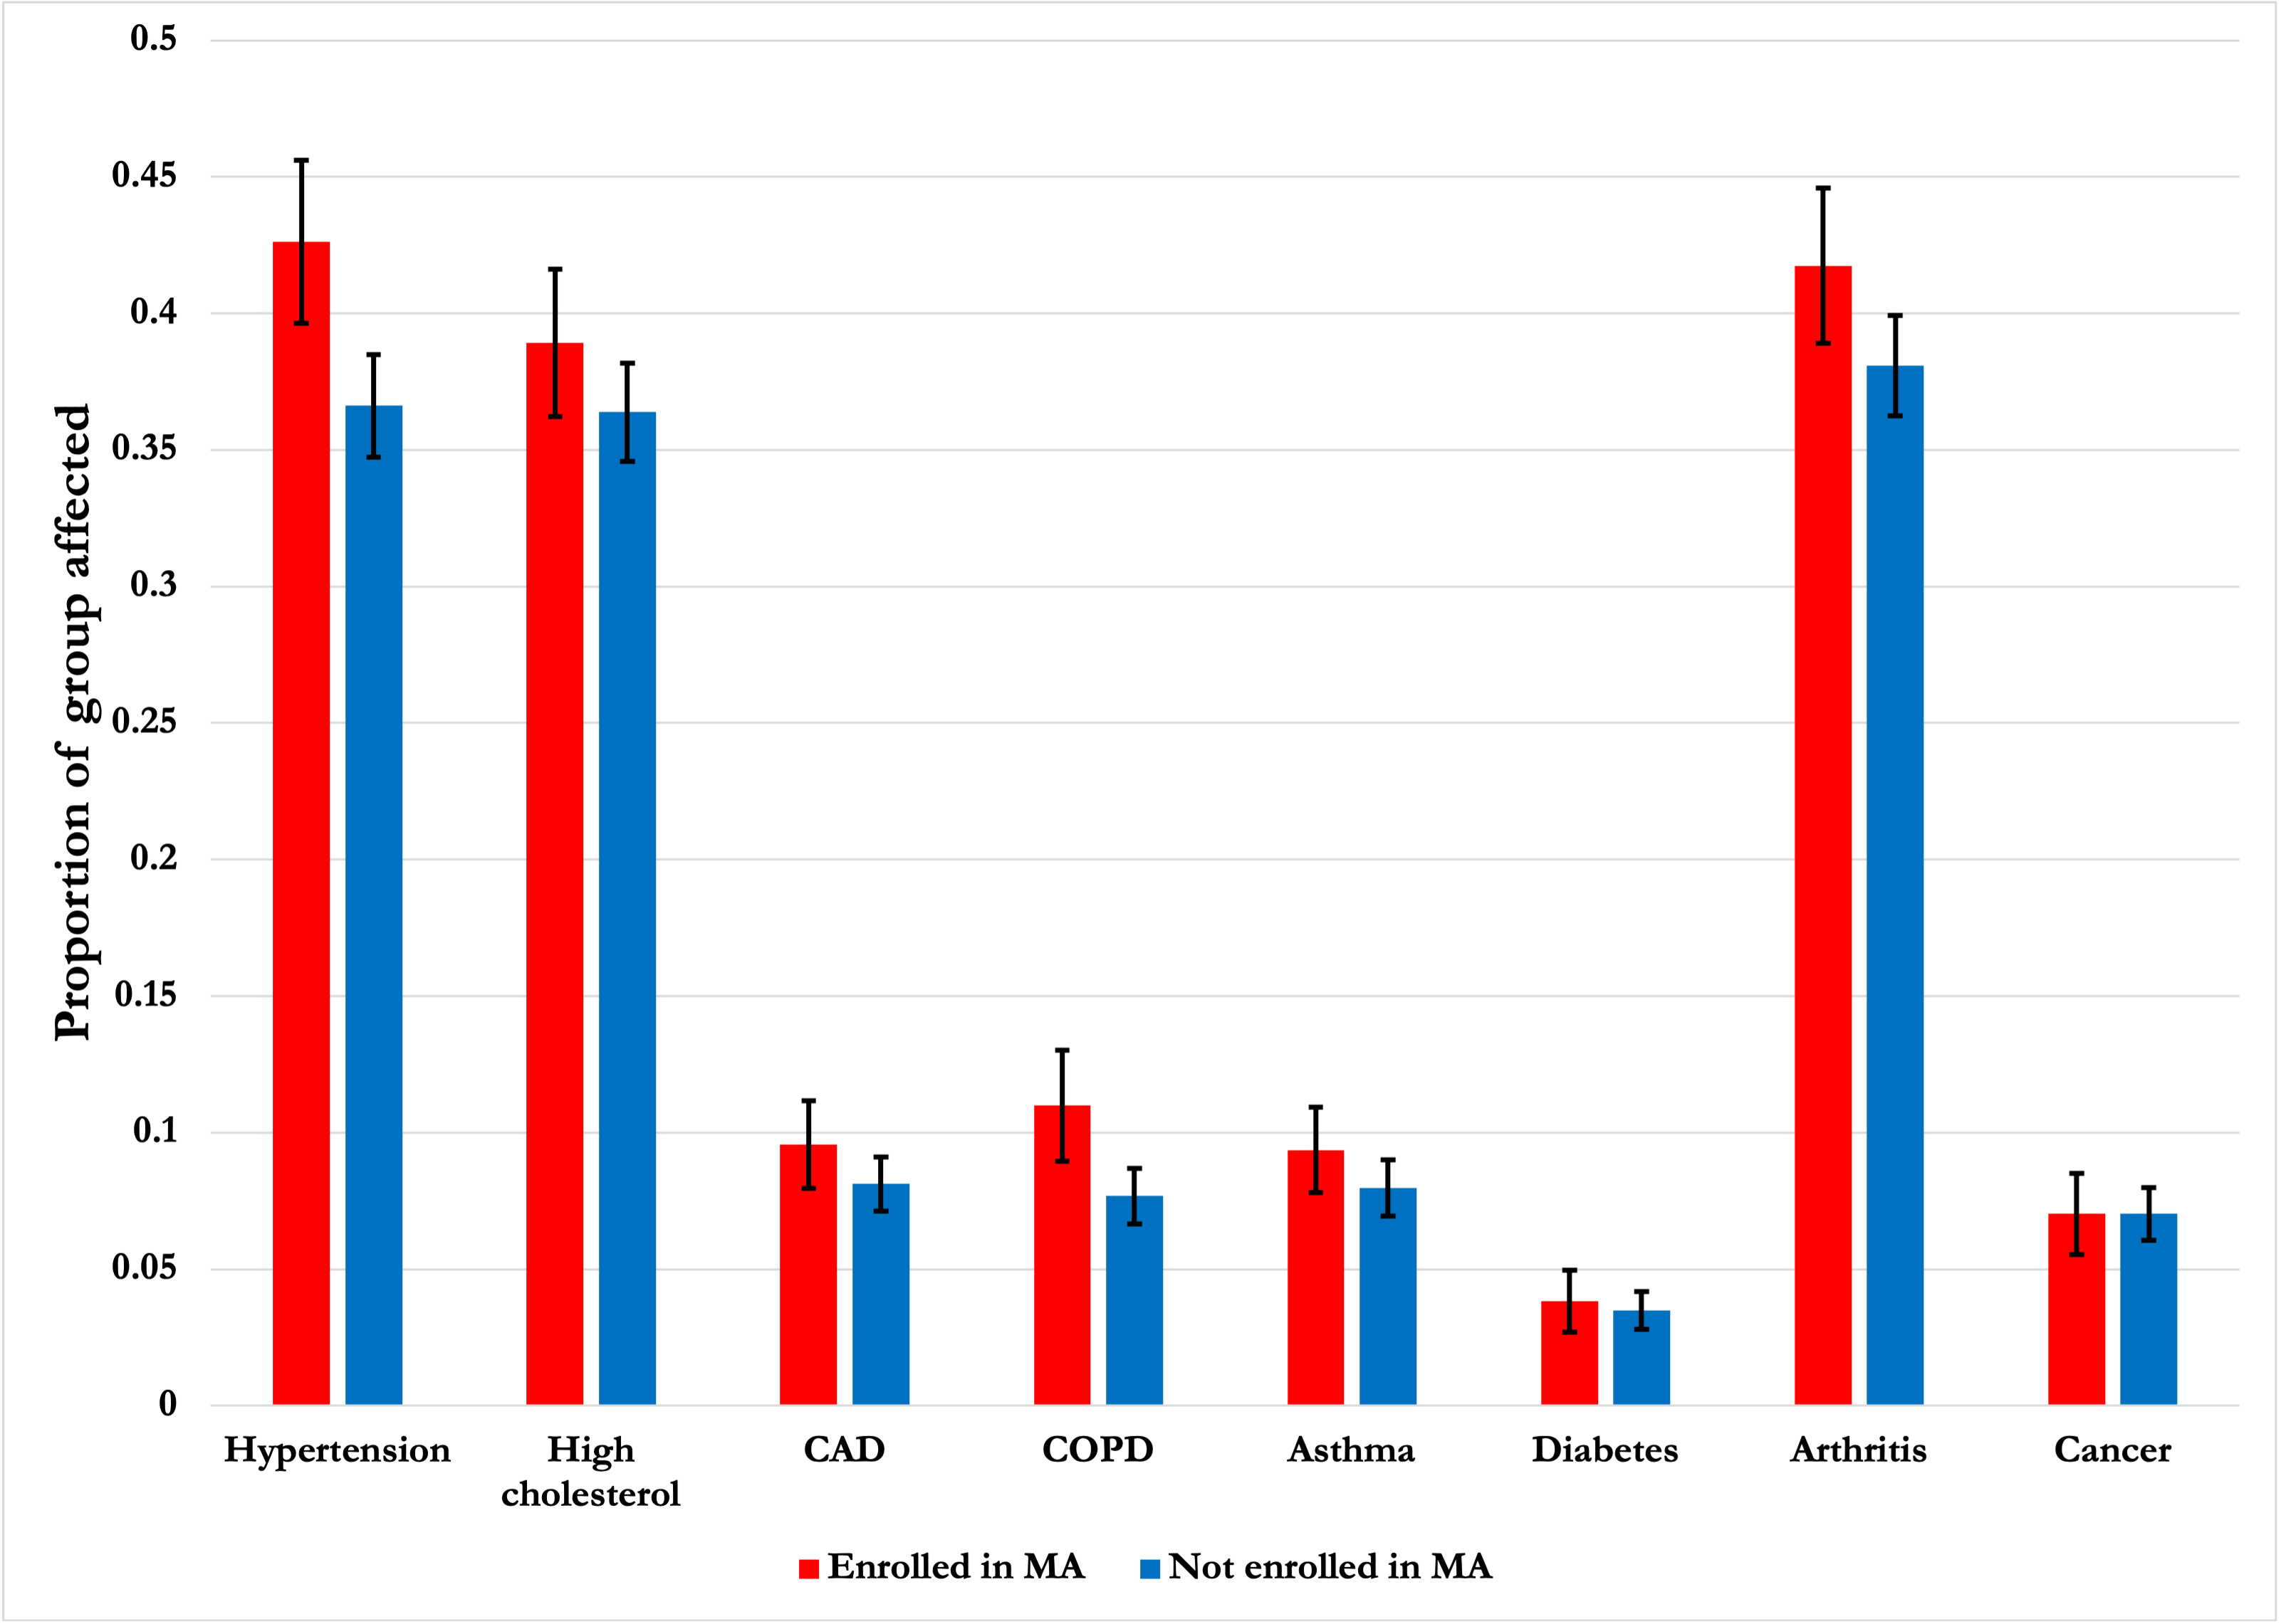
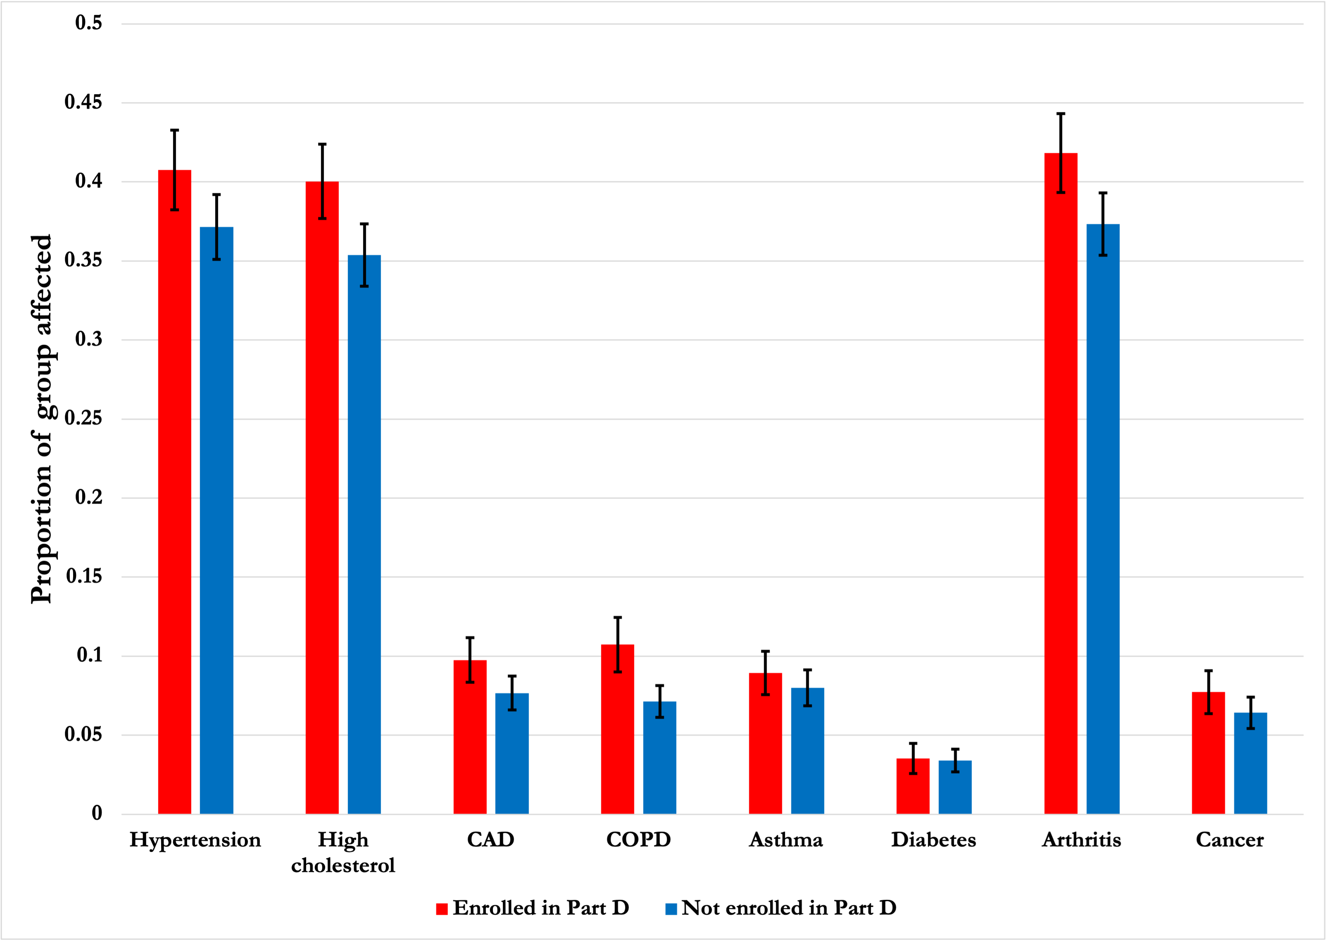
SUMMARY STATS
Incidence of selected health conditions by enrollment status
Left: MA sample, Right: Part D sample
95% confidence intervals shown

Slide 7
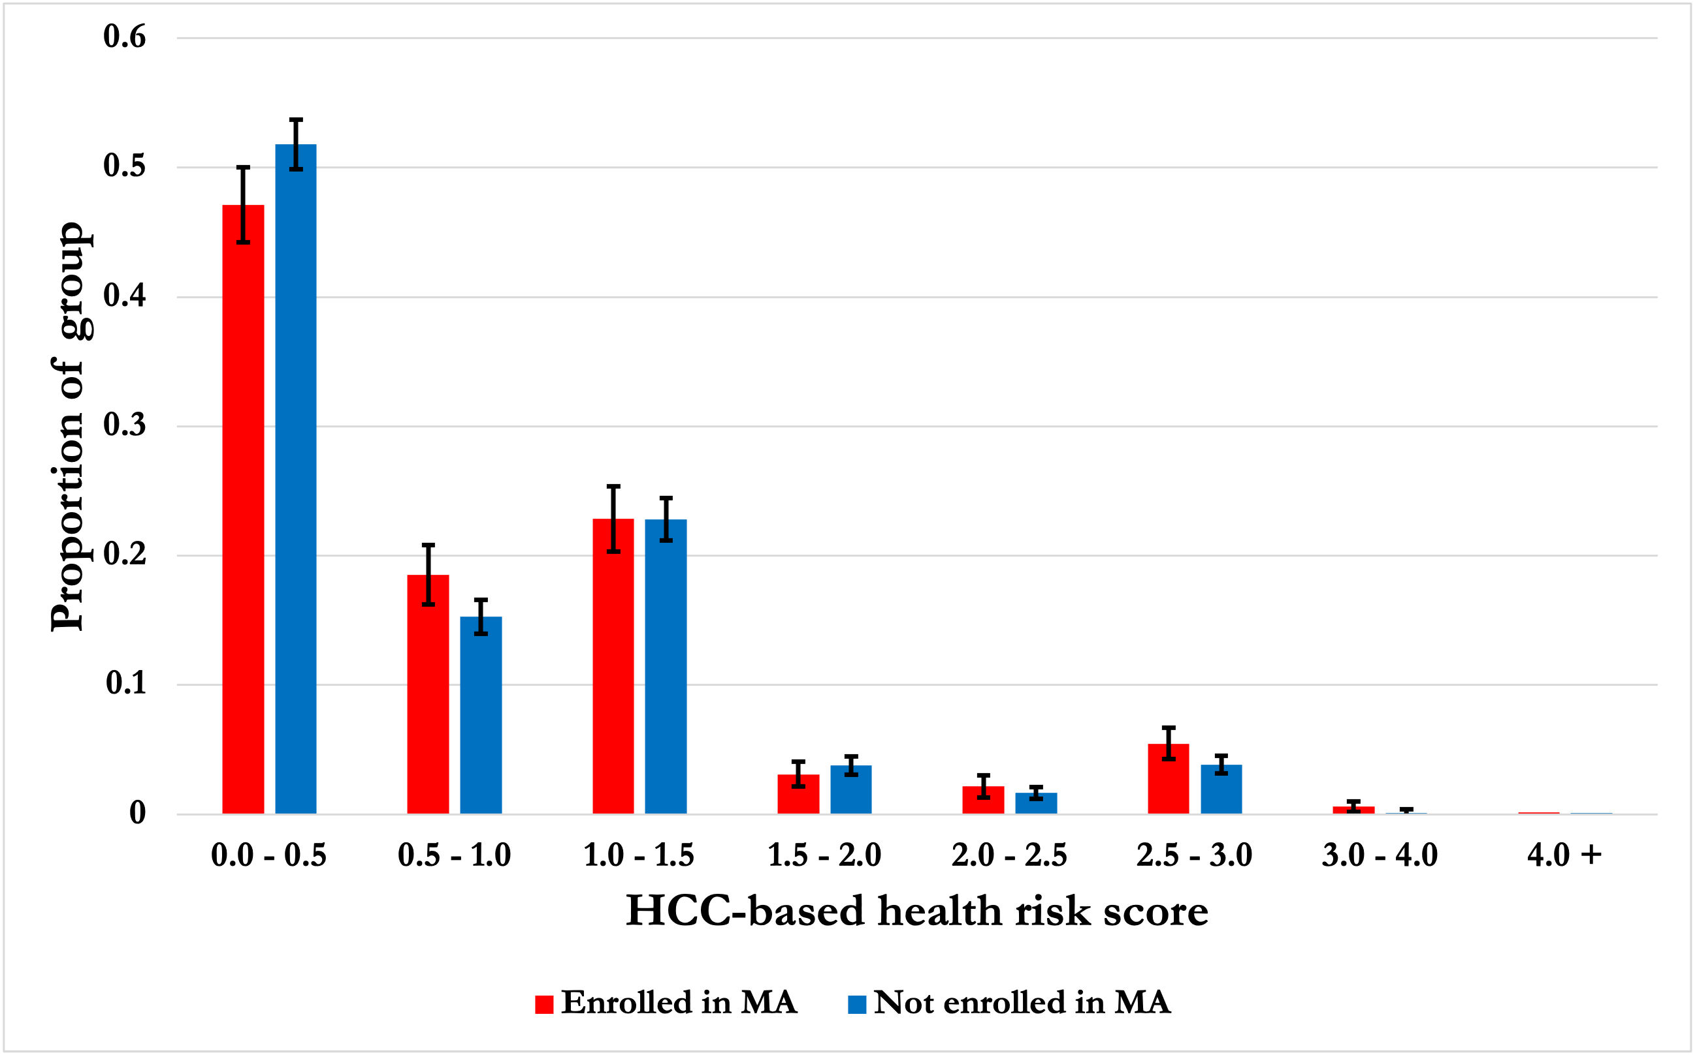
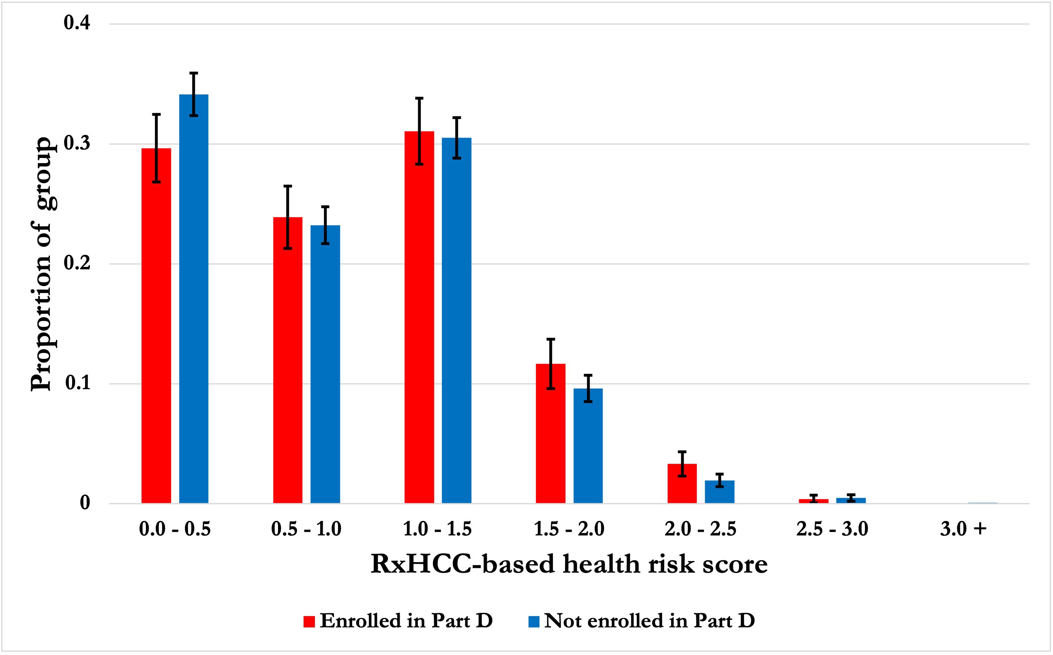
SUMMARY STATS
Distribution of health risk scores by enrollment status
Left: MA sample, Right: Part D sample
95% confidence intervals shown

Slide 8
MODEL SPECIFICATION
Enrollment_{i} = probability that observation i is enrolled in MA or Part D
Condition_{i} = takes on value 1 if observation i has a certain medical condition
Risk_{i} = HCC-based (for MA sample) or RxHCC-based (for Part D sample) health risk score of observation i
X_{i} = Other observable attributes of observation i
Sex
Race
Income
Education
Urban/rural status
Receiving care from VA, Tricare, or IHS
Z_{i} = Year dummy variables
Logit(Enrollment_{i}) = 𝝱 Condition_{i} + 𝛄 X_{i} + 𝝳 Z_{i}
Logit(Enrollment_{i}) = 𝝱 Risk_{i} + 𝛄 X_{i} + 𝝳 Z_{i}

Slide 9
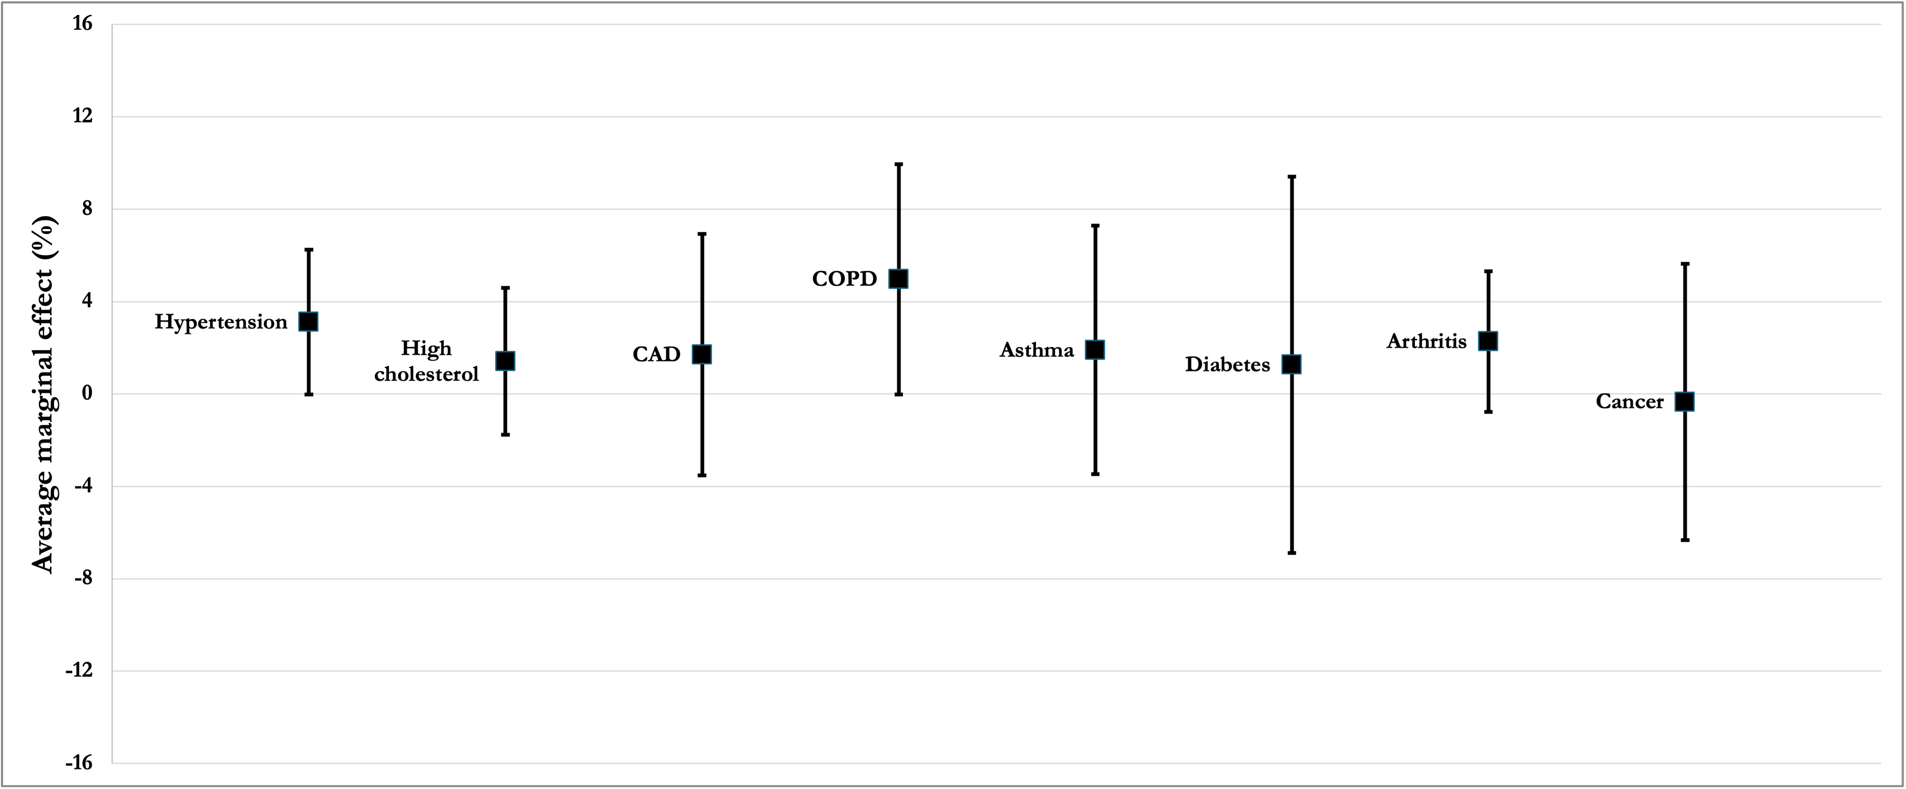
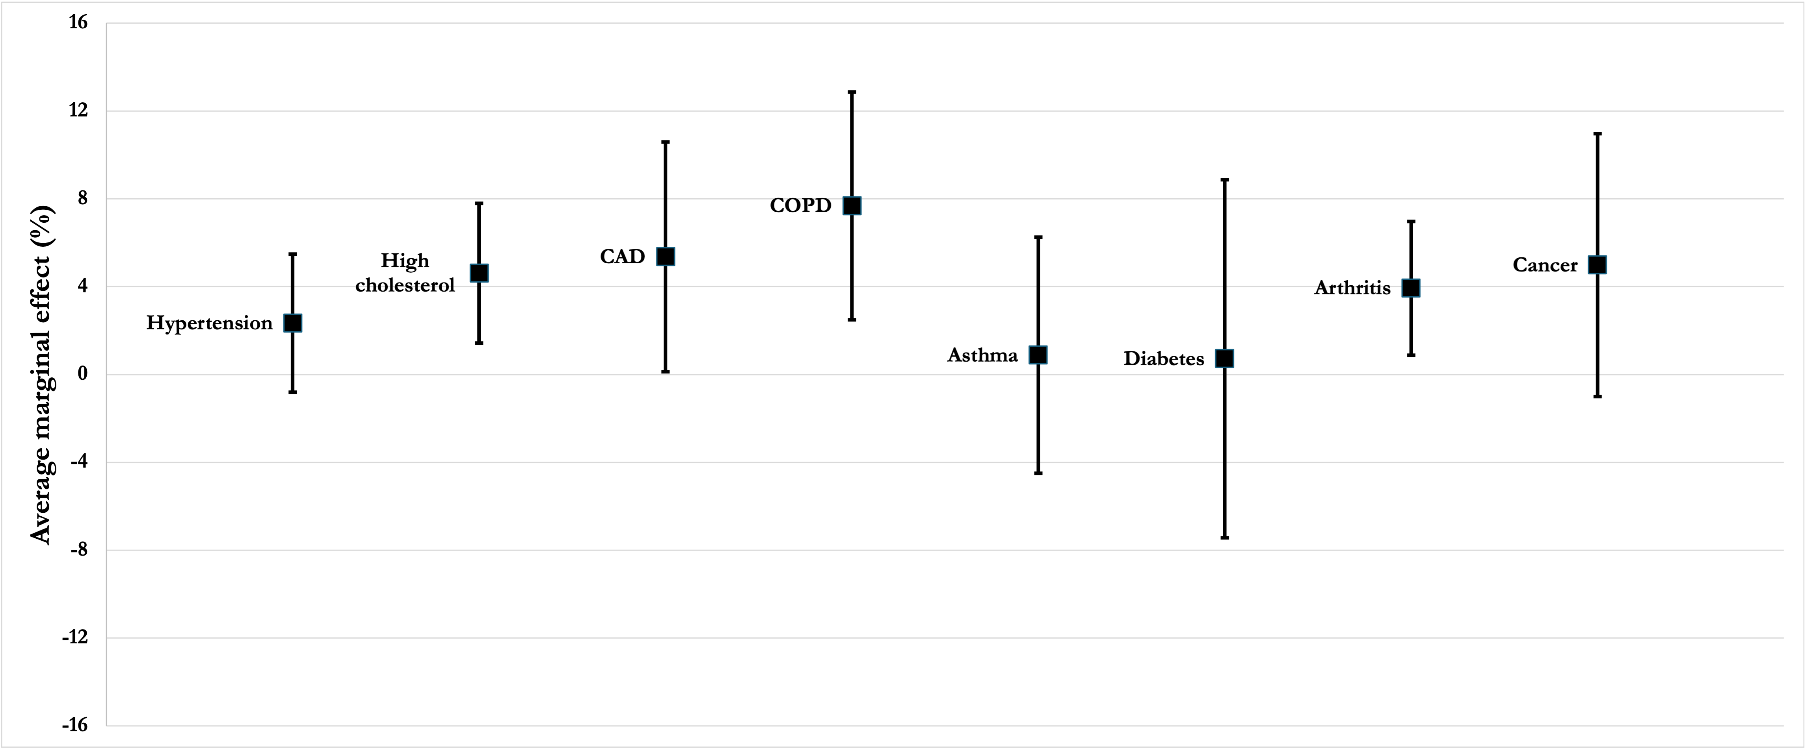
RESULTS
Average marginal effect of having a certain health condition
Top: results for MA sample
Bottom: results for Part D sample
95% confidence intervals shown

Slide 10
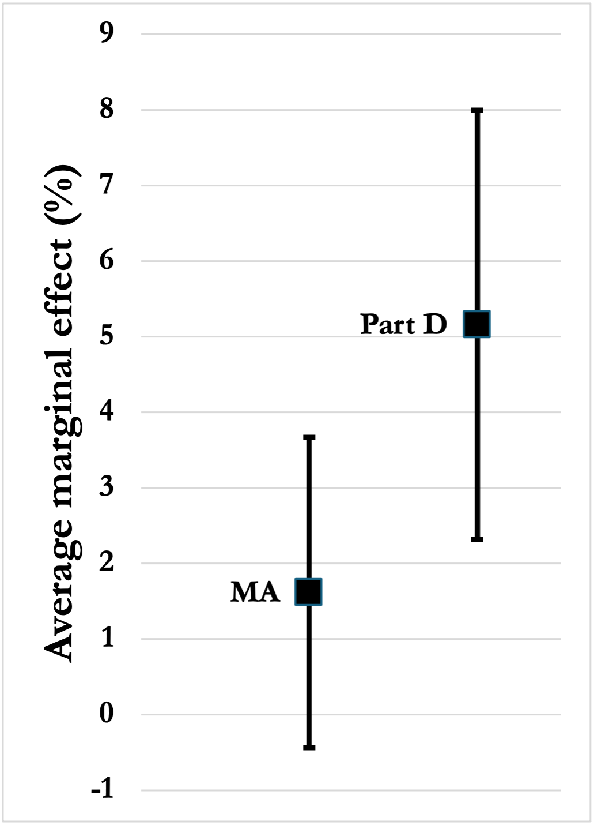
RESULTS
Average marginal effect of a one-unit increase in health risk score
95% confidence intervals shown

Slide 11
LIMITATIONS
Sample size (sample of just over 5,000 observations may not be representative of population of over 7 million)
Measurement error
A. In health condition variables
B. In health risk score variables
Failure to account for other private insurance coverage and levels of coverage within MA and Part D

