Slide 1
Speech-to-Text followed by Sign Language Converter for the Deaf
Bridging the communication gap for the deaf and hard-of-hearing community

Slide 2

Do You Know ?
Approximately 1.5 billion humans in the world are experinecing hearing problem that count around 20 % of world population.
At least 700 million people will need hearing rehabilitation by 2050, when it is predicted that approximately 2.5 billion people would have some degree of hearing loss.

Slide 3
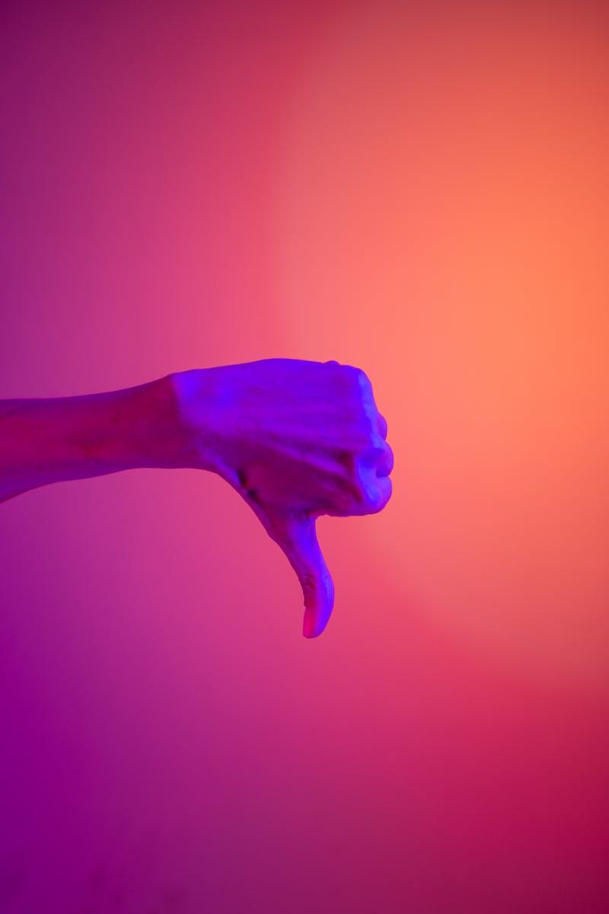
Introduction
Project aims to provide solution for deaf and hard-of-hearing community
Converts spoken language into text followed by generating a video that display sign language for the input audio
Making communication more inclusive and accessible
This presentation focuses on the use of audio to sign language converter to promote inclusive communication
The technology has the potential to bridge the gap between the hearing and the hearing impaired

Slide 4
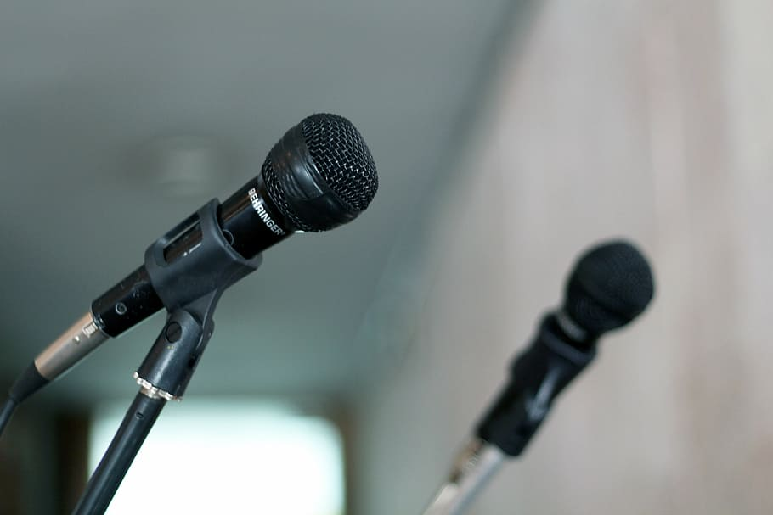
Speech-to-Text Conversion
System takes spoken language as input and converts it to text
Uses speech recognition technology
Accuracy of conversion depends on clarity of speech
Speech to Text is a speech recognition technology that enables recognition and translation of spoken language into text through computational linguistics
In the project we are using python “speech_recognition” module in order to the recognize the audio input

Slide 5

Text-to-Sign Language Conversion
Text that has been generated is in string format .
Each character in the string is mapped with the image in background .
All the images are grouped up together followed by creating video .
Video is played .

Slide 6

Importance of Sign Language
Deaf people may rely on sign language more than spoken language
Sign language is a critical means of communication for the deaf community
Being able to understand sign language promotes social inclusion
Sign Language allows deaf to participate equal footing with others

Slide 7
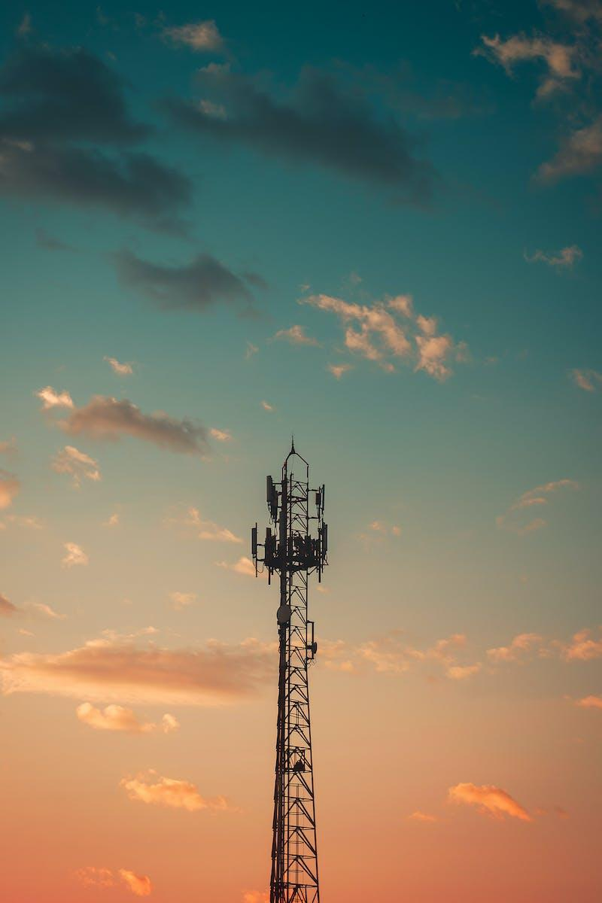
Benefits of Speech-to-Text with Sign Language
Enhances communication between deaf and hearing people
Reduces the need for interpreters
Allows for greater independence and autonomy for deaf individuals
It can be extensively used in social gathering , schools .
The software can be interpreted in multiple electronical devices likes smart phones , laptops etc.

Slide 8
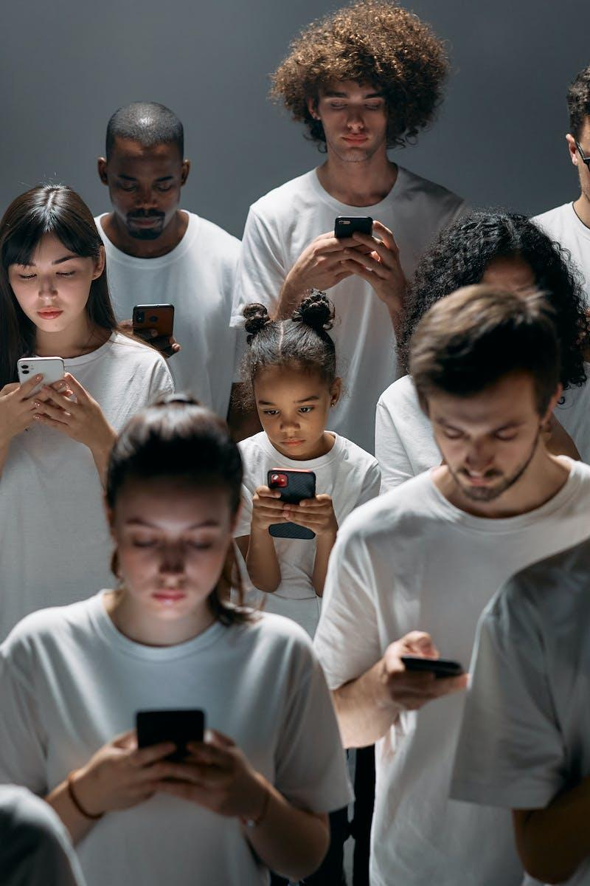
Challenges and Future Developments
System relies on accuracy of speech recognition technology
Customization of sign language can be complex
Future developments could include improved accuracy and expanded language support .
In future we are planning to customize an emoji that will play create and play the sign language .

Slide 9
Conclusion
The “Speech to Text followed by Sign Language Converter technology" is a potential tool for fostering inclusive communication, to sum up. Although there are still some obstacles to overcome, the advantages are too great to pass up.
This technology has the ability to reduce communication barriers and foster greater inclusivity in our society as it develops and accuracy rates rise.

