Slide 1
Liam – Collaborative Software
Portrayed By Kyle Fitzpatrick
x15754001

Slide 2
What is Collaborative Software?
Collaboration software enables the sharing, processing and management of files, documents and other data types among several users and/or systems. This type of software allows two or more remote users to jointly work on a task or project.

Slide 3
Why use Collaborative software?
“No point in running each function in an isolated independent manner”
We work More efficiently
Meeting Timelines/Deadlines
Stay on Budget
Learn new skills – by working together
It Makes Sense?!

Slide 4

Different Types of Collaborative software
IBM Connections

Slide 5

Different Types of Collaborative software
Pidoco

Slide 6
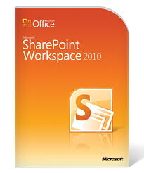
Different Types of Collaborative software
Microsoft SharePoint Workspace

Slide 7
Which one do I Recommend?
I Would Recommend the IMB Connections
Why? – Easy to use, not complicated at all
Microblogging function for messages
Social Network Service
Collaborative space for people to work together
Blogging function
Much More!!!

