Slide 1
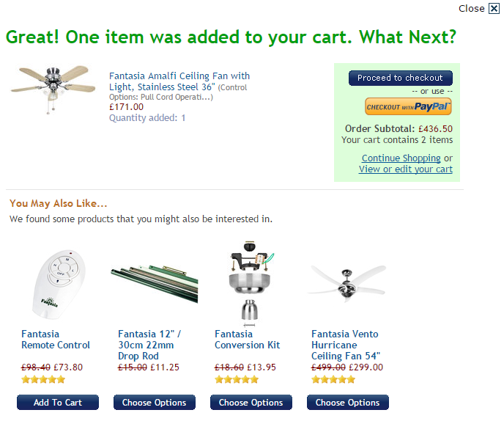

Payment Options - Clarify
Notes:
When a product is added to cart, can we display a prominent set of logos for the cards that are accepted. Note, the client is removing the ‘checkout with PayPal’ button that you see above so we will also need to include the PayPal logo (as PayPal is available on their sagepay payment platform).

Slide 2
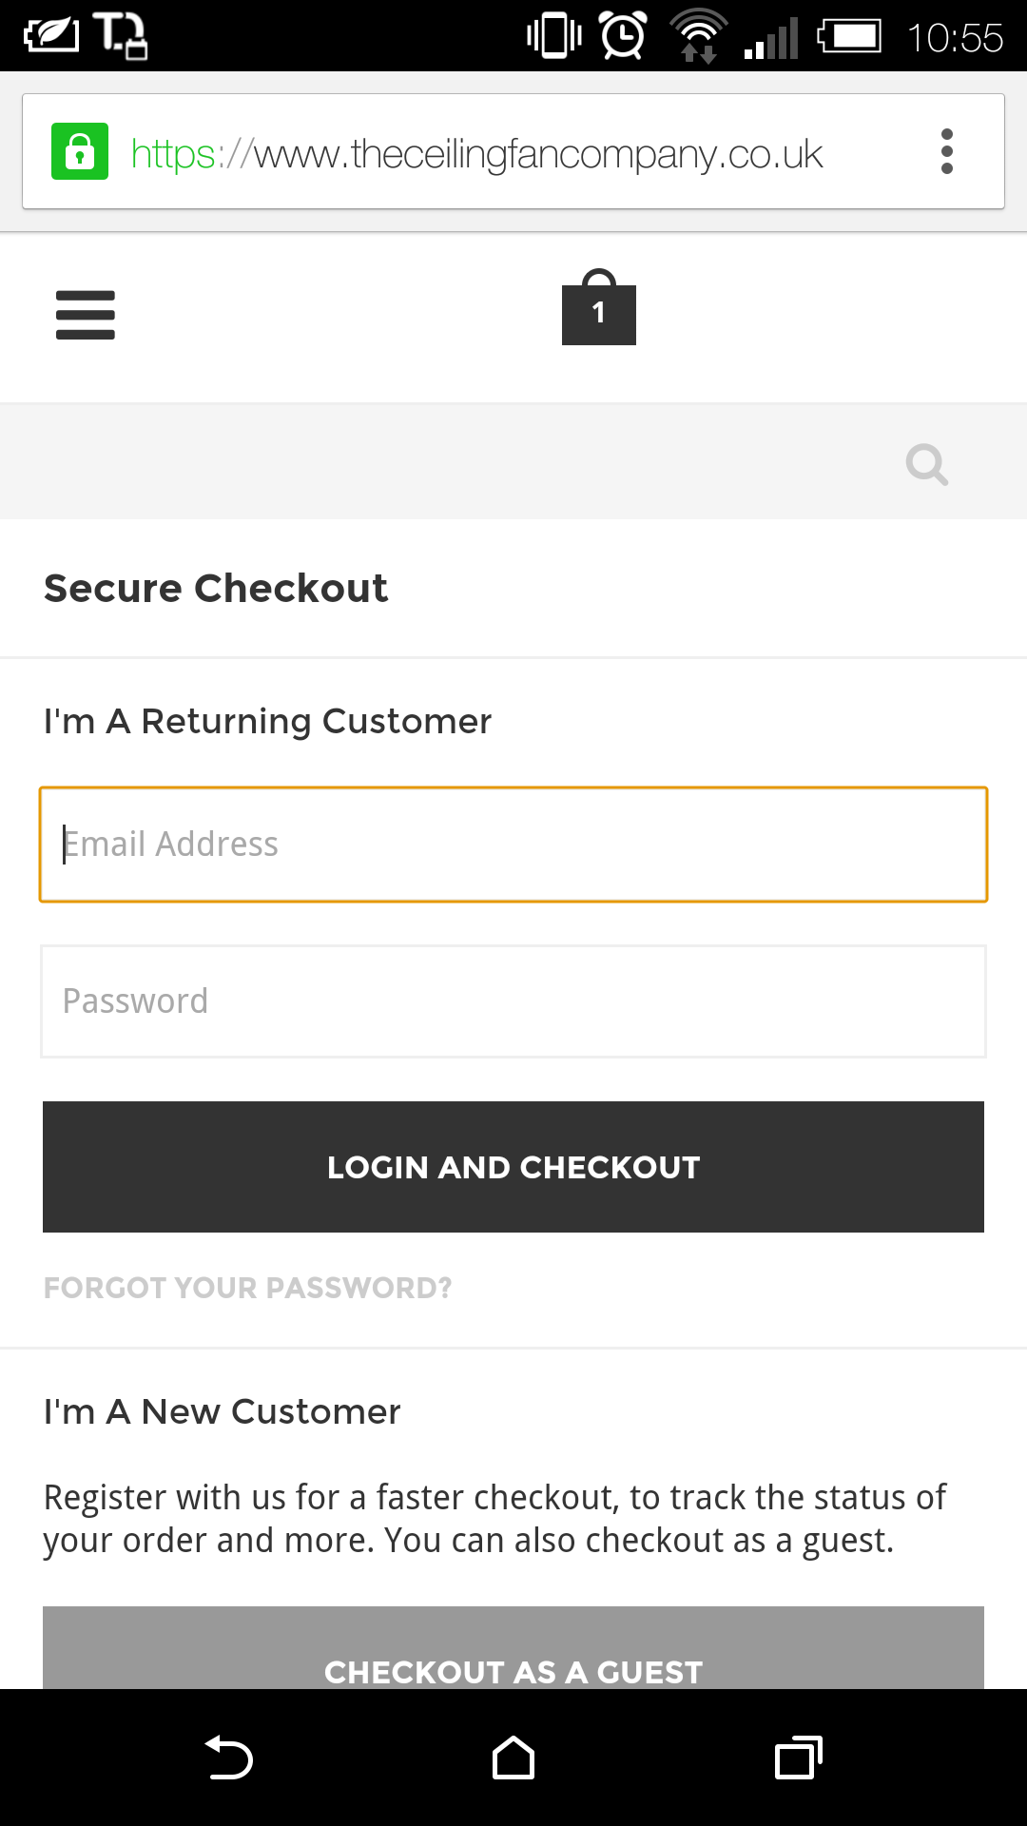
Mobile Checkout Form
Guest checkout should be higher up
Review form fields to remove redundancy
‘UK’ should be default option for country selection
Form labels need to be localised (‘state/province’ and ‘zip code’)
Trigger correct keypad for input type (email and phone number)
Source: Heuristics and user testing
Notes:
Can we tidy up the checkout form on mobile? In addition to the elements above, can we improve contrast of form labels and text entry boxes?

Slide 3
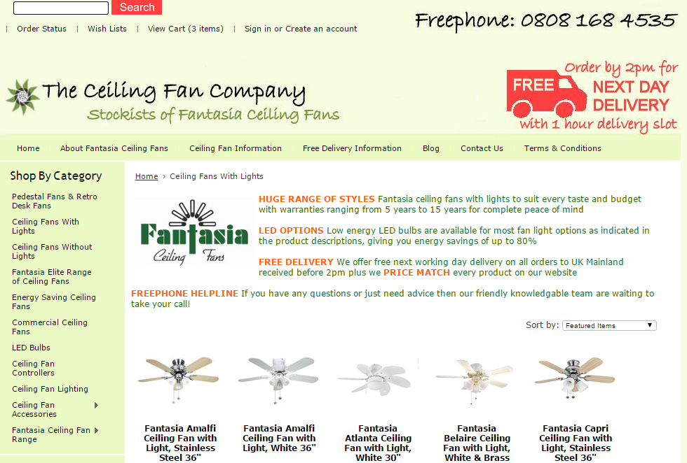
Page titles – What page am I on?
Source: Heuristics and EyeQuant
Notes:
Can we include page titles on all product listing pages (page titles for the homepage and product page are included in the wireframes).
For the product

