Slide 1
MandazaTV
App Description
Luke Steuber
Notes:
[Sources]
Local manifest: samsung/tizen/config.xml (retrieved 2026-08-10).

Slide 2
Revision History
Version | Updated | Description | Author
1.3.0 | 10 Aug | Initial Samsung TV app description | Luke Steuber
— | — | No prior revision | —
Notes:
[Sources]
Local manifest: samsung/tizen/config.xml (retrieved 2026-08-10).

Slide 3
Contents
UI Structure
Application Screen
Usage Scenario
Menu and Functions
Remote Key Policy
Language Support
Notes:
[Sources]
Document structure follows the supplied Samsung app-description template.

Slide 4
UI Structure
• One full-screen procedural canvas with an optional local HH:MM clock.
  • One bottom dock: New Pattern, Next Palette, and Clock On/Off.
  • No secondary pages, account, payment, settings, or external network.
    • Visible focus and every primary action use the Samsung Smart Remote.
Notes:
[Sources]
UI and interaction source: samsung/tizen/index.html (retrieved 2026-08-10).

Slide 5
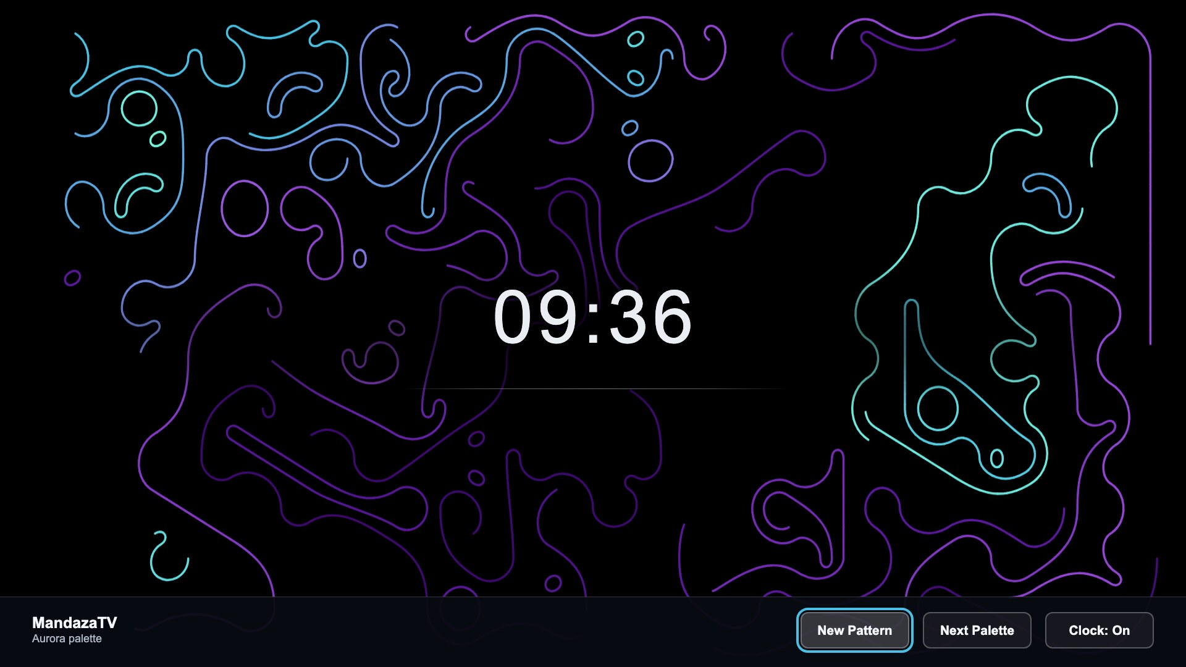
UI Structure – Application Screen
Notes:
[Sources]
Screenshot: samsung/seller-office-assets/screenshots/01_aurora-controls-1920x1080.jpg (captured 2026-08-10 from the Tizen package renderer).

Slide 6
Usage Scenario
• Launch MandazaTV: the canvas, local clock, and dock appear.
• Left/Right moves focus; Select activates New Pattern, Next Palette, or Clock.
• Play/Pause regenerates. With the dock hidden, an arrow shows it; Select regenerates.
• Return hides the dock first; Return again exits MandazaTV.
• No sign-in, purchase, activation, account, or network access is required.
Notes:
[Sources]
Usage and remote behavior: samsung/tizen/index.html (retrieved 2026-08-10).

Slide 7
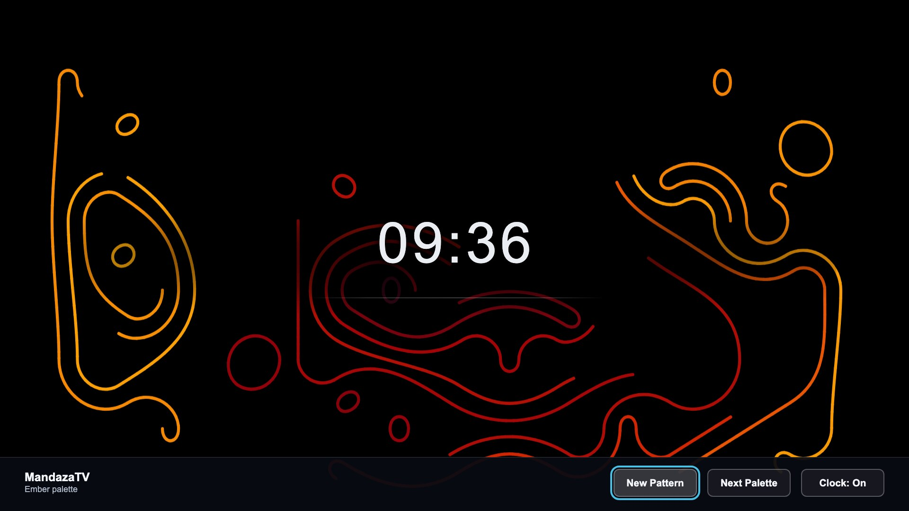
Menu and Function Description
Three controls: New Pattern, Next Palette, Clock.
Notes:
[Sources]
Screenshot: samsung/seller-office-assets/screenshots/02_ember-controls-1920x1080.jpg (captured 2026-08-10 from the Tizen package renderer).
Control behavior: samsung/tizen/index.html (retrieved 2026-08-10).

Slide 8
Remote Key Policy
All primary actions are available from the Samsung Smart Remote.
Button | Action | Remarks
ENTER / OK | Activate focused dock control; ambient view: new pattern | Primary action
LEFT / RIGHT | Move dock focus; when hidden, show dock | Navigation
UP / DOWN | Keep focus within the dock | Navigation
PLAY / PAUSE | Generate a new Mandaza pattern | Primary action
RETURN (dock shown) | Hide the control dock | First press
RETURN (dock hidden) | Exit MandazaTV | Second press
HOME | Return to Samsung Home; app follows lifecycle | System
CHANNEL + / − | No app action | System
EXIT | System exit behavior; no in-app prompt | System
Notes:
[Sources]
Key handling: samsung/tizen/index.html (retrieved 2026-08-10).

Slide 9
Language Support
Items | Contents
Application language | MandazaTV v1.3.0 is English-only. There is no in-app language selector; current UI labels remain English.
Notes:
[Sources]
Local manifest and UI labels: samsung/tizen/config.xml and samsung/tizen/index.html (retrieved 2026-08-10).

