Slide 1

NON-EQUILIBRIUM MOLECULAR DYNAMICS: SHOCK PHYSICS
Michigan State University
Ryan Marcus
Tom Dixon
Janes Krek
Luke Stanek
Devin Lake

Slide 2
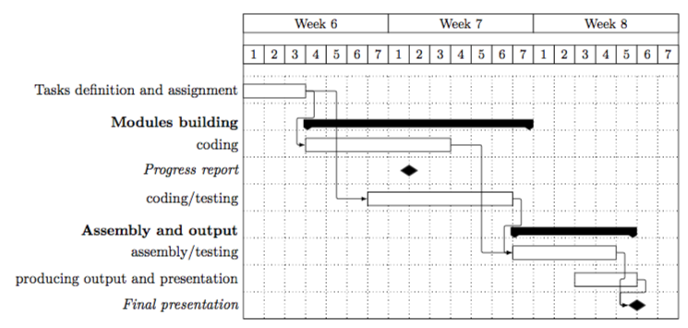

Slide 3
Tube Cell
Generating Cells as Shock is applied.
Variables: Length of Tube, particle density, radius of tube, etc
4 Boundaries, 2 momentum mirrors.

Slide 4
Piston
Piston will be a momentum mirror.
Initial Velocity and Force of the Piston.
Will use LJ units.

Slide 5
In Case of Emergency
Team Effort!
Multiple people assigned to a task, so if someone gets stuck or sick the other should be there.
Git Repository to keep files together.

Slide 6
Questions?

