Slide 1
Workplace Data Analysis
By: Luke Stodgel
Youtube link: https://youtu.be/HW_8mqiiL2I

Slide 2
Table of Contents
Top Three Variables that Lead to Attrition
How were those variables picked?
The Best Linear Regression Model
Hypothesis Test
Additional Insights About the Data

Slide 3
Top Three Variables that Lead to Attrition
Business Travel, Relationship Status, Years Since Last Promotion
How were those variables picked?
What were the results?

Slide 4
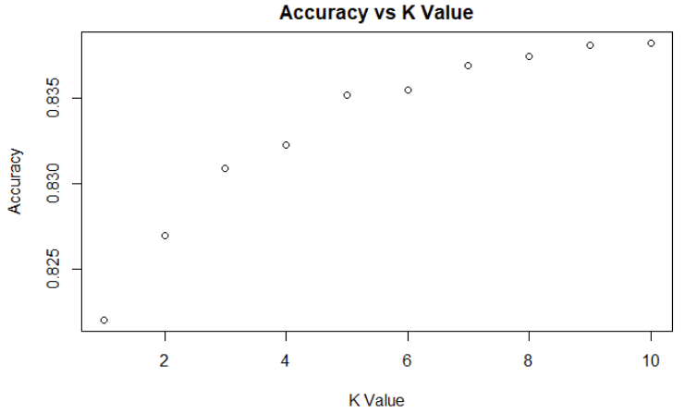
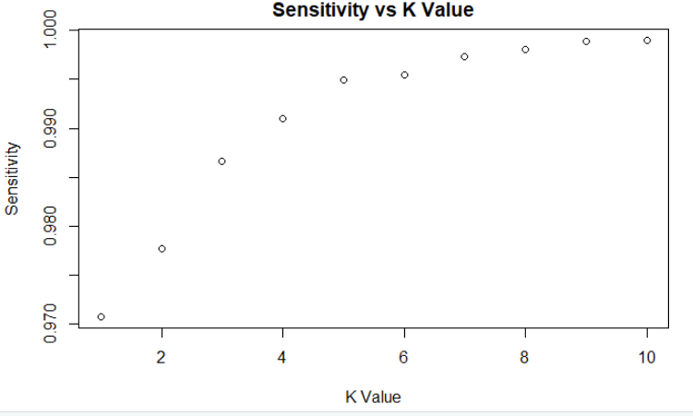
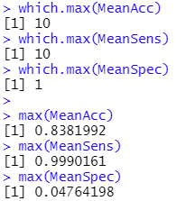
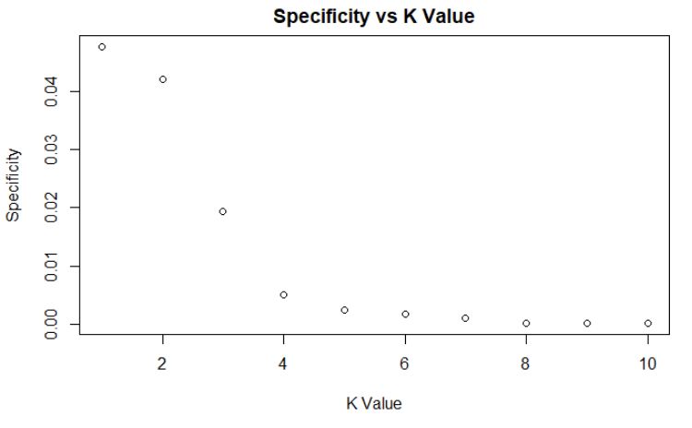
Results:
KNN

Slide 5
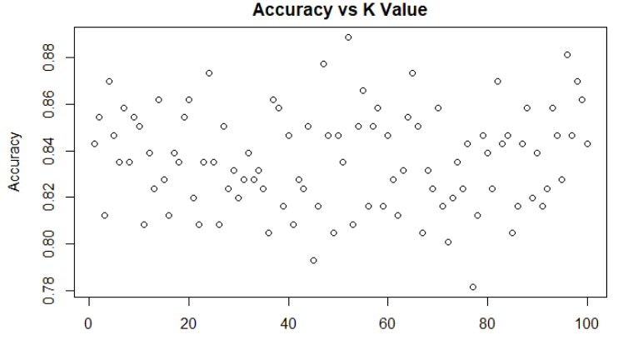
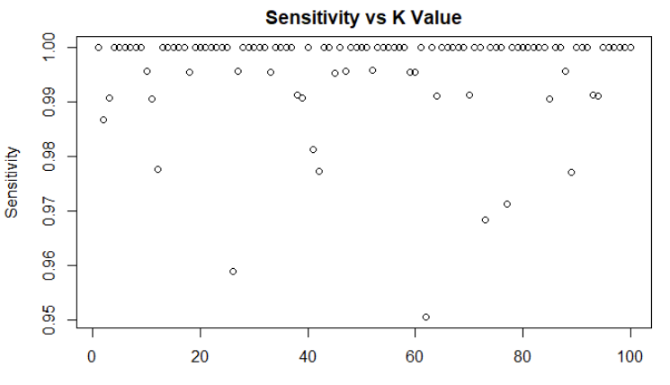
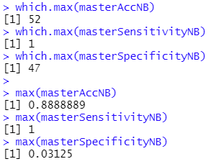
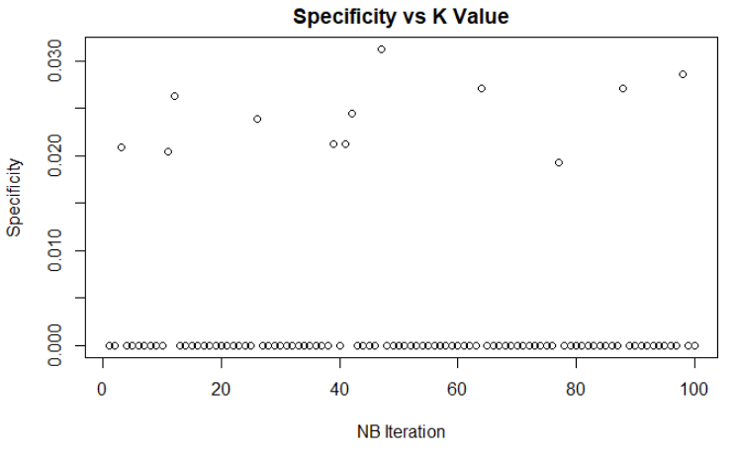
Naive Bayes

Slide 6
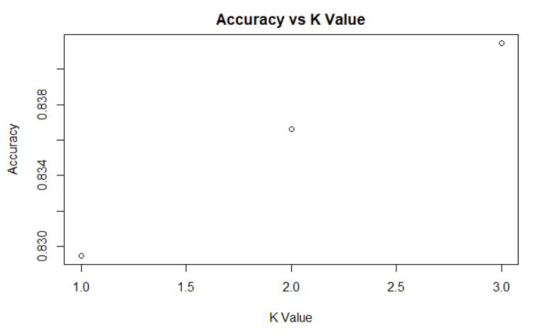
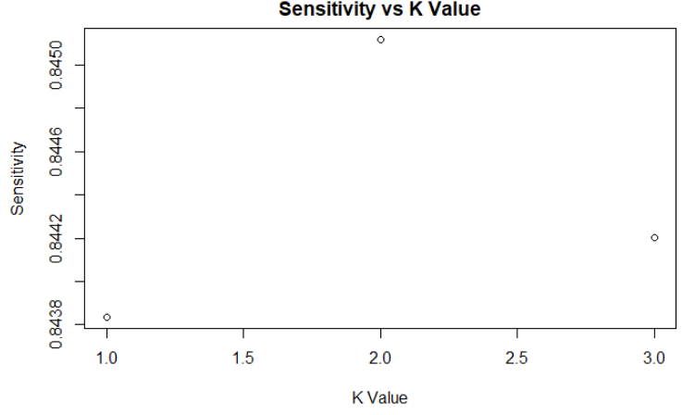
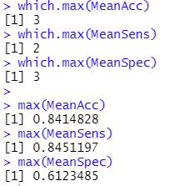
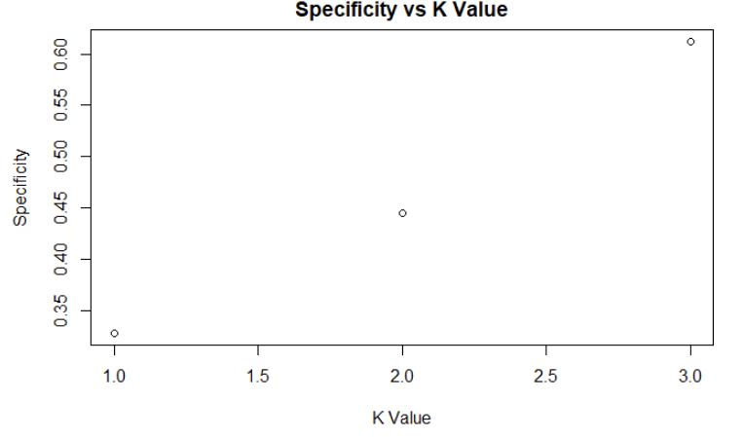
Knn.cv -
Winner!

Slide 7
The Best Linear Regression Model
Used Job Role and Total Working Years to get the best model
Obtained RMSE = 1600.099
How were those variables picked?

Slide 8
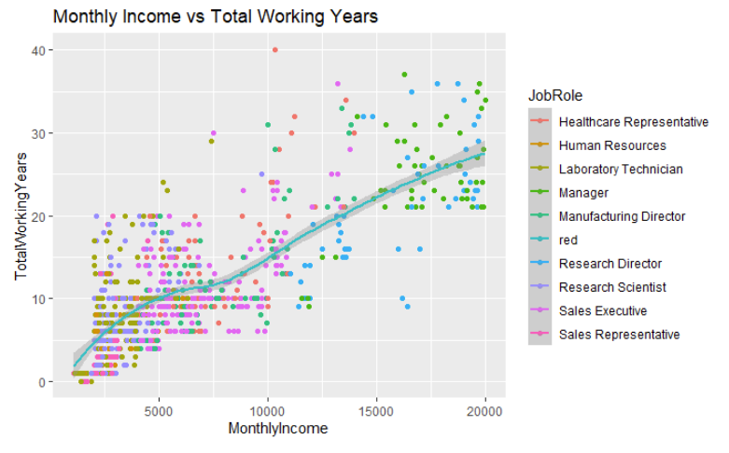
Picture of Linear Regression Model

Slide 9
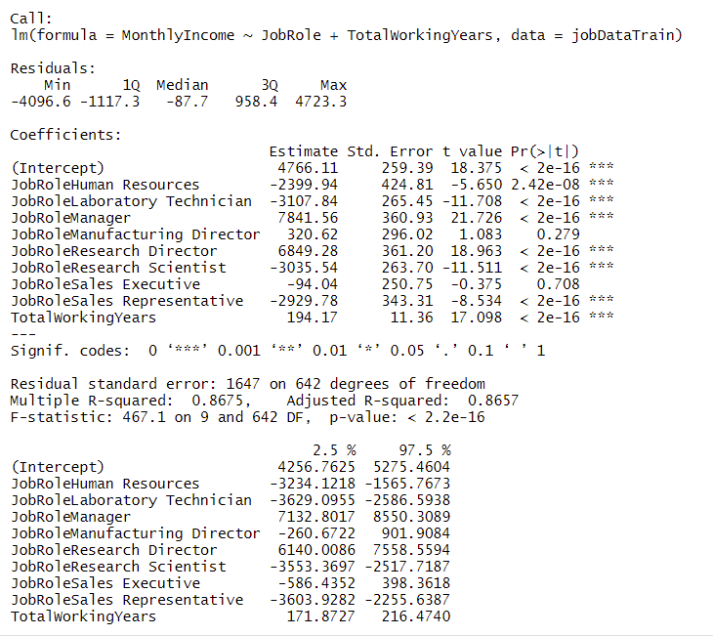
Hypothesis Test

Slide 10
Additional Insights
18.32% of people age 18-40 left their jobs.
11.18% age 40-60
16.86% of men left their jobs
14.97% of women

Slide 11
Thank you

