Slide 1
Maximilian Maeder: A Rising Star in Kitesurfing
Maximilian Maeder is a name that has quickly become synonymous with excellence in the world of kitesurfing. Born on September 12, 2006, this Singaporean athlete has achieved remarkable milestones at a young age, making him an inspirational figure for aspiring athletes worldwide.

Slide 2
Personal Background
Maximilian's multicultural heritage plays a significant role in his unique upbringing. With a Singaporean mother and a Swiss father, he spent his childhood navigating diverse cultures and environments. His early years were split between Singapore, Switzerland, and Sulawesi, Indonesia, where his parents built a dive resort in Wakatobi.

Slide 3
Career Achievements
Maximilian is the reigning champion in the Formula Kite World, Asian, and European championships. At 16, he became the youngest winner in any Olympic sailing class competition. In the 2024 Summer Olympics in Paris, he won a bronze medal in the Men's Formula Kite event, making him the youngest Olympic medalist in Singapore's history at 17.

Slide 4
Additional Career Highlights
Maximilian is a three-time Formula Kite Youth World Champion (2021-2023) and has won various open championships across Europe, Asia, and Pan America, showcasing his versatility and dominance in the sport.

Slide 5
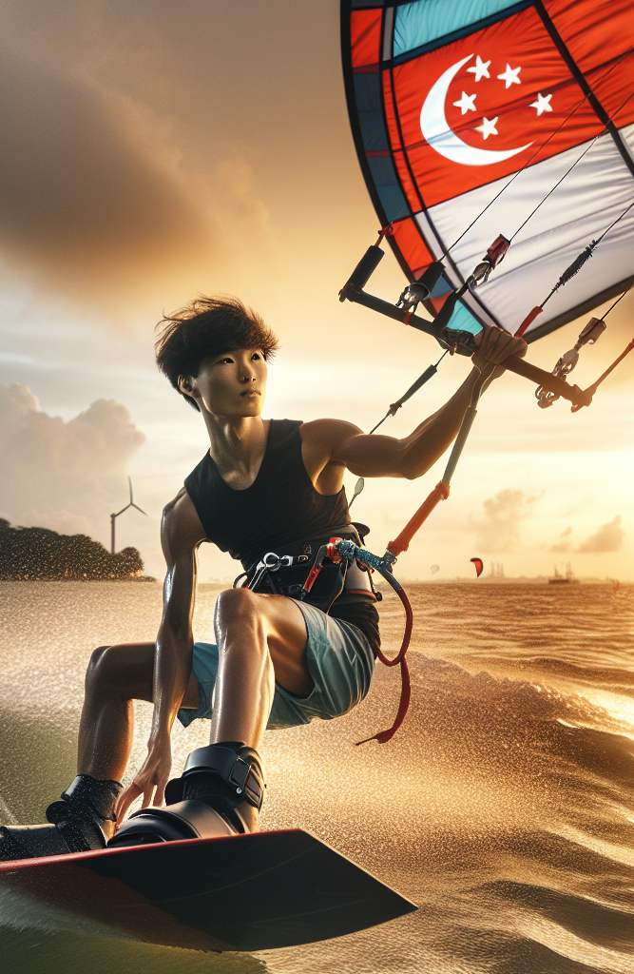
Training and Education
Maximilian began kitesurfing at age six, initially with kiteboarding before transitioning to foil boarding. Homeschooled from age 12 to focus on his sport, he trained on the professional circuit, often racing against adults, honing his competitive edge.

Slide 6
National Service
In Singapore, mandatory National Service is a rite of passage. Maximilian views it as an opportunity for personal growth and national contribution. His national service has been deferred to allow him to train and compete in the 2028 Los Angeles Olympics.

Slide 7
Skills and Languages
Maximilian's multicultural background has endowed him with linguistic skills. Besides his native English, he understands Mandarin, German, and French, making him a well-rounded individual capable of connecting with diverse communities.

Slide 8
Inspiration and Support
Maximilian's journey is a testament to determination, unwavering commitment, and robust family support. He encourages young athletes to chase their dreams relentlessly and not to be disheartened by challenges.

Slide 9
Conclusion
Maximilian Maeder's ascent in kitesurfing is a compelling narrative of talent, hard work, and familial support. His achievements bring pride to Singapore and serve as a beacon of inspiration for young athletes aiming to represent their countries on the global stage.

