Slide 1
FYP-(Resources)
Luke Taylor

Slide 2
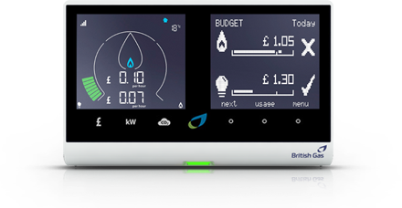
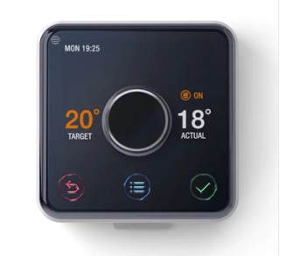
Project overview
Based on Internet of things, art installation, open data and environmental sensing.
My aim is to build a smart interactive art piece that can visualise the consumption and environmental impact of resources In the home environment.
This idea could then be taken and placed within the home to rival current modern smart meters from companies such as hive or British gas.

Slide 3
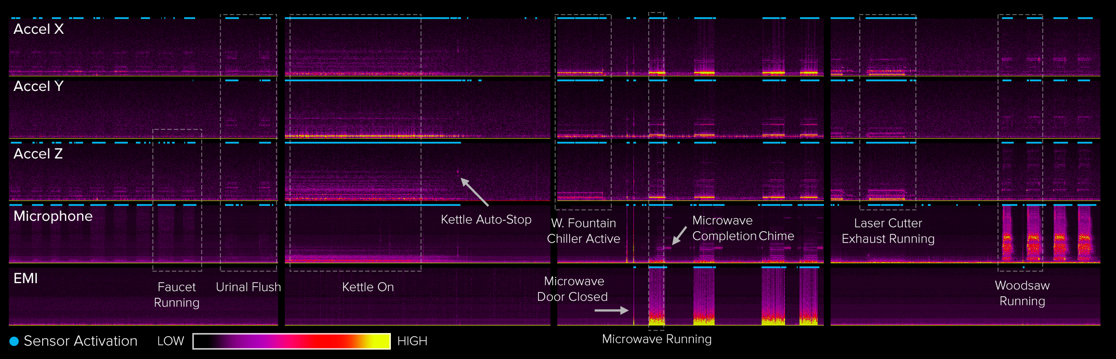
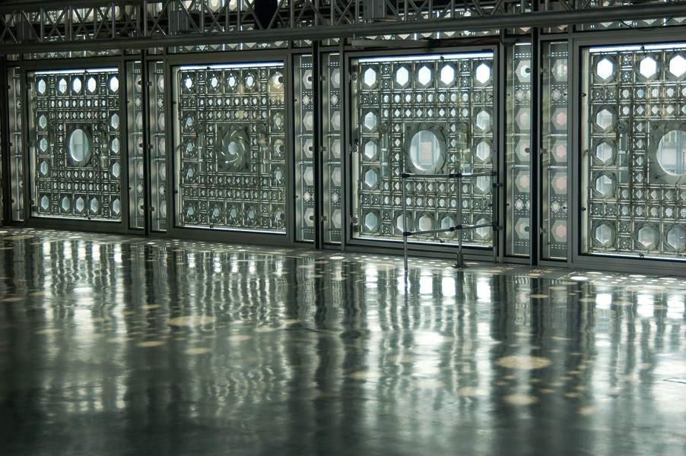
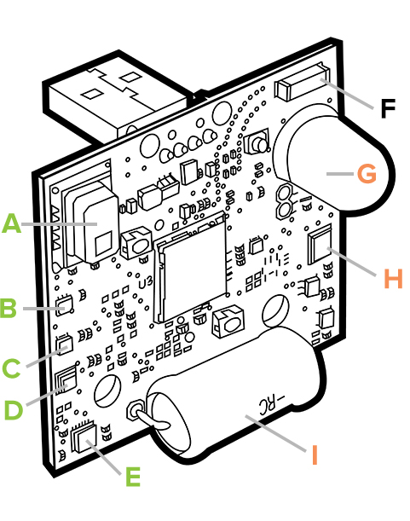
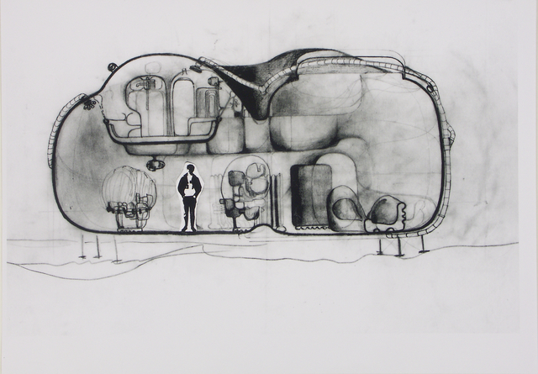
Inspirations
Arab world institute in Paris designed by Jean Nouvel.
changing metal façade that opens and closes like a cameras aperture to control interior light and temperature levels.
A synthetic sensor is a single, highly capable sensor can indirectly monitor a large context, without direct instrumentation of objects. One sensor can detect everything in a room.
A psychotropic house is a building designed to sense and mirror the psychologic state of their occupants and change aspects such as shape and layout accordingly, some homes have complete control of all aspects.

Slide 4
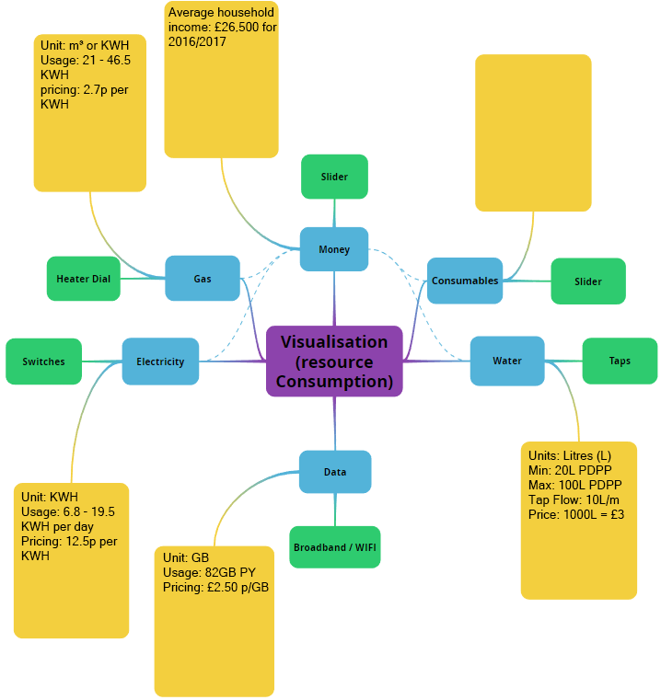
Resources Model
The model will be followed as a reference throughout the design and build of the installation.
It will include the main resources identified within the
Home, the different inputs and likely interfaces for the
Final installation, how they link together and the measurement methods and parameters.

Slide 5
Ideas

Slide 6
Prototyping

