Slide 1
Purpose
To develop an Electronic Lab Notebook (https://en.wikipedia.org/wiki/Electronic_lab_notebook)
with the following features:
Desktop application with intuitive GUI.
Data can be stored in local folder by project names or synchronized the folder with cloud drive.
It supports three working modes: single-user, multiple-user, lab manager(PI)-lab member.
In the GUI, users can create, upload or delete office documents (Word, PowerPoint, Excel) or use
the built-in editor tool to edit the content in each component.
It enables to the user to search by names or dates in each component.
It provides calendar functions for the user and the calendar no only helps the user to arrange the
daily work but also has the hyperlinks to each component to edit information there and there will
be a time stamp for in each component.
7. It’s free but we can also add the payment function for the working modes.
https://splice-bio.com/the-7-best-electronic-lab-notebooks-eln-for-your-research/
reviews current 9 popular ELNs for the researchers. We can think more about our software to differentiate it.

Slide 2
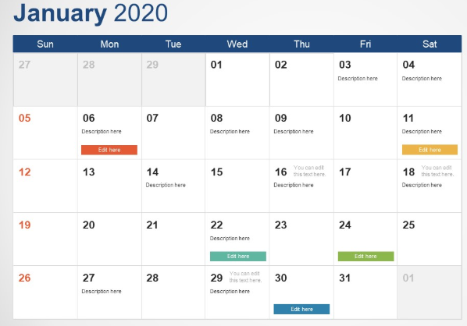
GUI frame
Experiment Plan
Component
Project1
Protocol
Result
Content Display Panel
Sample Storage
Reagent Inventory
.
.
.
Calendar
Status Display Panel

Slide 3
Backend Logic of single-user mode
(use case diagram)
Search by time for the components in projects
User Account Database
Register/Log
Each Project
with time stamp:
Verify
Project
List
Manage
Authenticate to connect
Experiment Plan
Protocol
Result
Sample Storage
Reagent Inventory
Logged in User
CRUD
Manage
Synchronous
data
Local disk
Cloud drive
Each task in
calendar must have
an assigned project and
optionally assigned components.
Calendar
Store projects by name

Slide 4
Any ideas on
multiple-user mode
lab manager(PI)-lab member mode
How to share one cloud drive?
Lab manager (PI) creates projects
and assigns the projects for the members.
Different members can share the same projects

Slide 5
Supplementary Reference
https://michaelscodingspot.com/9-must-decisions-in-desktop-application-development-for-windows/

