Slide 1

Final Project PySpark Streaming and NLTK Text Processing:
Naïve Bayes Classification for Twitter Sentiment Analysis
Walsh, Luke
CSCI E-63 Big Data Analytics
2016
Harvard University Extension School
Prof. Zoran B. Djordjević

Slide 2
Introduction
Topic: PySpark Streaming and NLTK Text Processing
Objective/Problem Statement:
Build a PySpark Streaming application using Python’s NLTK library that analyzes the sentiment of Tweets about a given topic/search term in near-real time
Data sources:
Training dataset: Twitter Sentiment Analysis Dataset
Contains ~1.5 million Tweets already classified as 1 or 0 for positive or negative sentiment
Source: http://thinknook.com/twitter-sentiment-analysis-training-corpus-dataset-2012-09-22/
Twitter Public Filtered Stream:
“Returns public status that match one or more filter predicates”
Ex URL: https://stream.twitter.com/1.1/statuses/filter.json?track=trump
Data for this analysis collected in batches of 45 seconds

Slide 3
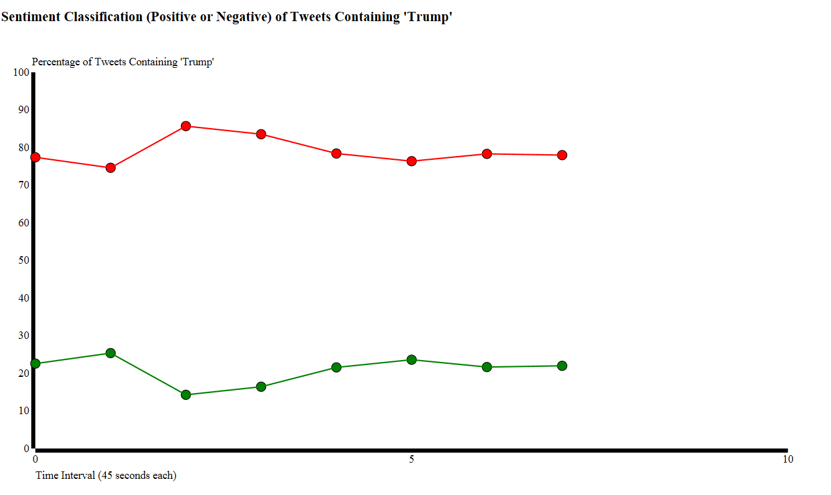
Output “Sneak Peek”

Slide 4
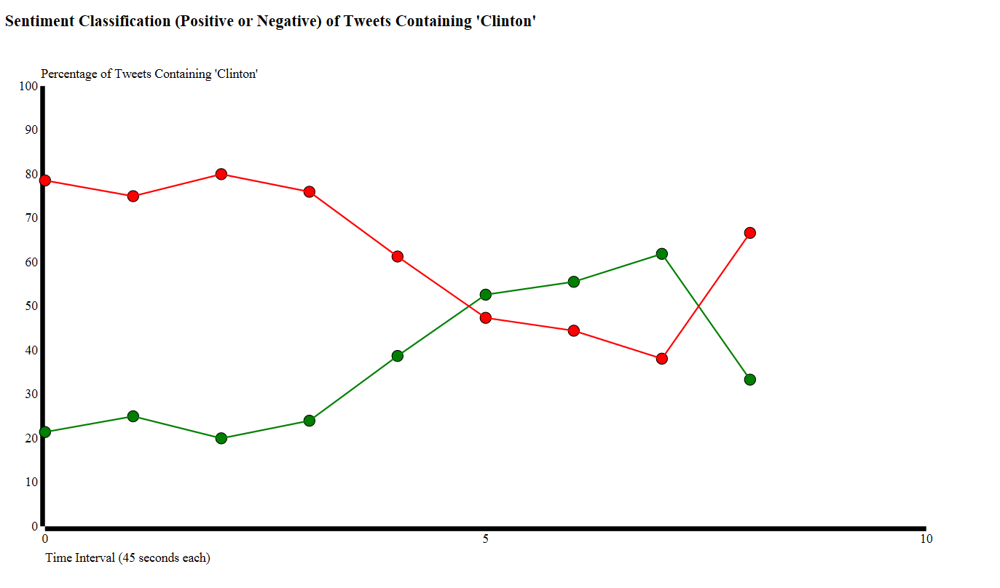
Output “Sneak Peek”

Slide 5
Technology
CentOS 6.7 VM running on VMWare Workstation 11.0
3.6 GB RAM
Intel® Core™ i5-3337U CPU @ 1.80 GHz
Hadoop 2.6.0-cdh5.7.0
1 live data node (pseudo-distributed environment)
~35 GB disk memory available
Spark Streaming (PySpark)
Spark version 1.6.0
Python version 3.3.3
Python NLTK library
D3.js for visualization

Slide 6
Process
Train a model that will classify Tweets as positive or negative
Set up Twitter stream and format incoming tweets to run through the model
Run batches of Tweets through the classifier and capture results
Visualize

Slide 7
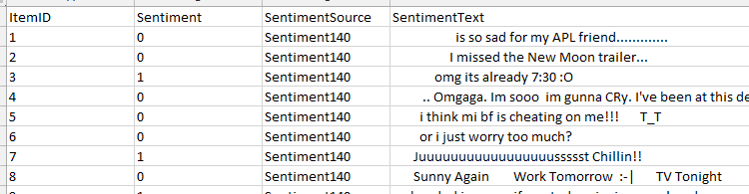
1. Train Model
Using a Naïve Bayes model
Frequently used in text/document classification
Features are typically extracted based on most common words
Assumes independence between features
Not entirely valid assumption, especially in the context of sentences. But, still useful.
Using unigrams extracted from the tweets, so relationships between words is not know by the model
Training dataset is ~1.5 million Tweets already classified (static)

Slide 8
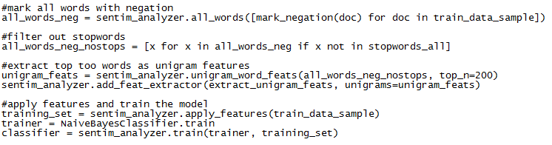
1. Train Model
Used SentimentAnalyzer (Python NLTK package) to:
Apply negation to all words (e.x. ‘not good’ -> ‘good’ becomes ‘good_NEG’)
Even though we’re using unigrams, this allows the model to attempt to distinguish negated words
Break Tweets into unigrams (so ‘good_NEG’ would be counted as a unigram)
Remove all stopwords so the features of the model aren’t words like ‘is’
Extract the top 200 most common unigrams to use in the classification model
Train the classifier model -Python NaiveBayesClassifier (NLTK package)
Test the model on some sentences:
test_sentence1 = [(['this', 'program', 'is', ‘bad'], '')]

Slide 9
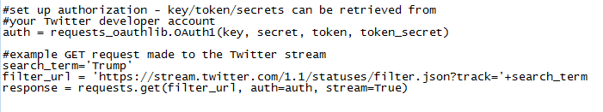
2. Connect Twitter Stream
First create app on Twitter’s developer webpage and deal with API key’s/secret and user token/secret
Need authentication in order to access the Twitter stream
For more info: https://dev.twitter.com/oauth/overview
Use Python’s requests and requests_oauthlib packages to setup connection
Requests_oauthlib – handles authorization
Requests – allows the Spark streaming context make REST calls to the Twitter API

Slide 10
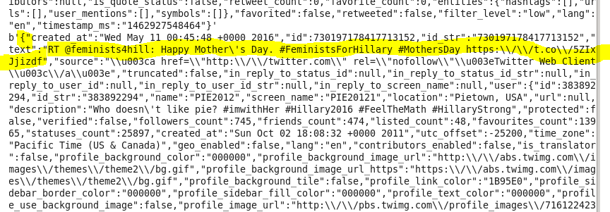
2. Connect Twitter Stream
First create app on Twitter’s developer webpage and deal with API key’s/secret and user token/secret
Need authentication in order to access the Twitter stream
For more info: https://dev.twitter.com/oauth/overview
Use Python’s requests and requests_oauthlib packages to setup connection
Requests_oauthlib – handles authorization
Requests – allows the Spark streaming context make REST calls to the Twitter API

Slide 11
3. Start Streaming and Classify!
For each batch of Tweets that comes in, format the data to prepare to run through the classifier
Apply the Naïve Bayes model features to the tweets
Classify Tweets and capture output:
In this case we’re just capturing number of positive/negative tweets per batch

Slide 12
Live Demo

Slide 13
4. Visualize
Use standard D3.js library to produce trend graphs (nothing fancy)
But! Potential for many other interesting visualizations
Ex: using Tweets’ location data to plot where the Tweet happened
Combined with sentiment analysis we could see how different regions feel about a subject on Twitter

Slide 14
Output

Slide 15
Pros vs. Cons
Pros:
Spark has very fast batch processing compared to something like Hadoop due to in memory computations
Spark is well suited for streaming applications and is scalable
Python NLTK library has many built-in tools to assist in NLP
Overall, PySpark Streaming and NLTK are very useful
Cons:
No major cons from this demo project, but online research raised a few possibilities:
Python has useful tools but there are some things that are better handled or can only be done in Scala or Java, such as certain RDD operations
Scala and Java may potentially perform faster than Python. May depend on the application.

Slide 16
YouTube URLs, Last Page
Two minute (short): https://youtu.be/_DY7L50deqo
15 minutes (long): https://youtu.be/ARP5q4LiMSc

