Slide 1

Final Project PySpark Streaming and NLTK Text Processing:
Naïve Bayes Classification for Twitter Sentiment Analysis
Walsh, Luke
CSCI E-63 Big Data Analytics
2016
Harvard University Extension School
Prof. Zoran B. Djordjević

Slide 2
Introduction
Topic: PySpark Streaming and NLTK Text Processing
Objective/Problem Statement:
Build a PySpark Streaming application using Python’s NLTK library that analyzes the sentiment of Tweets about a given topic/search term in near-real time
Data sources:
Training dataset: Twitter Sentiment Analysis Dataset
Contains ~1.5 million Tweets already classified as 1 or 0 for positive or negative sentiment
Source: http://thinknook.com/twitter-sentiment-analysis-training-corpus-dataset-2012-09-22/
Twitter Public Filtered Stream:
“Returns public status that match one or more filter predicates”
Ex URL: https://stream.twitter.com/1.1/statuses/filter.json?track=trump
Data for this analysis collected in batches of 45 seconds

Slide 3
Technology
CentOS 6.7 VM running on VMWare Workstation 11.0
3.6 GB RAM
Intel® Core™ i5-3337U CPU @ 1.80 GHz
Hadoop 2.6.0-cdh5.7.0
1 live data node (pseudo-distributed environment)
~35 GB disk memory available
Spark Streaming (PySpark)
Spark version 1.6.0
Python version 3.3.3
Python NLTK library
D3.js for visualization

Slide 4
Process
Train a model that will classify Tweets as positive or negative
Set up Twitter stream and format incoming tweets to run through the model
Run batches of Tweets through the classifier and capture results
Visualize

Slide 5
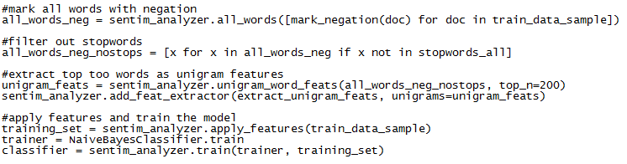
1. Train Model
Used SentimentAnalyzer (Python NLTK package) to:
Apply negation to all words (e.x. ‘not good’ -> ‘good’ becomes ‘good_NEG’)
Break Tweets into unigrams (so ‘good_NEG’ would be counted as a unigram)
Remove all stopwords so the features of the model aren’t words like ‘is’
Extract the top 200 most common unigrams to use in the classification model
Train the classifier model -Python NaiveBayesClassifier (NLTK package)
Test the model on some sentences:
test_sentence1 = [(['this', 'program', 'is', ‘bad'], '')]

Slide 6
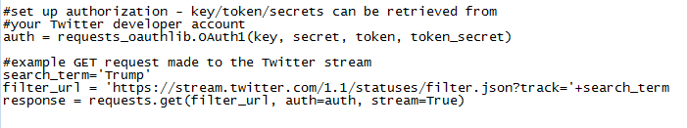
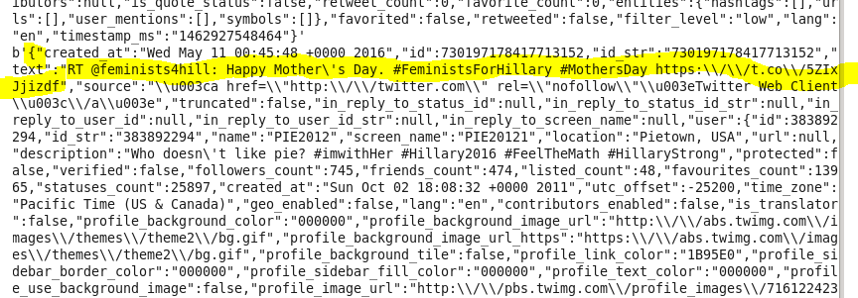
2. Connect Twitter Stream
First create app on Twitter’s developer webpage and deal with API key’s/secret and user token/secret
Use Python’s requests and requests_oauthlib packages to setup connection
Results are returned as JSON object, so the data needs to be parsed into a usable format

Slide 7
3. Start Streaming and Classify!
For each batch of Tweets that comes in, format the data to prepare to run through the classifier
Apply the Naïve Bayes model features to the tweets
Classify Tweets and capture output:
In this case we’re just capturing number of positive/negative tweets per batch

Slide 8
4. Visualize
Use standard D3.js library to produce trend graphs (nothing fancy)
But! Potential for many other interesting visualizations
Ex: using Tweets’ location data to plot where the Tweet happened
Combined with sentiment analysis we could see how different regions feel about a subject on Twitter

Slide 9
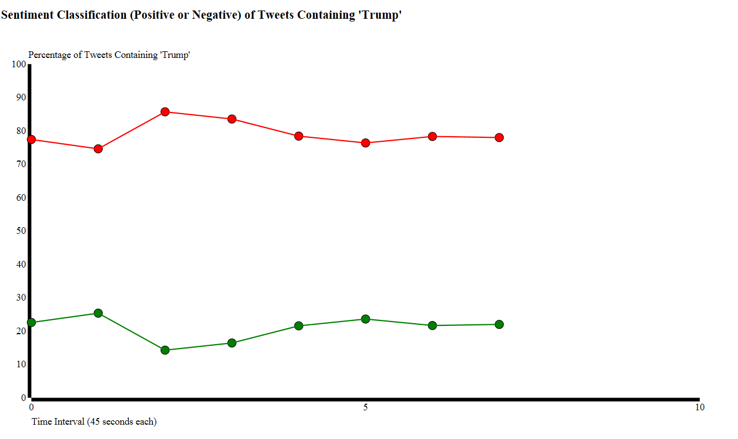
Output

Slide 10
Pros vs. Cons
Pros:
Spark has very fast batch processing compared to something like Hadoop due to in memory computations
Spark is well suited for streaming applications and is scalable
Python NLTK library has many built-in tools to assist in NLP
Overall, PySpark Streaming and NLTK are very useful
Cons:
No major cons from this demo project, but online research raised a few possibilities:
Python has useful tools but there are some things that are better handled or can only be done in Scala or Java, such as certain RDD operations
Scala and Java may potentially perform faster than Python. May depend on the application.

Slide 11
YouTube URLs, Last Page
Two minute (short): https://youtu.be/_DY7L50deqo
15 minutes (long): https://youtu.be/ARP5q4LiMSc

