Slide 1
An insightful look at IMDB data from 2006 and 2016
Team Members: Mahtab Karimipour, Luke Gonzales, Molly Eskelson

Slide 2
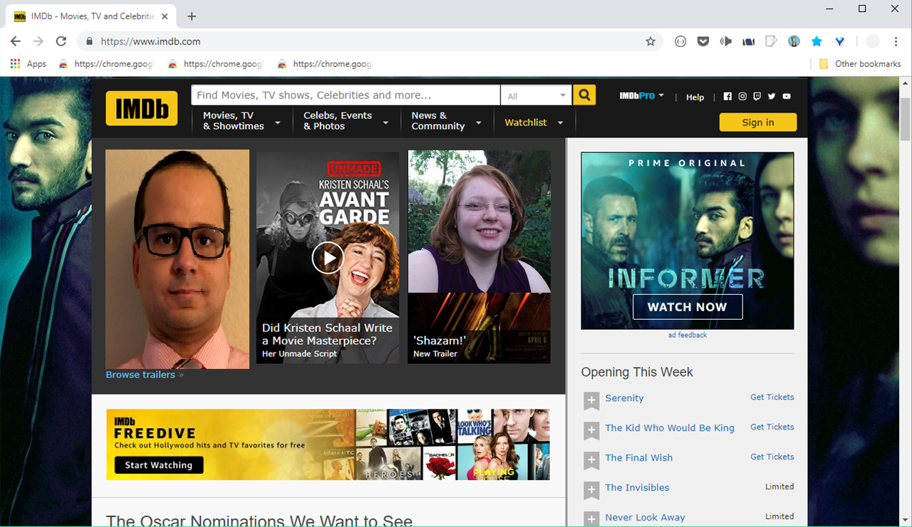
An insightful look at IMDB data
from 2006 and 2016
Notes:
Alternate title page: What I can do here is edit out the pictures of the three movies being shown to pictures of us. This is just a rough draft. Wont make a phot shop version without ya’lls ok. Our names would go with our pictures like how the website did it.

Slide 3
Motivation & Summary
* Define the core message or hypothesis of your project.
* Describe the questions you asked, and _why_ you asked them
* Describe whether you were able to answer these questions to your satisfaction, and briefly summarize your findings
Our project is to uncover patterns between movies released from 2006 and 2016 and their genres, critic scores, revenue, actors, directors, year, runtime minutes, rating, votes, and metascore.
As the data allows.
Notes:
* Define the core message or hypothesis of your project.
* Describe the questions you asked, and _why_ you asked them
* Describe whether you were able to answer these questions to your satisfaction, and briefly summarize your findings

Slide 4
Questions & Data
How much revenue do movies make per a genre?year?
What are the best/top 15 movies according to revenue? Year?
What is the average rating for movies? (by each genre?) then what would be a good or bad movie rating score (rating vs metascore)?
Applying the average movie ticket cost, how many people bought a ticket for the movie vs the number of people (votes) who saw the movie? (by genre?)
Does the length of run time effect a movies rating?
Is there a relationship between a movies revenue and the rating users give it?
Analyzing the difference between meta score(critiques) and users(rating)
Who are the top directors and actors- actors and directors show up in the most films in this 10 year span

Slide 5
Data Cleanup & Exploration
Coulums Reveunue and metascore had some values of blank
Notes:
* Describe the exploration and cleanup process
* Discuss insights you had while exploring the data that you didn't anticipate
* Discuss any problems that arose after exploring the data, and how you resolved them
* Present and discuss interesting figures developed during exploration, ideally with the help of Jupyter Notebook

Slide 6
Data Analysis
* Discuss the steps you took to analyze the data and answer each question you asked in your proposal
* Present and discuss interesting figures developed during analysis, ideally with the help of Jupyter Notebook
Notes:
* Discuss the steps you took to analyze the data and answer each question you asked in your proposal
* Present and discuss interesting figures developed during analysis, ideally with the help of Jupyter Notebook

Slide 7
Discussion
* Discuss your findings. Did you find what you expected to find? If not, why not? What inferences or general conclusions can you draw from your analysis?
Notes:
* Discuss your findings. Did you find what you expected to find? If not, why not? What inferences or general conclusions can you draw from your analysis?

Slide 8
Post Mortem
Originally we were doing a project on yelp dataset but after experiencing difficulties with both the excel and JSON versions of the dataset we unanimously agreed to moved on to another project.
Discuss any difficulties that arose, and how you dealt with them
* Discuss any additional questions that came up, but which you didn't have time to answer: What would you research next, if you had two more weeks?
Notes:
Discuss any difficulties that arose, and how you dealt with them
* Discuss any additional questions that came up, but which you didn't have time to answer: What would you research next, if you had two more weeks?

Slide 9
Questions

