Slide 1
DESIGN AND FABRICATION OF PORTABLE HYDRAULIC “C” PRESS MACHINE FOR BUSH-FITTING
Industrial Defined Problem

Slide 2
Student Name | Enrolment No.
HARDIK LUKHI | 120050119040
ASHISH BHOJANI | 120050119016
AKASH JASOLIYA | 120050119026
SAURABH BHUT | 120050119519
Internal Guide | External Guide
MILI J. HOTA | ANANTBHAI MORADIYA
Mechanical department, | Director,
BITS edu Campus, | GOYANI MACHINES PVT. LTD.
Vadodara | Makarpura GIDC, Vadodara

Slide 3
Description of Project Problem
As per GTU Industrial training, we have done our training in GOYANI MACHINES PVT. LTD.
This company produces Injection Molding machines and PET stretch blow moulding machine.
The machine is work on hydraulic power.
To reduce vibration bushing is done in guide hole
Moving plates which is used in machine have guide shafts (Tie bar) which guide the plate.
Bushes can be fitted on plate by two method one is shrink-fit and another is press-fit

Slide 4
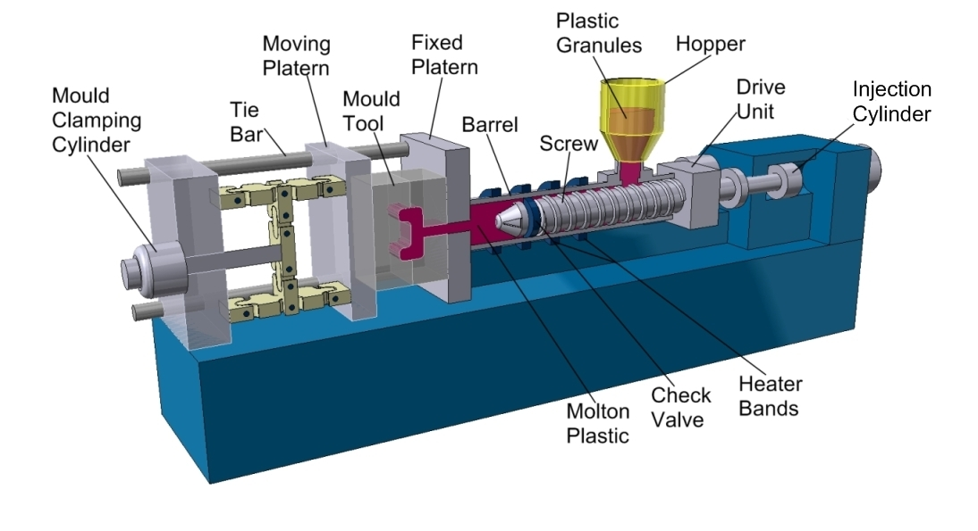
Injection Moulding Machine

Slide 5
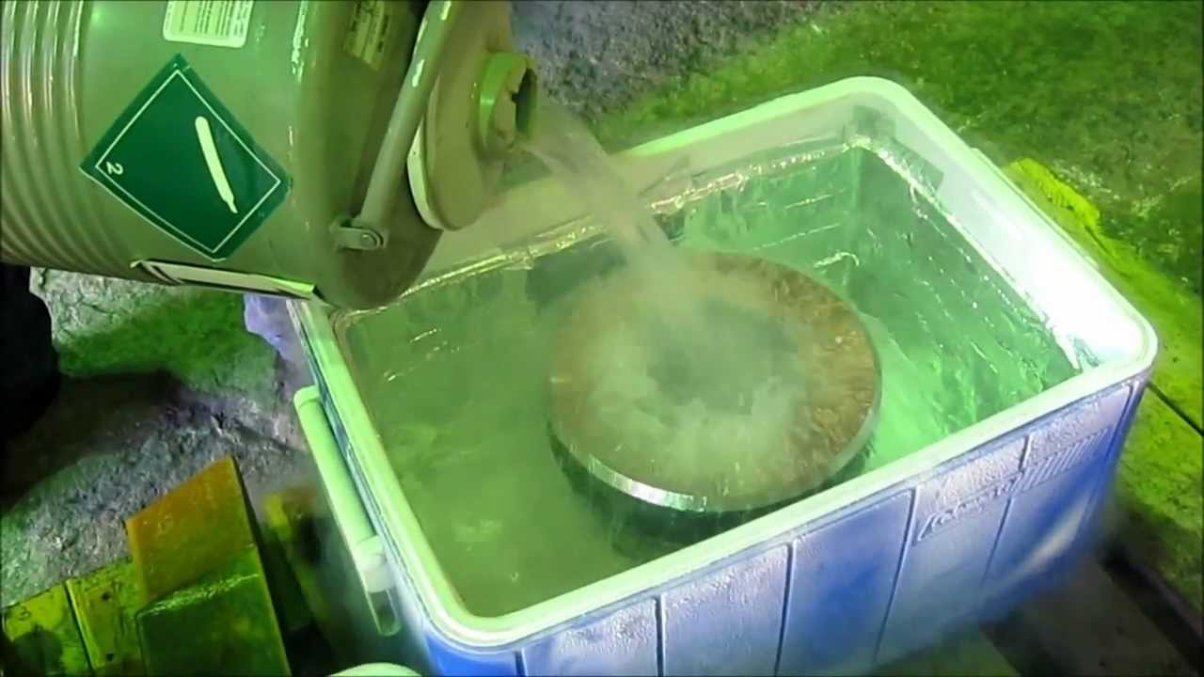
Shrink-fit can be done by liquid nitrogen. It is easiest method.
Bush is dipped in liquid nitrogen. This process shrinks bush and it can befitted inside guide hole.
But liquid nitrogen is expensive for small scale industries. So they use press-fit method.
Shrink fit with Liquid Nitrogen

Slide 6
Press-fit can be done by applying force on bush.
Press-fit is can be done with hammer or by pressing it with any machine.
In industry they fit bush by manually impacting hammer on bush.
This process can take 15 to 20 minute to fit single bush.
Each machine has 20 to 24 bushes to be fitted.
So this process becomes too slow. This process also required too much human effort.
In figure there is shown bush fitting with press fit method. Bush is being fitted in bush hole by manually hammering on it

Slide 7
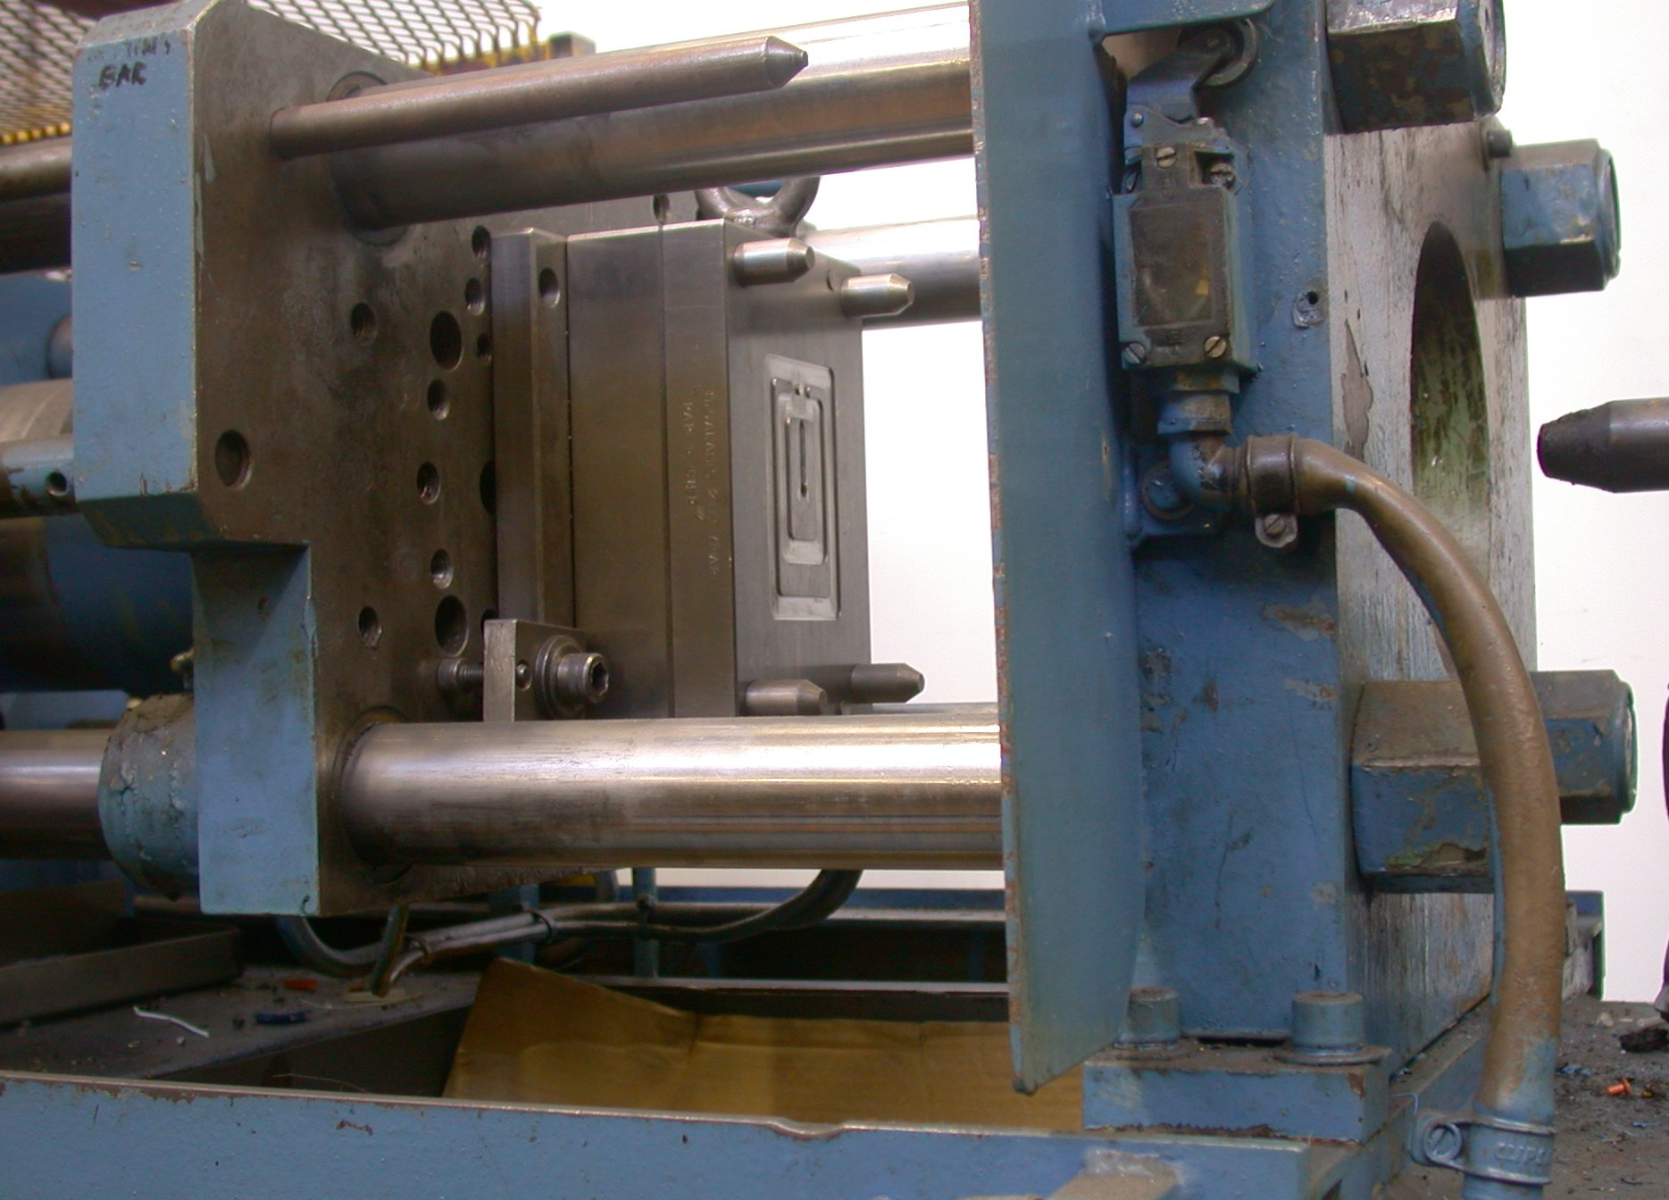
Bush is fitted here
Moving Plates
Tie bar

Slide 8
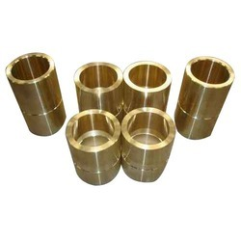
Bushes

Slide 9
Objectives and Abstract
According to above problem we are working on project to make a press which can minimize human effort and maximize productivity. Which may take only 2 to 3 minute to fit the bush.
Expected outcome of project:
Portable press
Reduction in time required
Reduction in human effort required
Easily usable press
Bush fitting without defect on bush

Slide 10
Our objectives for the project are:
Design of “C” press.
Design of hydraulic.
Fabrication “C” press.

Slide 11
Patent Research Analysis
For press-fit of bush force required is high.
To get higher force Hydraulic system is suitable.
To fit bush on corner of the plate “C” framed press is suitable.

Slide 12
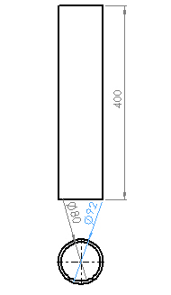
List of Component
Cylinder:
Material : EN8 (An unalloyed medium carbon steel)
Known as : 080M40
Yield Strength : 246.168 MPa

Slide 13
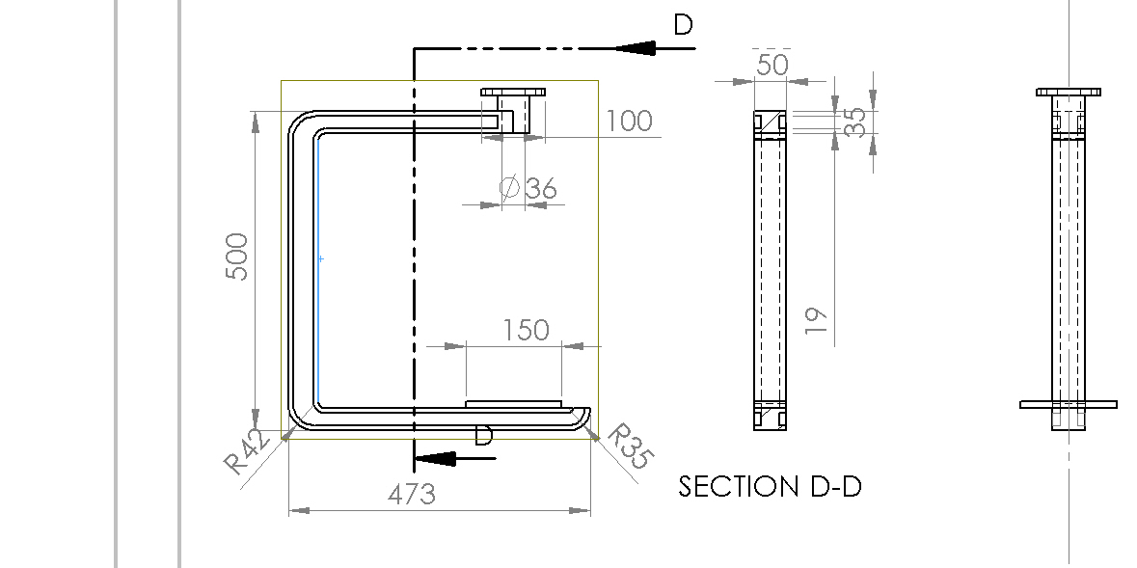
“C” Frame
Material : Mild Steel
Yield Strength : 246.168 MPa

Slide 14
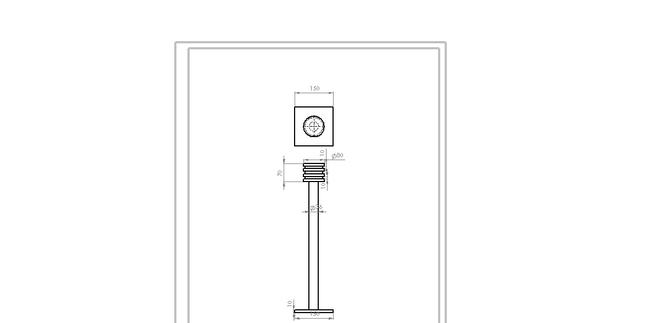
Piston with pressure plate:
Material : EN8 (Carbon Steel)
Yield Strength : 246.168 MPa

Slide 15
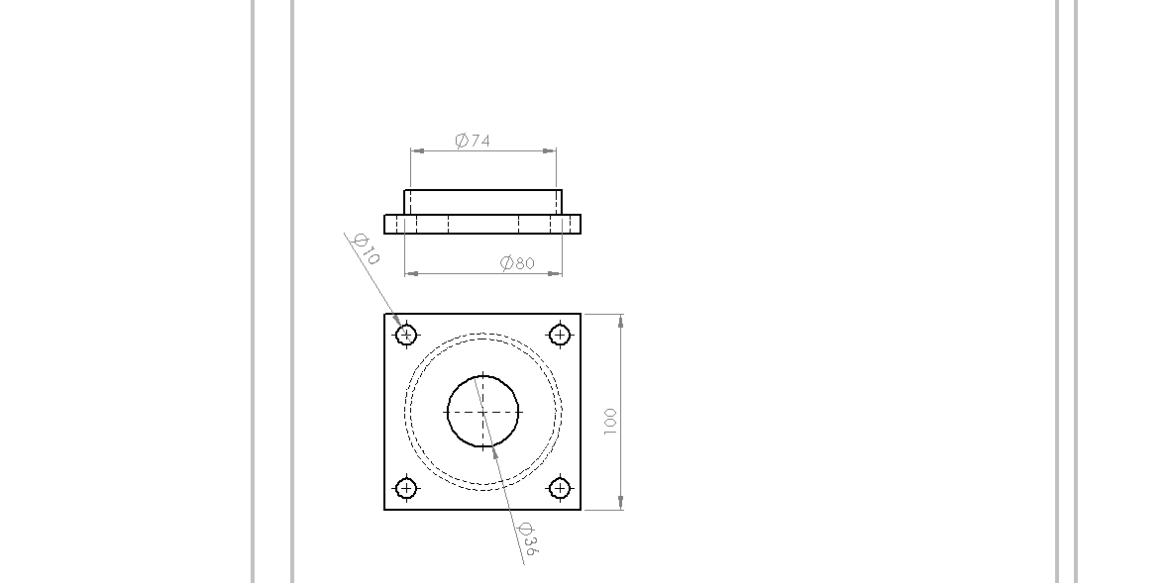
Hydraulic Cylinder Cover:
Material : EN8 (Carbon Steel)
Yield Strength : 246.168 MPa

Slide 16
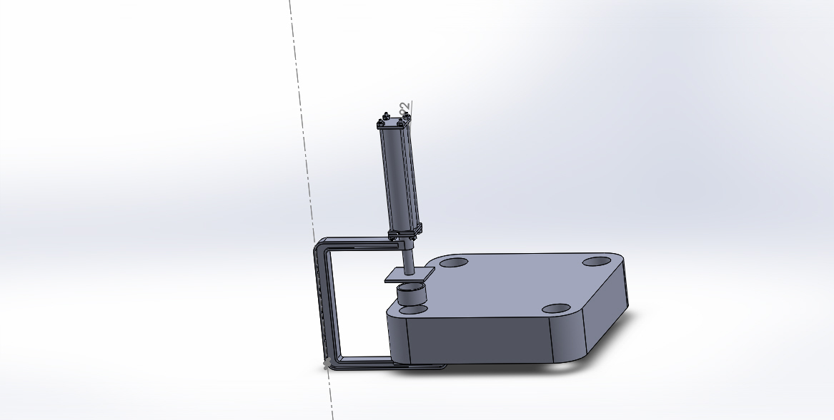
Assembly of Hydraulic “C” press

Slide 17
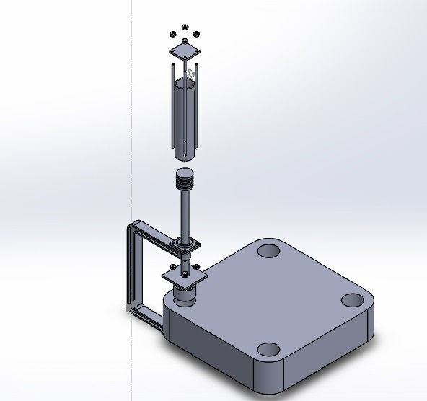
Exploded View of Design

Slide 18
Existing Work
We have made Design of “C” frame and Hydraulic. Calculation is given in below.
According to our requirement we have assembly of Hydraulic with the help of worker.
According to our design “C” frame is bigger then standard “C” frame available in market, so, we have ordered it From Amar Industries.

Slide 19
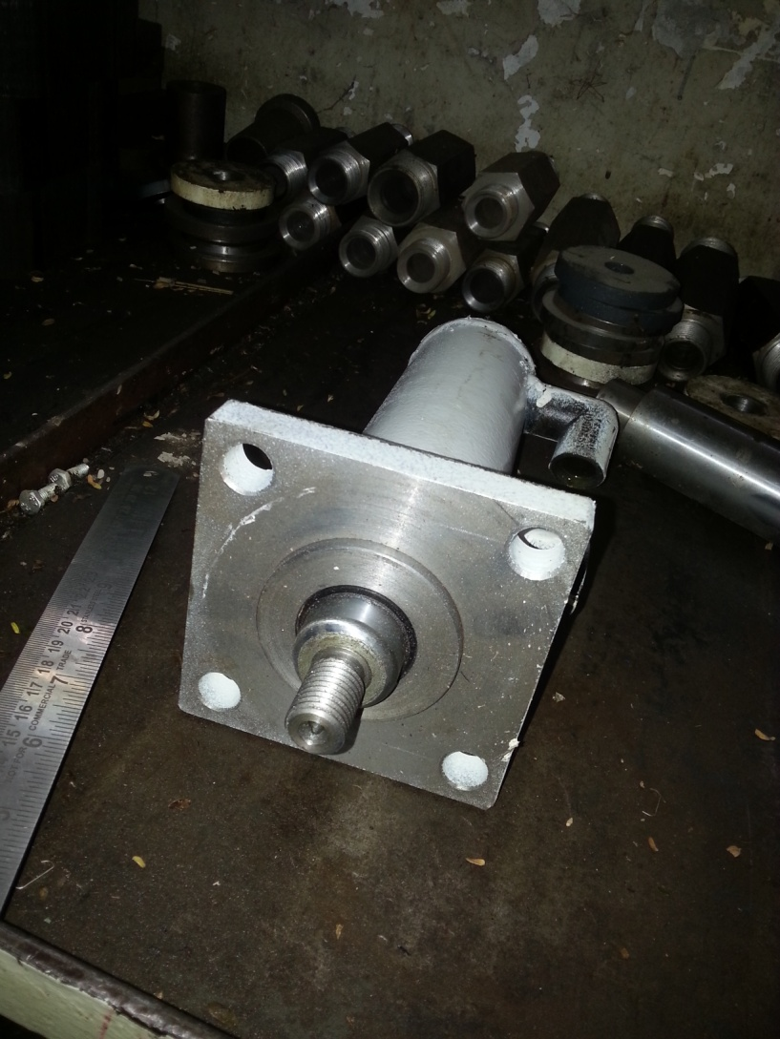
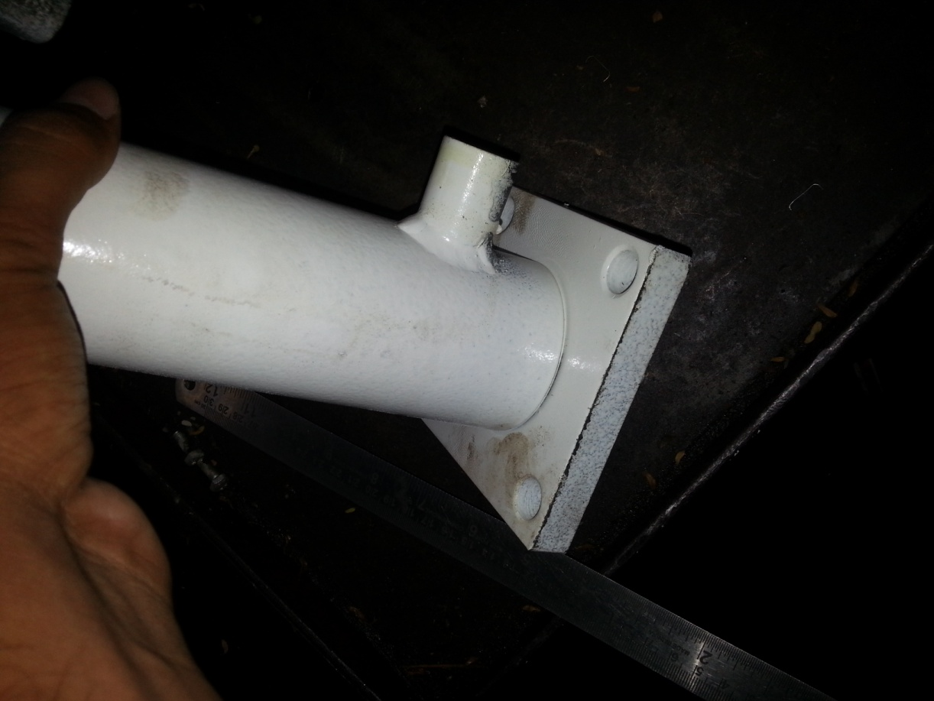
Assembled Hydraulic Cylinder

Slide 20
Calculation
Formula for it is given below
where :
P=means pressure of contacts expressed in N/mm^2
𝛿=means interference between the hub and bush expressed in mm
d=Nominal rim diameter expressed in mm
Eo=Hub Young's modulus expressed in N/mm^2
Do=Hub outer diameter expressed in mm
Vo=Hub Poisson's Ratio
Ei=bush’ Young's modulus expressed in N/mm^2
Di=bush’ internal diameter expressed in mm
Vi=bush’ Poisson's Ratio

Slide 21
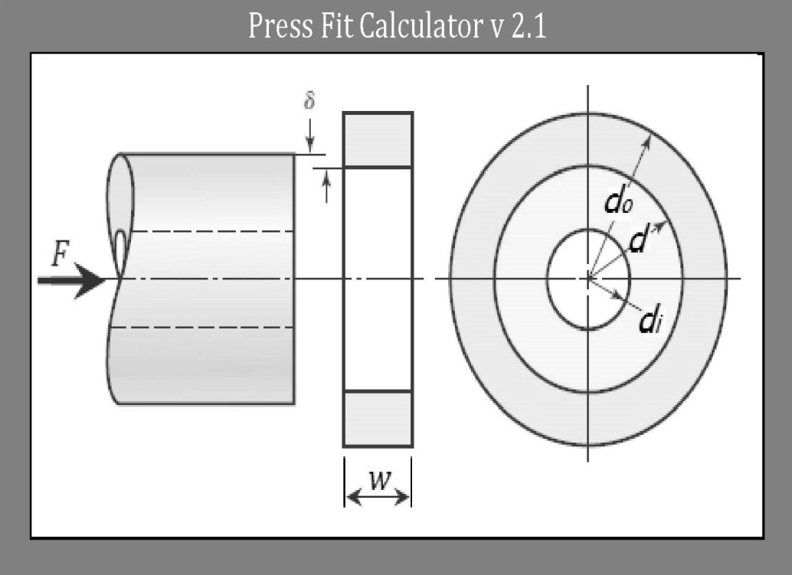
For calculating minimum force to engage or disengage these parts we can use the following formula
Where:
F= means the press fit Force expressed in N
P= means the pressure of contact expressed in
N/mm^2
μ : means the friction between hub and shaft
A: Area of outer circular surface of Bush
expressed in mm^2
press fit calculation and result is given below

Slide 22
Bush
Young’s modulus (GPa) | 117
Poisson’s ratio | 0.34
Internal diameter (mm) | 90
Outer diameter (mm) | 105
Tolerance (mm) | 10
Bush hole
Young’s modulus (GPa) | 110
Poisson’s ratio | 0.22
Internal diameter (mm) | 105
Max pressure Generated (MPa) | 20.8
Width of bush (mm) | 60
Friction between bush and bush hole | 0.30
Froce required (N) | 1,23,234

Slide 23
Stress strain analysis
To assure design whether it is safe or not under certain force.
It is calculated with two method
Analytical method :
,
t = 8,
M =W (effort) * l
=125000*229
=280,
A =1568,
x= 2t.

Slide 24
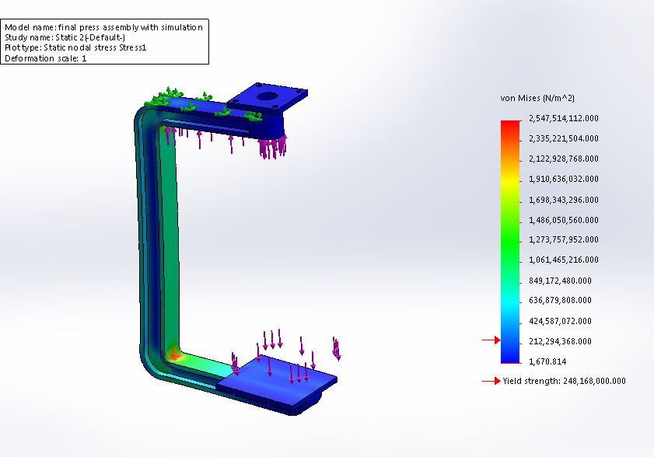
Solidworks Simulation:
According to simulation maximum tensile stress in the C frame is about 255 MPa.
Therefore, the result of both methods is almost same.

Slide 25
GANTT CHART
 | Jan 1-15 | Jan 16-31 | Feb 1-15 | Feb 16-29 | Mar 1-15 | Mar 16-31 | Apr 1-15 | Apr 16-31
Project Planning

Slide 26
CONCLUSION
Human effort required for fitting the bushes are much less then manual hammering method.
Time required for the bush fitting is much less,
i.e. from manual method for 25 mm and 50 mm diameter bush for bush fitting is 4 to 5 minutes and 7 to 8
And from C press it is 10 to 15 seconds and 20 to 30 seconds
By using Adjustable stud we can manage the length of rod for different size of plates and links.
Setting of the length with adjustable stud is less time consuming. It can be set within 20 sec for different size.

Slide 27
REFERENCES
Press Fit Pressure Calculation – Optimize Your Interference/Transition Fit Design 387-399 Precision Machine Design By Alexander H. Slocum By Society of Manufacturing Engineers
Hydraulic Design, Anant Moradiya, Director, Goyani Machine PVT. LTD.
Design of machine book By V. B. Bhandari, Tata McGrawHills
Machine Design book By R. S. Khurmi , J. K. Gupta , Eurasia Publishing house limited
Hydraulic Cylinder Design By V. B. Bhandari, Tata McGrawHills

