Slide 1
REPLICATION PROJECT
Machine Learning for
Volatility Forecasting
Replication and extension to 2016–2026 with open data
Christensen, Siggaard & Veliyev
A machine learning approach to volatility forecasting
Notes:
Source: Christensen, Kim; Siggaard, Mathias; Veliyev, Bezirgen: A machine learning approach to volatility forecasting. Manuscript, May 2022, arXiv:2601.13014v1 (January 19, 2026).

Slide 2
OVERVIEW
Structure and roles
01
Motivation & problem statement
Niklas
Slides 3–4
02
Research question & hypotheses
Adrian
Slides 5–8
03
Open data & replication design
Leo
Slides 9–11
04
Results: paper vs. replication
Lukas
Slides 12–15
05
Drivers, verdict & conclusion
Aleks
Slides 16–18
Christensen, Siggaard & Veliyev
02
Notes:
This slide serves as the agenda and handover plan between presenters.

Slide 3
BLOCK 1 / MOTIVATION
Why forecast volatility?
Volatility forecasts shape key financial decisions
Risk management: estimate future loss distributions and risk limits
Option pricing: expected price fluctuations determine option values
Portfolio construction: guide risk allocation and hedging
Structured products: payoffs and hedging depend directly on volatility
Core problem
Volatility is predictable, but market dynamics are nonlinear and have a low signal-to-noise ratio.
Example - Lehman Brothers- September 15, 2008
The largest bankruptcy in US history – volatility stayed extrem for months.
Christensen, Siggaard & Veliyev
03
Notes:
Source: Paper, Introduction, pp. 1–2. The authors emphasize asset pricing, portfolio allocation, and risk management, as well as the high predictability of volatility compared with returns.

Slide 4
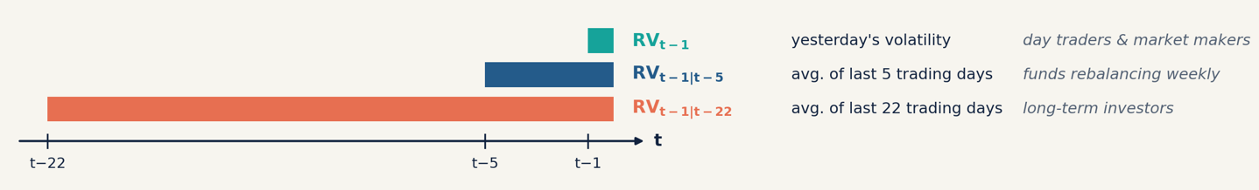
BLOCK 1 / PROBLEM STATEMENT
HAR as a robust benchmark
HAR (Corsi, 2009)
RV_{t} = β₀ + β₁·RV_{t−1} + β₂·RV_{t−1|t−5} + β₃·RV_{t−1|t−22} + u_{t}
The weekly and monthly terms are averages of RV over the previous 5 and 22 trading days (Corsi 2009, Eq. 5)
Simple linear model with daily, weekly, and monthly components
Approximates the long-memory property of realized variance
Established benchmark in the volatility literature
Open question
Can flexible ML models actually beat the parsimonious HAR benchmark?
To add: check the HAR equation and explain it visually if helpful
Christensen, Siggaard & Veliyev
04
Notes:
Source: Paper, Section 2.2, Equation (5), pp. 3–4. HAR uses daily, weekly, and monthly averages of lagged realized variance.

Slide 5
BLOCK 2 / RESEARCH QUESTION
Adrian
Research question and contribution
How accurately can ML methods forecast the realized variance of individual stocks compared to HAR models?
Paper contribution
First large-scale comparison of three ML families (regularized regression, trees, neural nets) against HAR on 29 Dow Jones stocks
ML beats HAR even with minimal tuning: neural nets lead with identical inputs, most ML models win with extra predictors. The edge is flexibility, not more data.
The ML advantage grows with the forecast horizon: it captures volatility’s long memory better than HAR’s fixed three-lag structure
Christensen, Siggaard & Veliyev
05

Slide 6
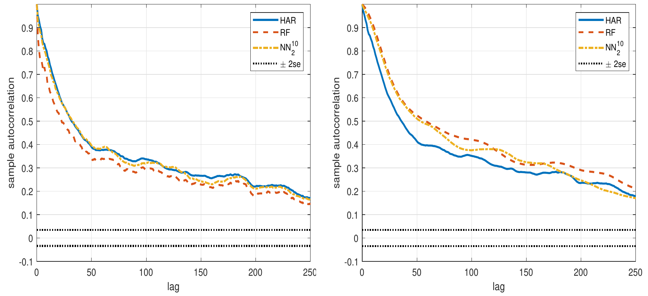
BLOCK 2 / PAPER RESULTS
Adrian
At longer horizons the ML edge grows, and random forest takes the lead
Fig. 8 · ACF of fitted RV (left 1-day, right 1-month)
Why? At the monthly horizon RF and NN fit a more persistent series than HAR → better approximation of RV’s long memory.
Caveat: part of the −40% reflects HAR-X/HARQ collapsing. Against LogHAR, RF is ~31% better.
Christensen, Siggaard & Veliyev
06
Notes:
Source: Paper, Table 2 and discussion, pp. 14–17. The best neural-network configurations achieve relative MSE values around 0.95. Random forest is slightly above HAR at 1.02; therefore, saying that every ML method consistently beats HAR would be too strong.

Slide 7
BLOCK 2 / OUR EXTENSION
Adrian
Does it still hold today?
Does ML's edge over HAR hold out-of-sample in a new regime,
2016–2026, using only open data?
Our hypotheses
H1 – Same inputs as HAR:
Using only past realized volatility (daily, weekly, monthly), machine learning forecasts about as well as the Heterogeneous Autoregressive (HAR) model.
H2 – Additional predictors:
Once additional predictors such as implied volatility and the VIX are added, machine learning outperforms the HAR model.
H3 – Forecast horizon:
The advantage of machine learning over the HAR model grows with the forecast horizon, from one day to one week to one month.
Christensen, Siggaard & Veliyev
07

Slide 8
BLOCK 2 / CONTRIBUTION
Adrian
Our contribution
We re-run the paper's design on a new
sample (2016–2026), with all test periods after the paper’s data ends.
What our replication adds
A real stress test: the paper was only tested on a calm market (2015–2017)
COVID test: three splits with COVID in training, in the test period, or removed
Open data: VOLARE replaces the paid NYSE TAQ data, so anyone can rerun the study
More robust evaluation: QLIKE loss and a strict no-look-ahead rule
Christensen, Siggaard & Veliyev
08

Slide 9
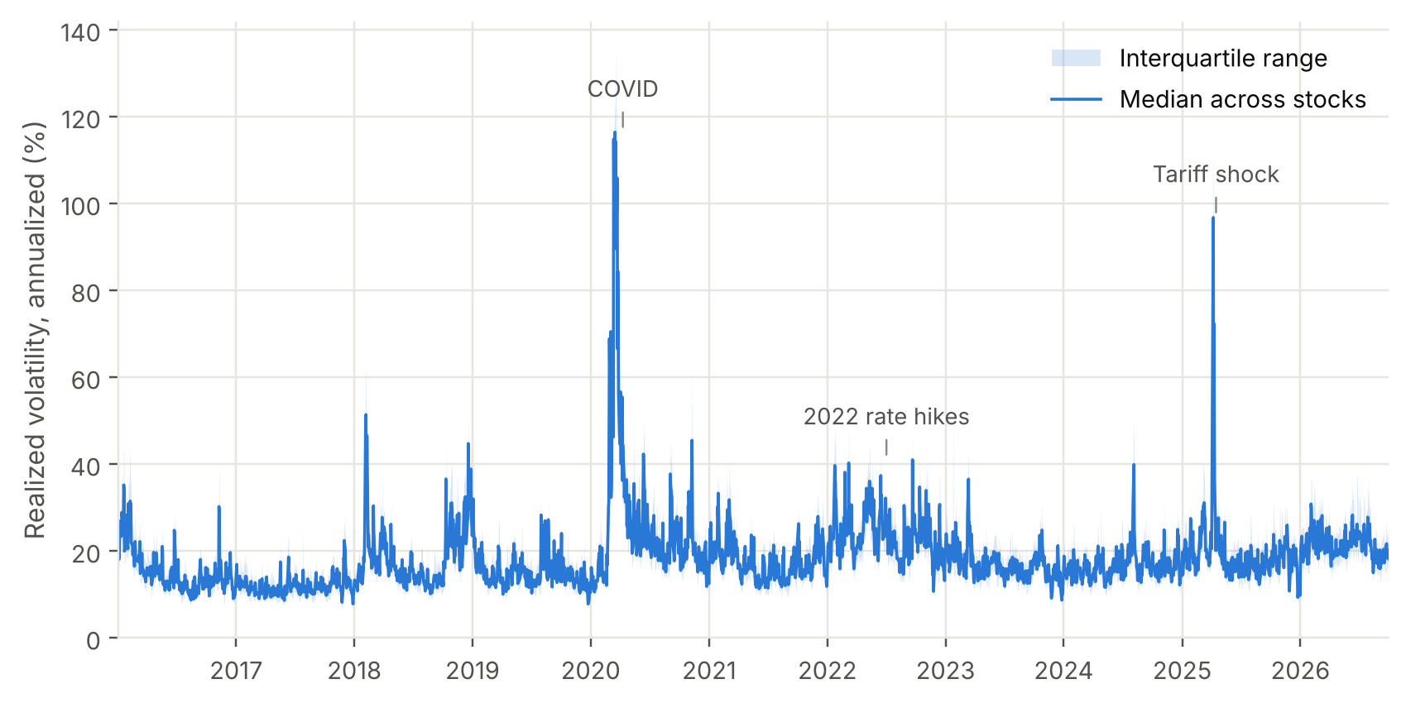
BLOCK 3 / DATA
Leo
Dataset and target variable
30
2016–26
Dow Jones stocks
as listed in VOLARE
sample period
Jan 2016 – Sep 2026,
2,701 trading days
Source: VOLARE (Cipollini et al. 2026), cleaned tick data, free
Target: 5-min realized variance (+ quarticity, semivariances)
Implied vol: 30-day ATM, LSEG Workspace (26 of 30 stocks)
Macro: VIX, T-bill, EPU, ADS, Hang Seng
Firm: 1-week momentum, dollar volume
Christensen, Siggaard & Veliyev
09
Notes:
Data: 30 Dow stocks from VOLARE (open access, built from cleaned tick data). Target is daily 5-minute realized variance, the same estimator as the paper (which used paid NYSE TAQ data).
Extra predictors as in the paper: implied volatility per stock (we use LSEG 30-day ATM IV; the paper used OptionMetrics model-free IV; JNJ and KO have no IV in LSEG), VIX, T-bill, EPU, ADS, Hang Seng, momentum, dollar volume.
The chart shows why the sample is interesting: two big volatility shocks, COVID in 2020 and the tariff shock in April 2025, plus the 2022 rate-hike year.

Slide 10



Firstly we calc. returns for every day and square those > realized volatility > proxy for daily realized vola.
Beide Modelle nutzen die Persistenz der Volatilität. GARCH bildet sie rekursiv über Renditeschocks und vergangene Varianz ab; HAR verwendet dafür direkt tägliche, wöchentliche und monatliche Realized Variance.
Why using HAR? Because it measures volatility intraday while GARCH only on a daily basis, if stock opens at 100 and closes at 100 GARCH reads info 0 Volatitliy / low Vola, but if intraday stock spicked from 100 to 120 and back to 100 it means high vola > HAR catches that. You could use GARCH intraday but you would have to cumulate all intraday forecasts.
For monthly and weekly data we calculate the daily variance over the last n days and use the average
BLOCK 3 / METHODOLOGY
Leo
Heterogeneous Autoregressive Model (HAR)
Minimal feature set M_HAR = Benchmark Modell (BMM)
RV = Realized Variance
RV lag: day (1d), RV average: week (5d), RV average: month (22d)
Model Level I-III
Level-I Benchmark
Level-II Regularization
Level-III Flexible ML models
HAR, LogHAR, LevHAR,
SHAR, HARQ
Ridge, Lasso,
Elastic Net
Bagging, Random Forest,
Boosting, Neural Networks
Christensen, Siggaard & Veliyev
10
Notes:
Source: Paper, Sections 2 and 3, especially pp. 13–15 and Table 1. M_HAR contains the three classic RV lags. M_ALL adds nine firm-level and macroeconomic variables.

Slide 11
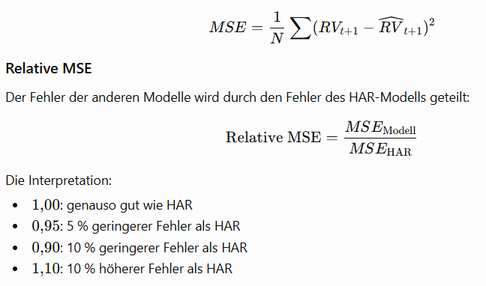
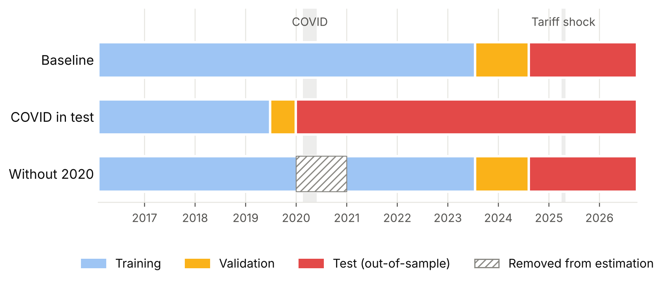
BLOCK 3 / EVALUATION
Leo
Out-of-sample design and tests
1
Training
2
Forecasts
3
MSE
4
DM + QLIKE
70% training
10% validation
20% test
Avg. RV over
1, 5, 22 days
Relative MSE
versus HAR
DM tests
QLIKE as check
Three sample splits: where does COVID sit?
Rolling re-estimation: OLS daily, regularized every 22 days, trees every 63 days
Neural nets: trained once, ensemble of best 5 of 10 seeds
No look-ahead: only targets realized by the forecast day enter training
Christensen, Siggaard & Veliyev
11
Notes:
Same design as the paper: forecasts of average RV over the next 1, 5 and 22 days, rolling re-estimation, relative MSE versus HAR, Diebold–Mariano tests.
Our extension: three splits. Baseline = paper's 70/10/20 split, so COVID ends up in the training data. COVID in test = train on calm 2016–mid 2019, test on 2020–2026 (like the paper's 1,000-day robustness check). Without 2020 = baseline split but the year 2020 removed from every estimation window.
All 12 models are estimated by our own Python code (volml.py) for 30 stocks, 2 information sets, 3 horizons and 3 splits.

Slide 12
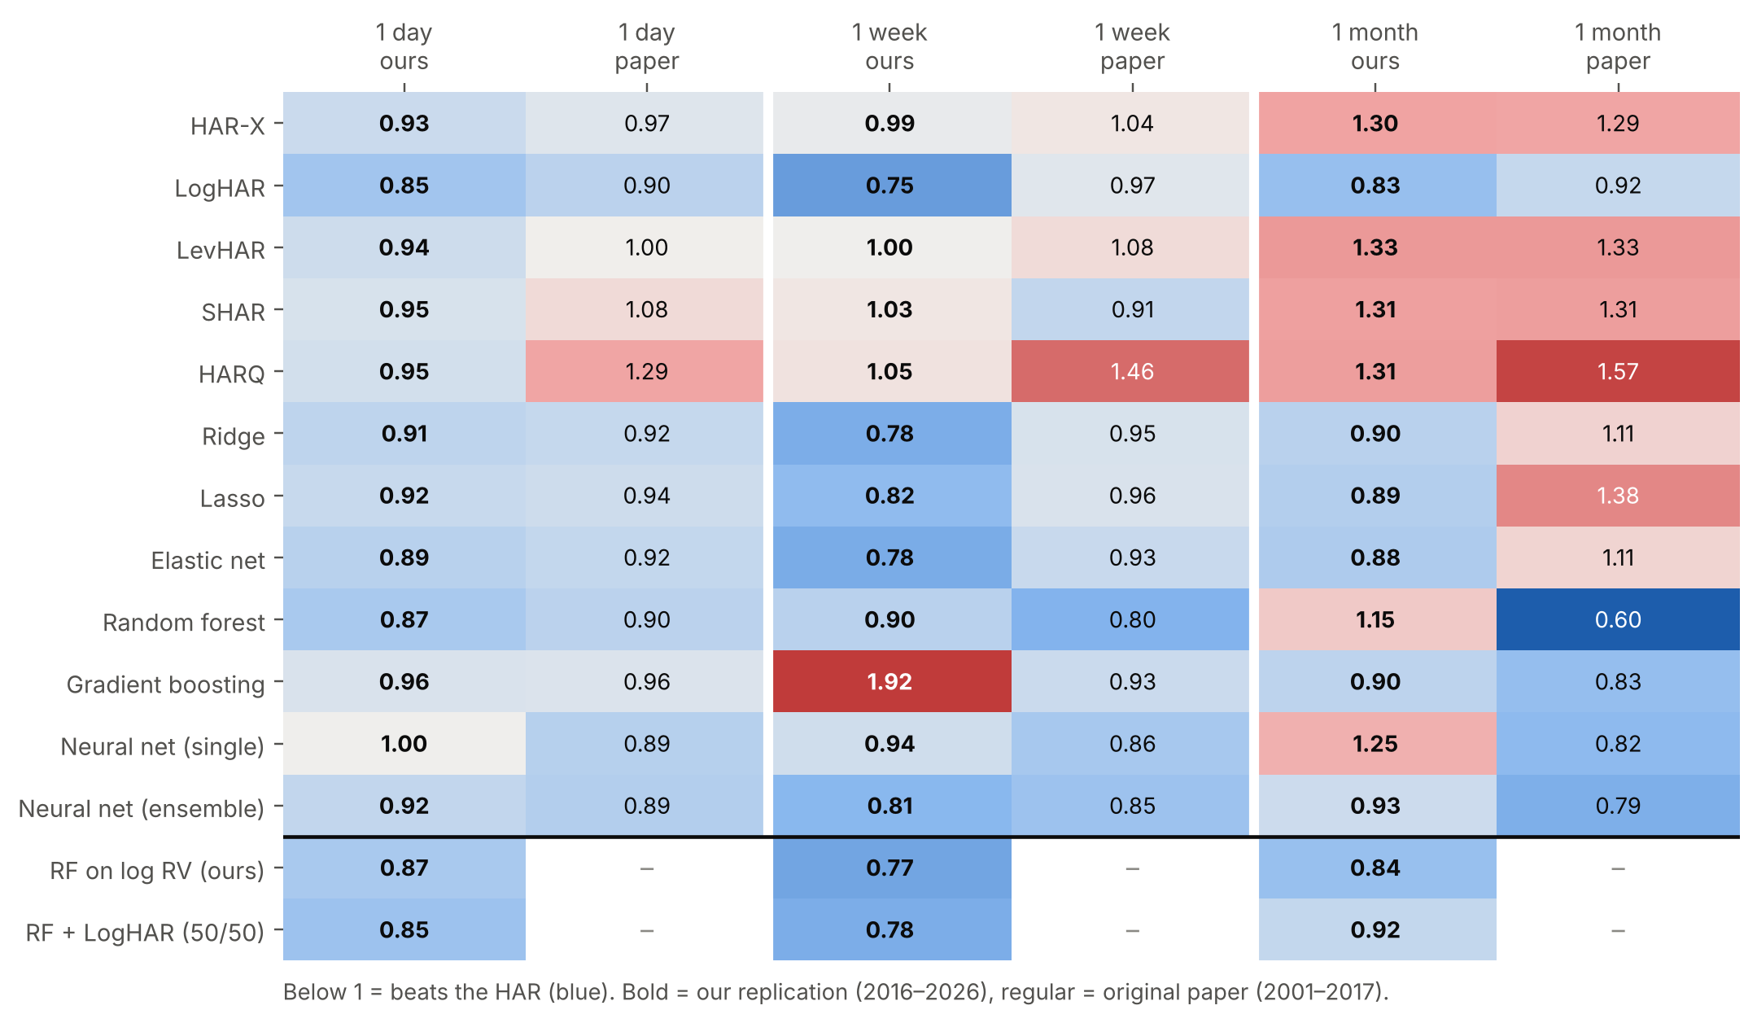
BLOCK 4 / OUR RESULTS
Lukas
One day ahead we replicate the paper closely; at one month the random forest only works on log RV
0.87 vs 0.90
Random forest, 1 day: ours vs paper; beats HAR for 28 of 30 stocks, DM test significant (**)
1.15 vs 0.60
Random forest, 1 month: the paper's strongest result does not carry over
0.84
Our fix, random forest on log RV, 1 month: beats HAR for 28 of 30 stocks (1 week: 0.77)
Source: own replication; VOLARE 5-min RV, Dow 30, 2016–2026; baseline split, all predictors (M_ALL); MSE relative to HAR (< 1 = better)
Christensen, Siggaard & Veliyev
12
Notes:
Heatmap: relative MSE vs HAR, our replication (bold) next to the paper, all predictors.
One day ahead the numbers are remarkably close: random forest 0.87 vs 0.90, elastic net 0.89 vs 0.92, LogHAR 0.85 vs 0.90.
One week: regularized models and the NN ensemble beat HAR clearly (0.78–0.82).
One month: random forest is worse than HAR (1.15) while the paper reports 0.60. Gradient boosting at one week (1.92) is driven by a single stock (Amgen).
Our fix: the same forest trained on log RV, like the LogHAR, and mapped back with a smearing factor from its out-of-bag residuals. One month: 0.84 instead of 1.15, beating HAR for 28 of 30 stocks; one week 0.77 instead of 0.90; one day unchanged (0.87). Likely reason: on levels a few extreme days dominate the leaf averages; logs damp them.

Slide 13
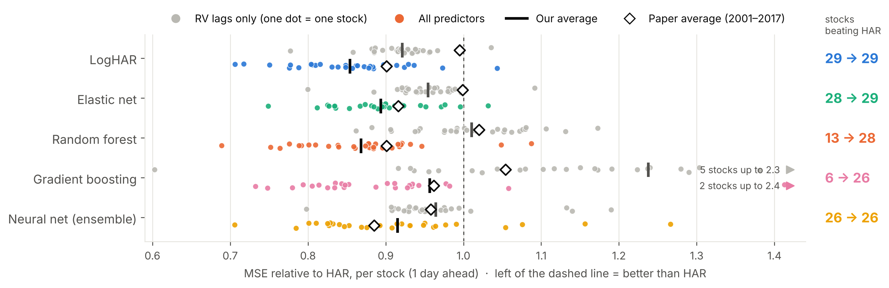
BLOCK 4 / OUR RESULTS
Lukas
As in the paper, extra predictors move almost every stock below HAR, not just a few
13 → 28
1.01 → 0.87
29 of 30
Random forest: stocks (of 30) where it beats HAR, RV lags only → all predictors
Random forest, average: the same shift as in the paper (1.02 → 0.90)
LogHAR and elastic net: stocks where they beat HAR with all predictors
Source: own replication; VOLARE 5-min RV, Dow 30, 2016–2026; baseline split, 1 day; one dot = one stock; paper averages from Christensen et al., Tables 2–3
Christensen, Siggaard & Veliyev
13
Notes:
One dot per stock, one day ahead. Grey: only past realized variance as input. Coloured: all predictors. The black bar is our average, the diamond the paper's average.
With RV lags only, the tree models are no better than HAR, exactly as the paper reports: random forest beats HAR for only 13 of 30 stocks.
With all predictors the whole cloud moves left of the dashed line: random forest beats HAR for 28 of 30 stocks, its average falls from 1.01 to 0.87 (paper: 1.02 to 0.90). LogHAR and elastic net beat HAR for 29 of 30.
So the gain is broad across stocks. Gradient boosting has a few extreme stocks with RV lags only (up to 2.3), which is why its averages look worse than its median.

Slide 14
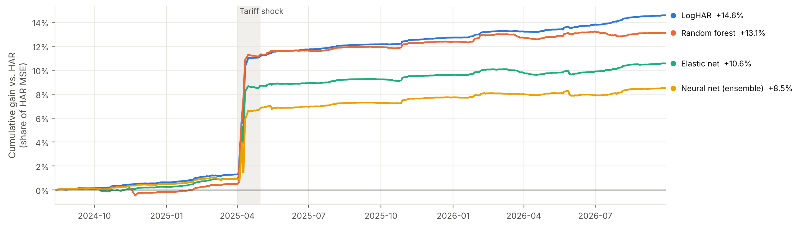
BLOCK 4 / OUR RESULTS
Lukas
Most of the ML gain comes from a single month: the April 2025 tariff shock
54%
1.00 → 0.79
0.96
HAR error: share of its squared error in April 2025, only 4% of test days
Random forest in April 2025: RV lags only vs all predictors: the gain comes from implied vol and VIX
Without April 2025: random forest only 0.96 vs HAR; LogHAR still 0.89
Source: own replication; VOLARE 5-min RV, Dow 30, 2016–2026; baseline split, M_ALL, 1 day; cumulative (HAR loss − model loss), scaled by each stock's mean HAR loss
Christensen, Siggaard & Veliyev
14
Notes:
Cumulative gain over HAR during the test period (Aug 2024 – Sep 2026). A rising line means the model is gaining on HAR.
Until March 2025 all models are only about 1% ahead. In April 2025 the lines jump: about 80% of the random forest's total gain comes from that single month. Why ML wins there: with RV lags only, random forest is no better than HAR in April 2025 (1.00); with implied volatility and VIX it is at 0.79. Forward-looking predictors react on the day of the shock, past RV only afterwards.
MSE on variance is dominated by extreme days: 54% of HAR's squared error falls into April 2025. Excluding it, RF is 0.96 and LogHAR 0.89 relative to HAR.

Slide 15
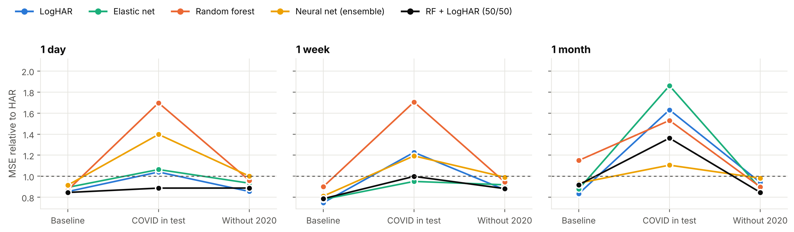
BLOCK 4 / OUR RESULTS
Lukas
Where COVID sits decides who wins, but a 50/50 random forest + LogHAR average beats HAR in every split (1 day)
1.70
0.89
0.87 → 0.96
Random forest, COVID in test: trained on calm 2016–19, it loses clearly to HAR (1 day)
RF + LogHAR (50/50), COVID in test: errors offset, beats HAR for 27 of 30 stocks (1 day)
Random forest, without 2020: the edge shrinks once COVID leaves training
Source: own replication; VOLARE 5-min RV, Dow 30, 2016–2026; M_ALL; three splits; h-day forecasts clipped to the range of h-day RV realized so far (insanity filter, < 0.5% of forecasts)
Christensen, Siggaard & Veliyev
15
Notes:
Same models, three splits. Baseline: ML beats HAR at 1 day and 1 week.
Black line: a plain 50/50 average of the random forest and LogHAR forecasts, fixed weights, nothing estimated. Random forest cannot forecast above its training range and undershoots in a crisis, LogHAR overshoots; averaged, the errors offset. At 1 day it beats HAR in all three splits (0.85, 0.89, 0.89). At 1 week it ties HAR with COVID in test (1.00). At 1 month with COVID in test every model loses to HAR, the combination included (1.36).
COVID in test: models trained on the calm 2016–2019 period must forecast March 2020. Random forest (1.70) and the NN ensemble (1.40) lose clearly to HAR at 1 day; At 1 month with COVID in test all models lose to HAR (1.1 to 1.9). Excluding the COVID weeks (Feb–May 2020), RF is at 0.95.
Without 2020: the ML edge shrinks (RF 0.96, elastic net 0.93), the plain linear HAR variants improve.
Why the ML edge shrinks without 2020: with 2020 in the estimation window the monthly HAR coefficient turns negative for 73% of stocks (median −0.05, +0.25 without 2020), so COVID weakens the linear benchmark itself.
For this comparison every h-day forecast is clipped to the range of h-day average RV realized up to the forecast day (no look-ahead, same rule for all models incl. HAR, < 0.5% of forecasts); without it LogHAR forecasts explode in March 2020.

Slide 16
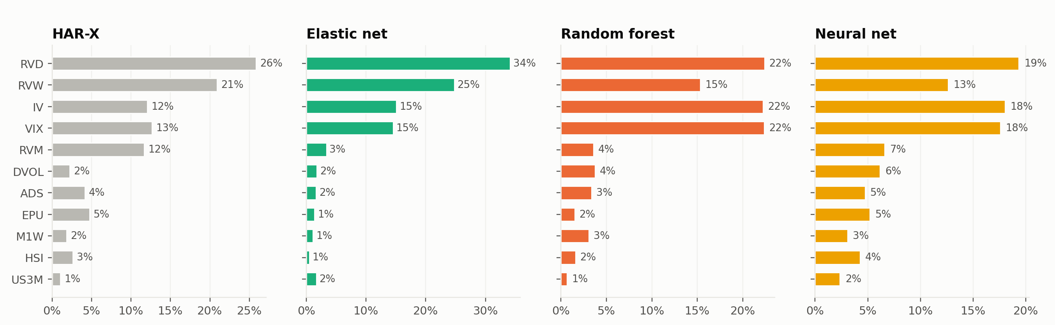
BLOCK 5 / ASSESSMENT
Aleks
Implied volatility and VIX matter as much as past RV for the nonlinear models
67%
Top 3
~5%
Random forest: daily RV, implied vol and VIX together, about 22% each
Implied vol: among the top drivers in RF and NN, as in the paper (Fig. 7)
Macro variables: ADS, EPU, Hang Seng, T-bill: about 5% or less each
Source: own replication; VOLARE 5-min RV, Dow 30, 2016–2026; ALE-based variable importance, M_ALL, 1 day, initial training window, average of 8 stocks
Christensen, Siggaard & Veliyev
16
Notes:
Variable importance from accumulated local effects (as in the paper), normalized to 100% per model.
Linear models rely mostly on daily and weekly RV. Random forest and NN give implied volatility and VIX the same weight as daily RV, matching the paper's finding that ML models weigh market expectations more.
Macro variables each contribute 5% or less.

Slide 17
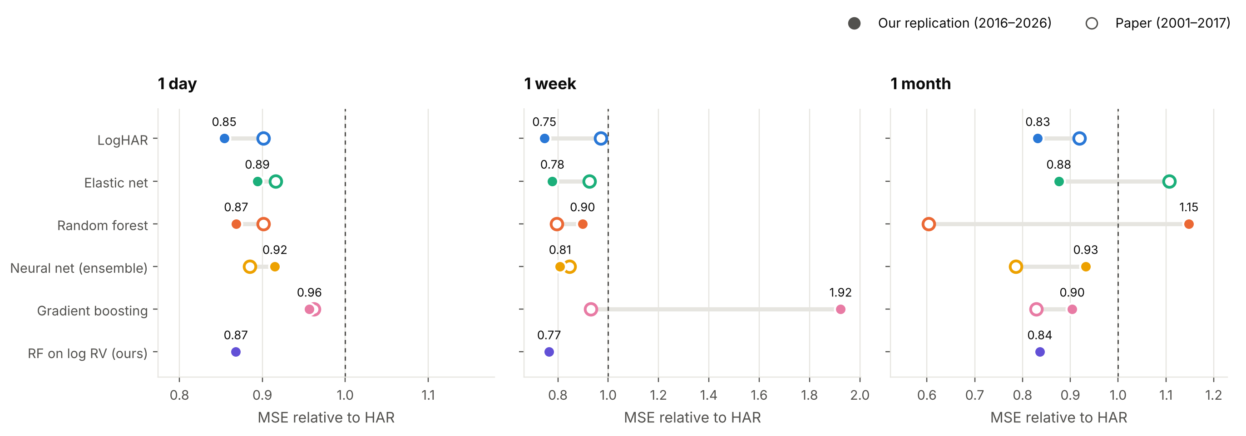
BLOCK 5 / ASSESSMENT
Aleks
Verdict: H1 and H2 hold in the baseline split, H3 does not
H1 ✓
H2 (✓)
H3 ✗
RV lags only: ML ≈ HAR at 1 day (RF 1.01, NN 0.96, elastic net 0.95)
Extra predictors: ML beats HAR at 1 day (RF 0.87, EN 0.89), but driven by one shock
Longer horizons: no growing edge; random forest 1.15 at one month (paper 0.60), 0.84 on log RV
Source: own replication; VOLARE 5-min RV, Dow 30, 2016–2026; baseline split, M_ALL; filled = ours, hollow = paper
Christensen, Siggaard & Veliyev
17
Notes:
H1 holds: with only RV lags the ML models are roughly as good as HAR.
H2 holds in the baseline split, but most of the gain comes from April 2025, and it reverses when COVID is out-of-sample.
H3 is not confirmed: the paper's large one-month gains for random forest (0.60) do not replicate (1.15); LogHAR and the NN ensemble stay below 1.
Robust takeaway: the log-transformed HAR is the most stable model across horizons and splits in our data.

Slide 18
BLOCK 5 / ASSESSMENT
Aleks
Deviations, limitations, and transfer
Practical relevance
Deviations
Our project
Risk management and VaR
Option pricing and hedging
Volatility-linked structured products
Sample 2016–2026 instead of 2001–2017
VOLARE 5-min RV instead of NYSE TAQ
IV: 30-day ATM (LSEG) instead of model-free; no earnings dummy
Re-estimation every 22/63 days, not daily
NN: best 5 of 10 seeds (paper: 10 of 100)
Not run: adaptive/post lasso, MCS, VaR
Open data: VOLARE, LSEG, FRED
All 12 models trained by our Python code
3 horizons × 2 predictor sets × 3 splits
Evaluation: DM tests, QLIKE, ALE importance
Own additions: RF on log RV, RF + LogHAR combination
Which findings remain valid in our dataset?
Christensen, Siggaard & Veliyev
18
Notes:
Source for the paper results and VaR: Sections 6–7, pp. 32–35. The proposed R implementation using highfrequency and MCS transfers the method to the team's own project and comes from the group plan, not directly from the paper.

