Slide 1
Finding the shortest path in a maze: Dijkstra’s algorithm
Łukasz Kwiecień

Slide 2
Dijkstra’s Algorithm
Is a solution to the single-source shortest path problem in graph theory
Created by Edsger W. Dijkstra in 1956
Input – weighted graph and source vertex
Output – lengths of shortest paths from a given source vertex to all other vertices

Slide 3
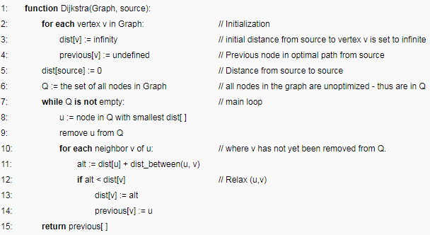
Pseudocode

Slide 4
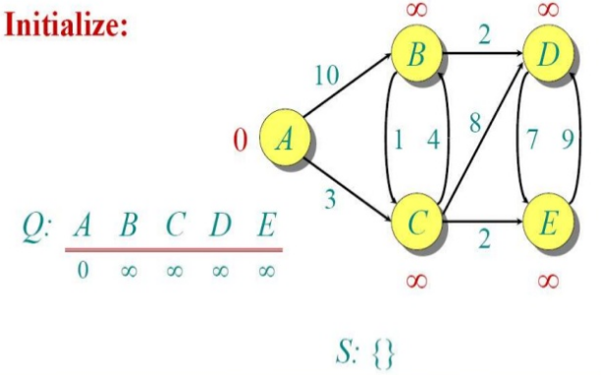
Example

Slide 5
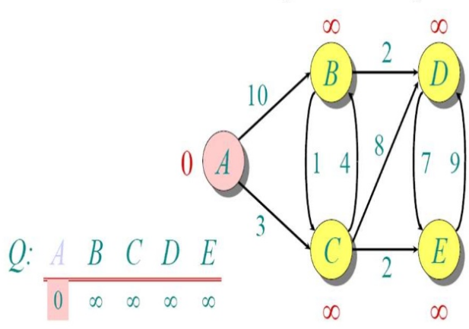

Slide 6
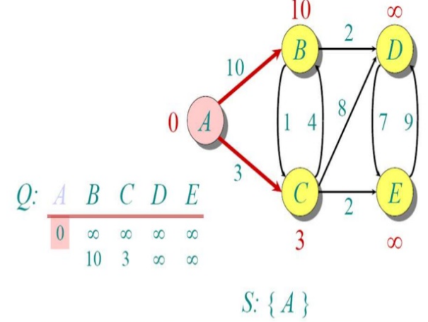

Slide 7
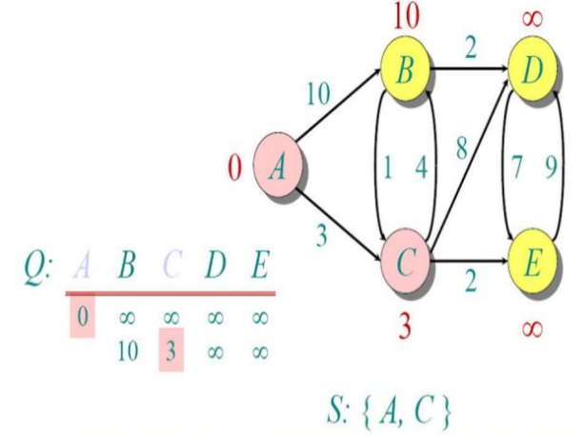

Slide 8
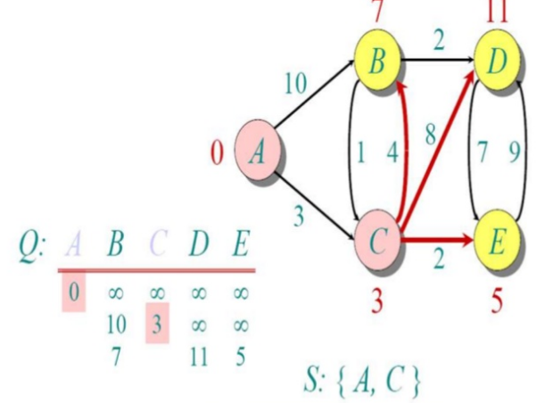

Slide 9
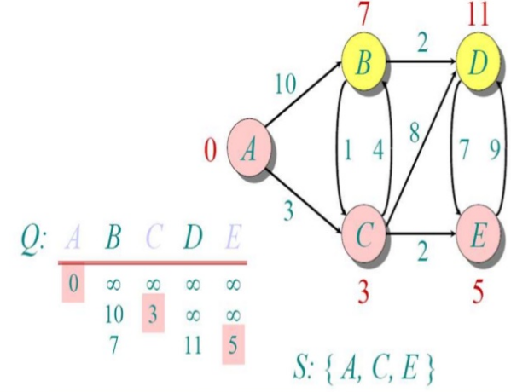

Slide 10
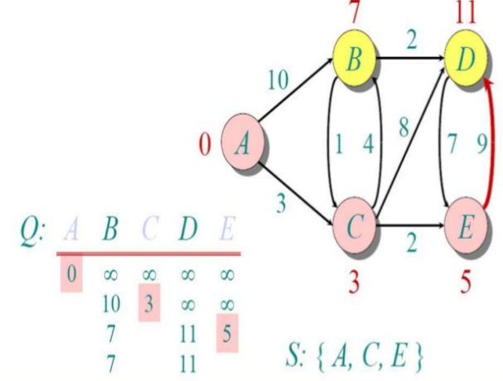

Slide 11
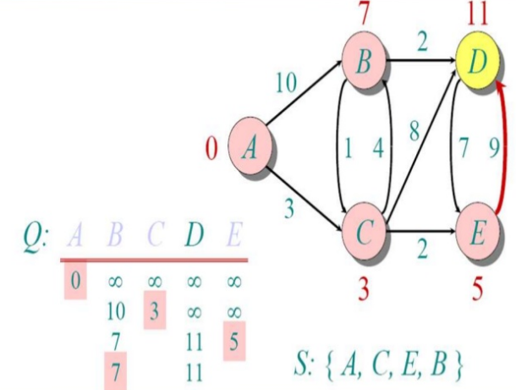

Slide 12
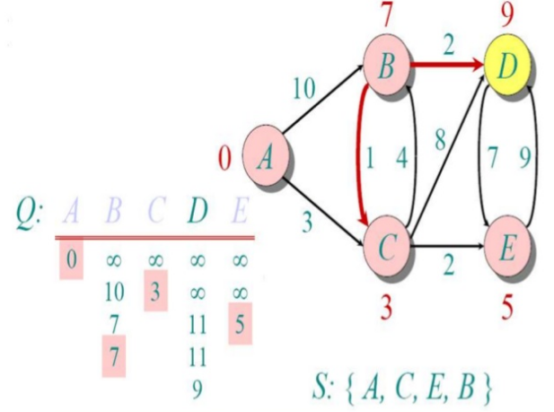

Slide 13
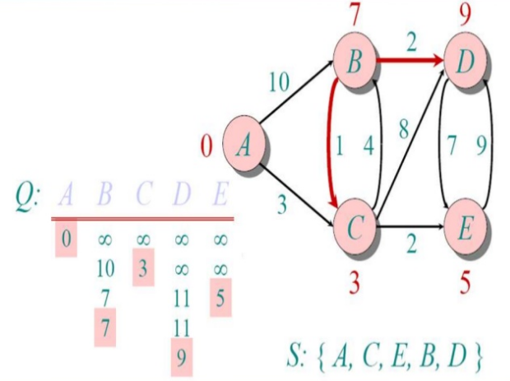

Slide 14
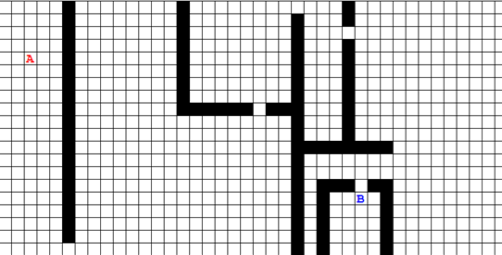
Finding the shortest path in a maze

Slide 15
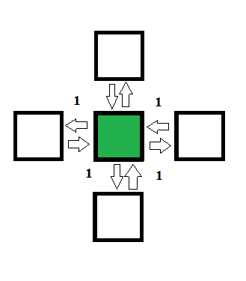
Grid as a graph

Slide 16
Pseudocode

Slide 17
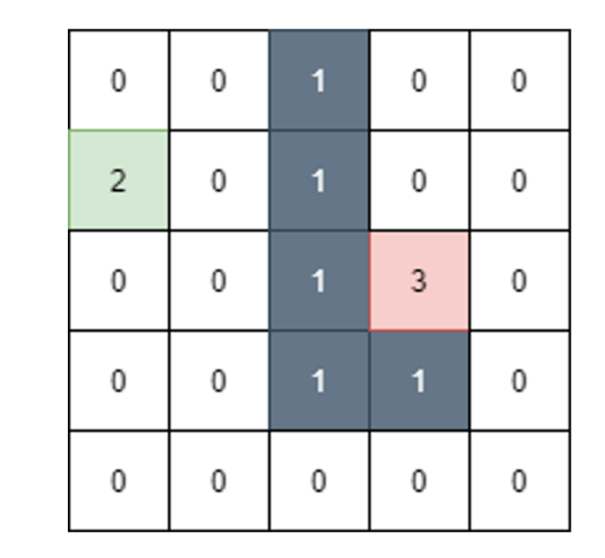
input

Slide 18
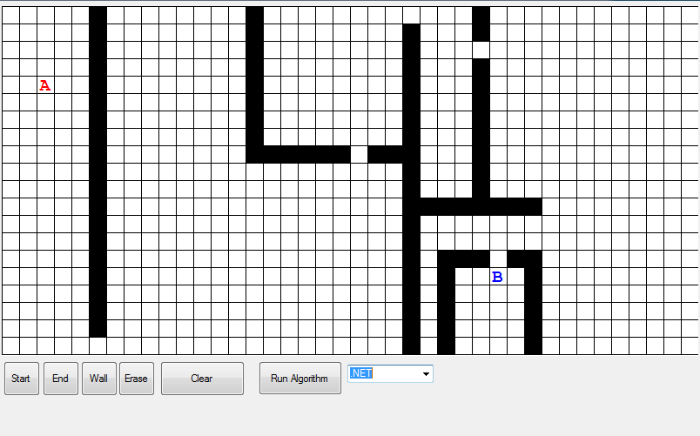
GUI

Slide 19
