Slide 1
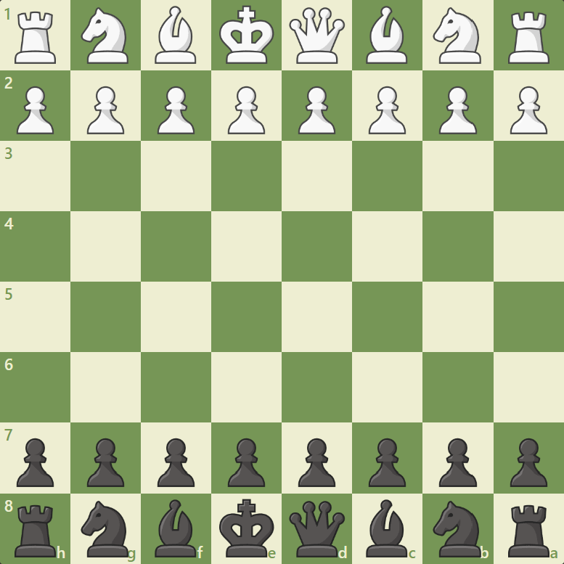
Board position numbering
figure index numbering
plotting
0
1
2
3
4
5
6
7
1
2
3
4
5
6
7
8
8
9
10
11
12
13
14
15
9
10
11
12
13
14
15
16
16
17
18
19
20
21
22
23
24
25
26
27
28
29
30
31
32
36
0 1 2 3 4 5 6 7
33
34
35
37
38
39
40
41
42
43
44
45
46
47
48
49
50
51
52
53
54
55
17
18
19
20
21
22
23
24
56
57
58
59
60
61
62
63
25
26
27
28
29
30
31
32
0 1 2 3 4 5 6 7

Slide 2
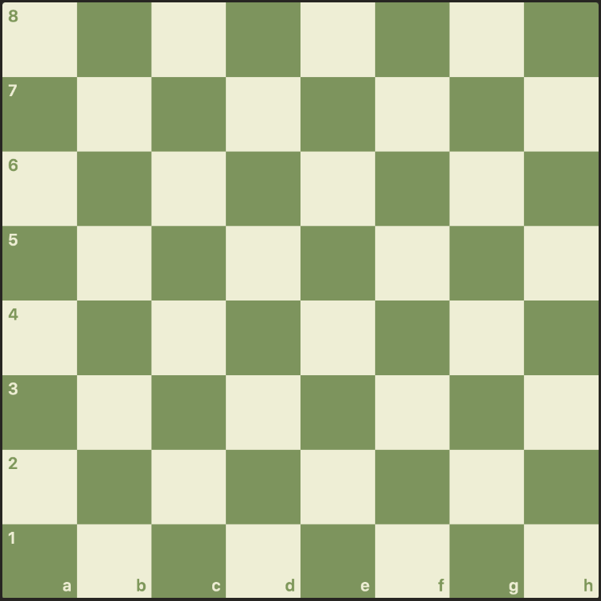



Slide 3
Board position numbering
Movement numbring
Boundary lookup table
0
1
2
3
4
5
6
7
0
1
2
3
4
5
6
7
1
8
8
8
8
8
8
4
8
9
10
11
12
13
14
15
8
9
10
11
12
13
14
15
5
9
16
16
16
16
12
7
16
17
18
19
20
21
22
23
16
17
-17
19
-15
21
22
23
5
13
17
17
17
17
15
7
24
25
26
27
28
29
30
31
24
-10
-9
-8
-7
-6
30
31
5
13
17
17
17
17
15
7
32
33
34
35
36
37
38
39
32
33
-1
x
+1
37
38
39
5
13
17
17
17
17
15
7
40
41
42
43
44
45
46
47
40
+6
+7
+8
+9
+10
46
47
5
13
17
17
17
17
15
7
48
49
50
51
52
53
54
55
48
49
+15
51
+17
53
54
55
5
10
14
14
14
14
11
7
56
57
58
59
60
61
62
63
56
57
58
59
60
61
62
63
2
6
6
6
6
6
6
3

