Slide 1
DEVELOPMENT OF SIMPLEMERGE

Slide 2
The member of the project team
Lukas Guzauskas

Slide 3
Content
Introduce
Analysis
Design
Implementation
Non-functional requirements
Traceability table
Process history
Development supported

Slide 4
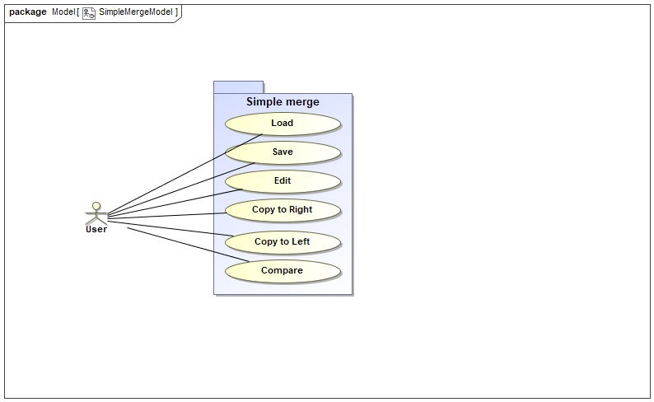
Introduce
The goal of this project is to create a SimpleMerge information system using Java language. The SimpleMerge displays two text files next to edit panel (side by side) and the user can use several functionalities: load, edit, save, compare 2 files and merge 2 files.

Slide 5
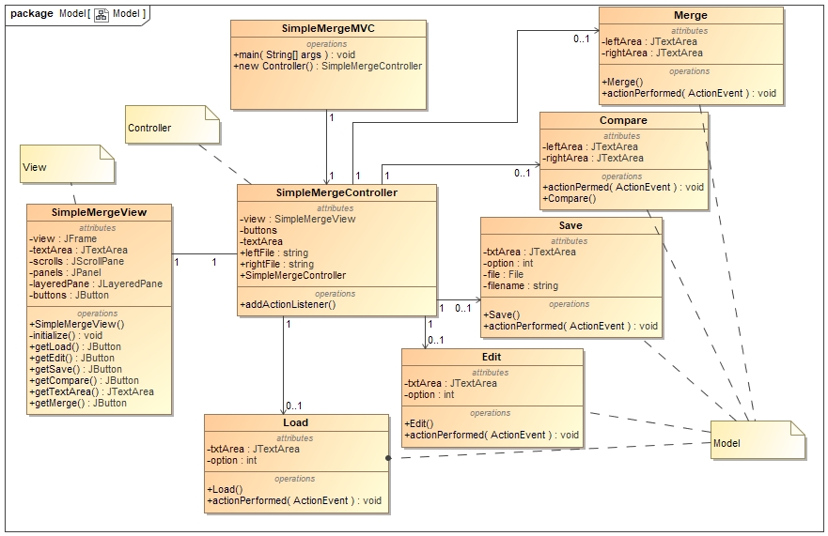
Analysis
Domain Model consist of 8 class diagrams.
View – SimpleMergeView
Controller - SimpleMergeController
Model:
- Load
- Edit
- Save
- Compare
- Merge

Slide 6
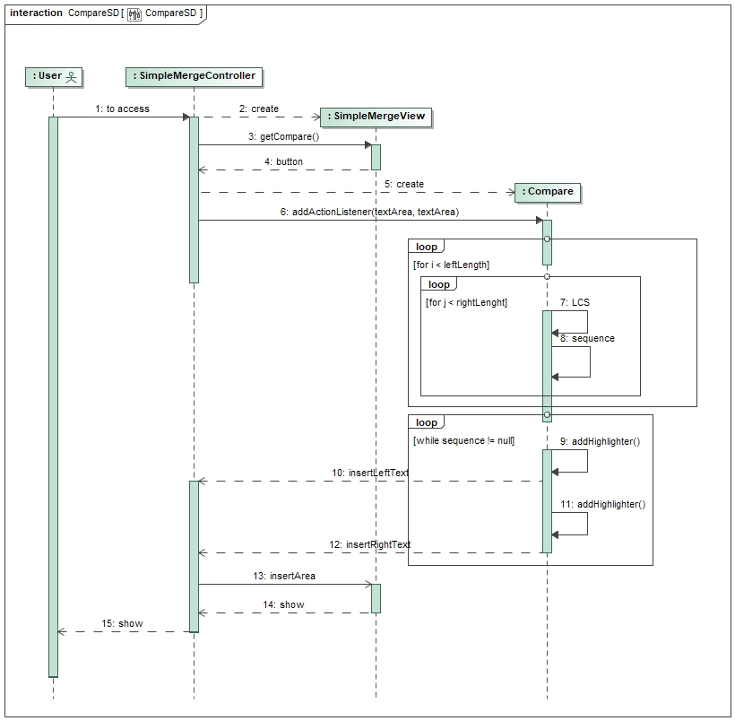
System sequence diagram (Design Model)
Following USE CASE requirements, I designed and communicated with SSD (System sequence diagram) related with USE CASE model. We have been designed major part of the design model that is a part of 6 SSD: LOADSD, EDITSD, SAVESD, COMPAREDSD, MERGESD. For example, compare sequence diagram:

Slide 7
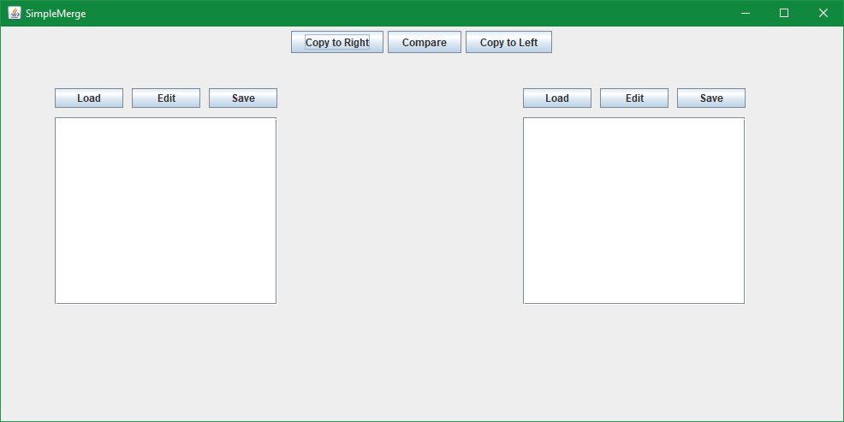
Implementation
My program consist of 3 features which should be implemented during development: load/edit/save file, comparing 2 files and merging 2 files. Then I have created GUI components which are supported by Eclipse development related with Java language. After creating GUI, I have written some Java codes that can be able to implement interface communication with GUI management for the user could click any button. When button is clicked, that is program controller must do its implementation in the program depending what the user wants to be passed to the program.

Slide 8
Non-functional requirements
1. Performance
- All functions of the SimpleMerge program could be completed from the requested function by the User. All functions shall be completed quickly.
2. Usability
- GUI (Graphical user interface): The system shall allow a user to interface with it through mouse events on button and view events on the text panels
- Language: All the contents of the system is supported English language.
- Test framework: The SimpleMerge program is to able used Junit and EasyMock testing.

Slide 9
Traceability table
 | UC1 | UC2 | UC3 | UC4 | UC5 | UC6 | NR1 | NR2
UC1
UC2 | X
UC3 | X | X
UC4 | X
UC5 | X |  |  | X
UC6 | X |  |  | X
NR1
NR2

Slide 10
Process history for 1 week
Create GitHub repository
Planning the goal of this project
Presentation on the project report about about SimpleMerge goal
Writing SRS document (USE CASE, Non-functional, System sequence diagram, etc.)

Slide 11
Process history for 2 weeks
Develop SimpleMerge program and design GUI components
Writing Java codes source for every class based on SRS
Creating SSD (System sequence diagram)
Launching SimpleMerge program
Finishing 2 features from loading/editing/saving files and comparing two files.
Updating SRS document and SSD diagram
Recording project management report.

Slide 12
Development supported
Eclipse development MVC concept
MagicDraws for used domain and design models
Junit 5 – used test case

