Slide 1

Contextmap

Slide 2
Team Ryam
Lukas Mayr
Hanna Mayr

Slide 3
Challenge
Display dxf-file on an open source map
Find a way to incorporate the information
Create a nice graphical user interface

Slide 4
Dream
Find an easy and straightforward way to show map
Display the most important information

Slide 5
How is it going?

Slide 6

Tricky

Slide 7
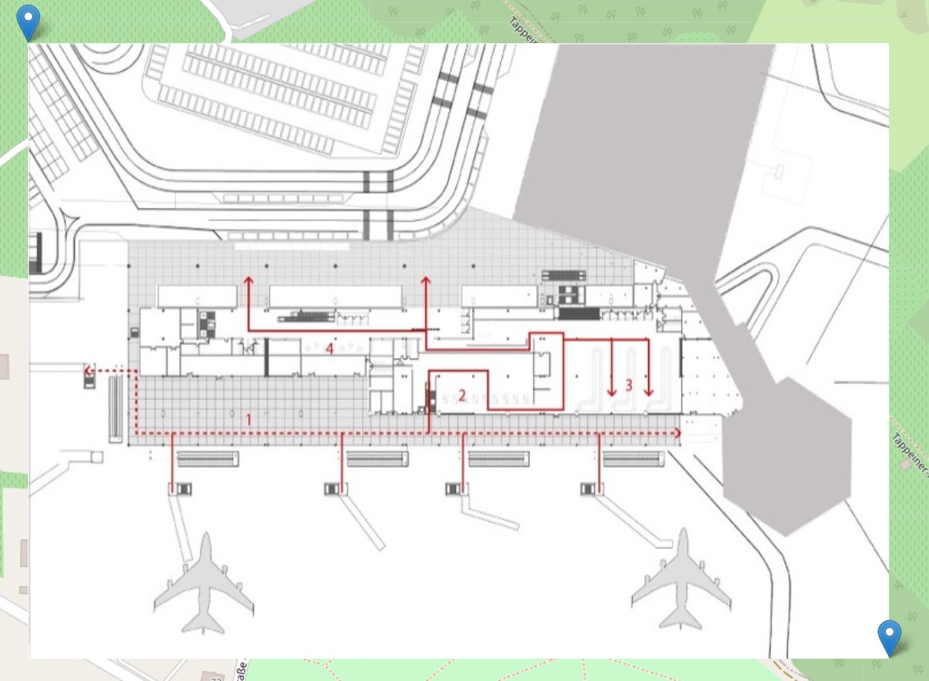
Focusing on layout

