Slide 1
Leave Management System

Slide 2

Lecture
Prof. Joe Bruen
Team: 4 Dev
Members:
Amjad Karim
Francis Nahimana
Petros H Ghebrezghi
Pheakdey Luk
Maharishi University of Management

Slide 3
Outline
Agenda
Software Architecture
Use Case Diagram
Service
Function
Problem Facing
Demo

Slide 4
Agenda
Our project is a leave management system in company where an employee is created via a REST web service call and leaves are applied, approved or rejected via AMQP, After reading from Queue and storing them on the database a manager is able to approve or reject a leave that is pending.
All employees can apply for any type of leave, an employee can only view his own pending, approved or rejected leaves but a manager can see all pending leaves of all employees and can add comments to them before approving or rejecting.

Slide 5
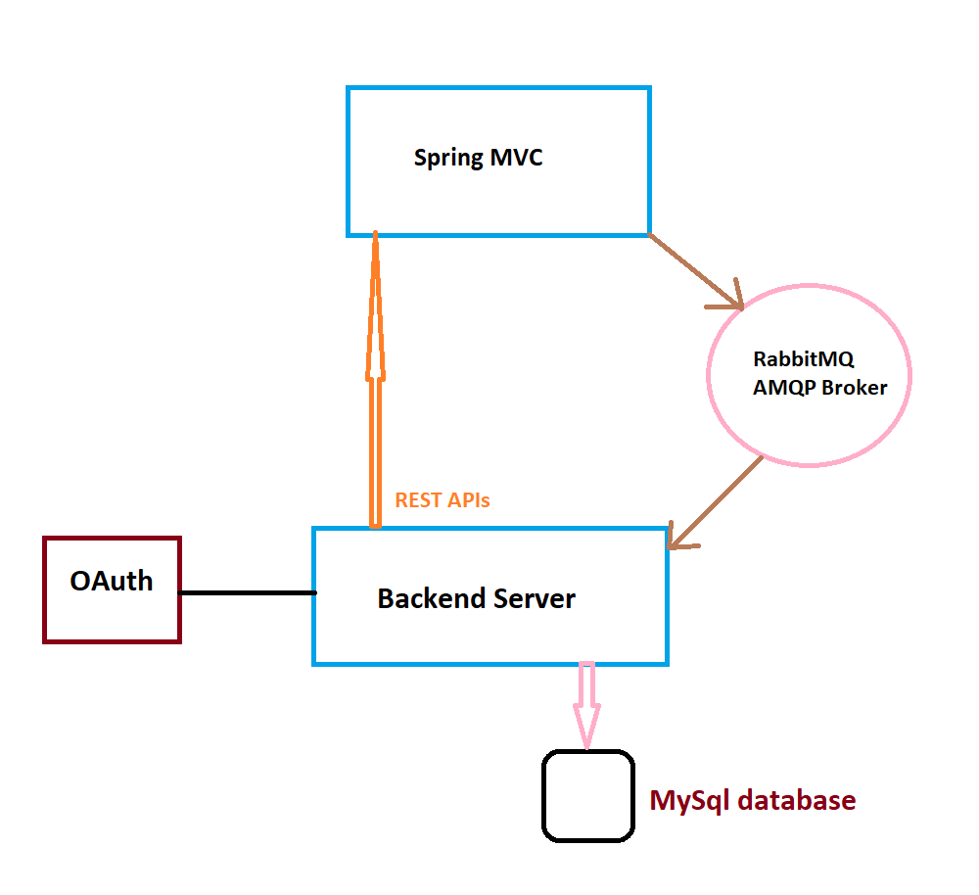
Software Architecture

Slide 6
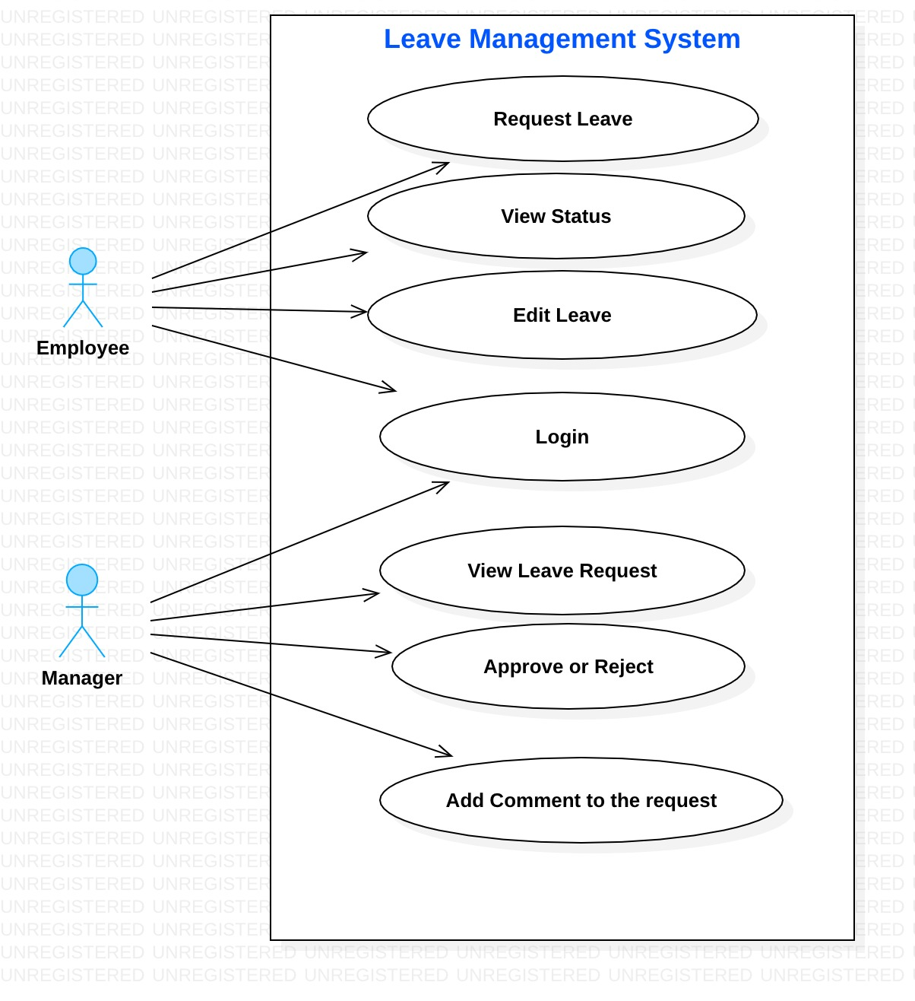
Use Case Diagram

Slide 7
Service
Leave Service
RESTful Web Service
AMQP - RabbitMQ
Hibernate - JPA

Slide 8
Function
- Create REST API
- Handle REST request
- Produce and Consumer Messaging

Slide 9
Problem Facing
- Relationships between entities
- Getting lazy loaded objects from a holding object
- Role based security at method level
- Having all four micro services communicate over the network

Slide 10
Thanks!
Any questions?

Slide 11

Let Start Demo

