Slide 1
Comparison of validity criteria for community mining algorithms
Authors:
Trzcionkowski Radosław
Szczygłowski Łukasz

Slide 2
Implementation
Validity criterias:
C Index criteria
Davies Bouldin criteria
Dunn Index
Modularity Q
PBM Criteria
Point Bisterial Criteria
Silhouette Width Criteria
Variance Ratio Criteria
Z Statistics Criteria
97% tests coverage
External evaluation:
Jaccard Coefficient
AMI, ARI (not used)
98% tests coverage
Nodes distance measurings:
Adjacency Relation Distance
Edge Path Distance
Neighbour Overlap Distance
Pearson Correlation Distance
88% tests coverage
39 unit tests with total coverage of 62,4%

Slide 3
Experiment 1
Validity criteria comparison

Slide 4
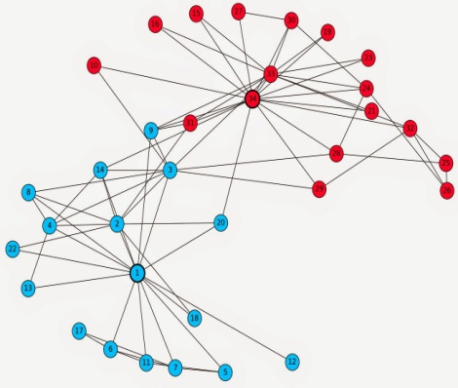
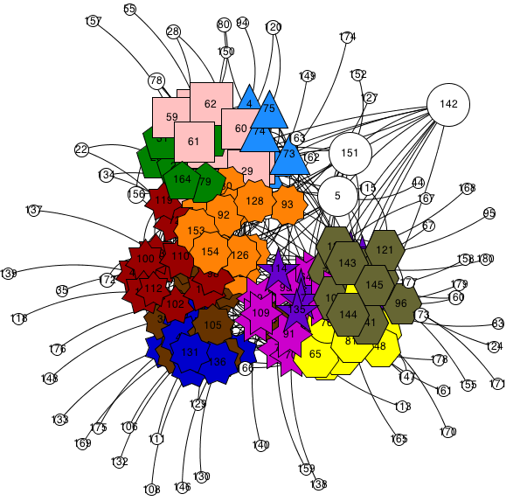
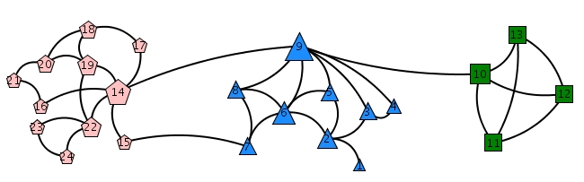
Clustered datasets
Zahary’s Karate
NCAA Football Bowl Subdivision
Sawmill Strike

Slide 5
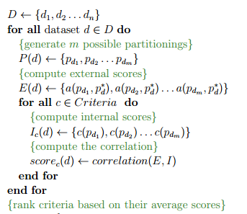
Core algorithm

Slide 6
Optimistic case
Avg. External evaluation: 0,78
Vectors correlation: Spearman
Results:
C Index ARD
C Index PCD
SWC 2 PCD
C Index NOD
Modularity Q
SWC2 NOD
PBM PCD
C Index EPD
Z Statistics EPD
PBM NOD
Core article:
Modularity Q
C Index PCD
SWC2 SPD
C Index SPD
SWC2 ICD

Slide 7
Medium case
Avg. External evaluation: 0,52
Vectors correlation: Spearman
Results:
C Index ARD
C Index PCD
C Index NOD
Modularity Q
PBM PCD
PBM NOD
Z Statistics EPD
C Index EPD
SWC2 PCD
Davies Bouldin NOD
Core article:
C Index PCD
C Index NOD
C Index ARD
Dunn Index ICD
SWC2 NOD
ASWC2 PCD
SWC2 NOD
Dunn04 ICD
Dunn41 SPD
Dunn01 SPD
Modularity Q
7

Slide 8
Pesimistic case
Avg. External evaluation: 0,32
Vectors correlation: Spearman
Results:
C Index NOD
PBM PCD
PBM NOD
C Index PCD
Modularity Q
C Index ARD
Z Statistics EPD
C Index EPD
Davies Bouldin PCD
SWC 2 NOD
Core article:
SWC2 NOD
ASWC2 NOD
Modularity Q
C Index PCD
C Index SPD
8

Slide 9
Experiment 2
Several clustering algorithms comparision
basing on the validity criteria

Slide 10
Considered algorithms
Jung Bicomponent Clustering
Jung Edge Betweenness Clustering
Jung Voltage Clustering
JavaML Density Based Spatial Clustering
JavaML Knode Clustering
JavaML Self Organizing Maps Clustering
Used dataset: Zahary’s Karate
Similar experiment approach as used in the first test

Slide 11
Results based on the best criteria - C Index
Name | Jaccard Ex. Evaluation | C Index NOD | C Index ARD | C Index PCD
Jung Bicomponent | 0.4605089949506484 | 0.18064609786610283 | 0.4985120814096288 | 0.2258478458692724
Jung Edge Betweenness | 0.4866310160427806 | 0.3 | 0.4285714285714287 | -0.2000000000000001
Jung Voltage Clustering | 0.5187105584220729 | 0.2475895522660684 | 0.43187310694120346 | 0.2789870794384364
JavaML Density Based Spatial | 0.4526717087868168 | 0.262039093595844 | 0.558564512088685 | 0.3547832539308114
JavaML Knode | 0.495616880650531 | 0.16444965781240056 | 0.13367560477810442 | 0.19711628953958574
JavaML Self Organizing Maps | 0.6724051154863459 | 0.22555020106813498 | 0.3239879888281027 | 0.24271250242535564

Slide 12
Conclusion
Modularity Q, as the most commonly used criteria, is highly ranked in all the cases considered in the experiment. However, there are more well-behaving criterias that can also be used to measure quality of community mining algorithms and become a basement of newly implemented.
Results acquired in the experiment are similar to the base article, however, some differences are noticeable especially in pesimistic and medium case. This might be caused by a different algorithm to create random partitioning of used datasets.
The experiment has shown that C Index with NOD, PCD or ARD is the most appropriate criteria for tested datasets. Even though it is one of the highest ranked criteria based on vectors correlation, it still can produce results that are way different comparing to the external evaluation with dataset’s ground truth, as shown in the second experiment.

Slide 13
Future work
Implement missing metrics calculating distance between network nodes.
Implement more validity criterias and include them in the experiment.
Additional criterias can be found at:
http://cran.r-project.org/web/packages/clusterCrit/vignettes/clusterCrit.pdf
Extend the experiment with bigger datasets, e.g. Enron.
Extend the clustering algorithms comparing experiment
with additional implementations of community mining.

Slide 14
References
http://webdocs.cs.ualberta.ca/~zaiane/postscript/SNA-Encyclopedia.pdf
http://webdocs.cs.ualberta.ca/~rabbanyk/criteriaComparison/ASONAM/
cameraReadyVersion/asonam12rabbanyk.pdf
http://jmlr.csail.mit.edu/papers/volume11/vinh10a/vinh10a.pdf
http://spaghetti-os.blogspot.com/2014/05/zacharys-karate-club.html
http://hal.elte.hu/~lanna/Publications/GraphEPLFinal_6o.pdf
http://webdocs.cs.ualberta.ca/~rabbanyk/TopLeader/
http://cran.r-project.org/web/packages/clusterCrit/vignettes/clusterCrit.pdf

Slide 15
Thank you

