Slide 1


The Standard Deviants - Group 1 EDAB Presentation
Group members :
Suhail Malek - 2023334119 Lwazi Nhlapo - 2021856345
Lukhanyo Kalashe - 2023575000 Botlhale Korku Agbotame - 2021484890
Kgomotso Natasha Sikhonde - 2021541467 Oratile Menyatsoe - 2023839000 Tsholofelo Motlhale - 2020619553

Slide 2


Introduction
Research Question
To what extent does the adoption of climate-smart agricultural (CSA) practices improve maize productivity and household food-nutrition security among smallholder farmers in North-West South Africa
Context: Data collected from 316 smallholder farmers in North-West Province (2022–2023)
Source: Omotayo et al. (2024) – Data in Brief article
Data Contents: Demographics, CSA practices, yield, income, HDDS and HFIAS
Tools Used: Google Colab for data cleaning, feature engineering, clustering and visualization.
Note: Attempted to contact the author of the article for greater insight but received no response.
Interactive dashboard available via QR code

Slide 3
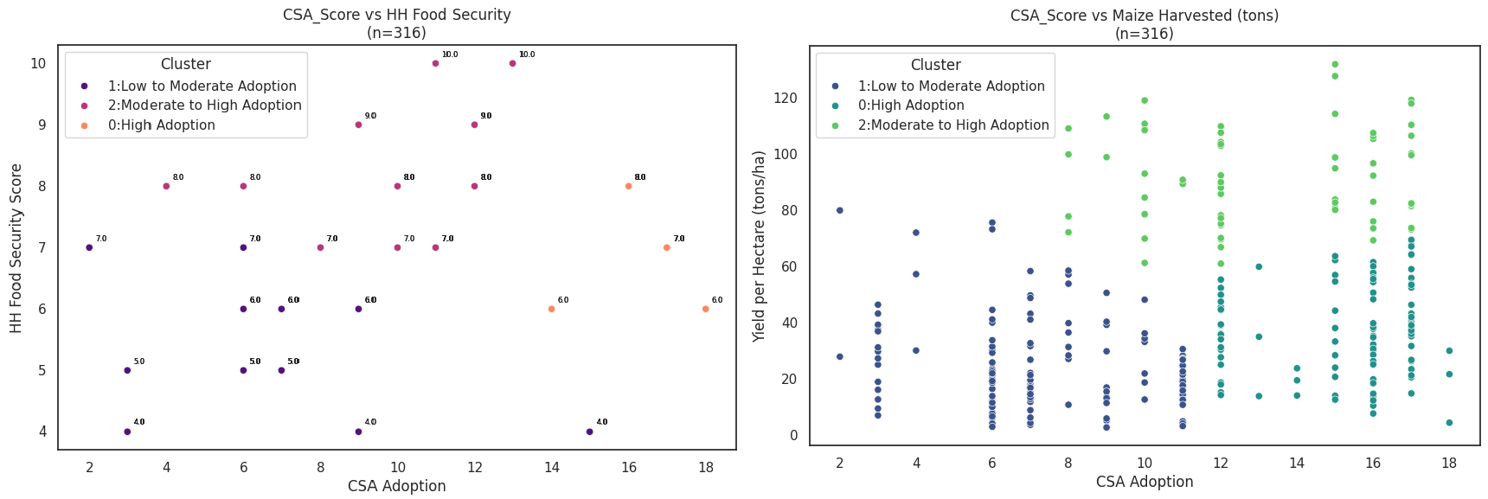
Impact of CSA on Maize Yield & Food Security In North West SA
Low CSA adoption score—>low HH Food Security Score
Clustered farmers according to CSA score
Medium CSA adoption Score —>highest HH Food Security Score
Low CSA adoption Score—>Low Maize yield per hectare
Uneven distribution means more factors affect HH food security & Maize productivity
Moderate CSA adoption Score—>Highest Maize yield per hectare
Extent of CSA adoption boosts but doesn’t guarantee productivity& food security
Moderate to Higher CSA adoption score boosts maize productivity

Slide 4
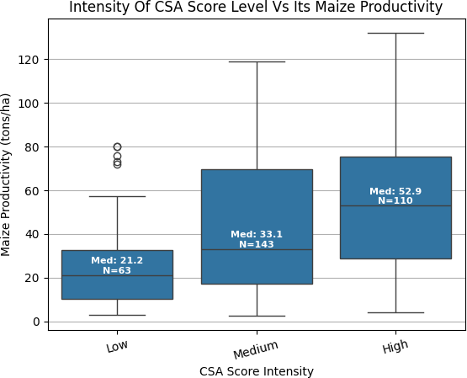
CSA score vs. Maize Productivity: Does Higher Adoption Lead to Better Yields?
Higher CSA adoption boosts yields, with median productivity rising from Low to High adoption levels.
High adopters show top performance, including the highest yields and standout outliers.
Medium group shows wide variability, indicating inconsistent results with partial adoption.
Outliers in all groups suggest other factors like soil, water and experience affect yields.
CSA isn’t the only driver,productivity depends on both CSA and external conditions.
Implementation quality matters, as variability at higher adoption levels reflects how practices are applied.

Slide 5
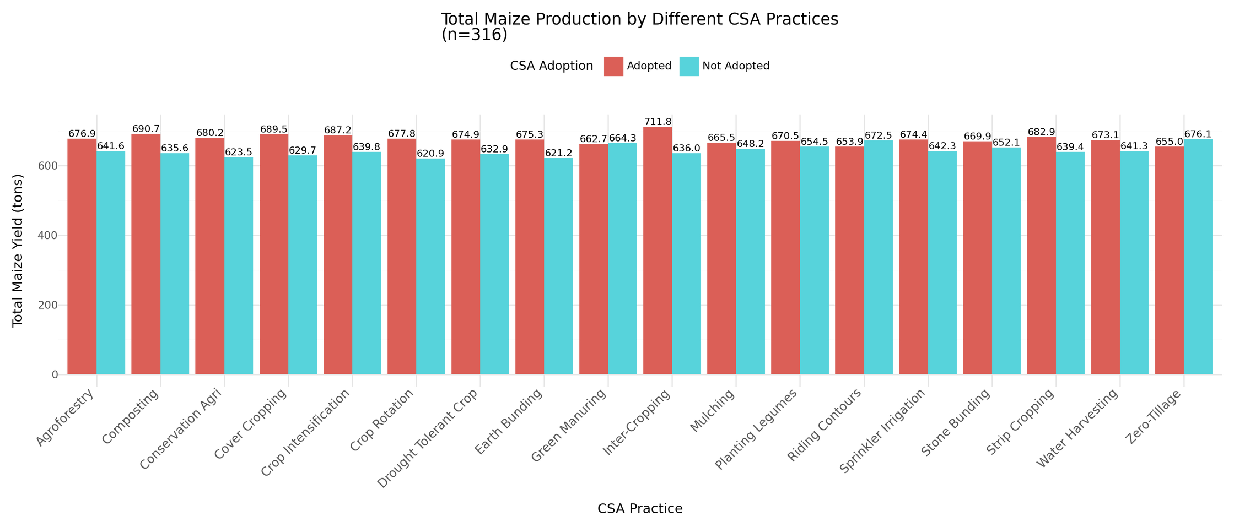
Impact of CSA Practices on total Maize Yield/Production
●CSA users always yield more than non-users across all practices.
Impact varies, suggesting some practices work better in certain conditions.
All practices boost yields, showing CSA's overall effectiveness.
●Inter-Cropping, Intensification, and Agroforestry show the biggest yield gains.

Slide 6

Limitations and Recommendations
Limitations
Recommendations
_{Missing or dropped Variables.} ●Promote CSA among low adopters to reduce food insecurity and
Limitation of farmers reported ^{vulnerability.}
●Address barriers for high adopters (e.g., water access, market limitations).
●Integrate CSA with complementary interventions like education and income diversification.
●Target moderate adopters with training to improve uptake and outcomes.
●Optimise practices for high adopters to stabilise yields and food security.
●Replicate effective strategies across regions by learning from successful clusters.
data bias.
Geographic Limitation.
Questionnaire access Limitation.
Derived factors may vary(Binary Variables and Dataset Variables).
Investigate variability causes to ensure consistent benefits.

