Slide 1
Warehouse Robotics – Capacity Constrained Transport
PDDL & PDDL+ Project
Luca Tassoni

Slide 2
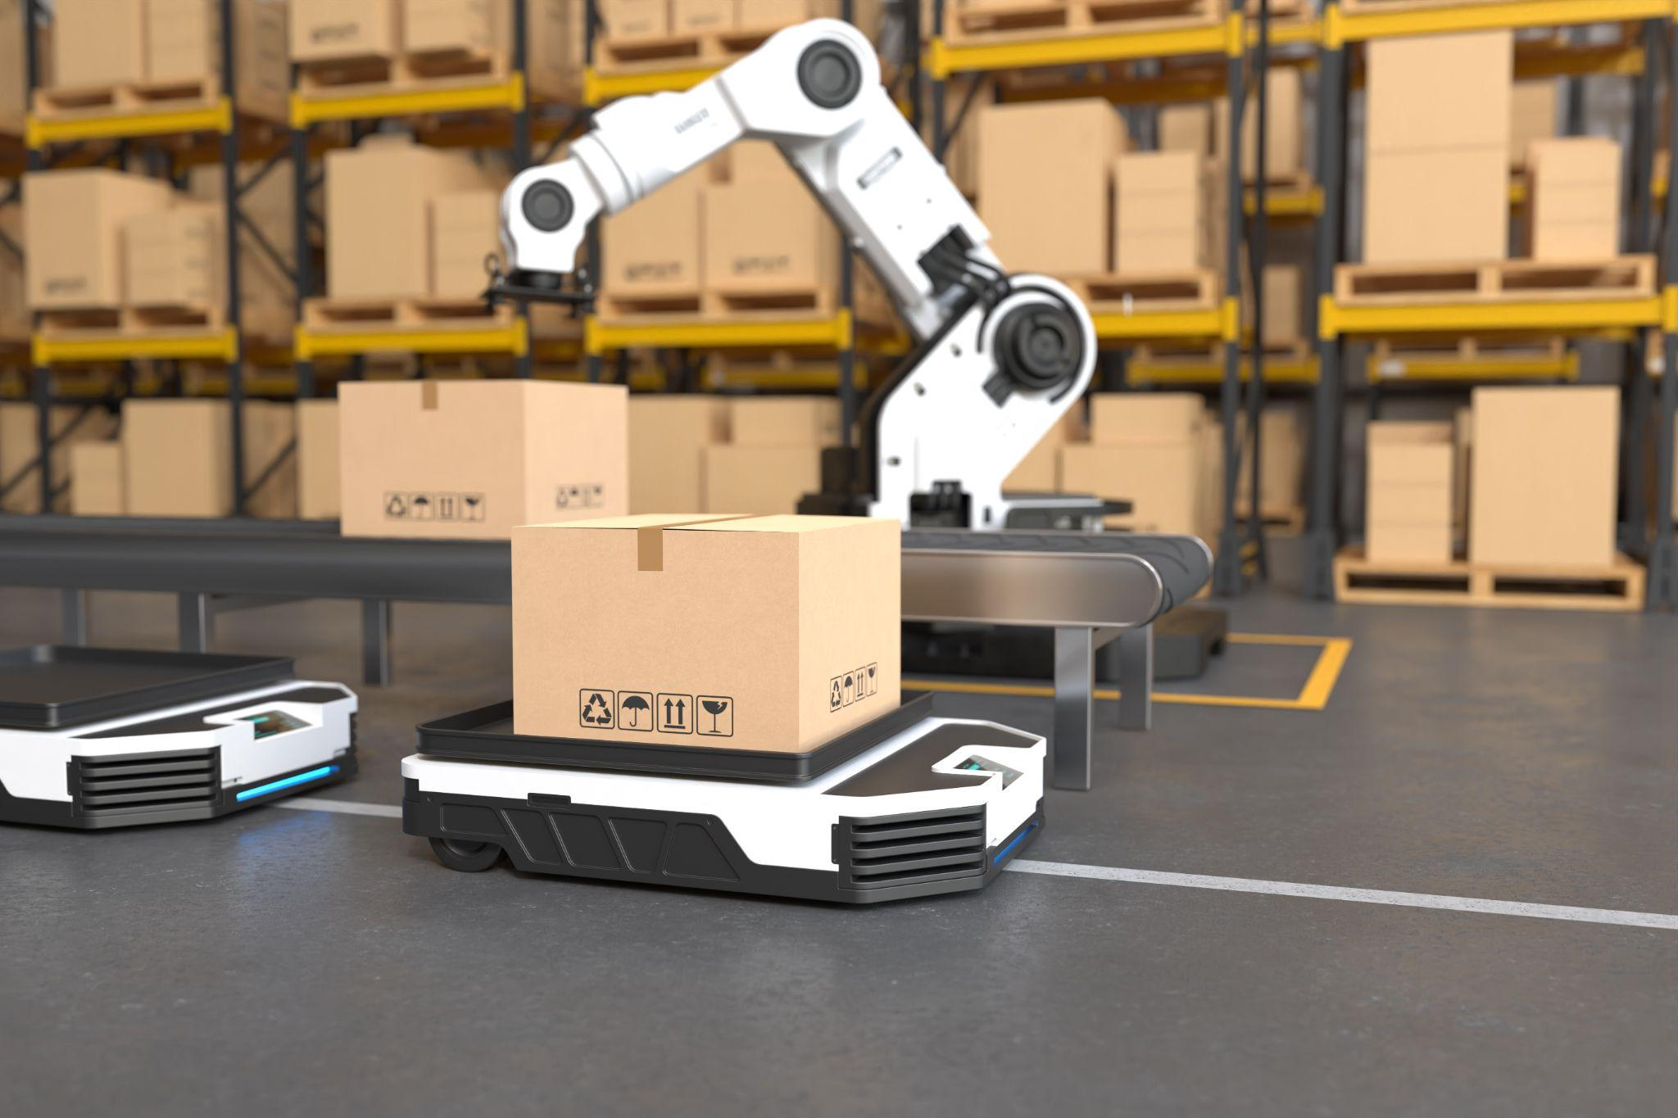
Problem & Domain Overview
Scenario
-Warehouse with robots, packages and location
-Robot collect packages and deliver them to delivery stations
-Each robot has capacity constraint (weight, size)
-Goal: minimize delivery trips by batching packages efficiently.

Slide 3
Classical PDDL Design
Predicates
Numeric Functions
robot-at
package-at
loaded
delivery-station
package-weight
package-size
robot current load
robot max capacity
Actions
Move
Load
Unload
The first version produced one-package-per-trip solutions. Added action:
-Delivery-trip

Slide 4
PDDL+ Extension
Thi domain extends the classical model with temporal dynamics
New predicates
and numeric fluents
loading
unloading
busy
loading-progress
unloading-progress
temporary weight
temporary size

Slide 5
Processes & Events
The loading and unloading processes are modified in three components:
ACTION
PROCESS
EVENT
start-loading
start-unloading
loading-process
unloading-process
finish-loading
finish-unloading
overload
Necessary to set the busy predicate to true
Increase and decrease the progress functions over time.
Triggered when the (un)loading-process is finished

Slide 6
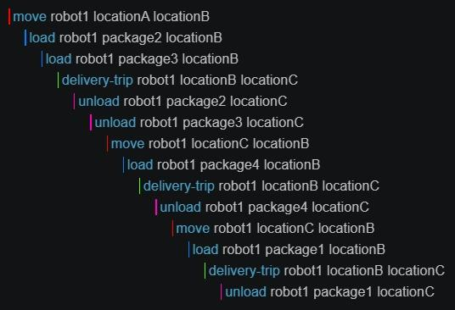
Demo

Slide 7
Challenges & Limitations
Challenges
Limitations
Future Work
Planner compatibility
Quantifier support
Plan optimality
Greedy batching
Fully connected warehouse
No collision avoidance
1D representation of packages
No parallelism between multiple robots
Better optimization, optimal planner
More realistic navigation
Parallelism with multiple robots

