Slide 1
Noted*
A Note-taking app presentation by Bella Luk
Sp-17
(Noted is the current working title)

Slide 2
What does it do?
Like google’s Keep app, but with a CALENDER & dates
A super TO-DO list app

Slide 3
Making taking quick notes & bullet-journaled style planning Digital &easier
Problem solving

Slide 4
Target audience
Busy young adults (“millennials”) who could use some organization. Are also always on their phones.

Slide 5
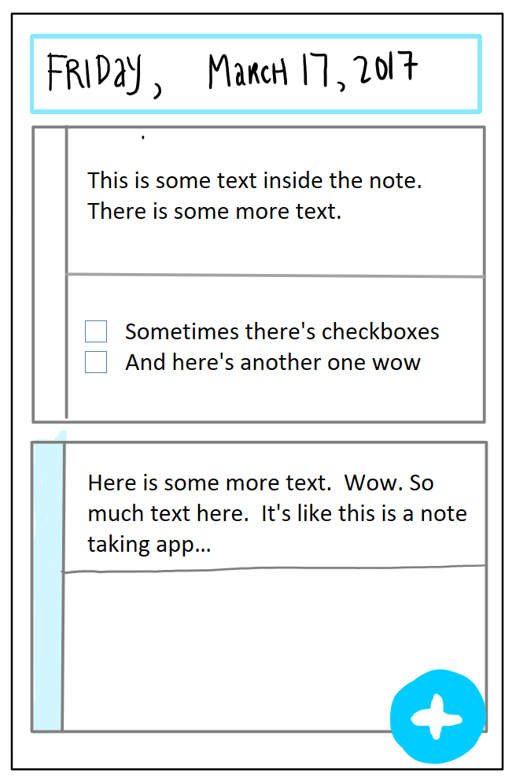
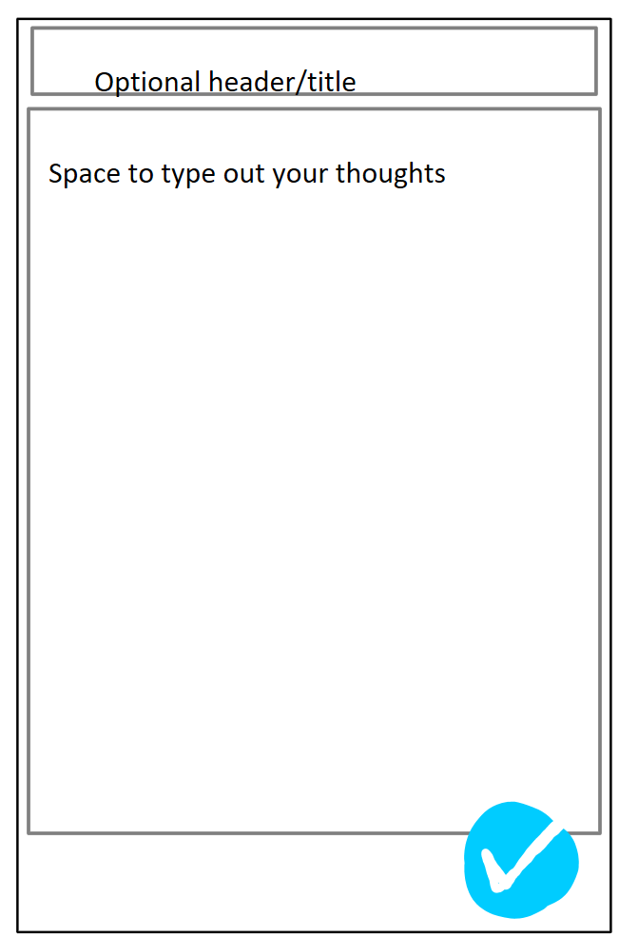
SCREEN FLOW:

Slide 6
COST:
Free w/ads
$2 to remove ads/get extra customization (date formats, colors, etc)

